Slide 1
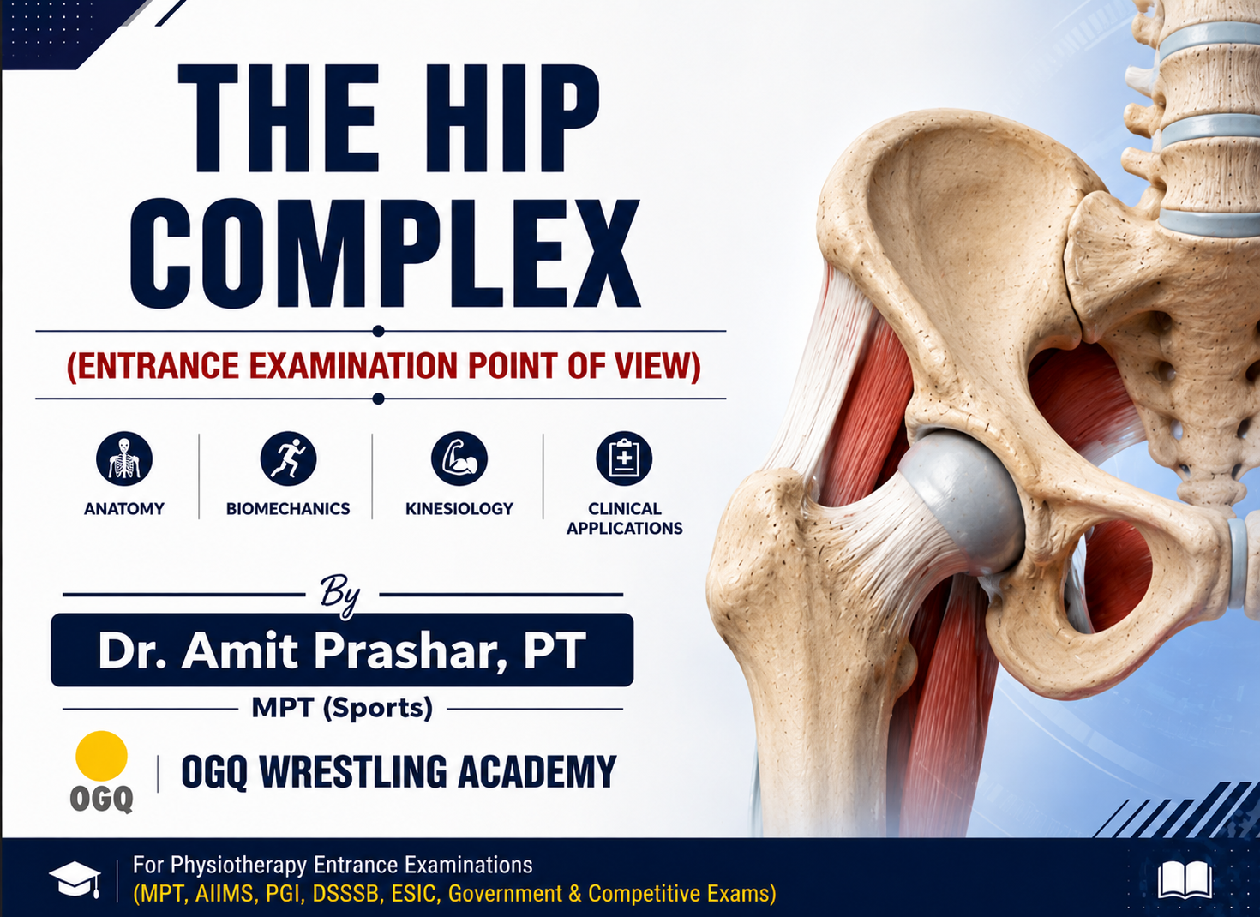
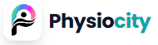

Slide 2
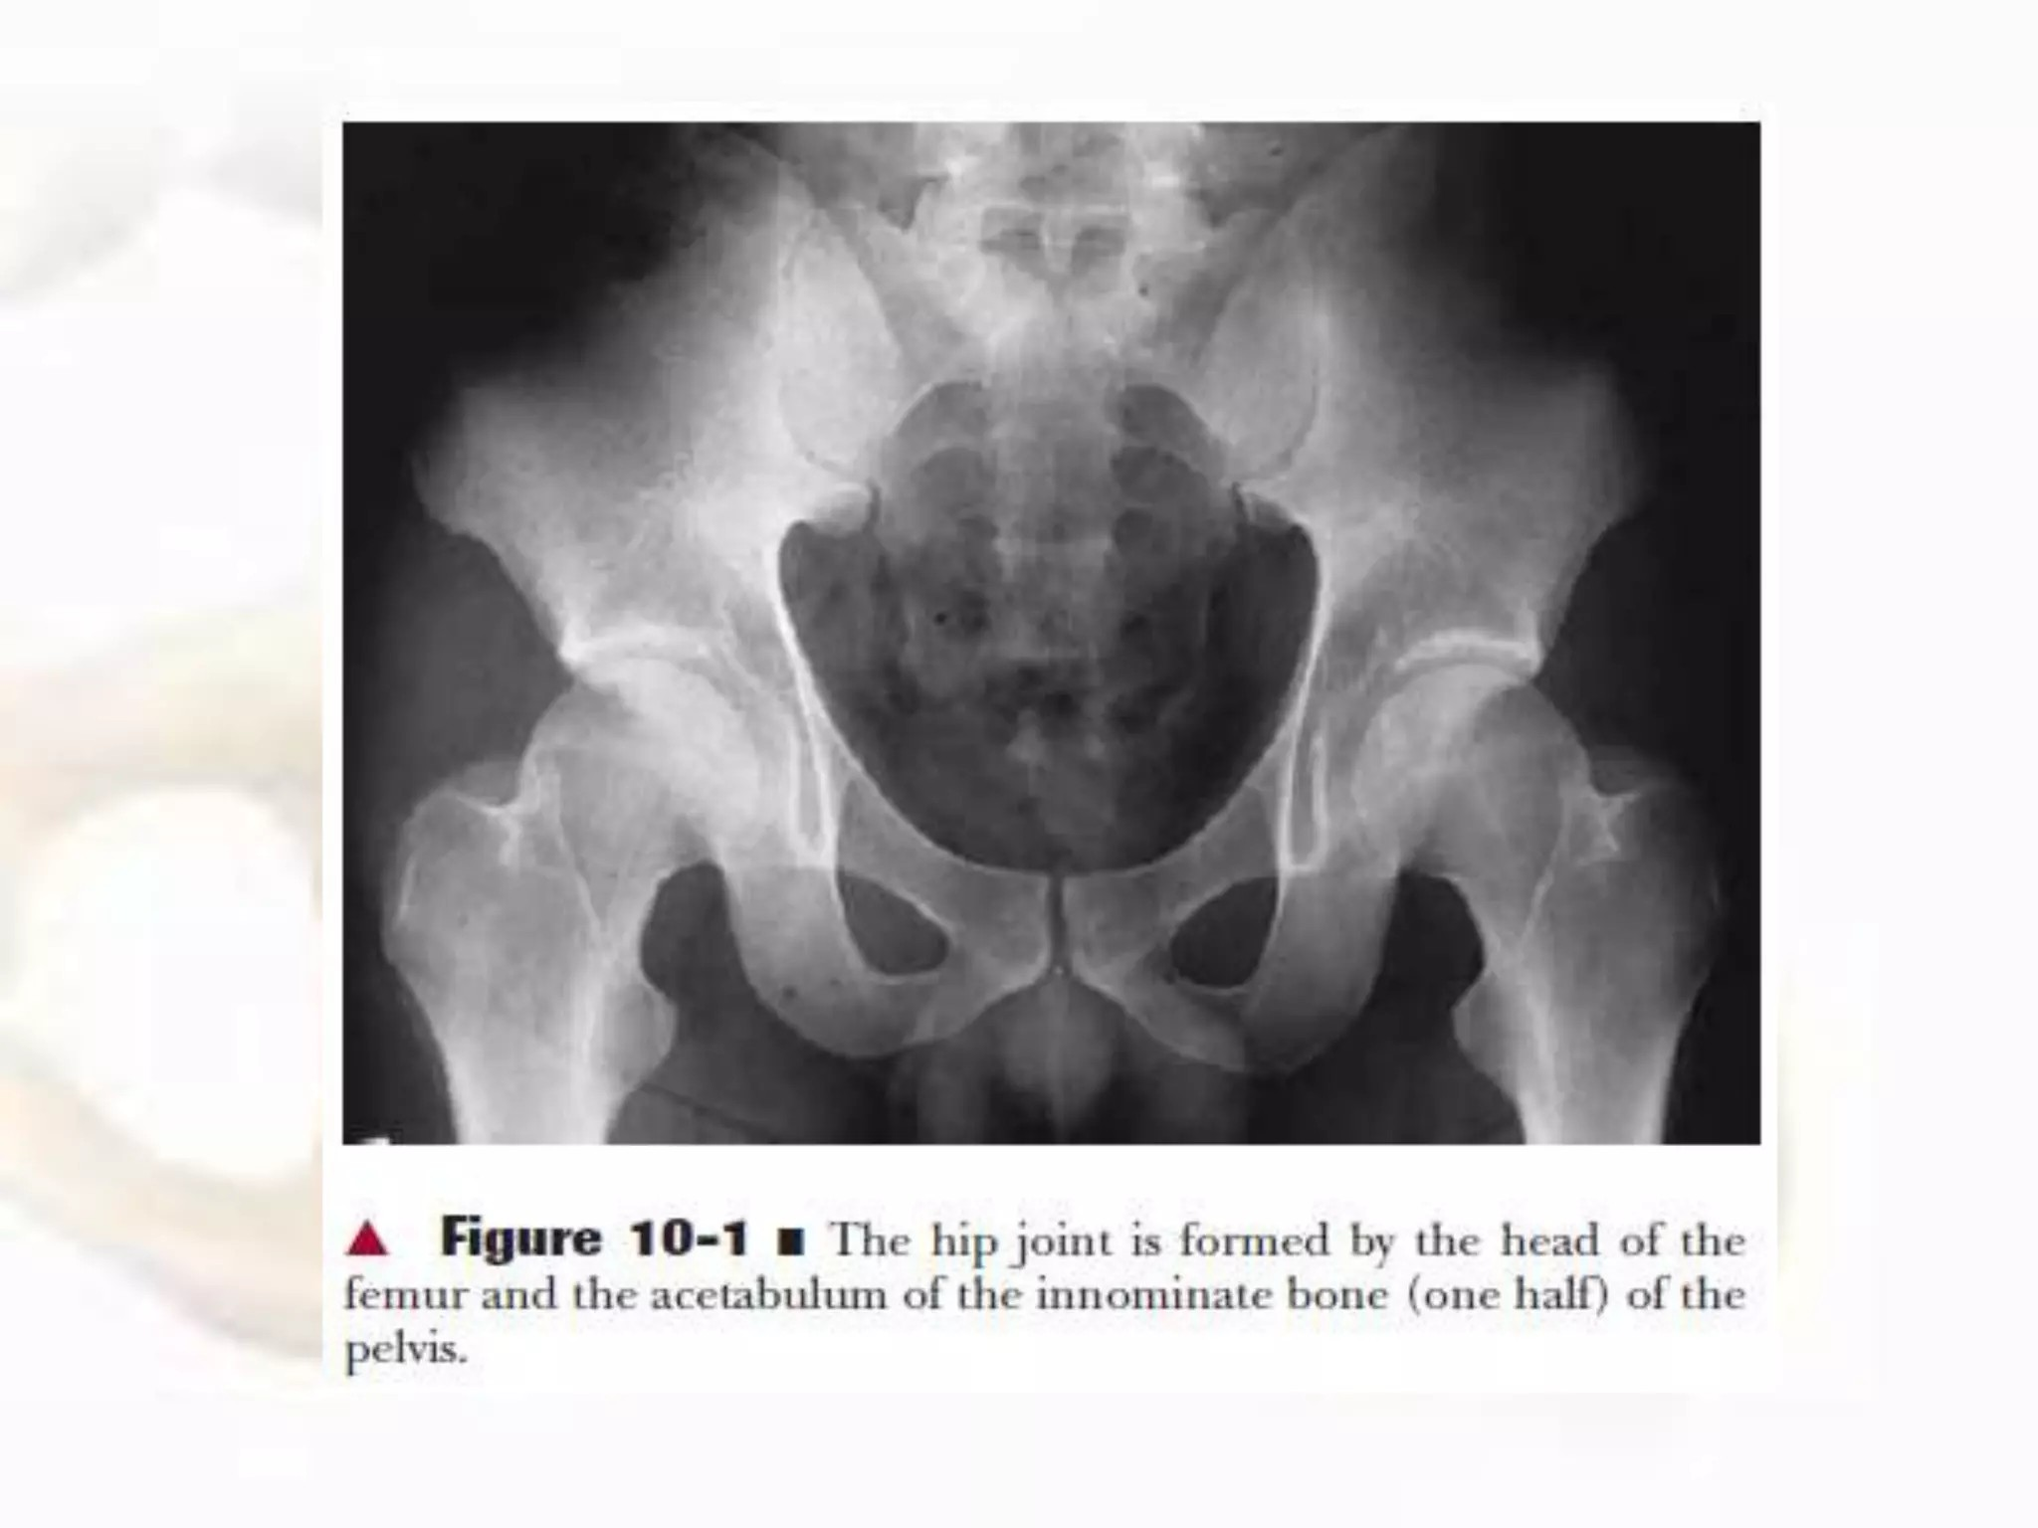

Slide 3
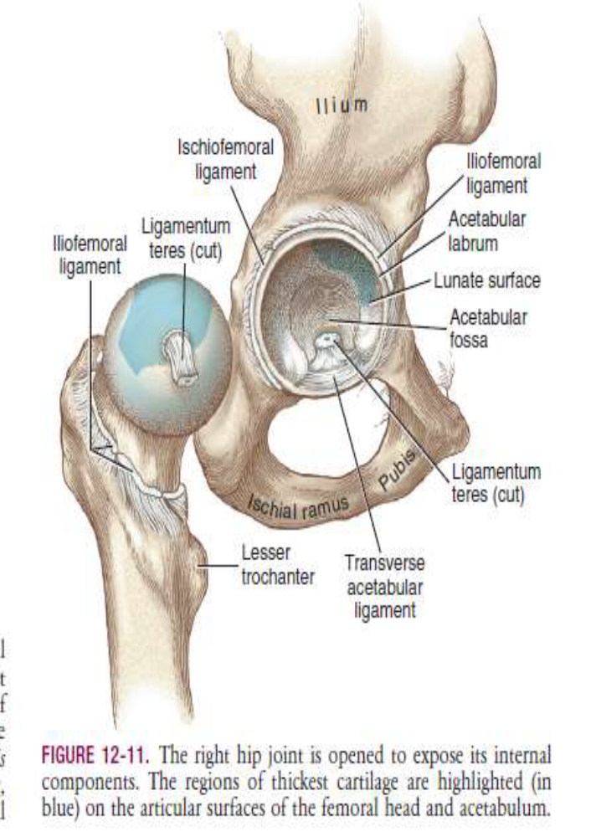
Introduction
Coxofemoral jt–Diarthrodial Snovial Ball and socket joint
Ilium contributes the most to acetabulum.
Full ossification,=20-25yrs of age.
Acetabular fossa–non articular part

Slide 4
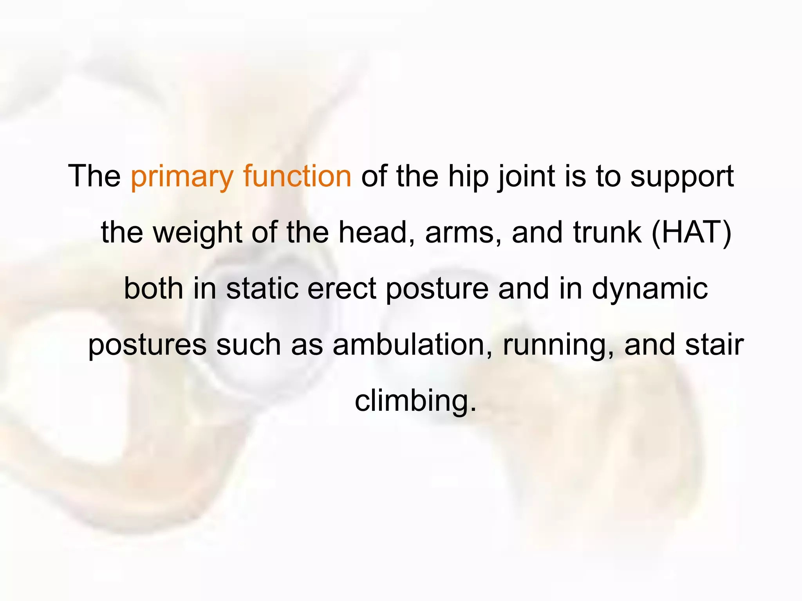

Slide 7
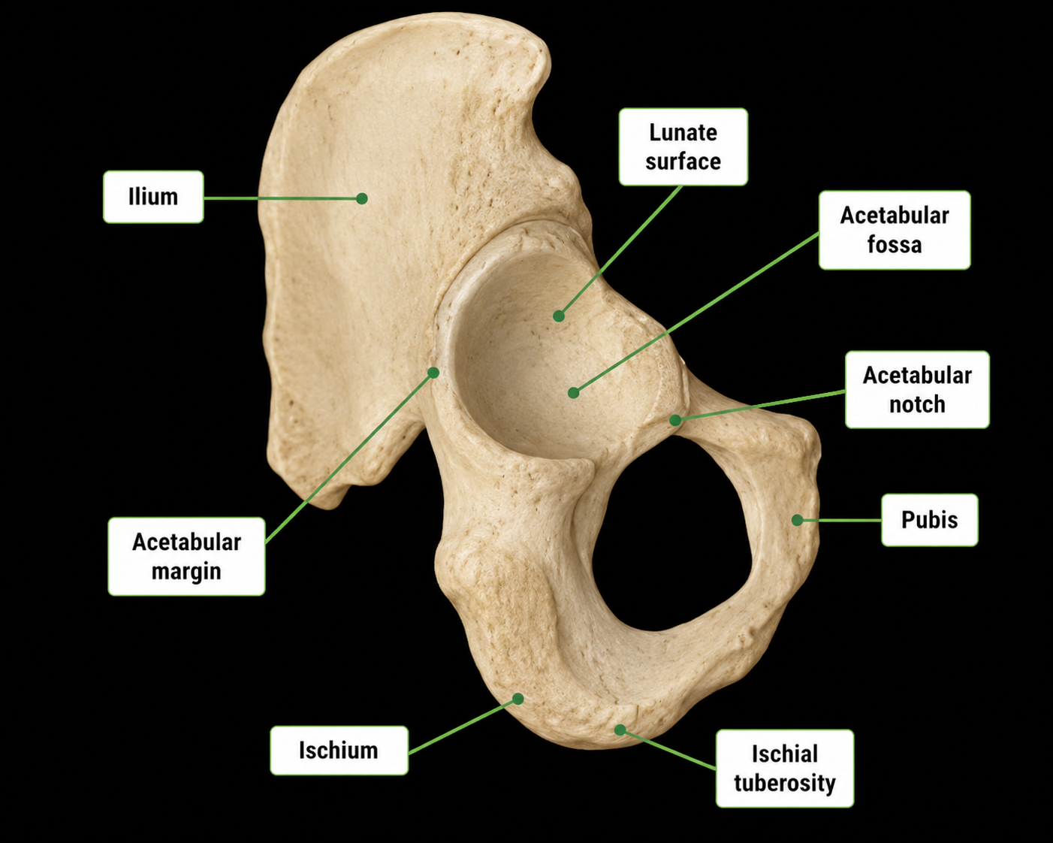

Slide 9
Also called as Angle of Wiberg (25-35 deg)
It measures how much acetabulum covers femur head in frontal plane
If Angle Inc- i.e >40(Coxa Profunda)
If Angle Dec – i.e < 16-25 (Dysplasia)

Slide 10
It measures extend to which acetabulum covers femur in horizontal plane.

Slide 11
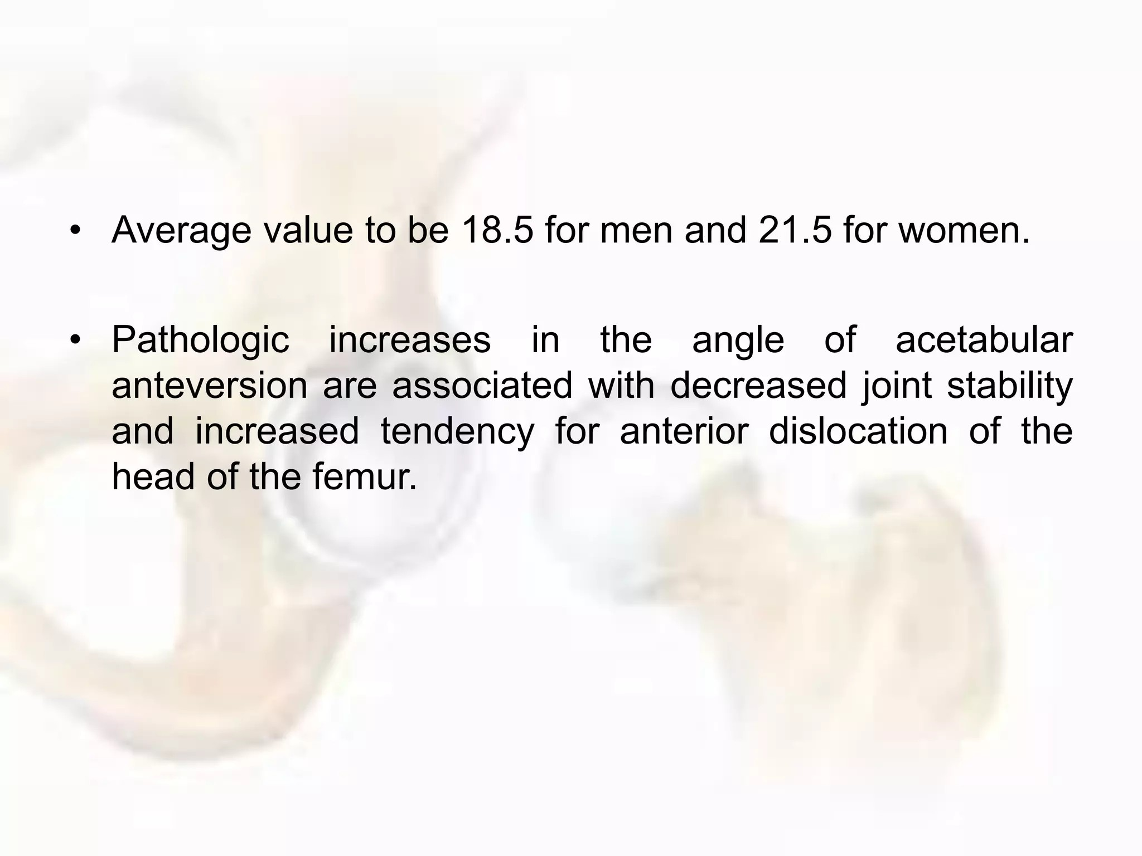
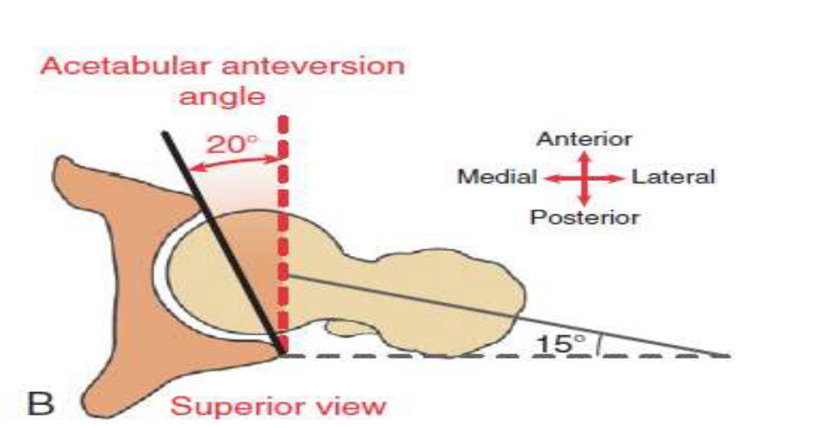
Anteverted Acetabulum- Instability
Retroverted Acetabulum- Impingement

Slide 12
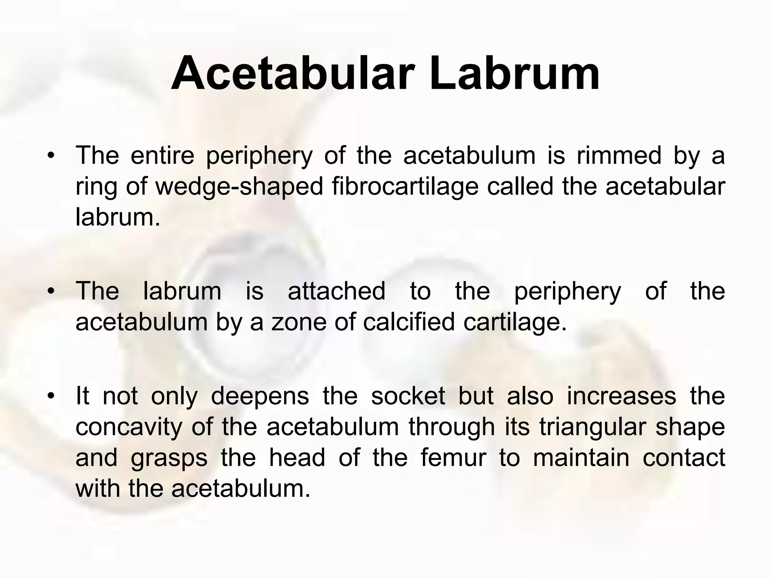

Slide 13
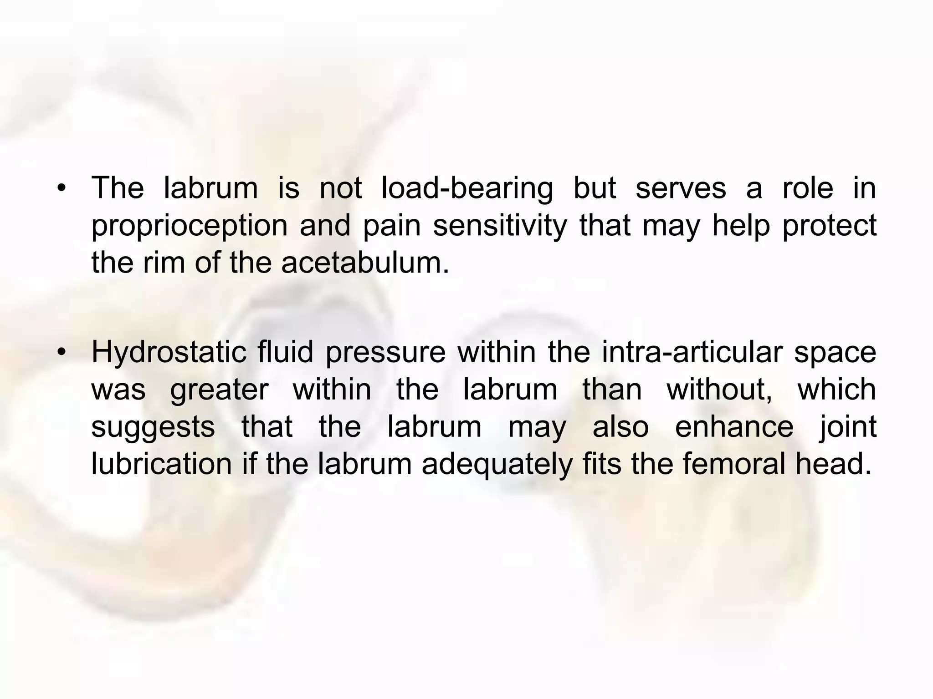

Slide 14
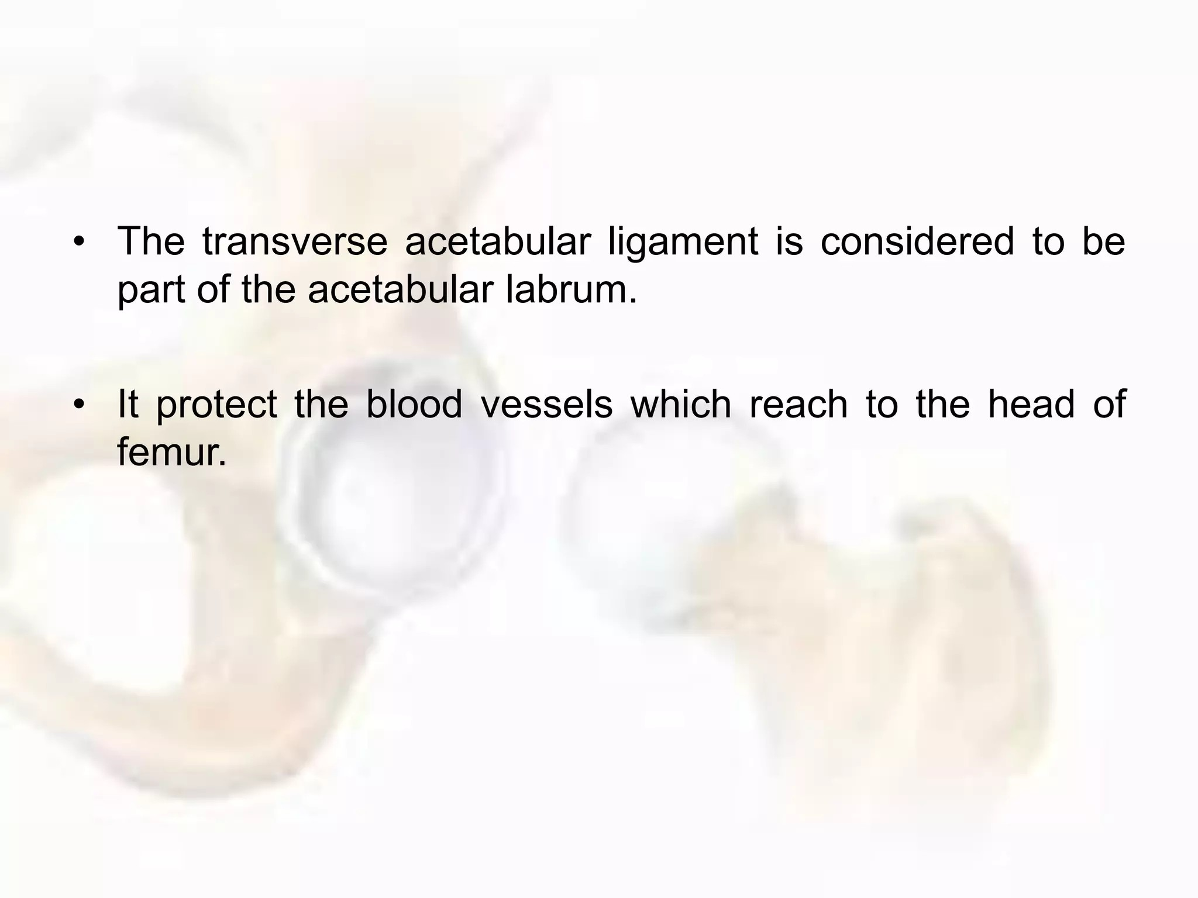
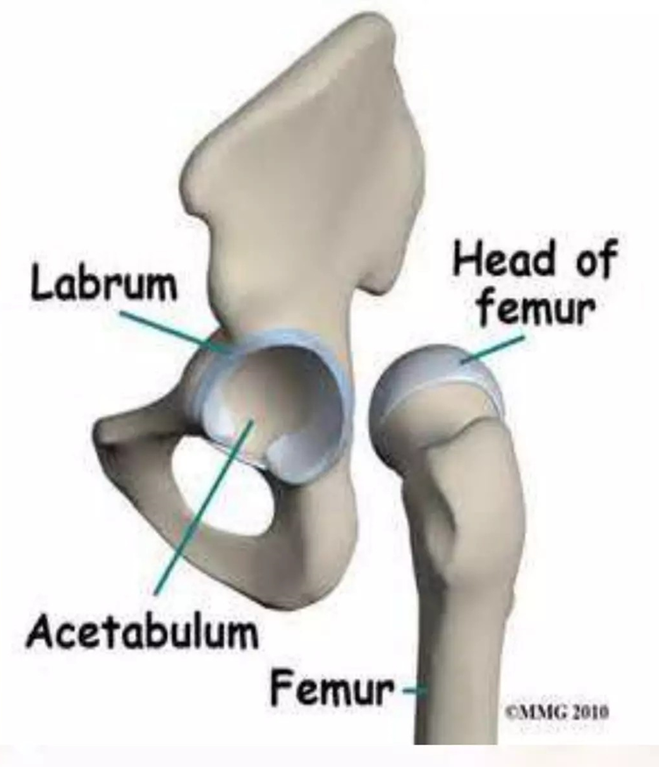

Slide 15
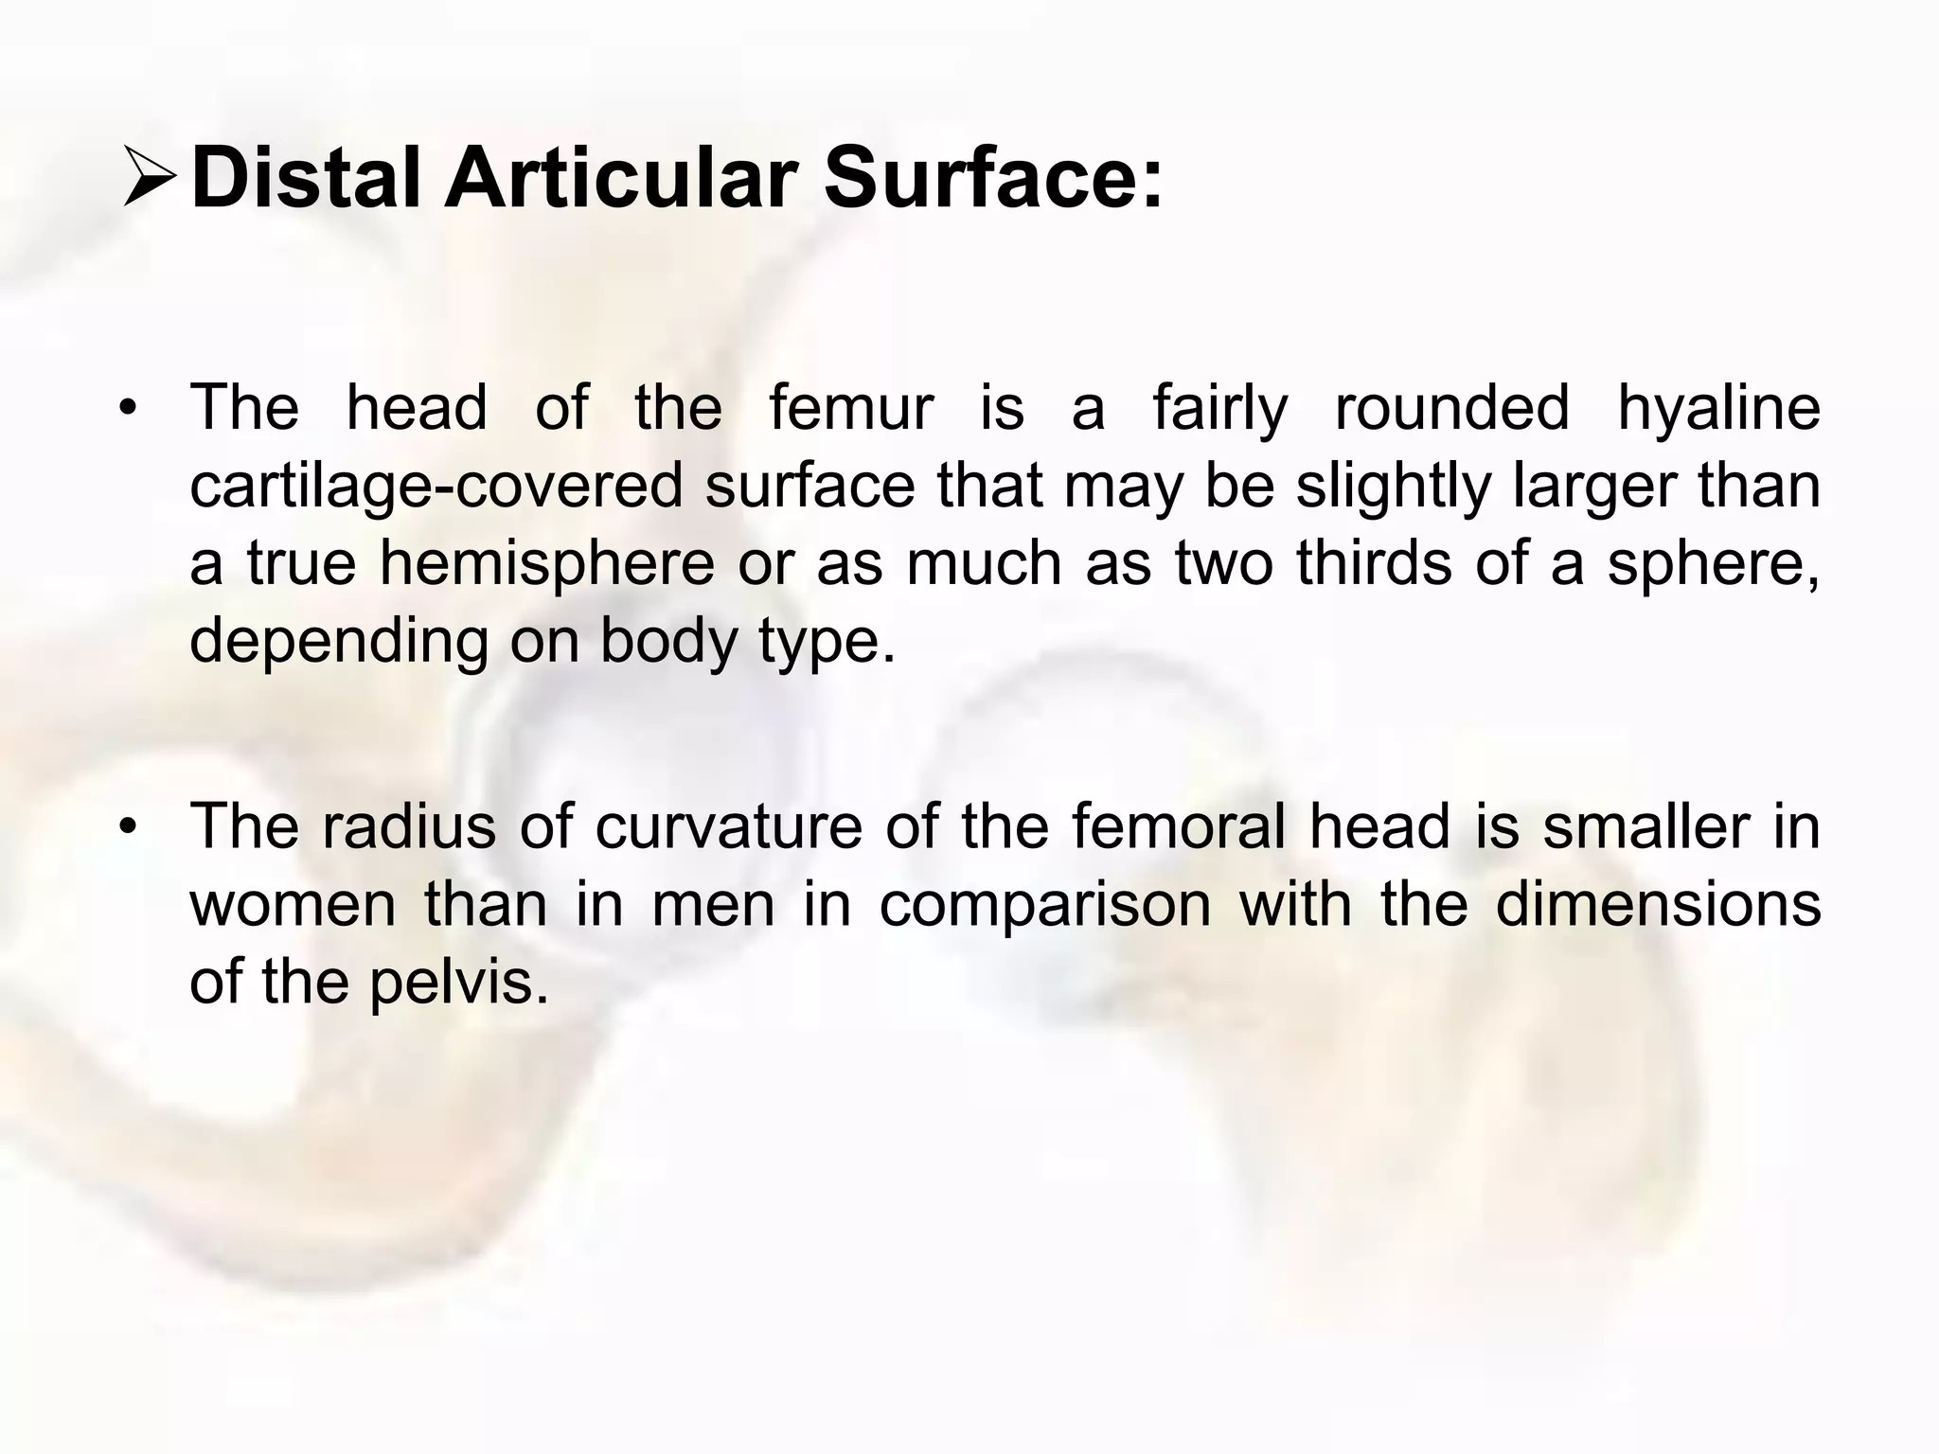
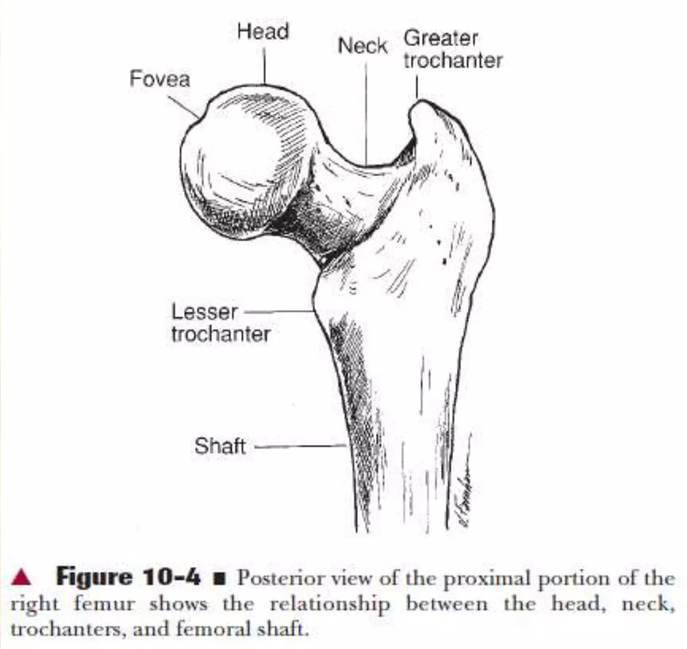

Slide 16
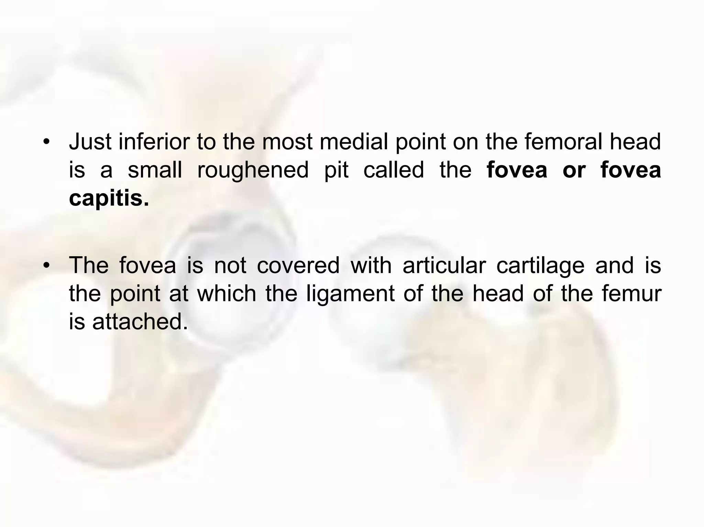

Slide 17
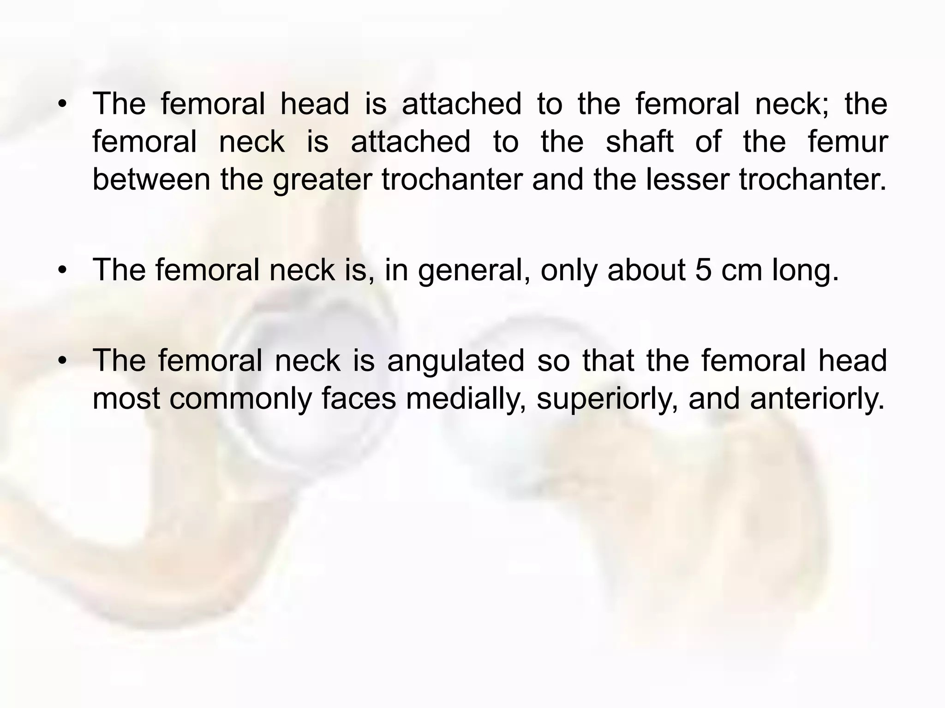

Slide 18
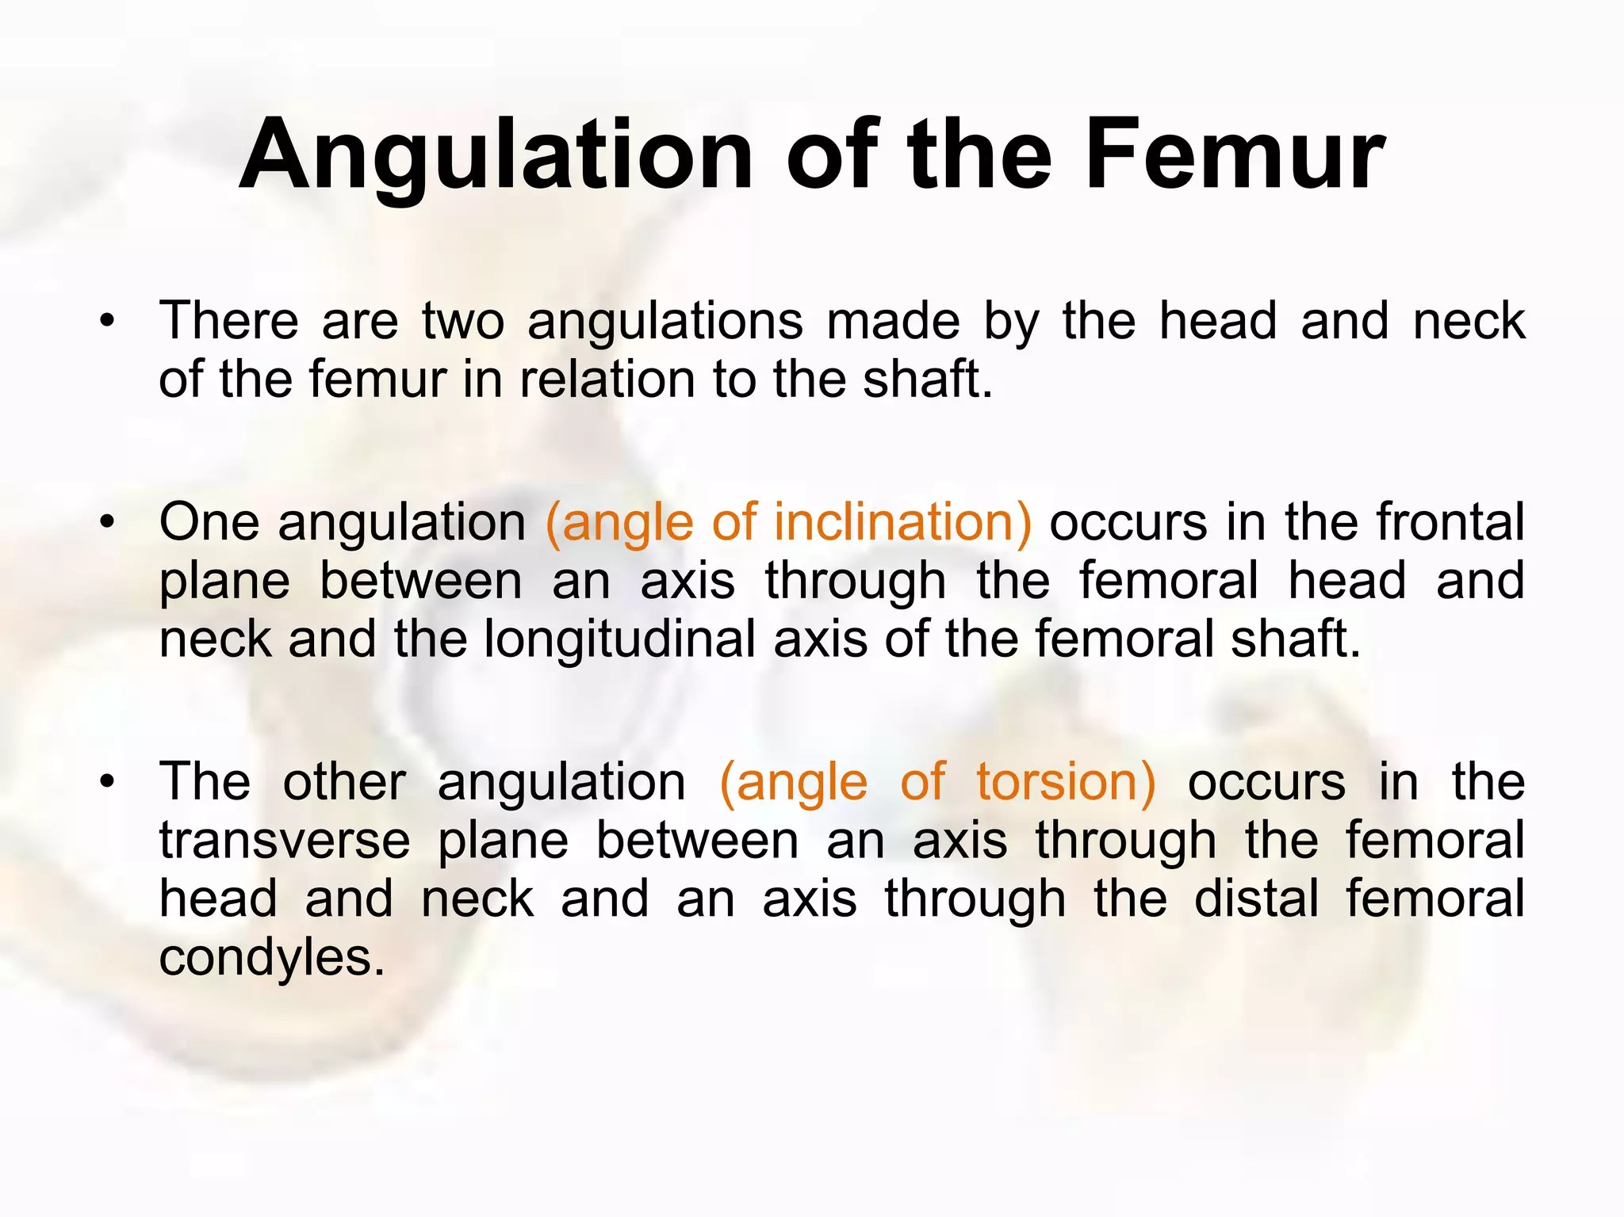

Slide 19
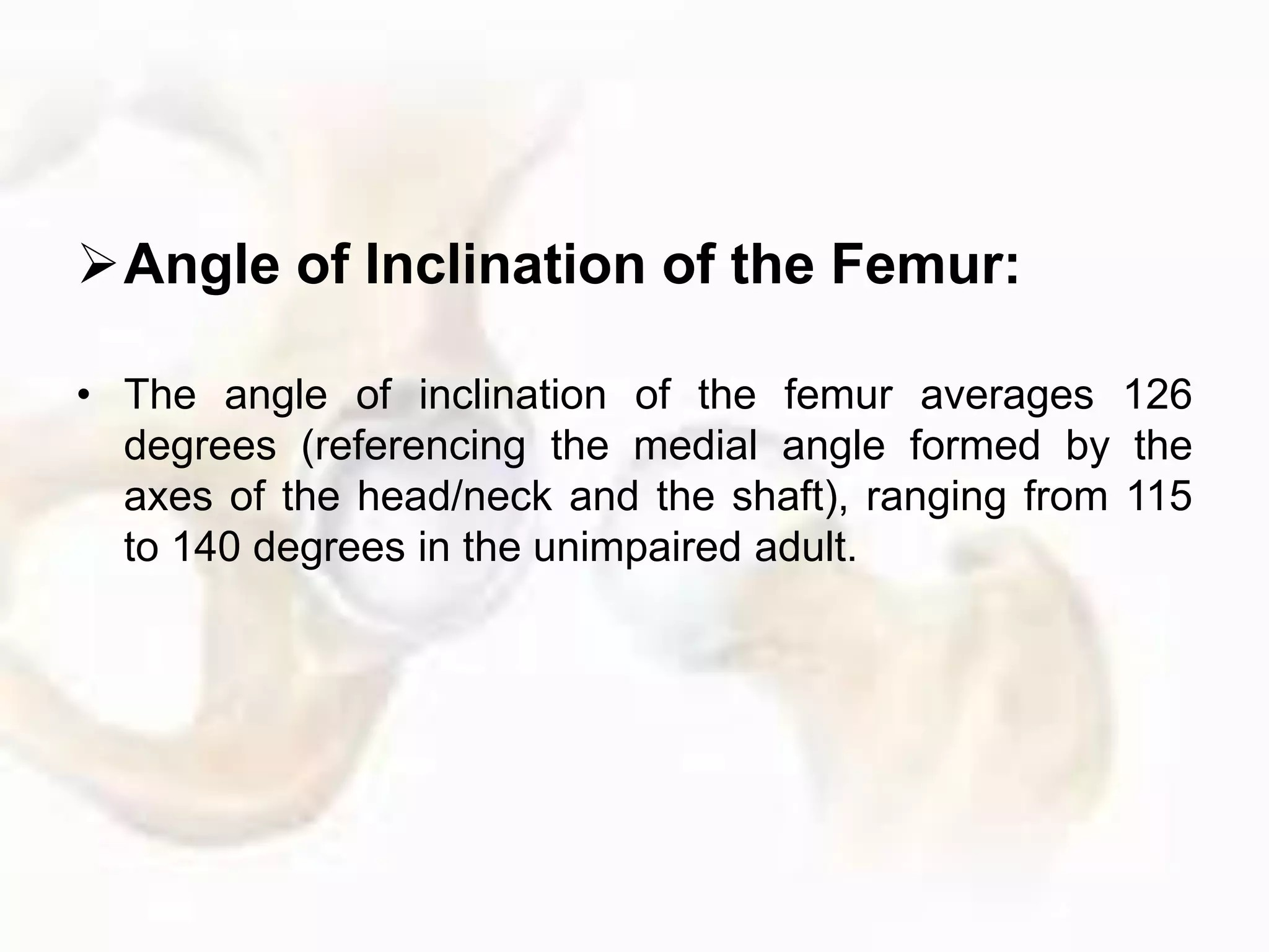

Slide 20
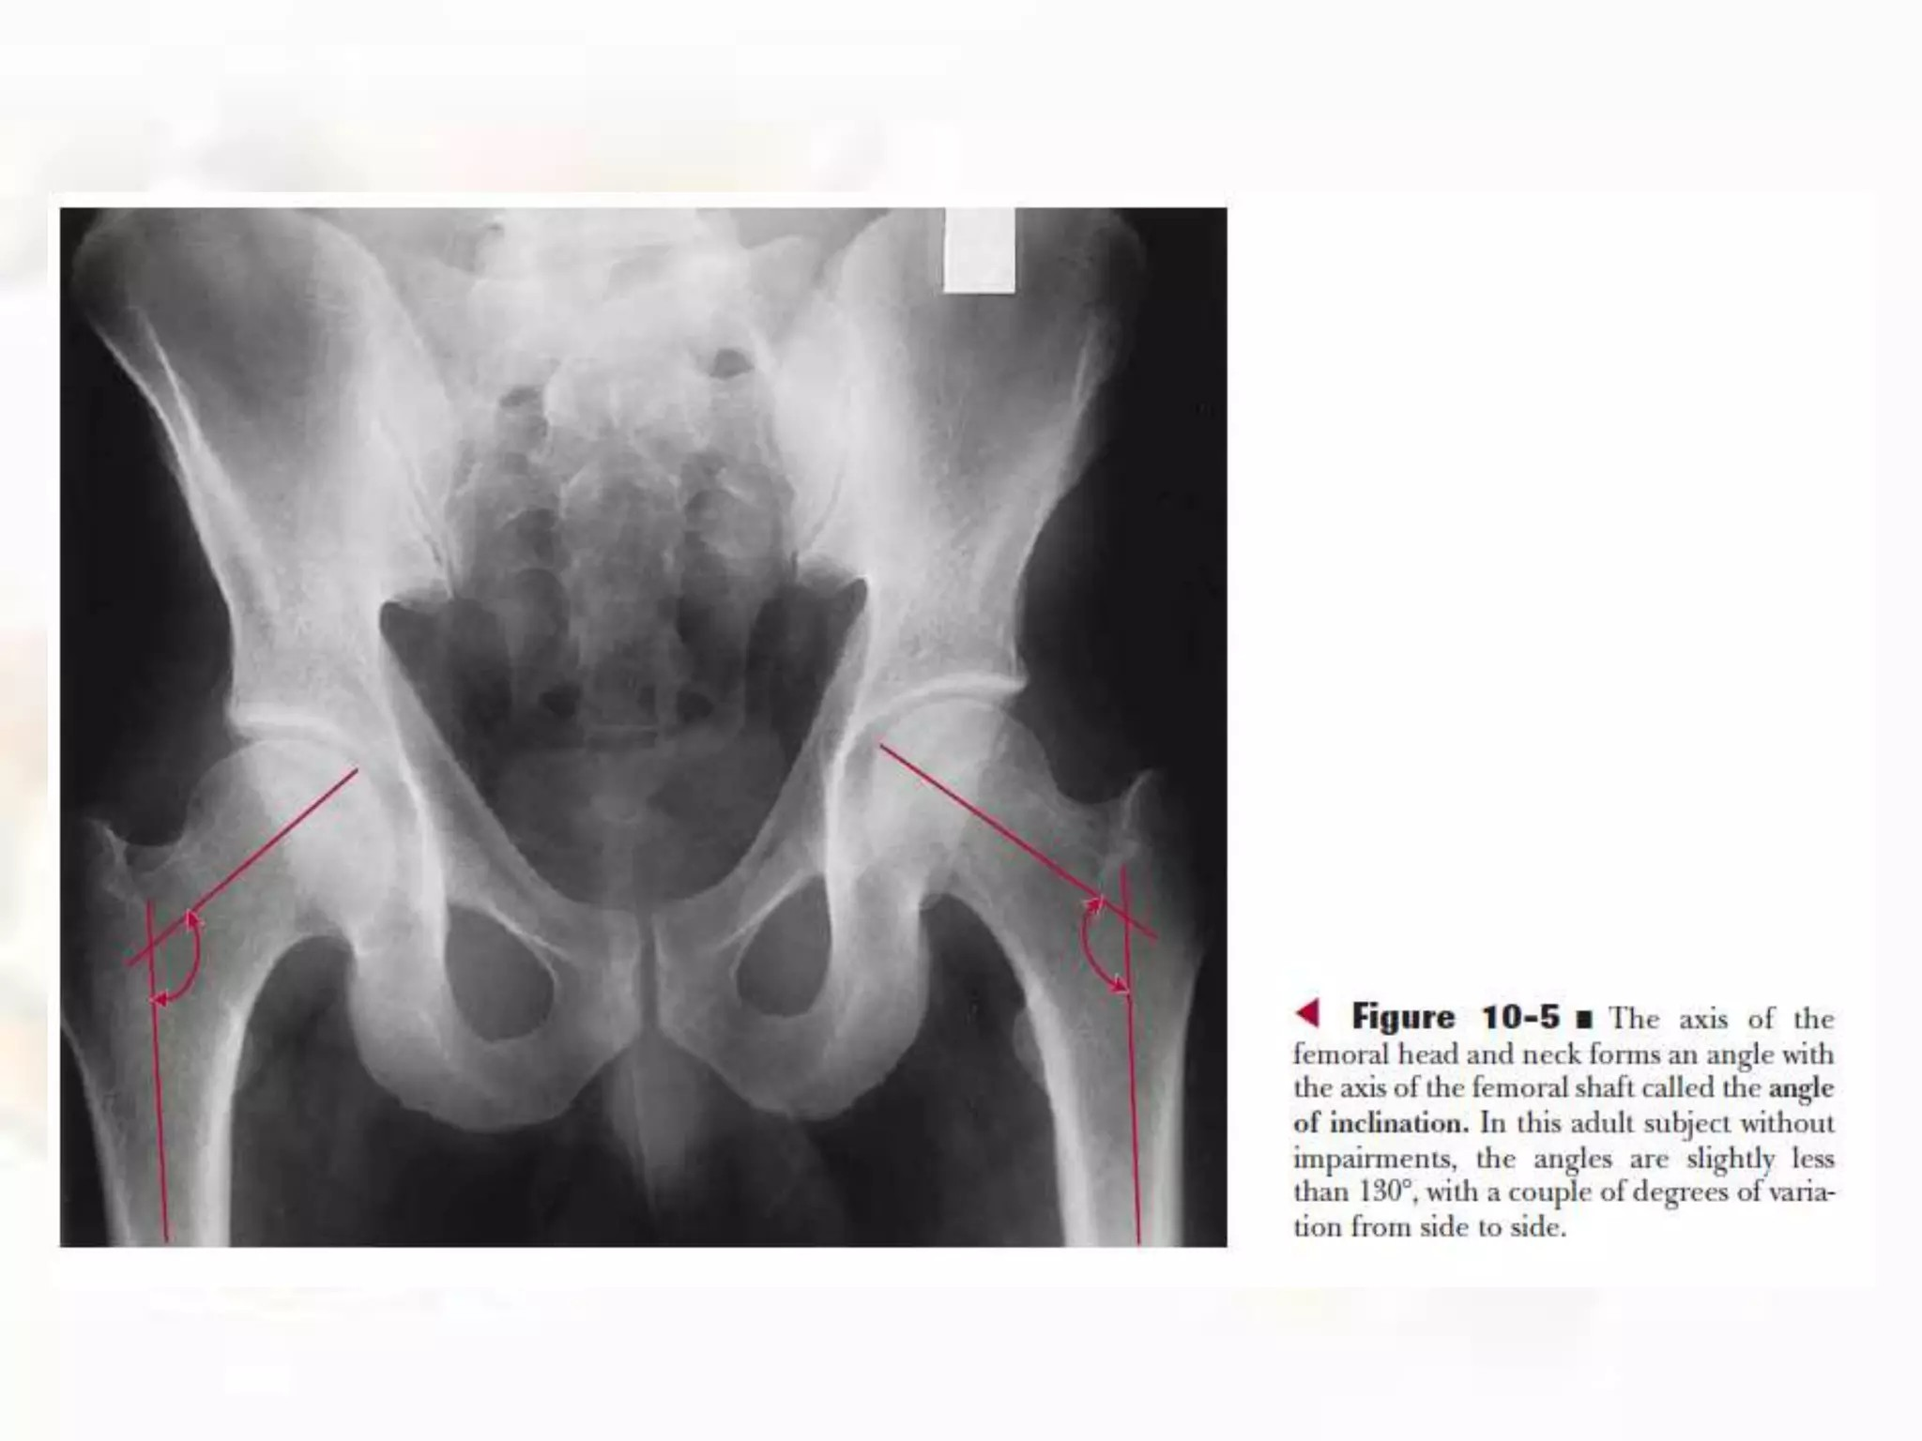

Slide 21
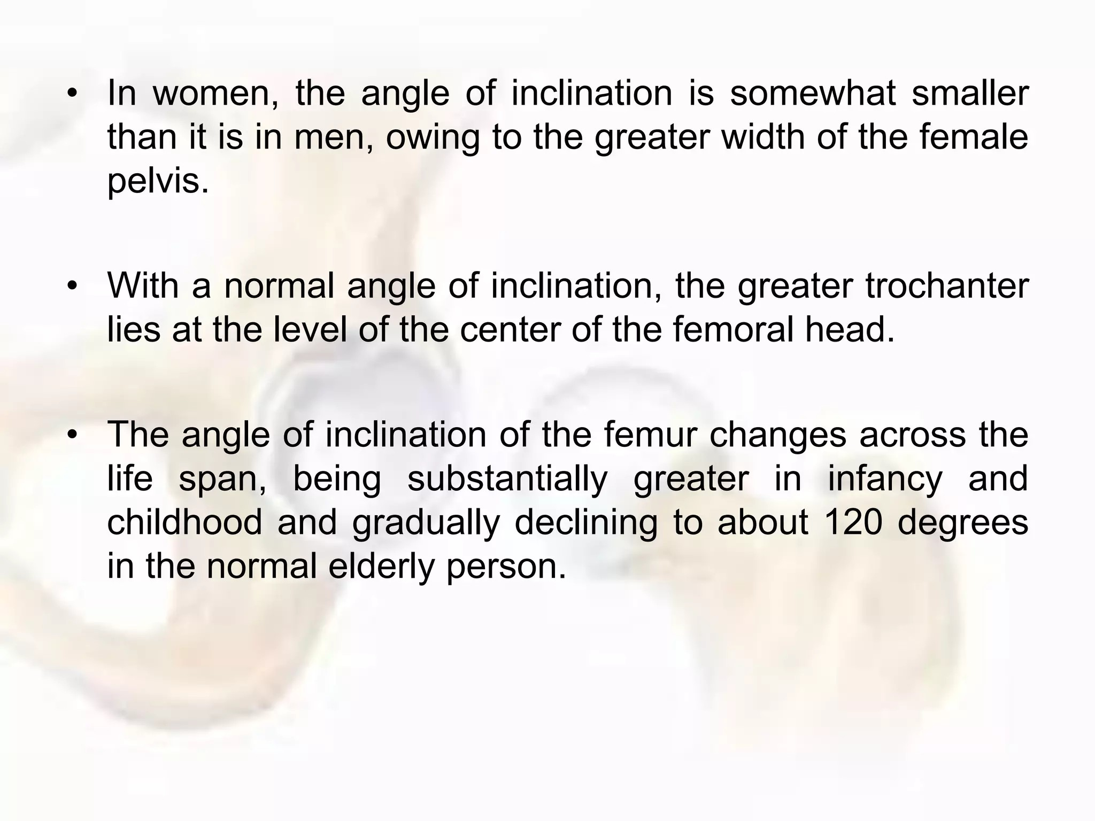

Slide 22
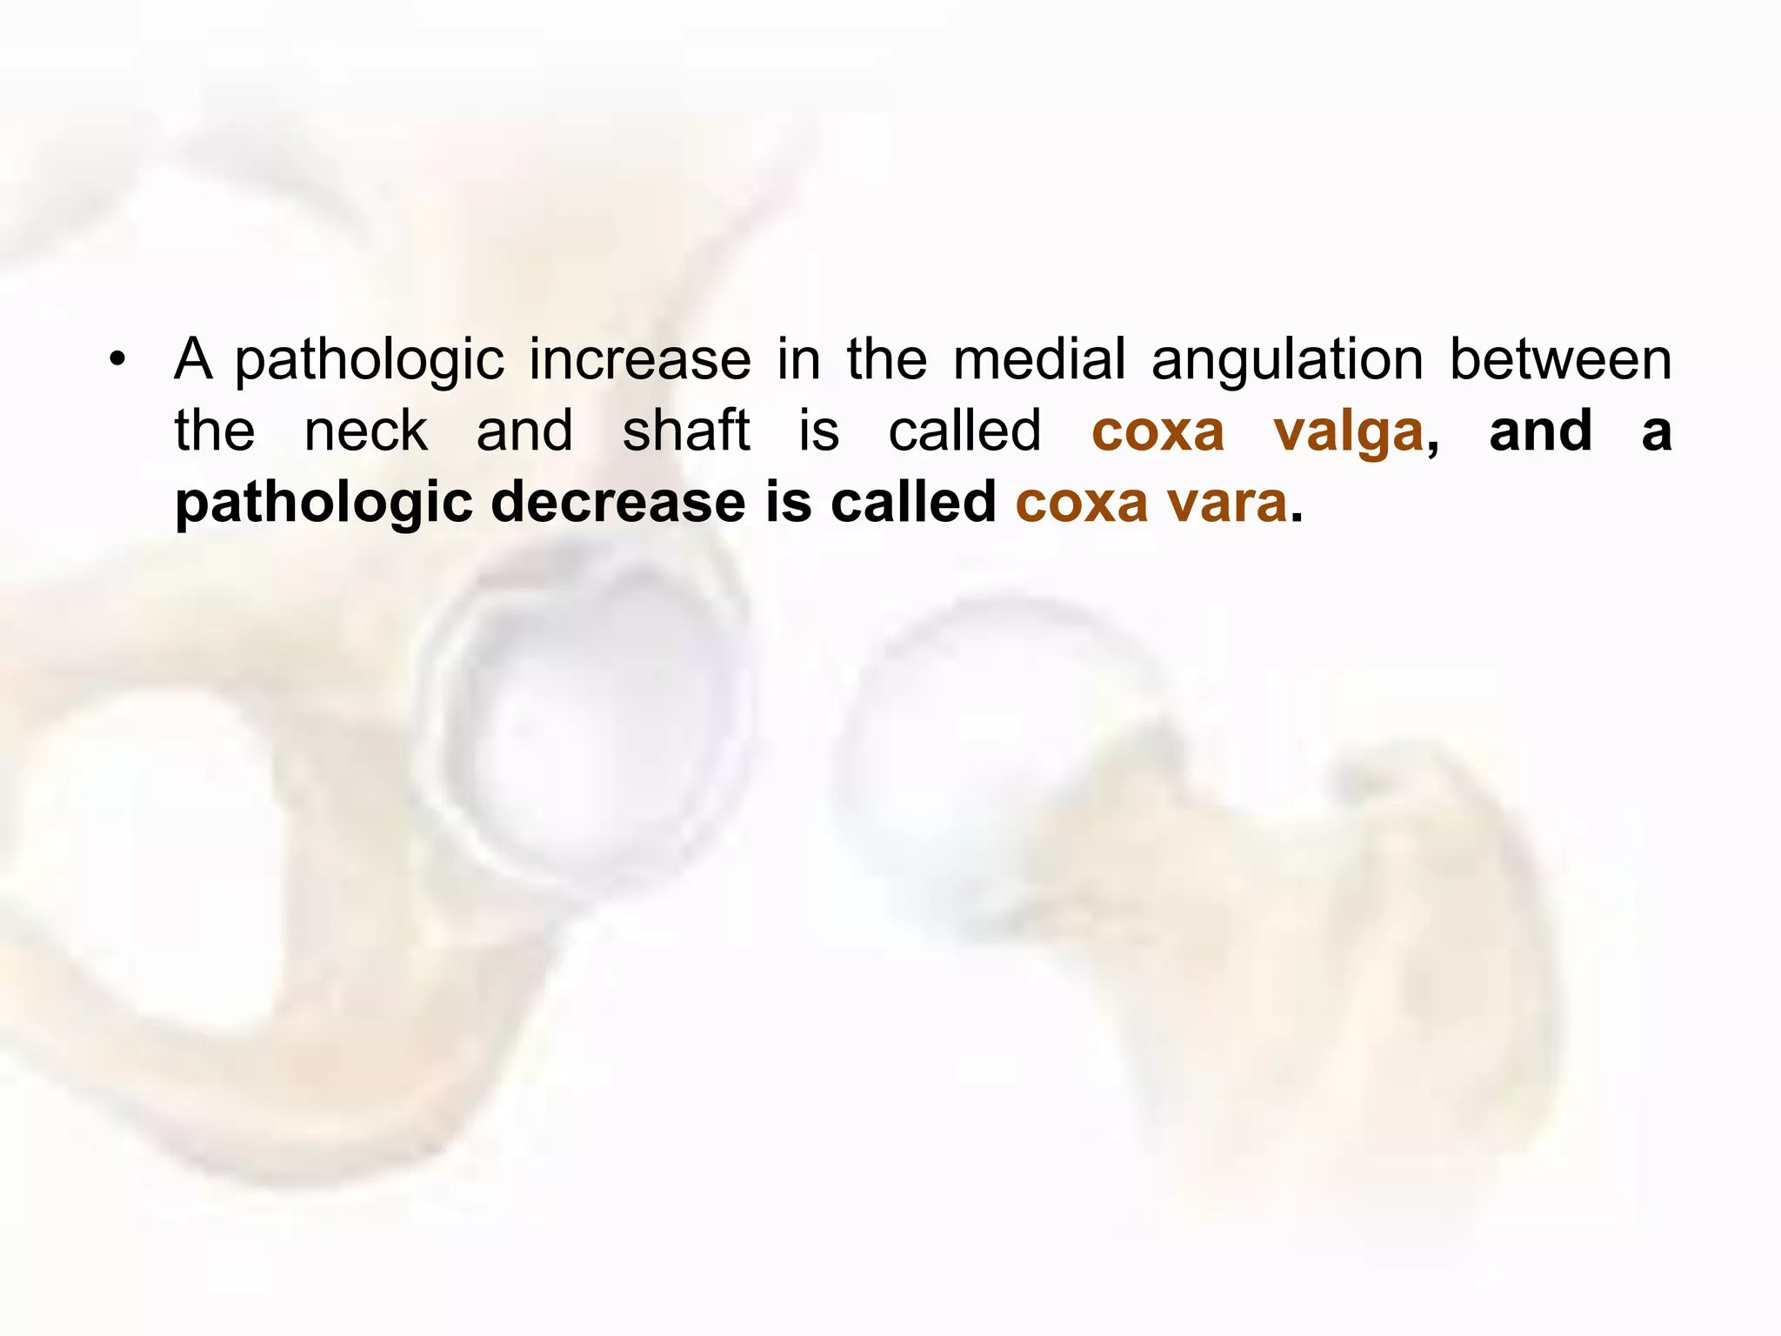
Coxa Valga will lead to dislocation
Coxa vara will lead to Slipped Capital Femoral Epiphysis & Femoral neck #

Slide 23
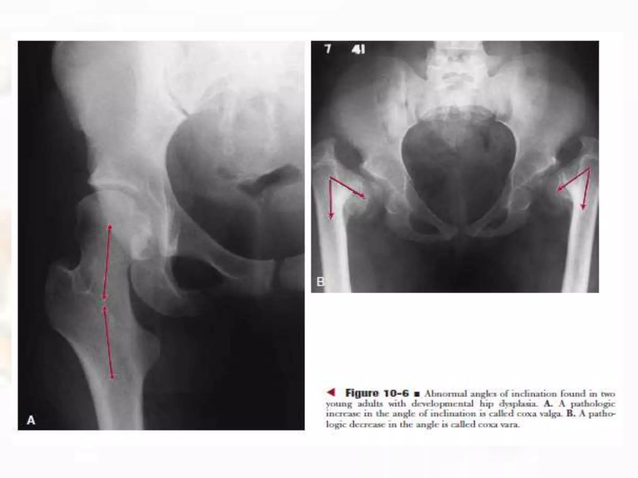

Slide 24
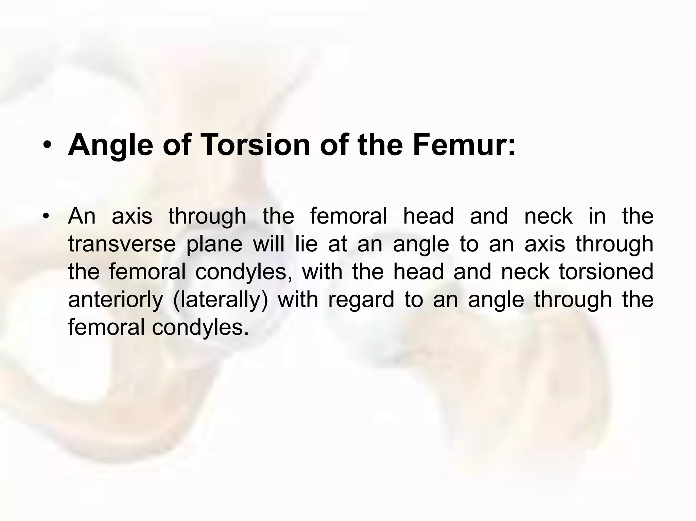

Slide 25
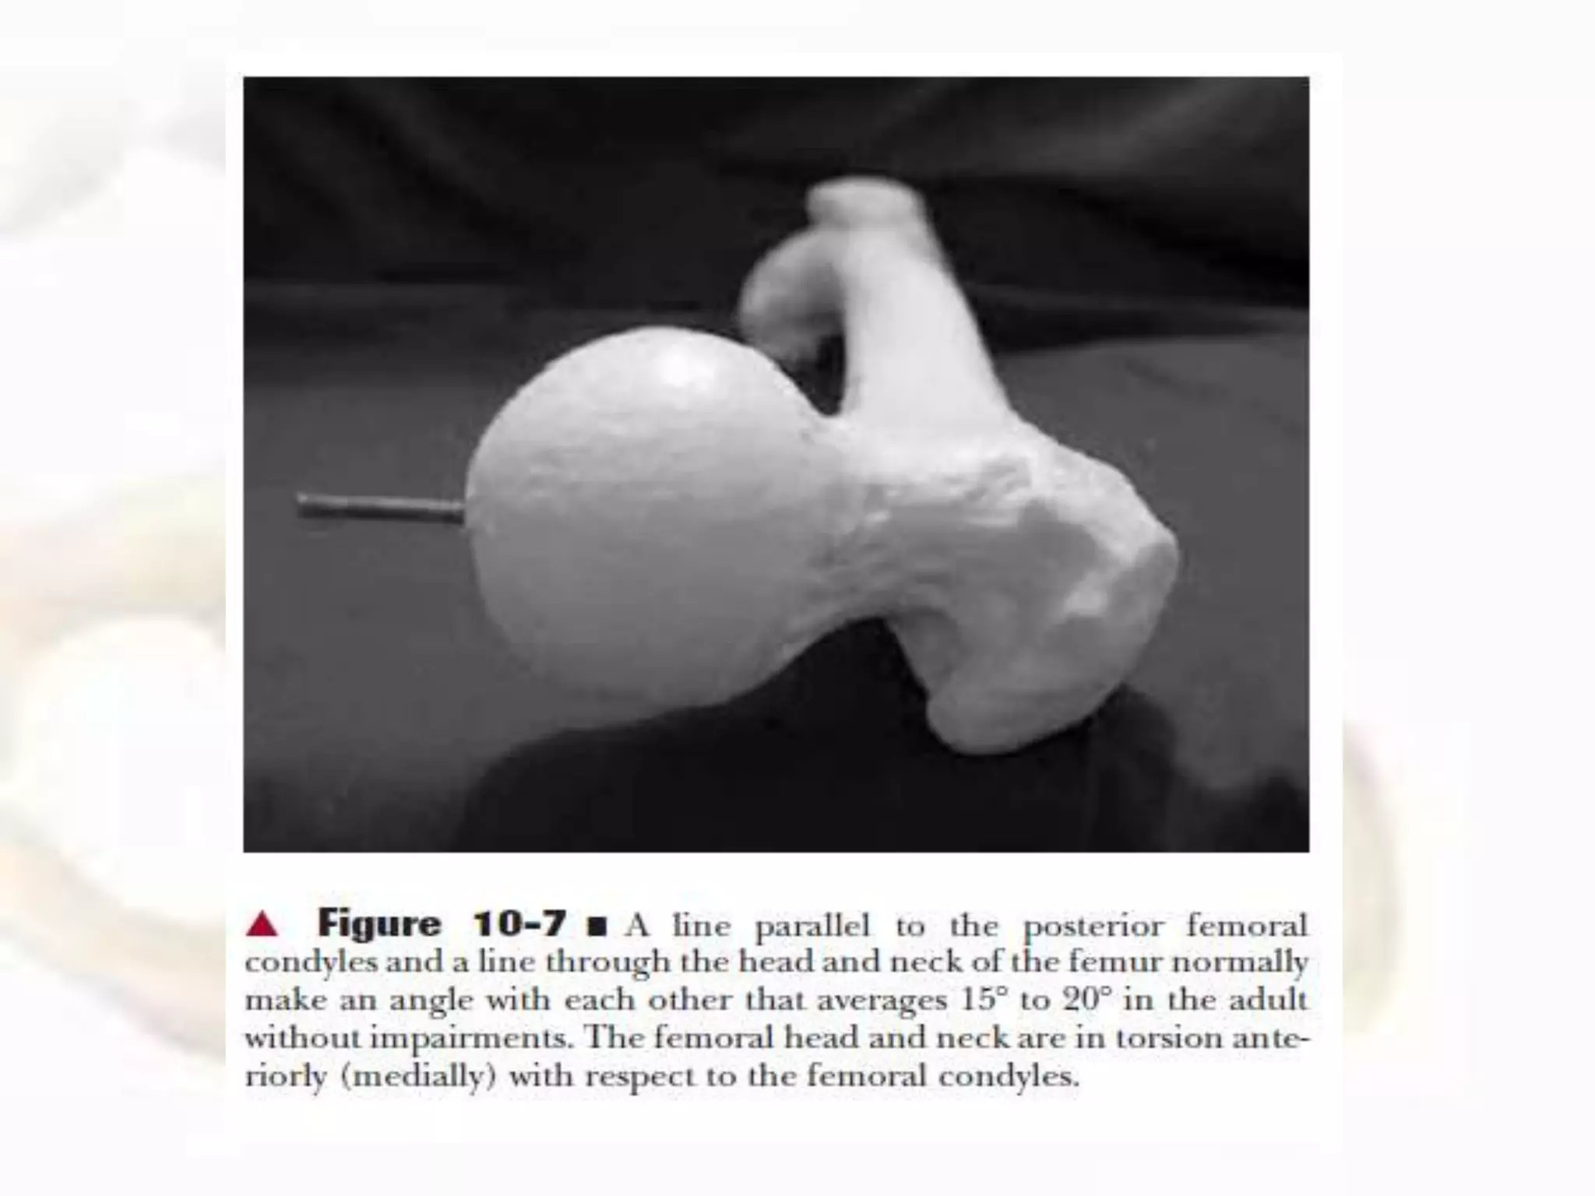

Slide 26
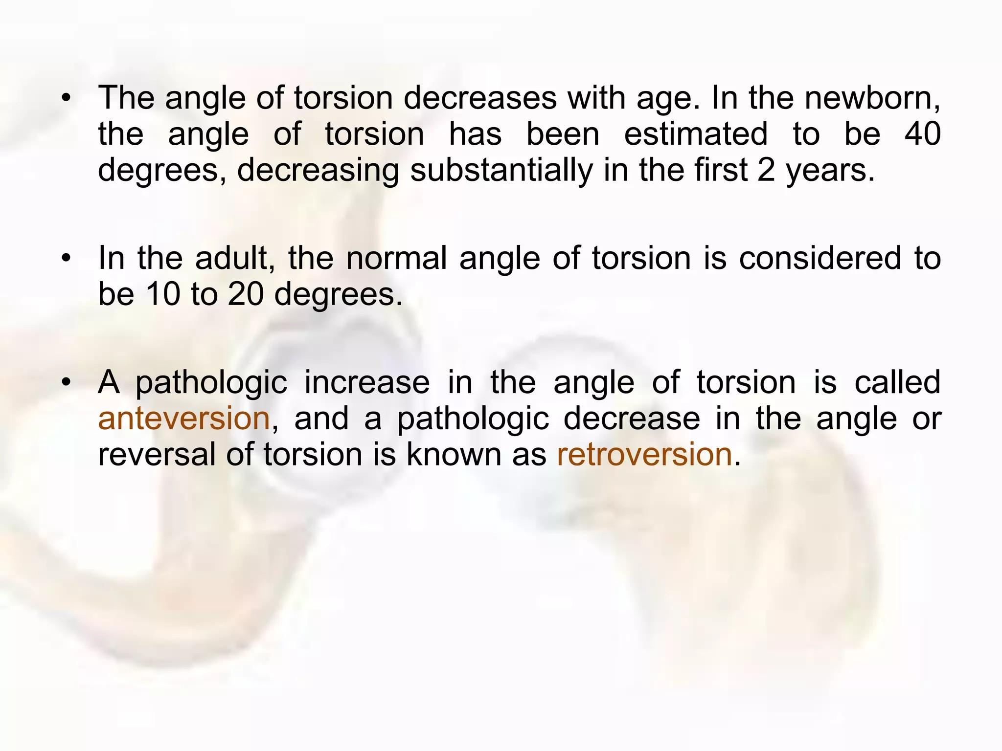
Anteversion will lead to Toe in Gait
Retroversion will lead to labral pathologies and impingement

Slide 27
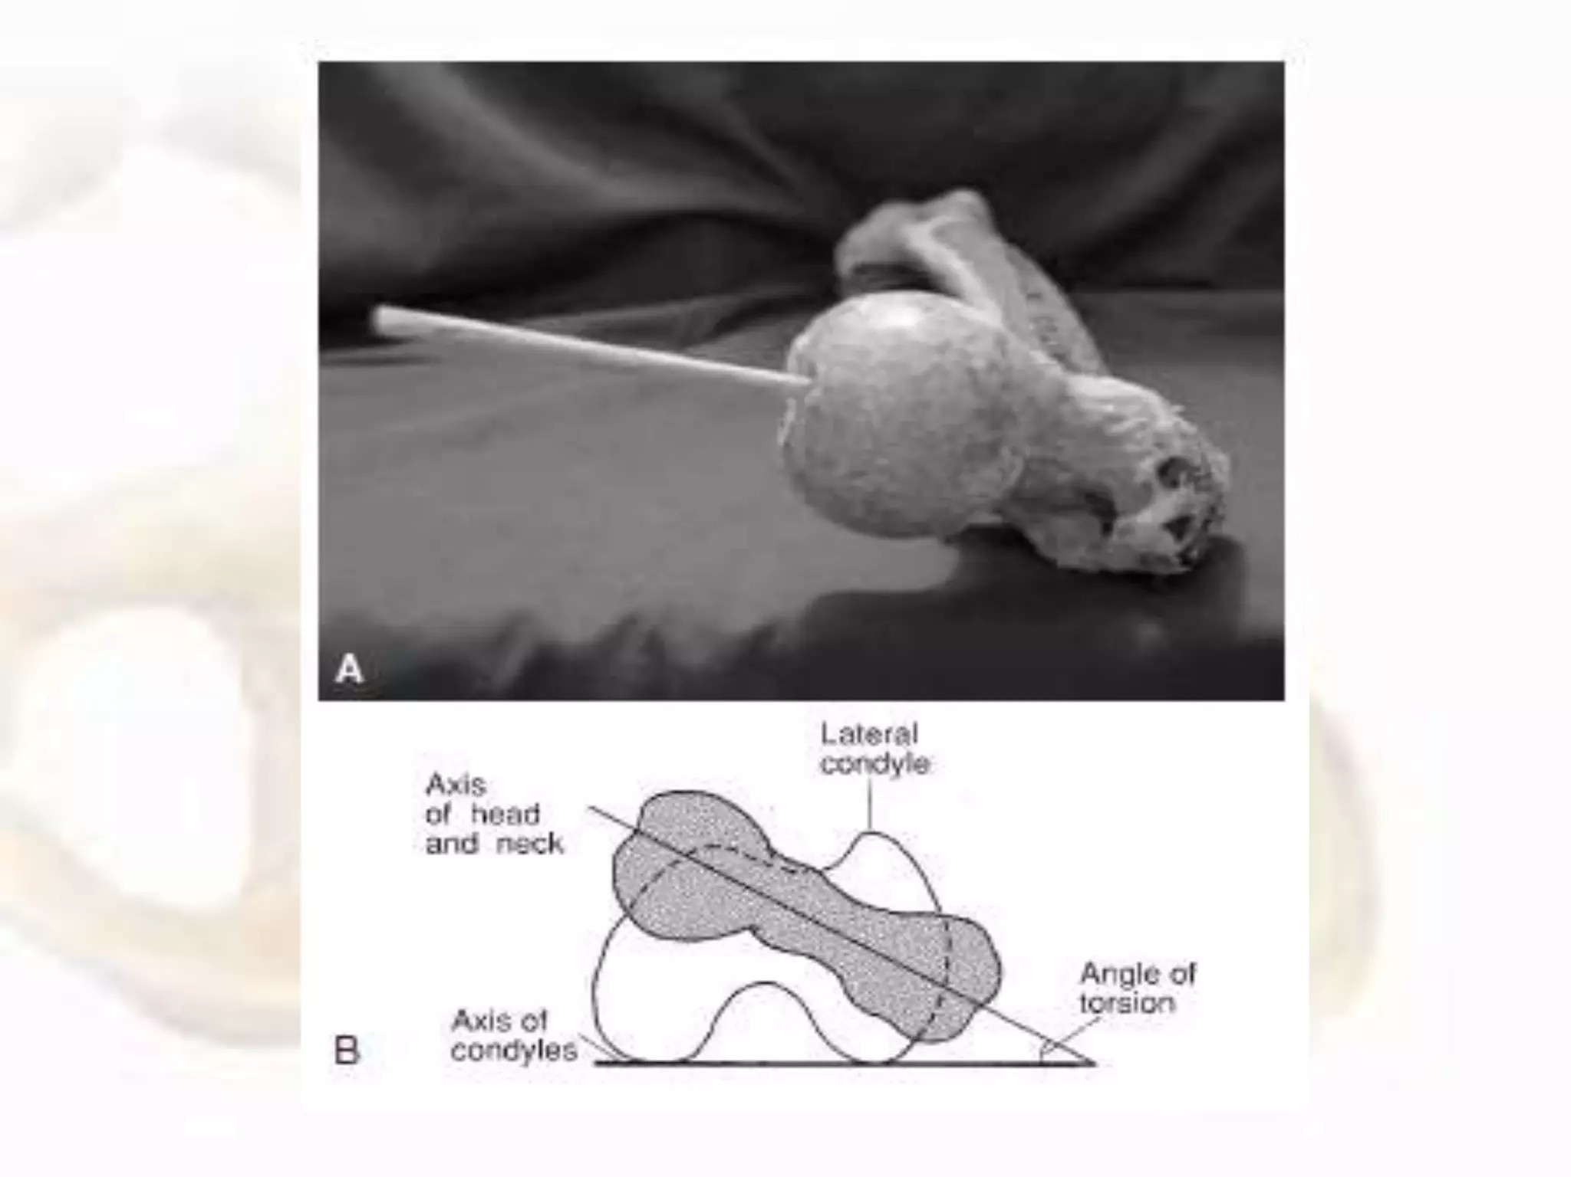

Slide 28
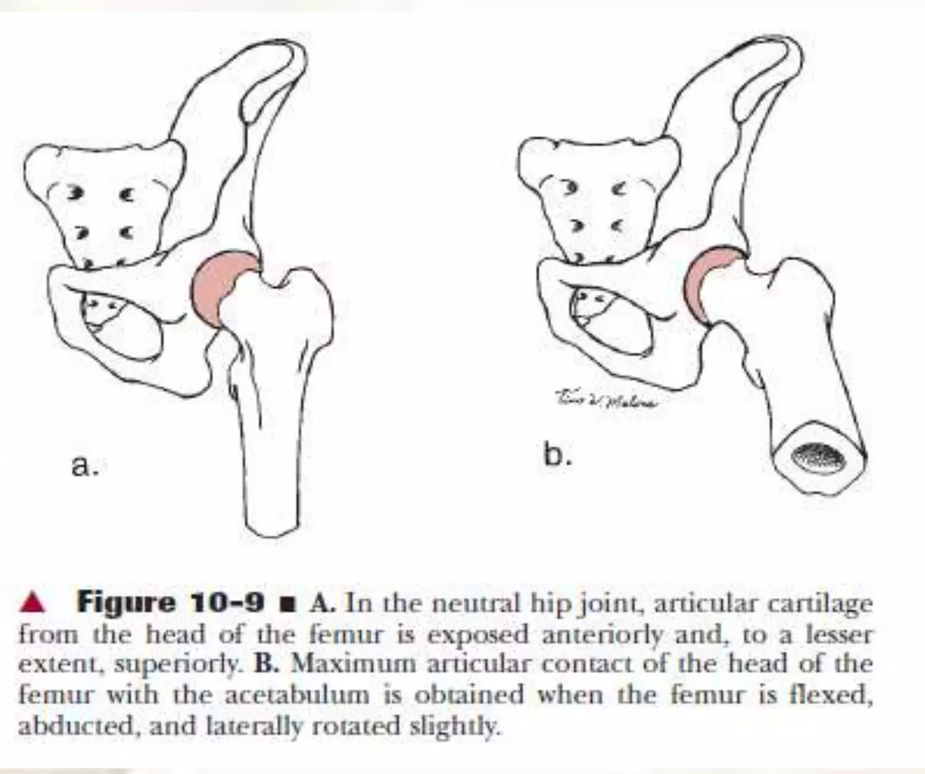
Articular Congruence

Slide 29
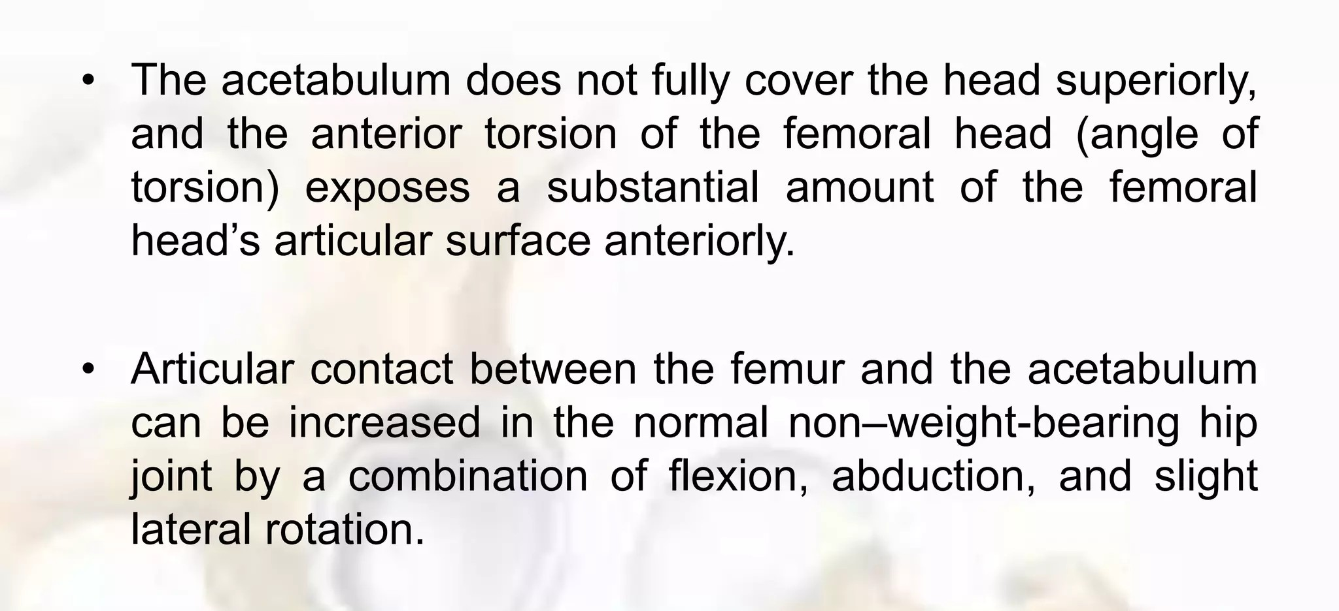
True Physiological position of Hip

Slide 30
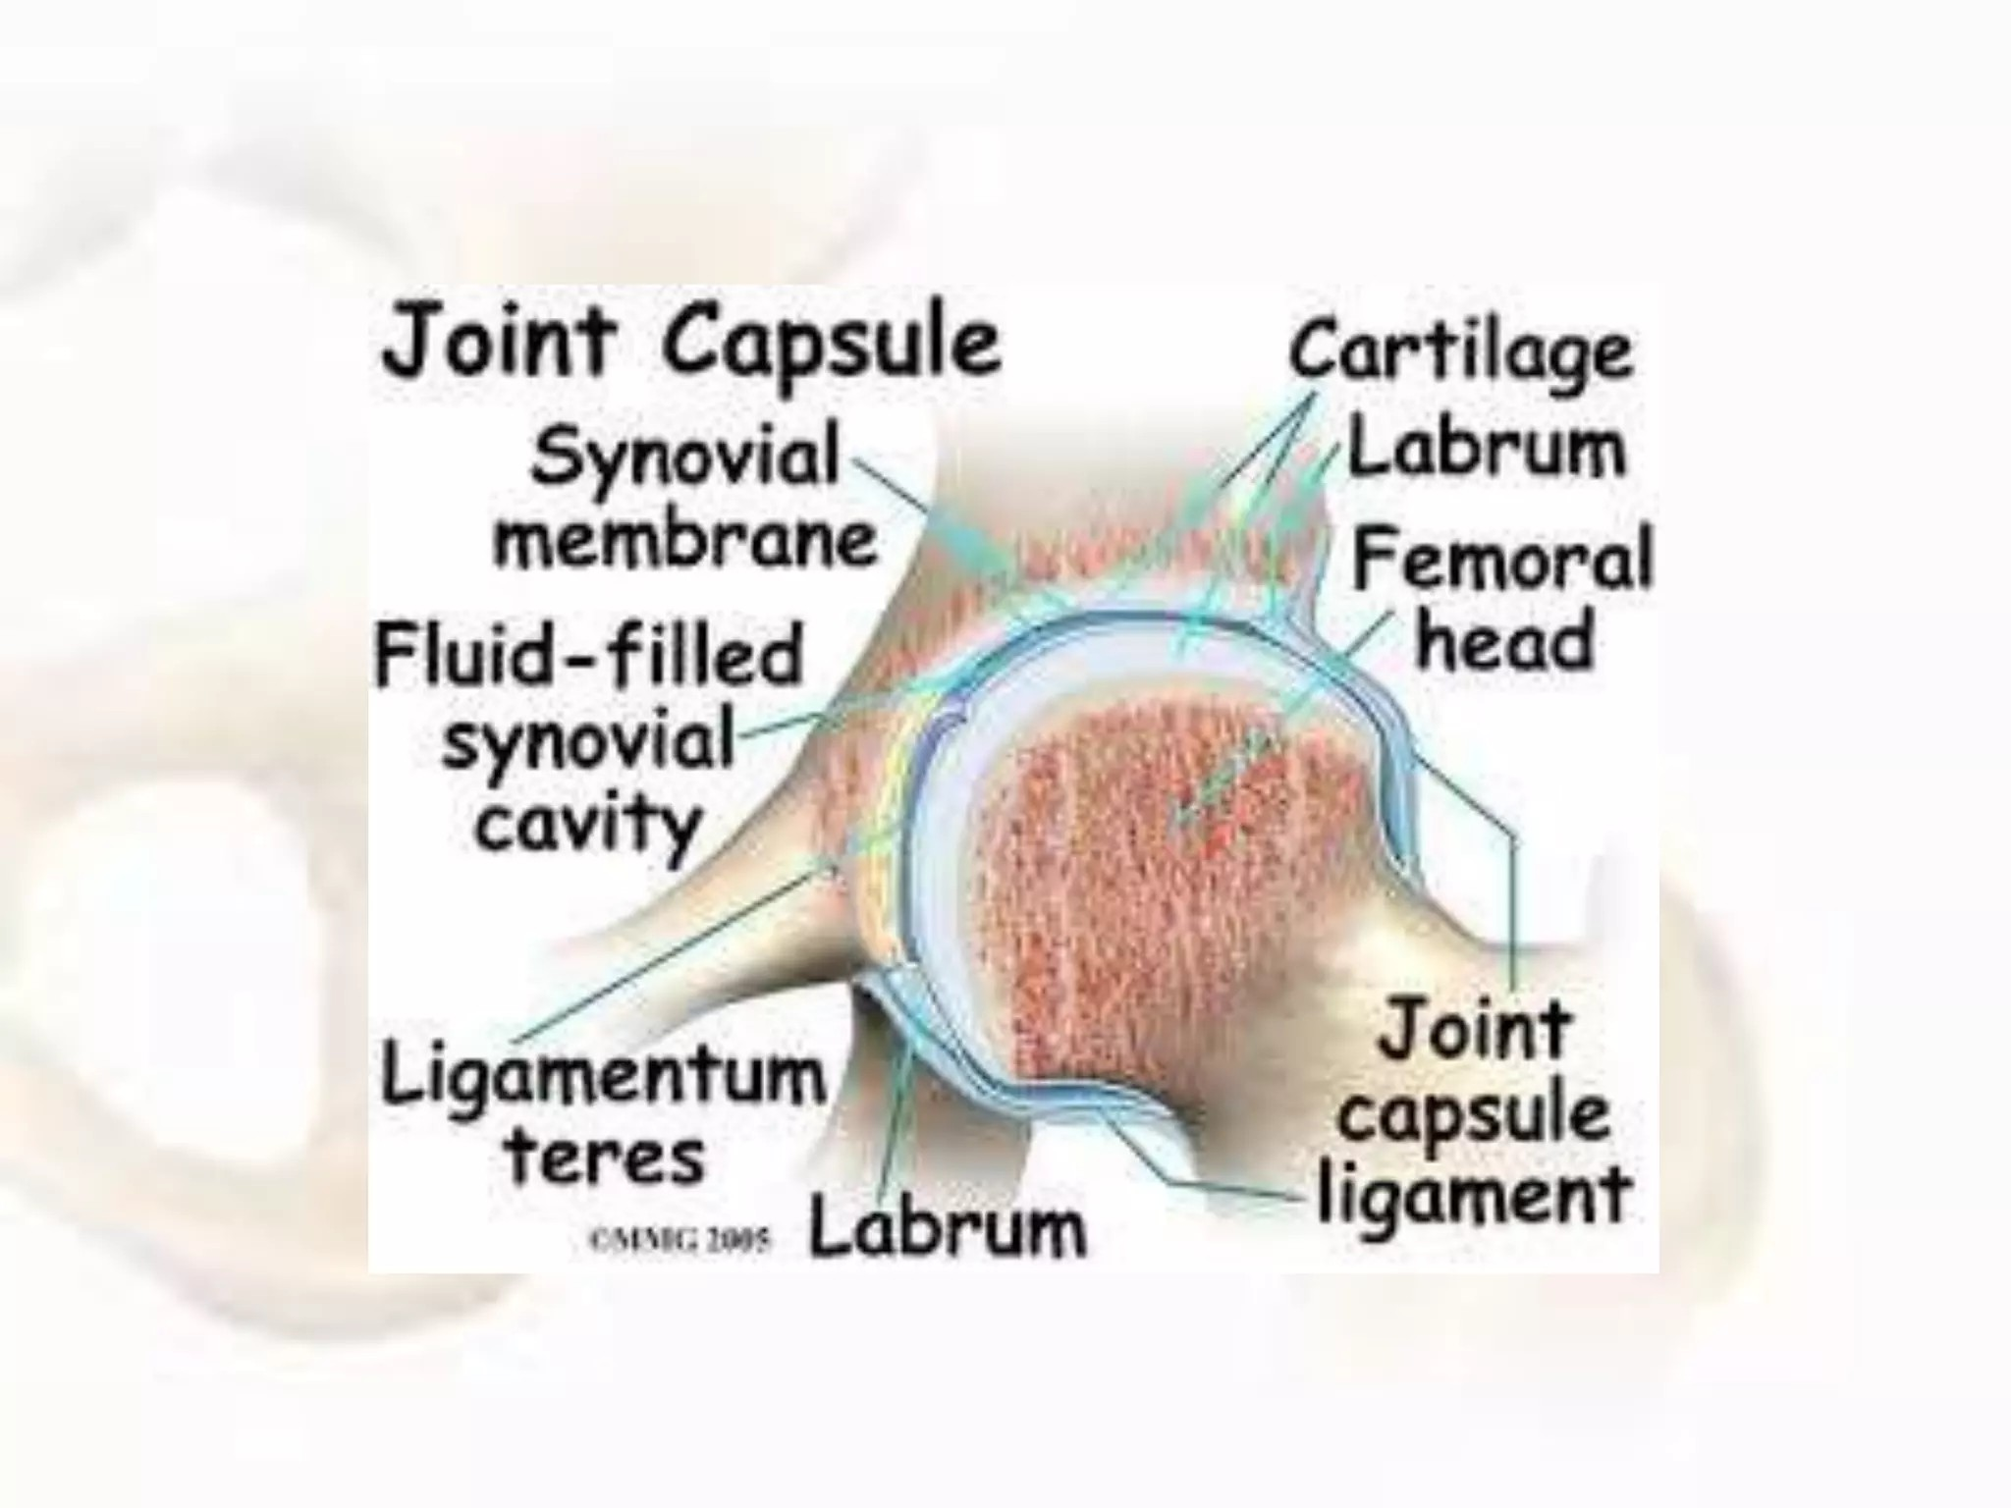

Slide 31
Hip Joint Capsule
Strong fibrous capsule that is a major stabilizer of the hip joint.
Attaches proximally around the acetabular rim beyond the labrum and distally to the base of the femoral neck.
Consists of longitudinal and oblique fibers with three capsular ligament thickenings.
Capsule is thick and strong antero- superiorly (high stress area) and thin posteroinferiorly.
Femoral neck is intracapsular, whereas greater and lesser trochanters are extracapsular.
Inner surface is lined by the synovial membrane.
Deep retinacular fibers run along the femoral neck and contain blood vessels supplying the femoral head and neck.
These vessels arise mainly from the medial and lateral circumflex femoral arteries.
Clinical Importance: Provides hip stability and maintains vascular supply to the femoral head.

Slide 32
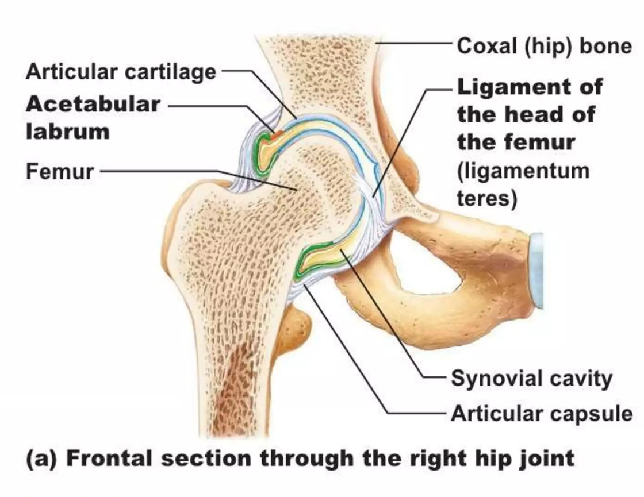
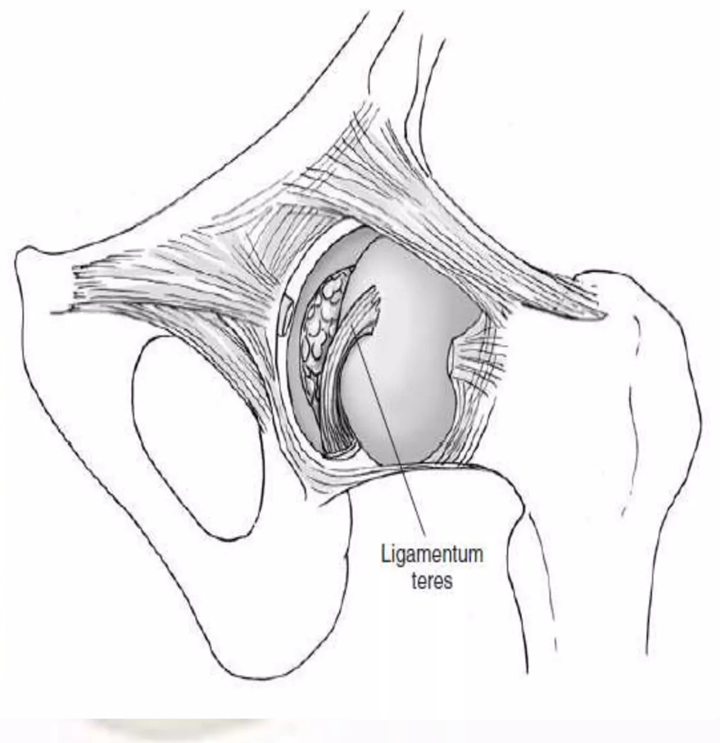
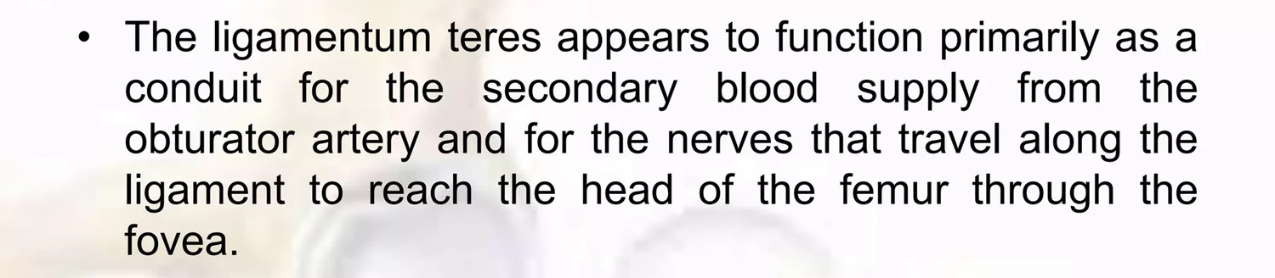
Hip Joint Ligaments
Ligamentum teres- Also called lg of head of femur.
It is intra articular, but extra synovial
Attachment & Path: It passes under and blends with the transverse acetabular ligament, ultimately attaching to the fovea of the femur.
Anatomical Structure: It is enclosed in a flattened sleeve of synovial membrane, meaning it is kept separate and does not communicate directly with the joint's synovial cavity.
Function/Tension: It becomes tensed when the hip joint is in a state of semiflexion and adduction.

Slide 33
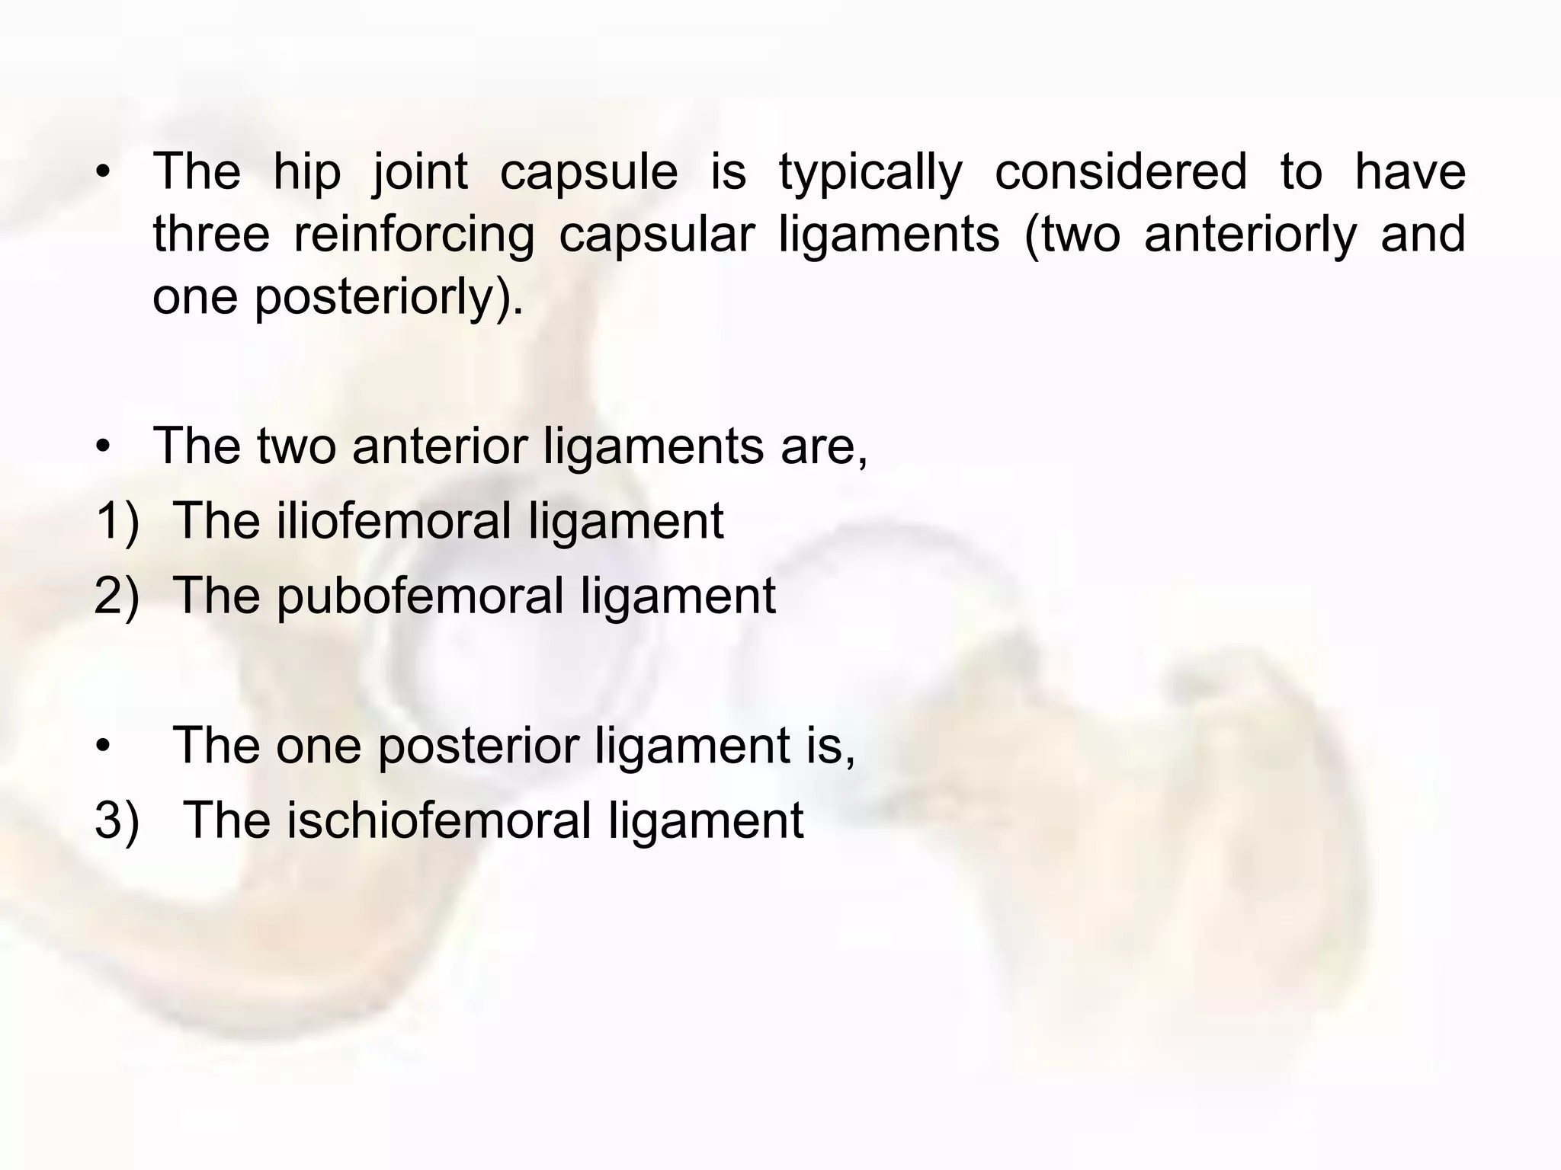

Slide 34
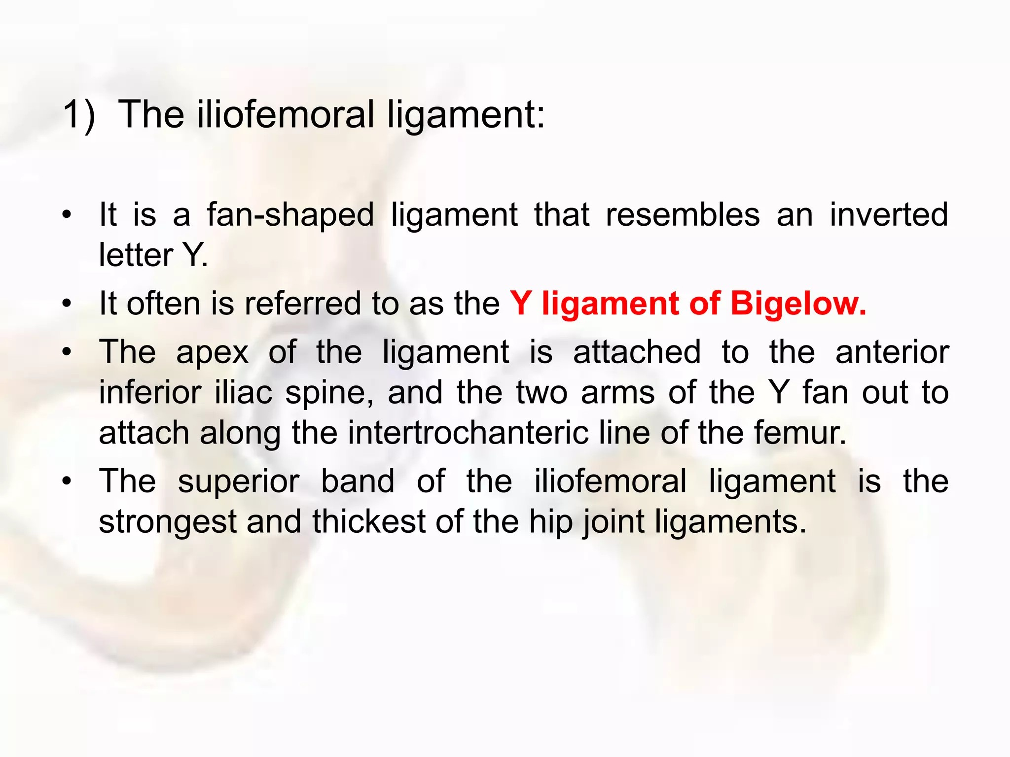
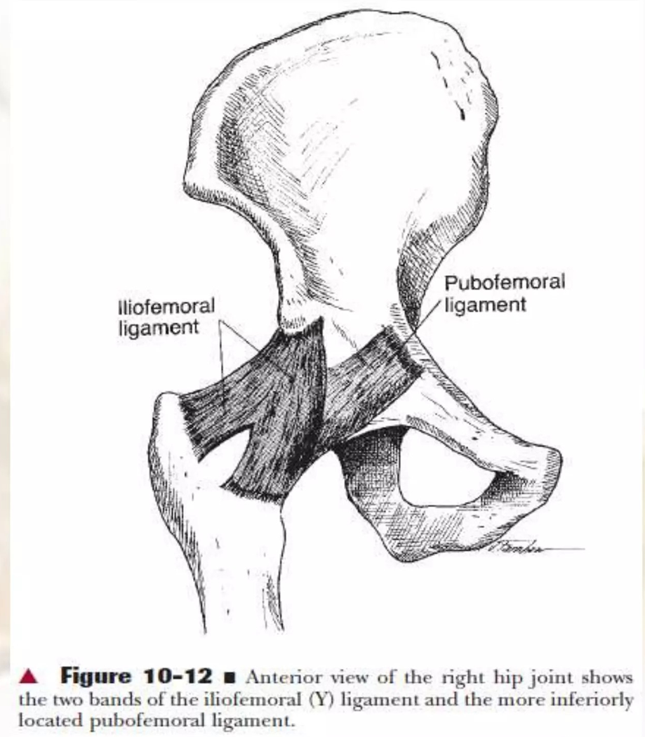
It Prevent Excessive Extension
Strongest lg of body

Slide 35
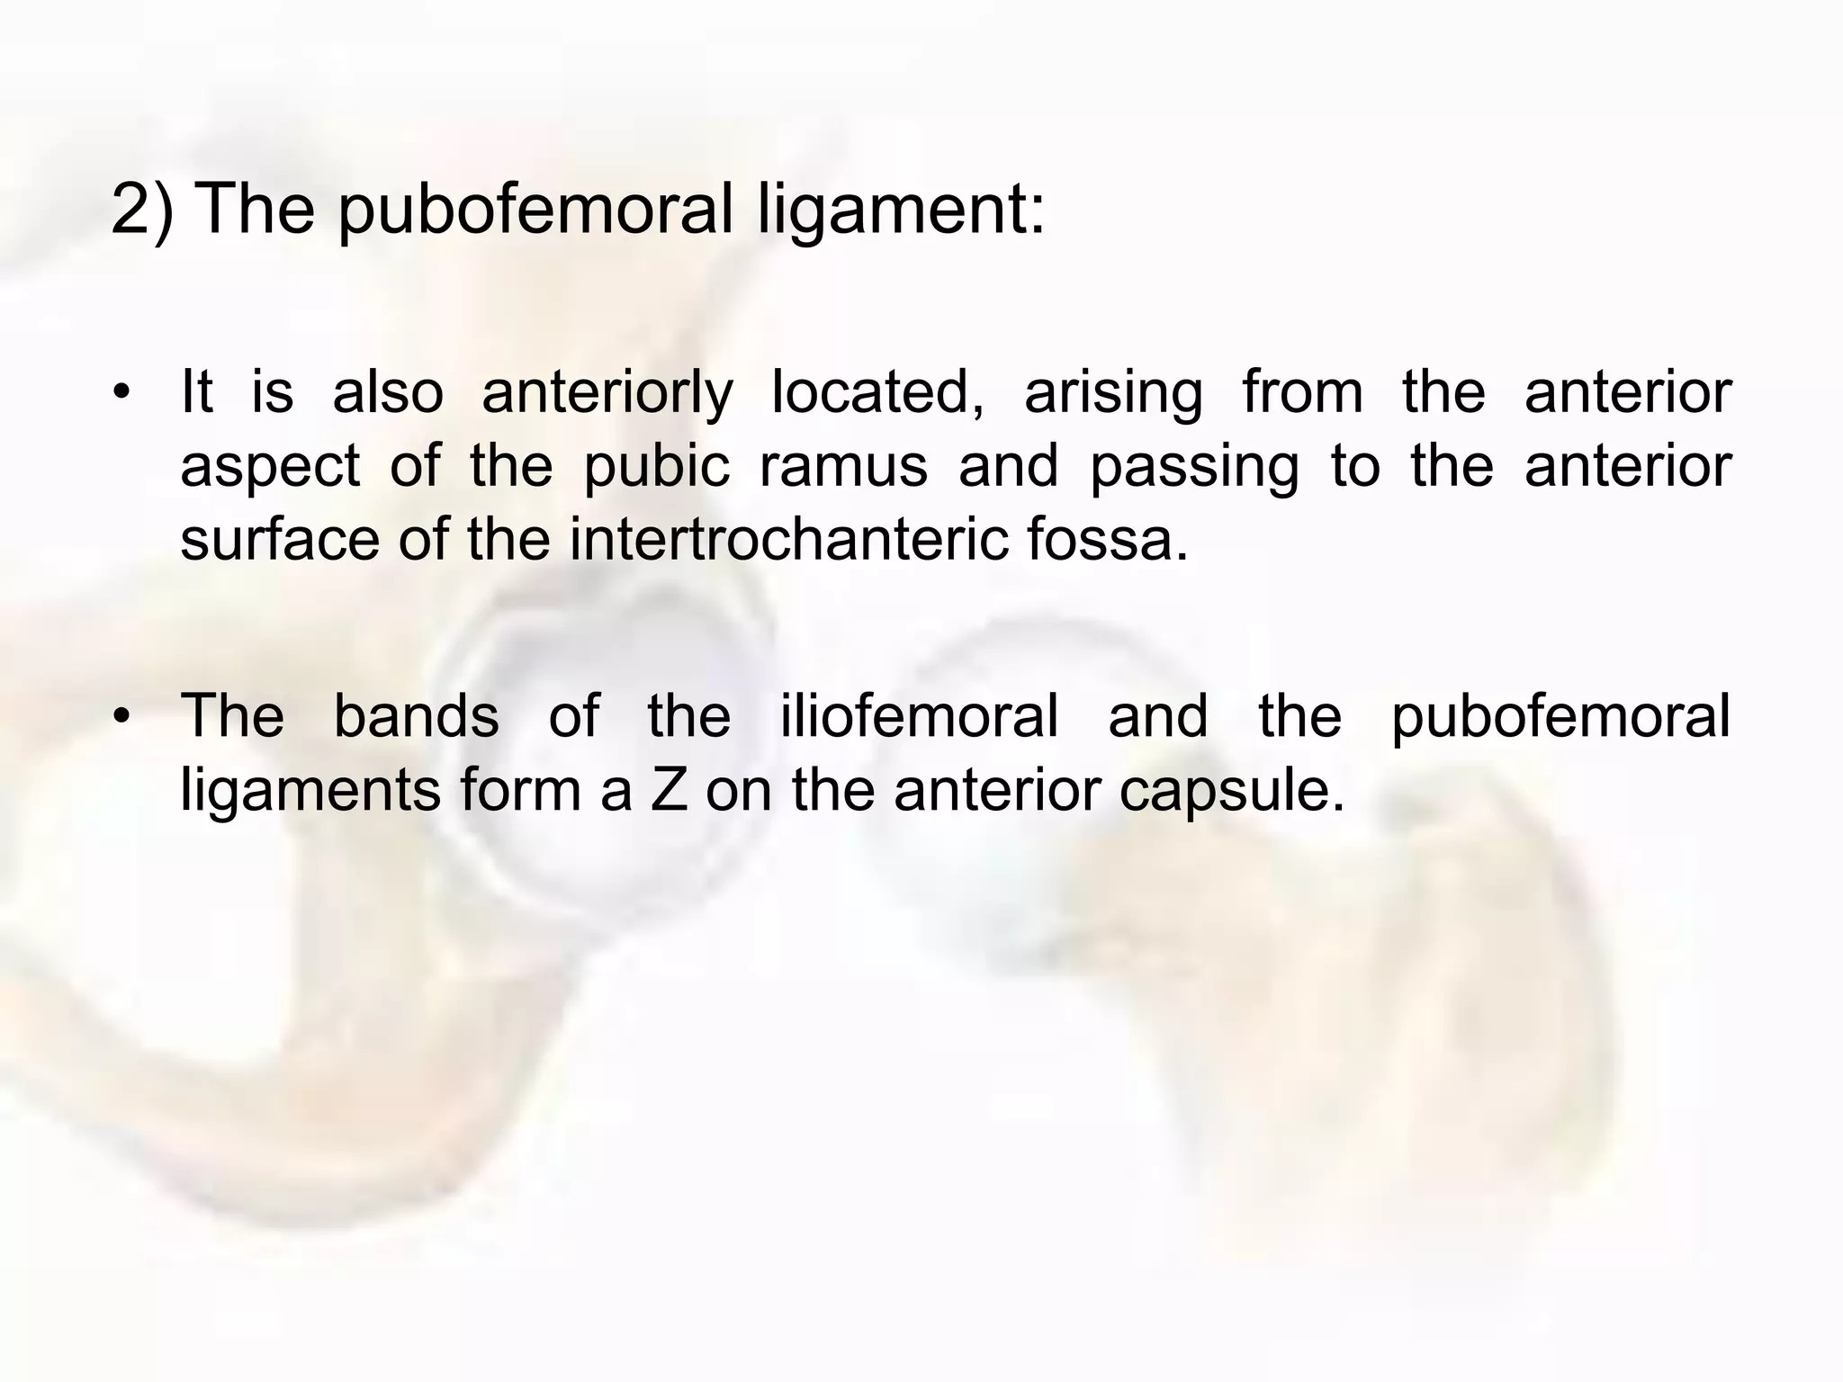
It prevents excessive abduction of the femur and limits extension.

Slide 36
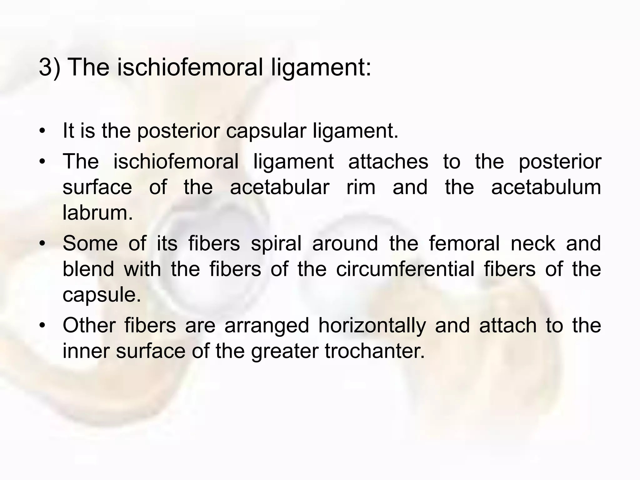
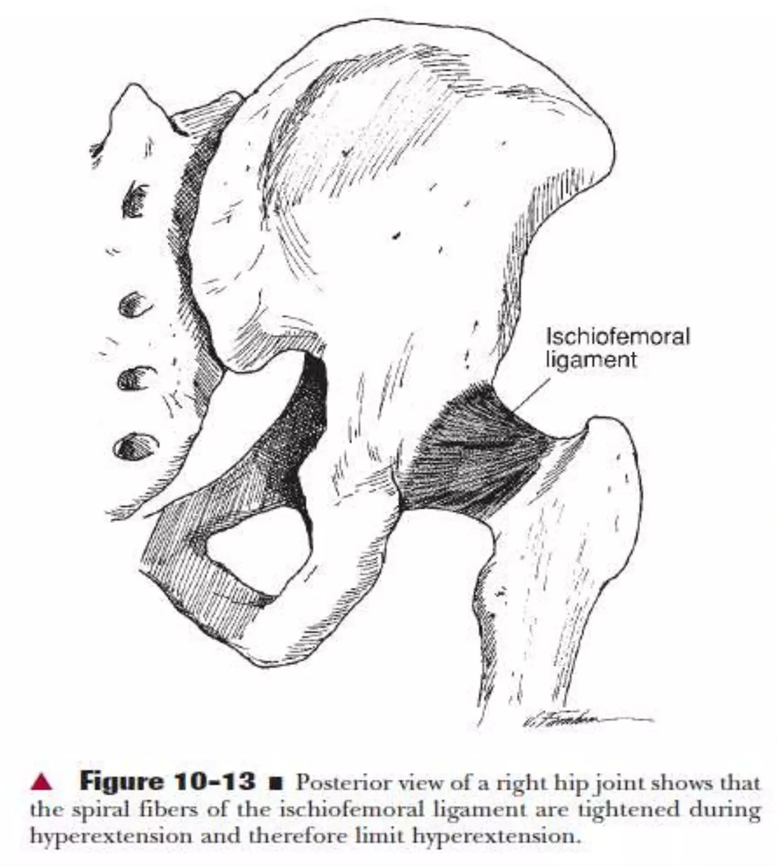
It is weakest of 3 lg and stabilize the hip in extension

Slide 37
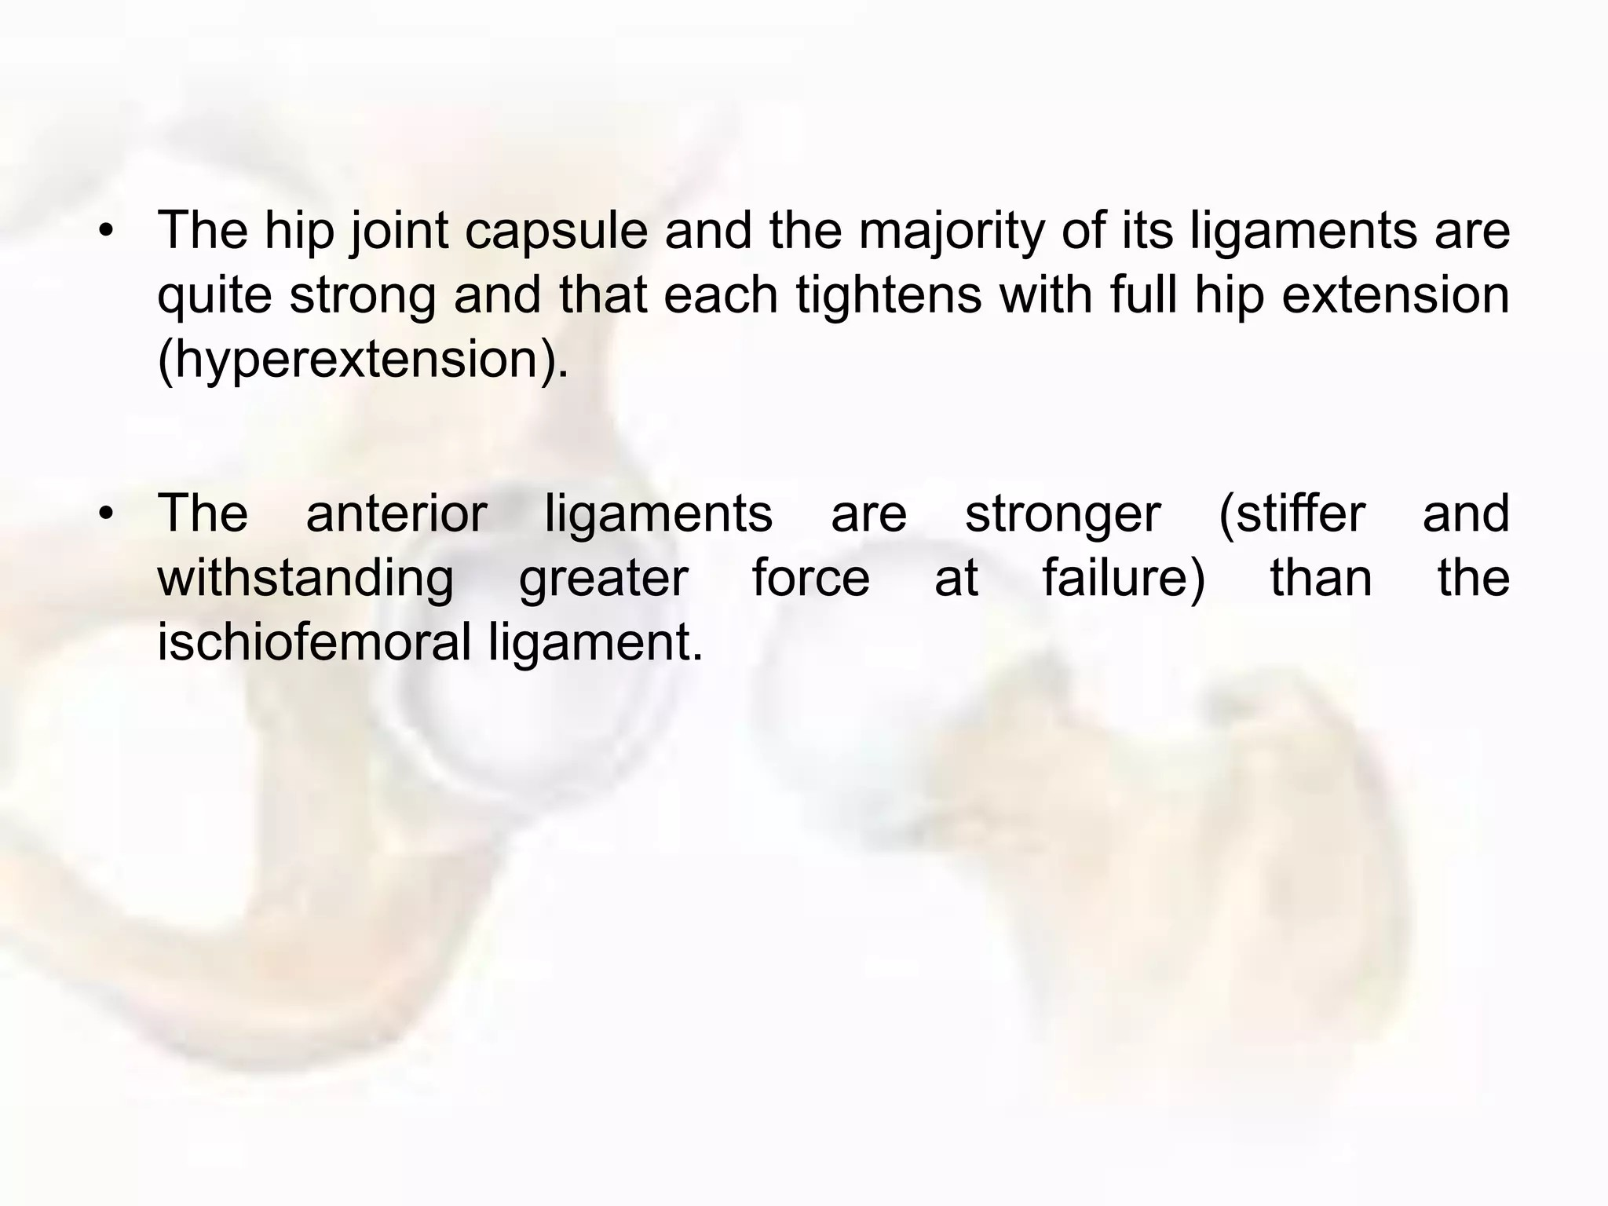

Slide 38
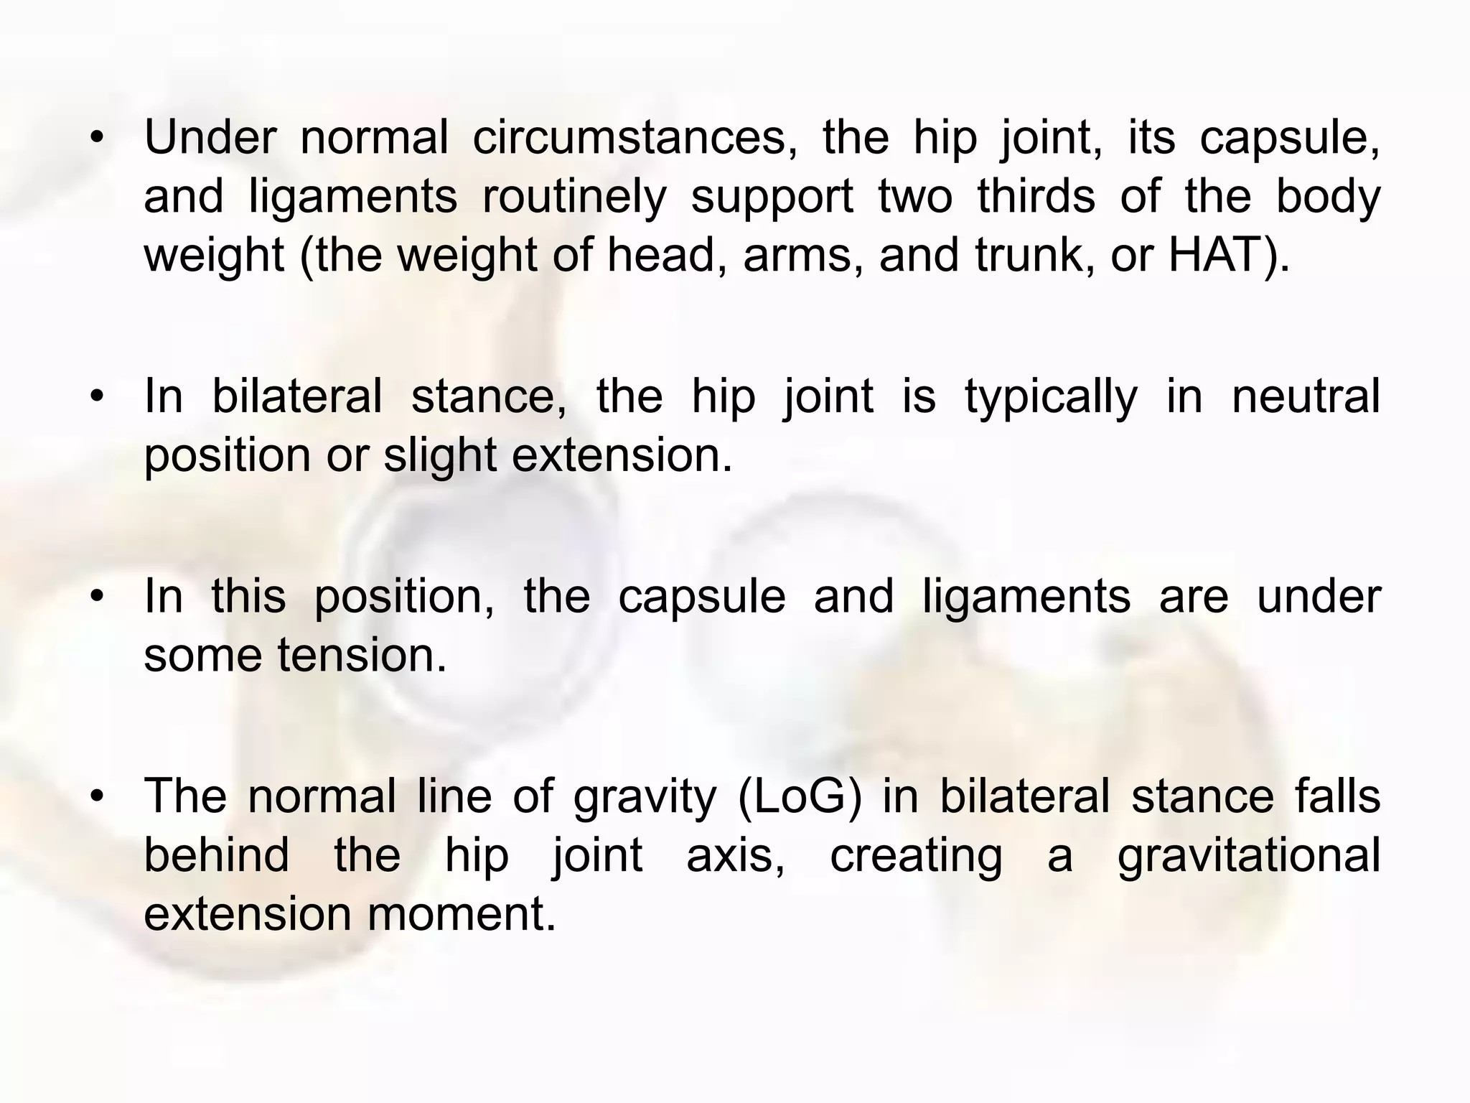

Slide 39
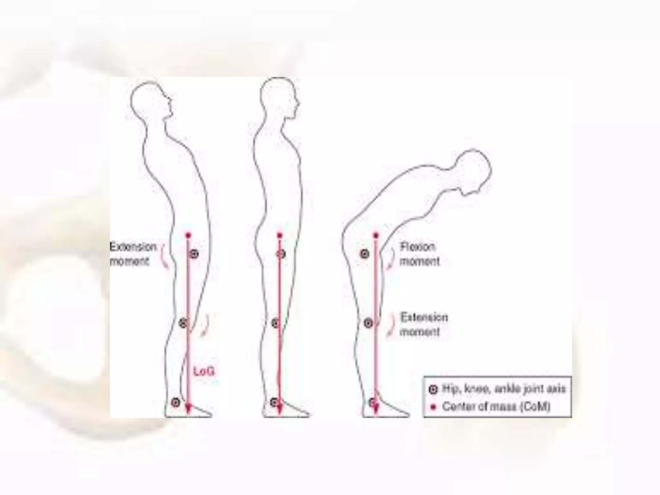

Slide 40
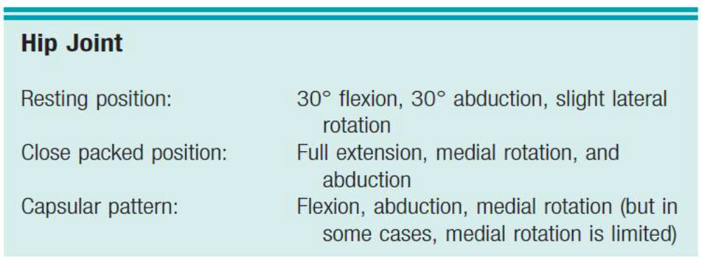
Maximal Joint Capacity -partially flexed and abducted position.
•a patient with an effusion in the hip joint is therefore most comfortable when the joint is held in this position

Slide 41
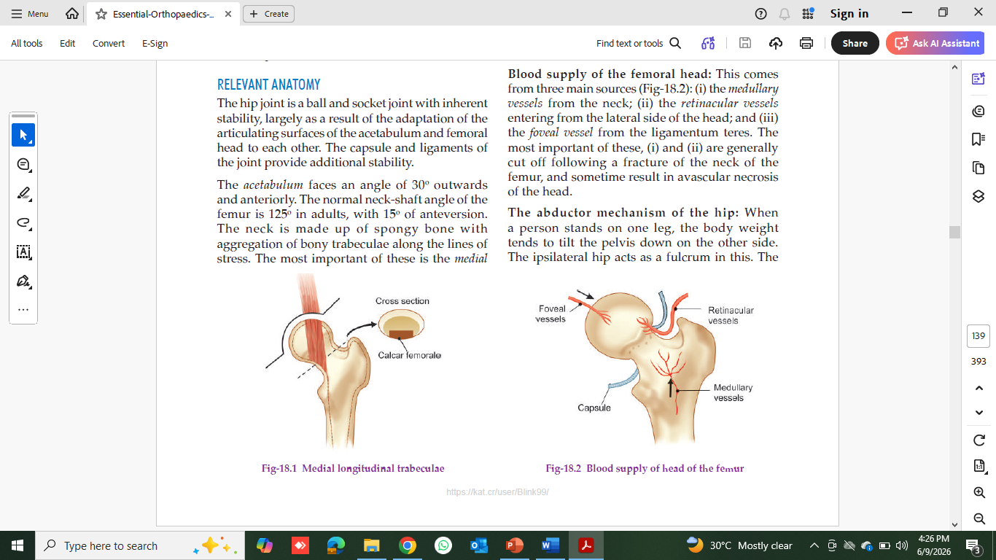
Blood Supply to Femur

Slide 42
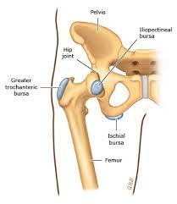
Bursae
Sub tendinous iliopectinealbursa
Trochanteric bursa

Slide 43
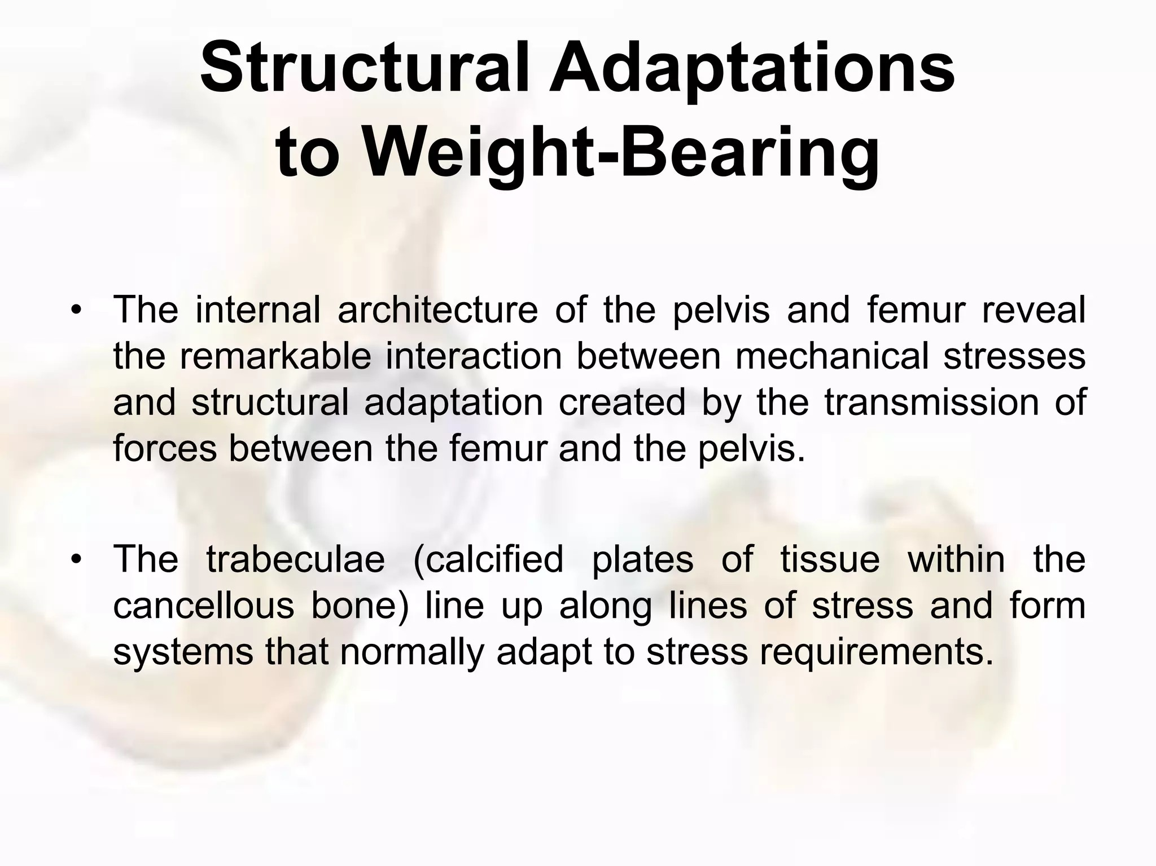

Slide 44
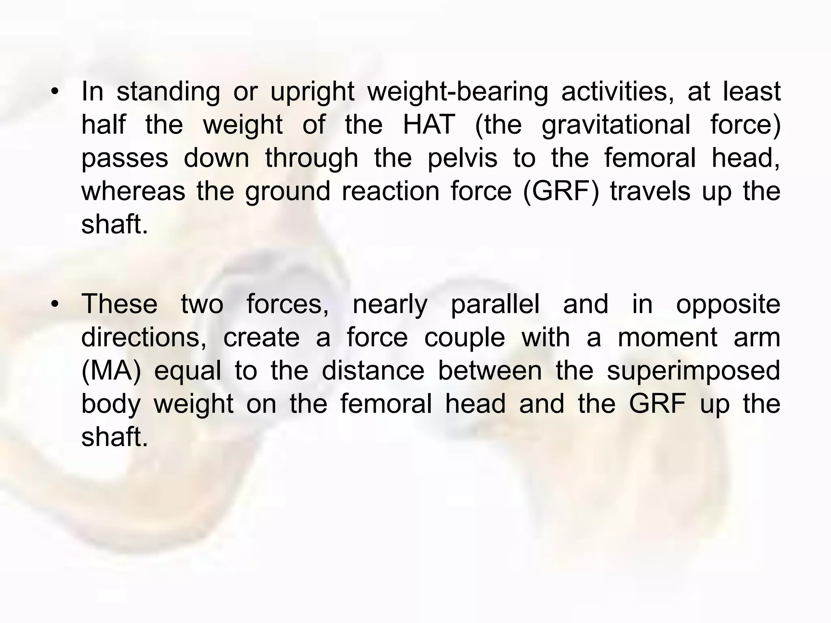

Slide 45
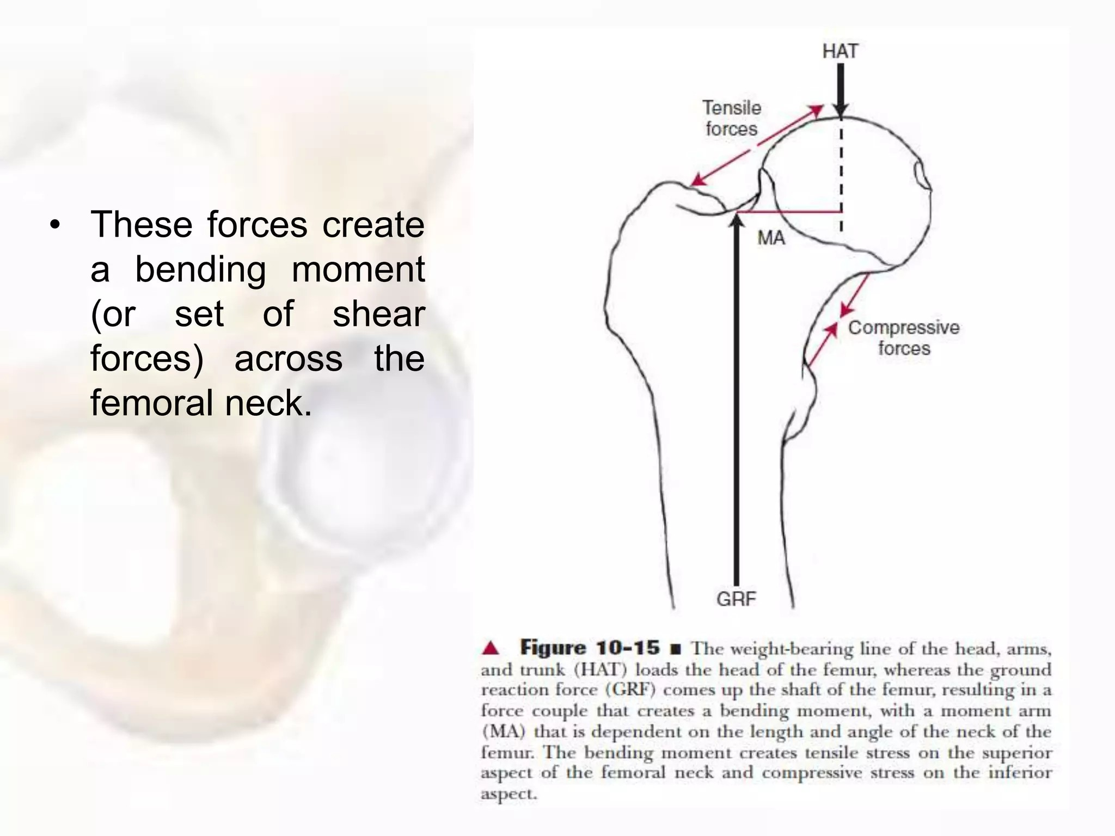

Slide 46
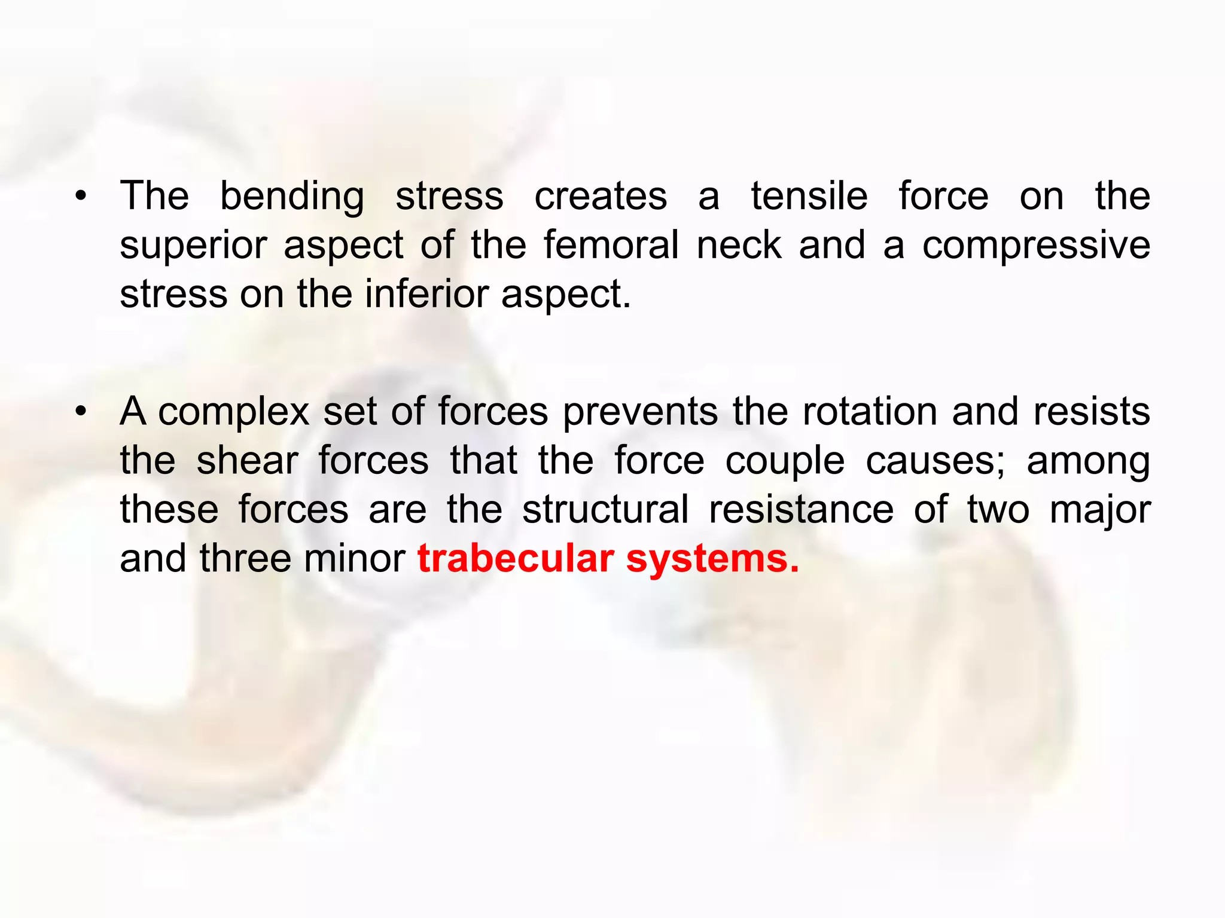

Slide 47
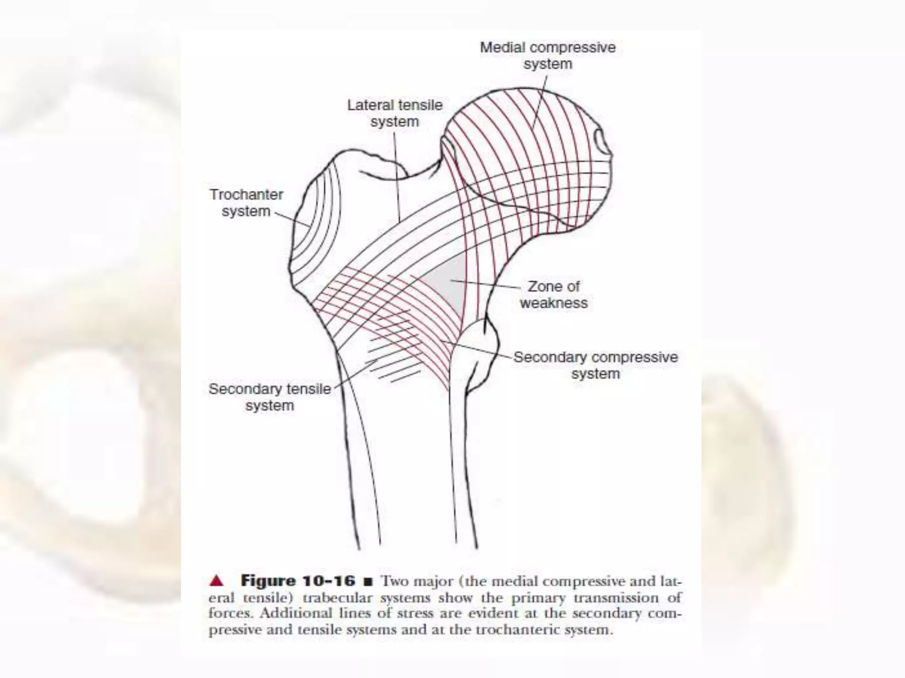

Slide 48
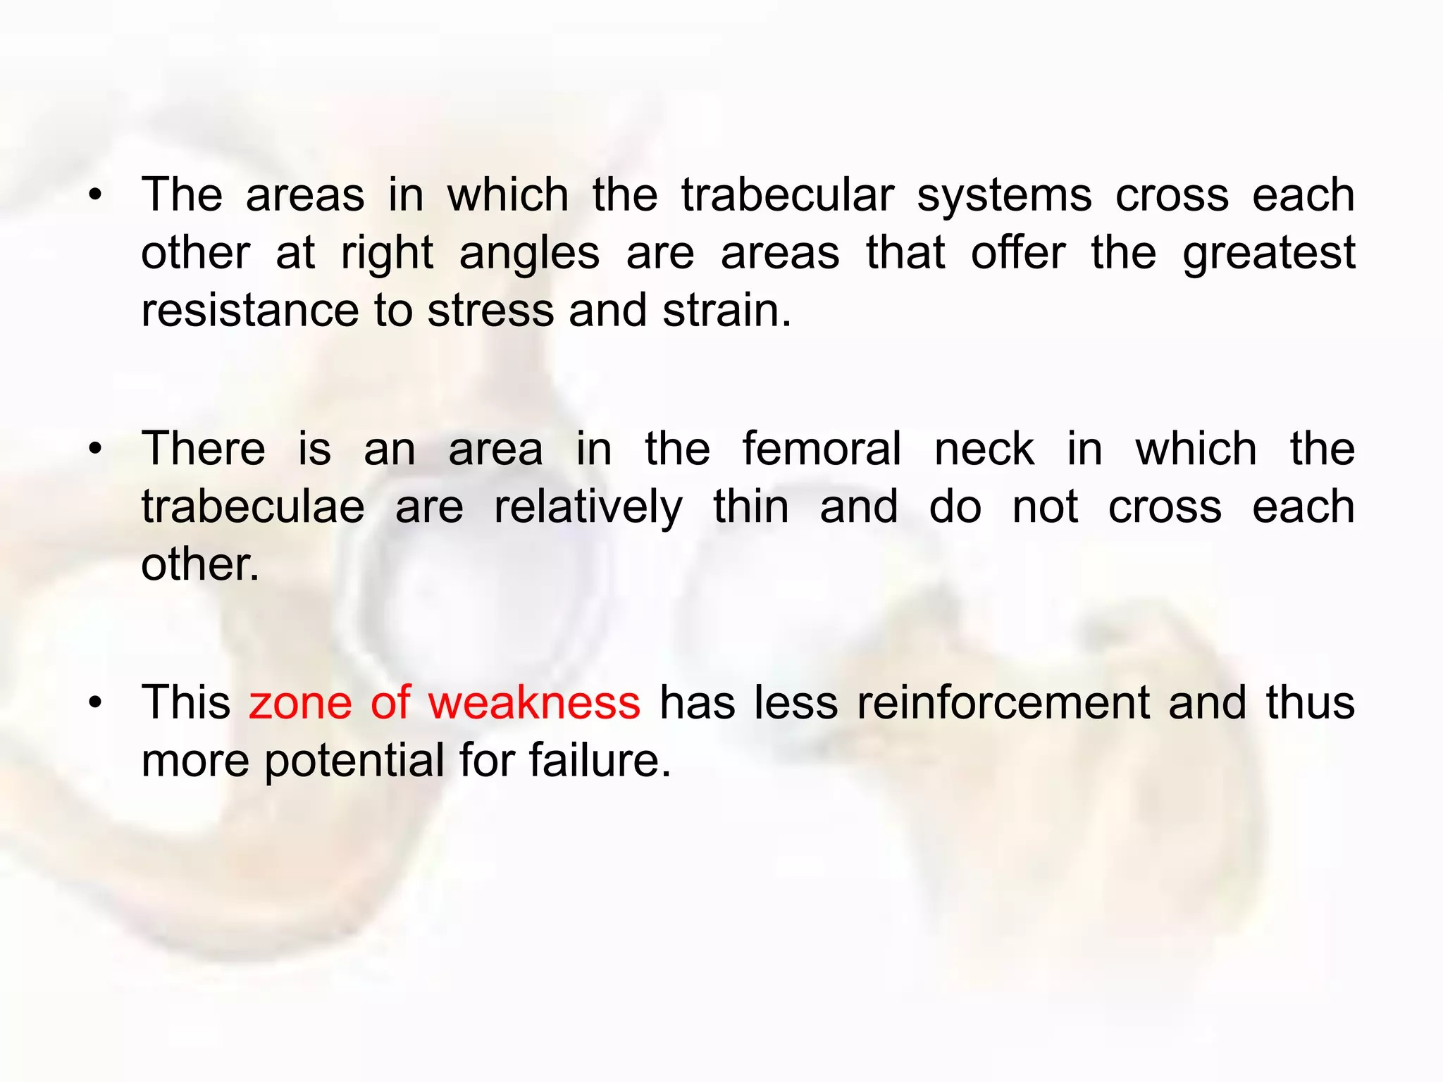

Slide 49


Slide 50


Slide 51



Slide 52



Slide 53


Slide 54


Slide 55


Slide 56


Slide 57


Slide 58


Slide 59


Slide 60


Slide 61


Slide 62
46. A hip joint has an effusion. According to joint capsule mechanics, what position will the patient naturally adopt to be most comfortable?
[ ] Full extension
[ ] Partial flexion and abduction
[ ] Full adduction
[ ] Internal rotation
12. What is the normal range of the Center Edge (CE) Angle?
1. 0-10 deg
2. 10-20 deg
3. 25-35 deg
4. 40-50 deg
24. What effect does the angle of torsion have on hip joint function?
[ ] Determines joint stability
[ ] Affects articular contact
[ ] Exposes more or less of the femoral head
[ ] All of the above
49. A 30-year-old patient has retroversion of the acetabulum. What clinical symptoms are most expected?
[ ] Instability
[ ] Impingement and labral pathologies
[ ] Toe-in gait
[ ] Fracture

Slide 63
5. The artery passing through the ligamentum teres is a branch of:
A. Femoral artery
B. Obturator artery
C. Inferior gluteal artery
D. Internal pudendal artery
6. The close-packed position of the hip joint is:
A. Flexion, abduction, ER
B. Extension with slight abduction and internal rotation
C. Flexion, adduction, IR
D. Neutral position
21. In open-chain hip flexion, the femoral head primarily:
A. Glides anteriorly
B. Glides posteriorly
C. Spins only
D. Distracts inferiorly
7. Barlow test is performed to:
A. Reduce hip dislocation
B. Detect hip flexion contracture
C. Dislocate an unstable hip
D. Assess hip abductor weakness

Slide 64


Slide 65


Slide 66

Hip Dislocation
Types
Posterior Dislocation (Most Common – ~90%)
Anterior Dislocation
Central Fracture-Dislocation

Slide 67
Posterior Hip Dislocation
Mechanism: Dashboard injury; force transmitted along femur with hip flexed.
Clinical Features:
Severe pain and inability to walk
Hip held in flexion, adduction & internal rotation
Limb shortening
Management:
Orthopaedic emergency
Urgent closed reduction under anesthesia
Traction followed by rehabilitation
Complications
Sciatic nerve injury
Avascular necrosis (AVN) of femoral head
Secondary osteoarthritis
Myositis ossificans
Clinical Pearl: Early reduction (within 6 hours) significantly reduces the risk of AVN and long-term complications.
Anterior Hip Dislocation
Rare injury
Mechanism:
▸ Hyperextension OR external rotation — or both simultaneously
Position of femoral head:
▸ Sits inferior to the acetabulum or obturator foramen
Hip held in abduction, flexion & external rotation
Central Fracture-Dislocation
Femoral head driven through acetabulum into pelvis
Usually associated with acetabular fracture
May require surgical reconstruction/THR

Slide 68
Always assess sciatic nerve function after posterior hip dislocation — foot drop or hamstring weakness = sciatic involvement
Hip dislocation = orthopedic emergency → avascular necrosis of the femoral head risk increases with delay in reduction
Always get CT after reduction to rule out intra-articular fracture fragments
Dashboard injury pattern → think posterior hip dislocation + knee injury simultaneously

Slide 69


Slide 70


Slide 71
Common causes: Road traffic accidents, falls, and sports injuries.
Common fracture sites: Neck of femur, Intertrochanteric region, Shaft, and Distal femur.
Clinical features include pain, swelling, deformity, limb shortening, and inability to bear weight.
A femoral shaft fracture may cause significant blood loss (up to 1–1.5 L).
Important complications: Avascular necrosis (neck fractures), non-union, malunion, infection, and joint stiffness.
Treatment involves reduction, internal fixation (nail/plate/screws), and early rehabilitation.
Most common site in elderly → Neck of Femur
Most common nerve injury with femoral fractures → Sciatic nerve (proximal injuries)
Blood supply to femoral head → Medial circumflex femoral artery
Most feared complication of neck of femur fracture → Avascular Necrosis (AVN)
Clinical Pearl: Neck of femur fractures in elderly patients are associated with high morbidity and often require surgical management.

Slide 72


Slide 73


Slide 74


Slide 75


Slide 76


Slide 77


Slide 78

Avascular Necrosis (AVN) of Femoral Head
Death of bone tissue of the femoral head due to interruption of blood supply, leading to collapse of the femoral head and secondary osteoarthritis.
Causes
Neck of femur fracture
Hip dislocation
Corticosteroid use
Alcoholism
Sickle cell disease
Clinical Features
Groin pain
Limping gait
Restricted hip ROM (especially internal rotation)
Progressive disability
Investigation
MRI (Gold Standard)
X-ray: Crescent sign in advanced stages
Exam Pearls
✔ Most common vessel involved → Medial circumflex femoral artery
✔ Most common complication of neck of femur fracture → AVN

Slide 79


Developmental Dysplasia of Hip (DDH)
Abnormal development of the acetabulum and femoral head resulting in instability or dislocation of the hip.
Risk Factors
Female sex
Breech presentation
First-born child
Positive family history
Clinical Features
Limb length discrepancy
Asymmetrical gluteal folds
Limited hip abduction
Delayed walking
Special Tests
Barlow Test (+)
Ortolani Test (+)
Galeazzi Sign (+)
Investigation
Ultrasound (<6 months)
X-ray (>6 months)- Reduced obliquity and loss of acetabular concavity.
Exam Pearls
✔ Most common congenital hip disorder
✔ Ortolani test reduces a dislocated hip
Galeazzi sign +

Slide 80

The term DDH includes
Dislocatable hips
Partial dislocation (subluxation) of the femoral head
Acetabular dysplasia (deficient development of acetabulum)
Complete dislocation of the femoral head

Slide 81




Frejkapillow or Pavlikharness can maintain Hip joint in FROG leg position for managing Hip dysplasia.

Slide 82

Legg-Calvé-Perthes Disease
Idiopathic AVN of the femoral head occurring in children, collapse of femoral head leading to flattening of head from Blood loss./ Interuption of lateral epiphyseal art.
Age Group- 4–8 years (commonly boys)
Clinical Features
Painless limp
Groin/thigh/knee pain
Restricted abduction
and internal rotation
X-ray Findings
Flattened femoral head
Fragmentation
Sclerosis
Exam Pearls
✔ Child + Limp + Hip pain = Think Perthes disease
✔ Unilateral involvement is more common

Slide 83

Slipped Capital Femoral Epiphysis (SCFE)
Posteroinferior displacement of the femoral head epiphysis relative to the femoral neck through the growth plate.
Age Group
10–16 years
Risk Factors
Obesity
Rapid growth spurt
Endocrine disorders
Clinical Features
Hip, groin, or knee pain
Limping
External rotation deformity
Restricted internal rotation
X-ray Finding
Ice Cream Slipping Off the Cone Appearance
Exam Pearls
✔ Most common adolescent hip disorder
✔ Obese adolescent + knee pain = suspect SCFE

Slide 84

Femoroacetabular Impingement (FAI)
Abnormal contact between the femoral head-neck junction and acetabular rim causing labral and cartilage damage.
Types
Cam Type- Femoral head abnormality
Pincer Type- Acetabular overcoverage
Clinical Features
Groin pain
Pain during squatting
Decreased hip flexion and internal rotation
Special Test
FADIR Test (+)
Exam Pearls
✔ Most common cause of early hip OA in young adults
✔ FADIR = Flexion + Adduction + Internal Rotation

Slide 85

Trendelenburg Gait
Definition
Abnormal gait caused by weakness/paralysis of hip abductors (Gluteus Medius & Minimus).
Causes
Superior gluteal nerve injury
Hip OA
DDH
Perthes disease
Clinical Features
Pelvis drops on opposite side during single-leg stance
Trunk leans toward affected side
Trendelenburg Test
Positive when pelvis drops on the unsupported side.
Exam Pearls
✔ Muscle involved → Gluteus Medius
✔ Nerve involved → Superior Gluteal Nerve (L4-S1)

Slide 86

Snapping Hip Syndrome (Coxa Saltans)
Definition
Audible or palpable snapping sensation around the hip during movement.
Types
External Type (Most Common)
Iliotibial band or Gluteus Maximus over Greater Trochanter
Internal Type
Iliopsoas tendon over iliopectineal eminence
Intra-articular Type
Labral tear
Loose bodies
Clinical Features
Snapping sensation
Clicking sound
Pain during hip movement
Exam Pearls
✔ Most common type → External snapping hip
✔ Most commonly involved tendon → Iliopsoas (Internal type)

Slide 87
Mobilization
Concave acetabulum- Convex Femoral Head
Hip Distraction/Caudal Glide- For pain control and general Mobility
Hip Posterior Glide- To increase Flexion, IR
Hip Anterior Glide- To increase Extension,ER

Slide 88


Total Hip Replacement
Cobalt chrome & Titanium- Femur
Polyethylene- Acetabulum
PMMA (Polymethyl Methacrylate)

Slide 89





Special Tests
Muscle Tightness

Slide 90



Slide 91

25. Following posterior approach THR, which movement combination should be avoided initially?
A. Flexion >90°, adduction and internal rotation
B. Extension and ER
C. Abduction and ER
D. Flexion and abduction only
26. A runner complains of lateral knee pain. Ober test is positive.
Which structure is tight?
A. Piriformis
B. Hamstring
C. Iliotibial band
D. Rectus femoris
28. A child aged 8 years develops limp and hip pain. X-ray shows avascular necrosis of femoral head.
Diagnosis?
A. SCFE
B. Perthes disease
C. DDH
D. Coxa valga
IMP) A patient stands on right leg. Left side pelvis drops. (AIIMS)
Which side gluteus medius is weak?
A. Left
B. Right
C. Bilateral
D. Cannot determine
Q1. Ortolani test is used to:
A. Dislocate a reduced hip
B. Reduce a dislocated hip
C. Assess femoral anteversion
D. Assess leg length

Slide 92
THANK YOU

