Slide 1
Exercise therapy part 1
Dr. Ojaswi Sahal (PT)

Slide 2
What’s into it
Mechanical Principles
Introduction to Movement
Introduction to Exercise Therapy
Starting Positions
Active Movements
Relaxation
Passive Movements

Slide 3
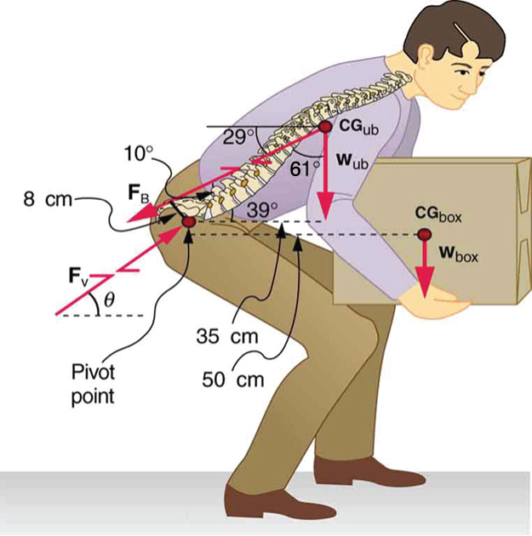

Mechanical principles
FORCE
Any push or pull, that alters the state of the body.

Slide 5
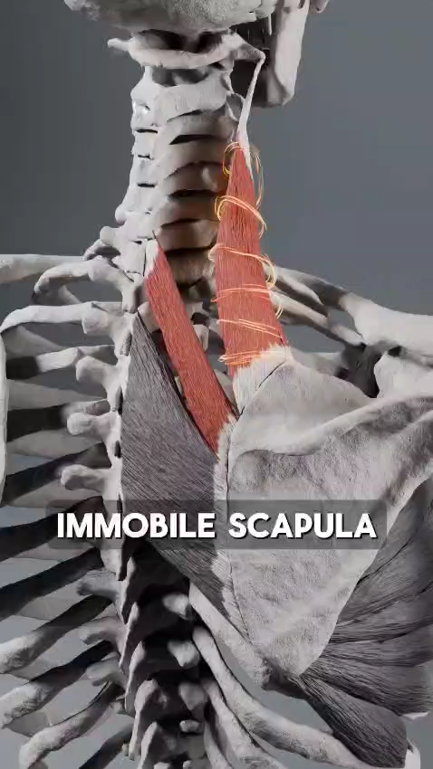
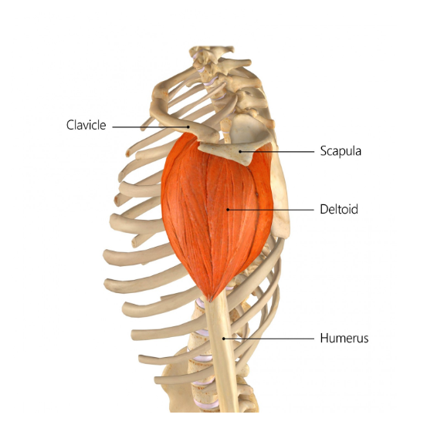

Slide 6
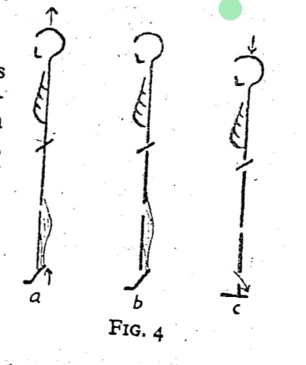
System of forces tending to separate parts of a body combined with equal and opposite forces which hold the parts together.
Measured in Newton.
In physiology, Tension and Force are used synonymously.
e.g – intramuscular tension is the force of muscle contraction.
TENSION
GRAVITY
Force by which, all bodies are attracted to earth.
Acts on human body also, counterbalanced by equal and opposite force.
e.g- plinth, buoyancy of water, isometric muscular contraction.
In erect position balance is maintained by the integrated contraction of many muscles called ANTI-GRAVITY MUSCLES.

Slide 7
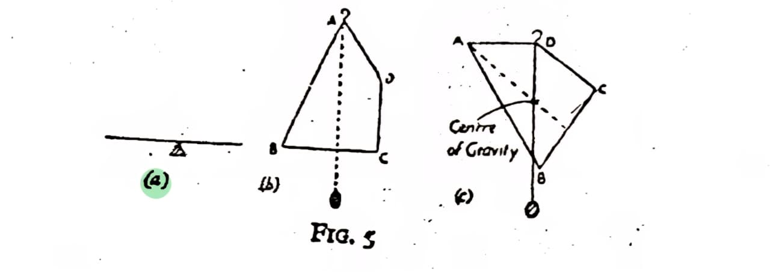
The centre of gravity
Point through which the earth’s attraction effectively acts .
The centre of gravity of the human body in the anatomical position is reputed to be in the vicinity of the body of the second sacral vertebra.

Slide 8
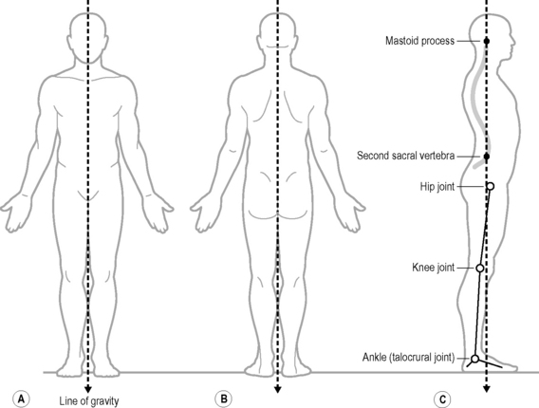
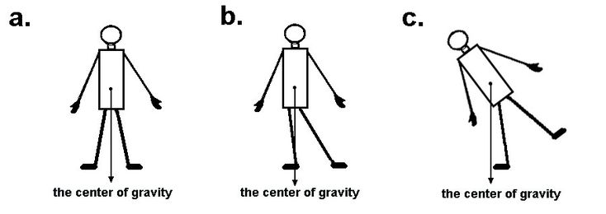
Line of gravity

Slide 9
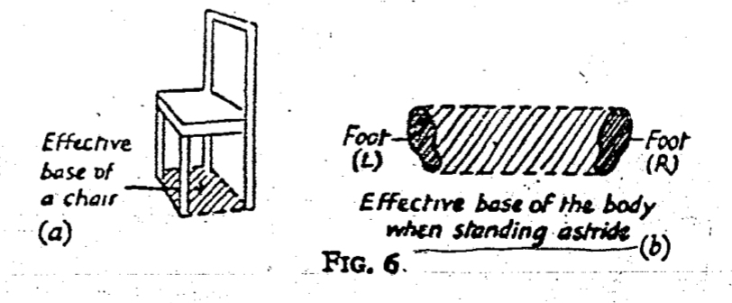
base
Area by which, a rigid body is supported.

Slide 10
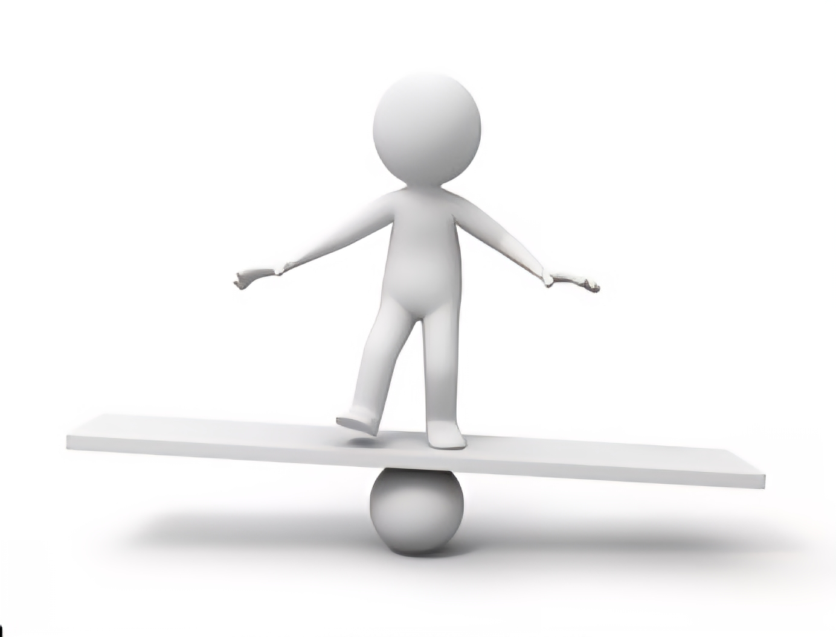
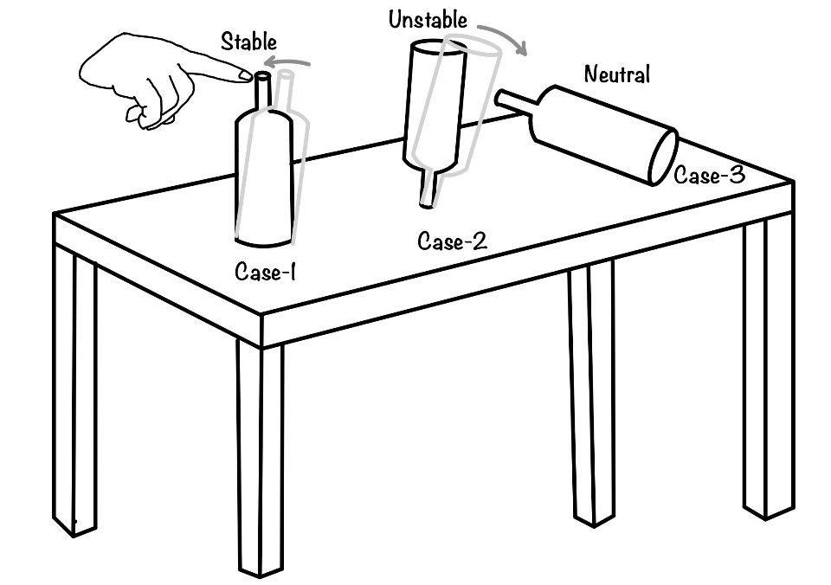
equilibrium
When the forces acting on a body are perfectly balanced & the body remains at rest.
3 TYPES

Slide 11
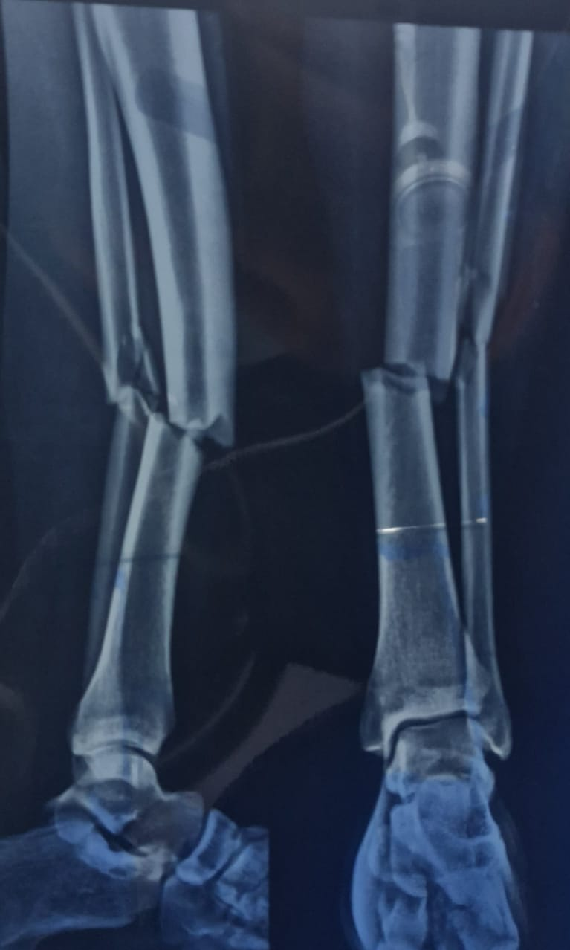
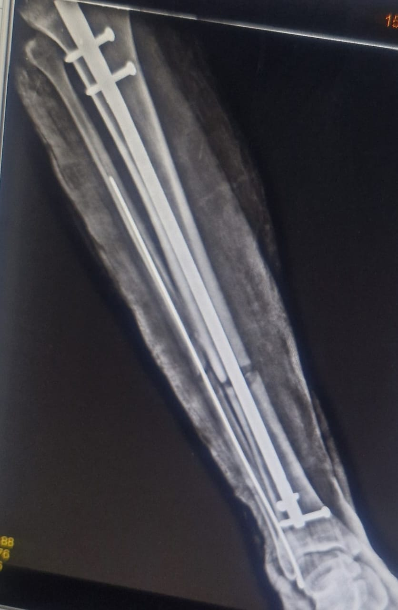
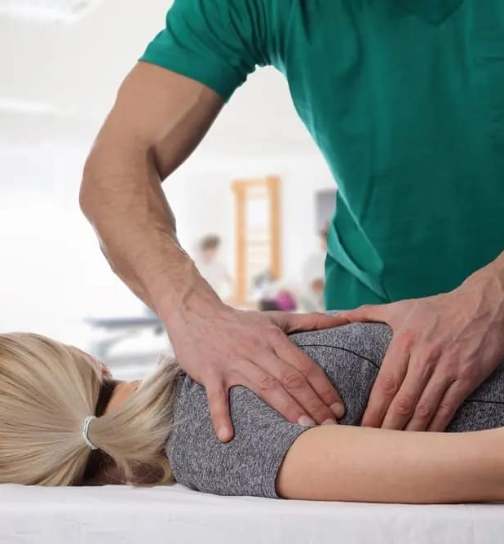
Fixation & stabilisation
Fixation- state of immobility
Stabilisation- relative immobility.
Can be active- by co-contraction of muscles
Can be passive- by manual pressure , strap , sand bag.
MECHANICA FIXATION

Slide 12
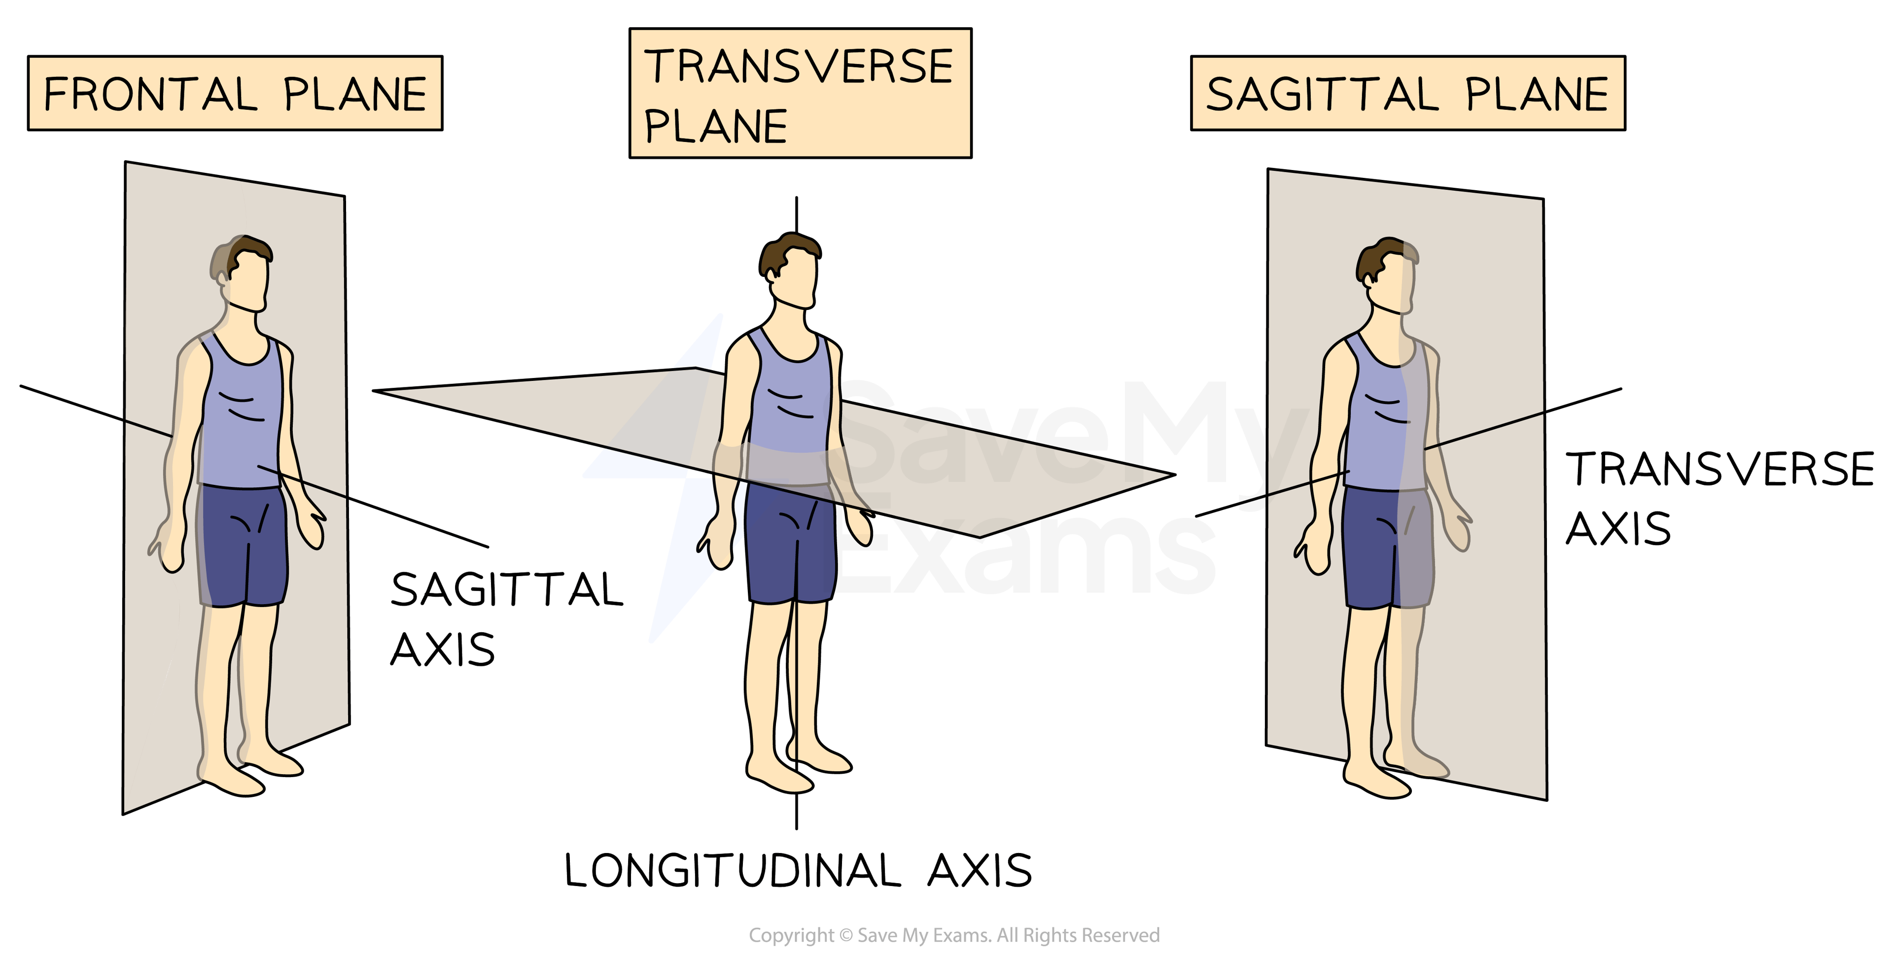
MECHANICS OF MOVEMENT
AXES & PLANES

Slide 13
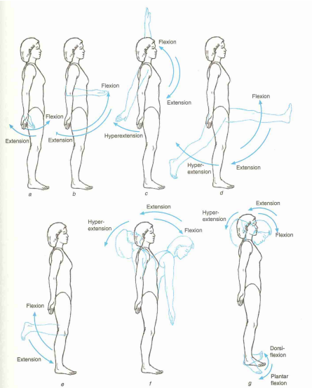

Slide 14
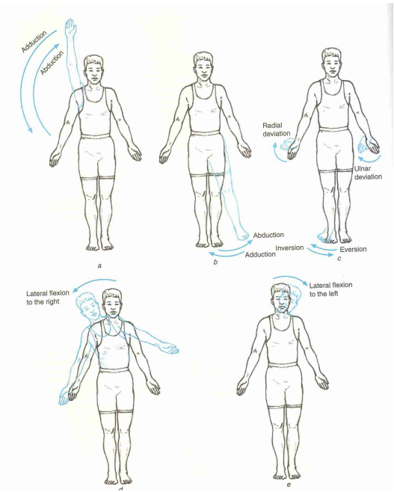
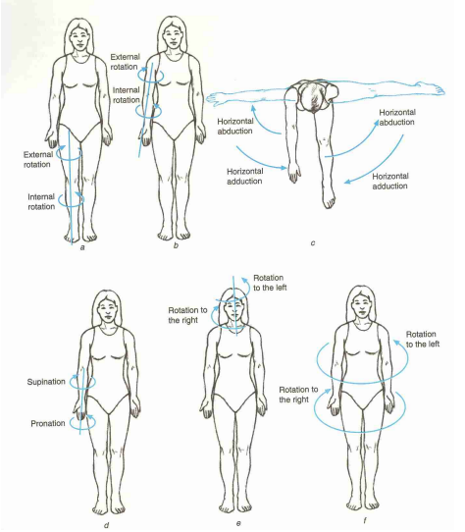

Slide 15
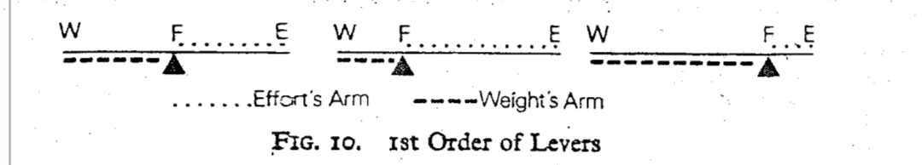
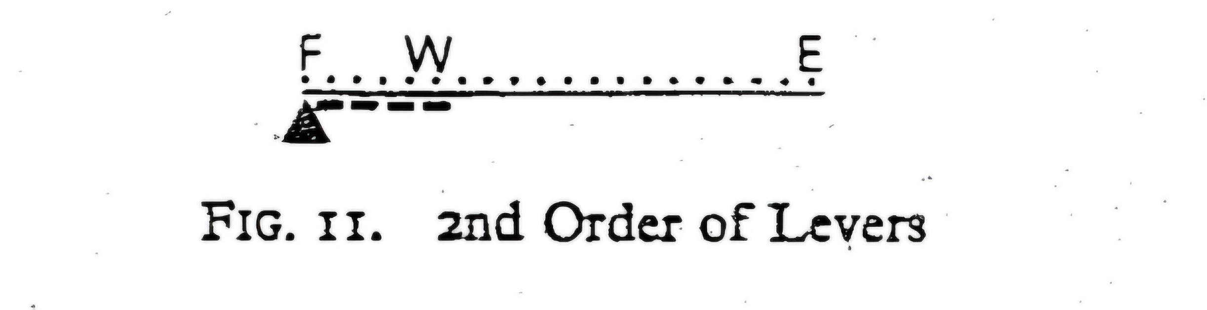
Levers
A rigid bar which is capable of movement about a fixed point, called a FULCRUM.(F)
Work is done with EFFORT (E).
Effort works on another force/Weight (W) or (R).
1ST ORDER LEVER – Atlanto-occipital joint,
2nd ORDER LEVER- Metatarso- phalangeal joint

Slide 16
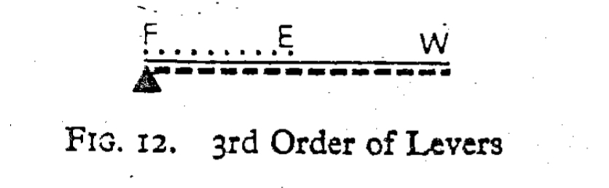
3RD ORDER LEVER – Knee Flexion

Slide 17
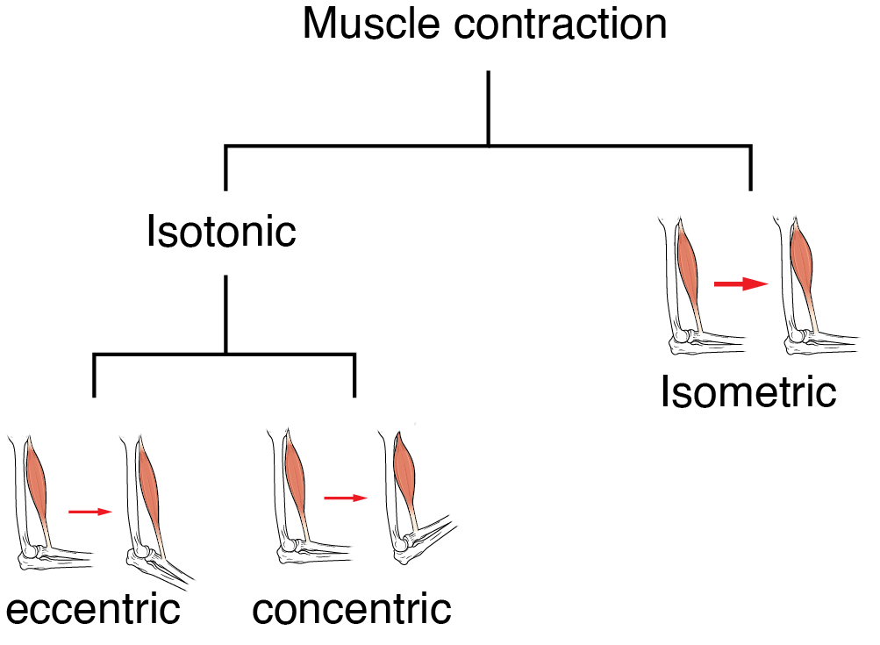
Types of movement
When muscles are inactive or relatively so, movement produced by the application of an external force is known as Passive movement.
Produced by contraction of muscles is Active Movement.
TYPES OF MUSCLE CONTRACTION:-

Slide 18
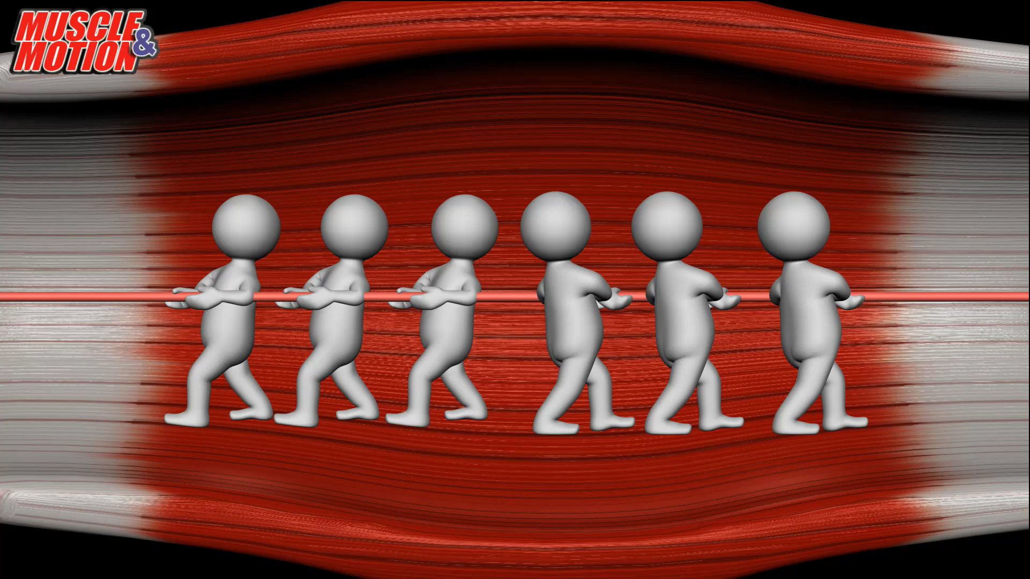

Slide 19
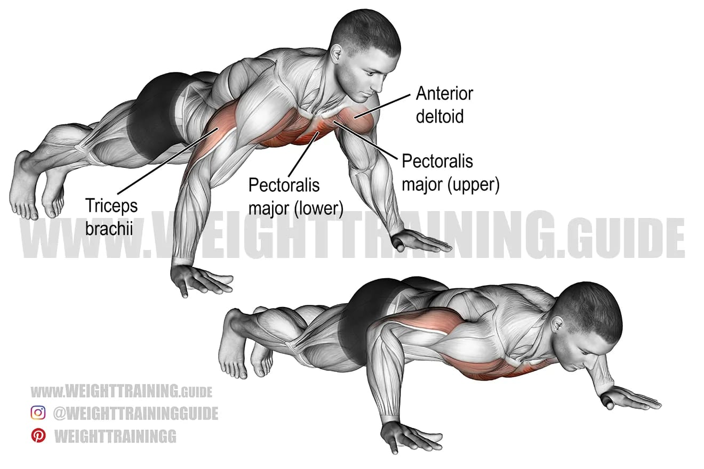
doubts
What happens to tone, in isometric contraction?
Is every muscle lengthening, eccentric contraction?
What happens to triceps in the descending phase of the push-up exercise?
What happens to Pect major in the ascending phase of the push-up exercise?

Slide 20
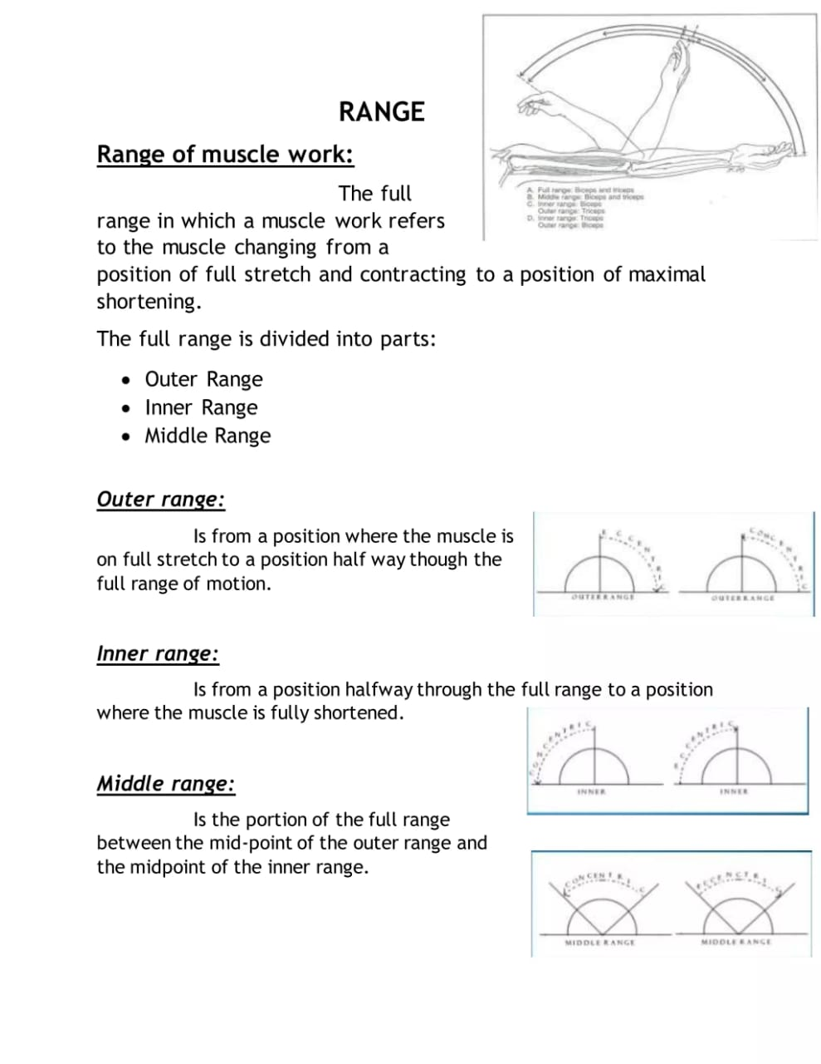
Range of muscle work

Slide 21
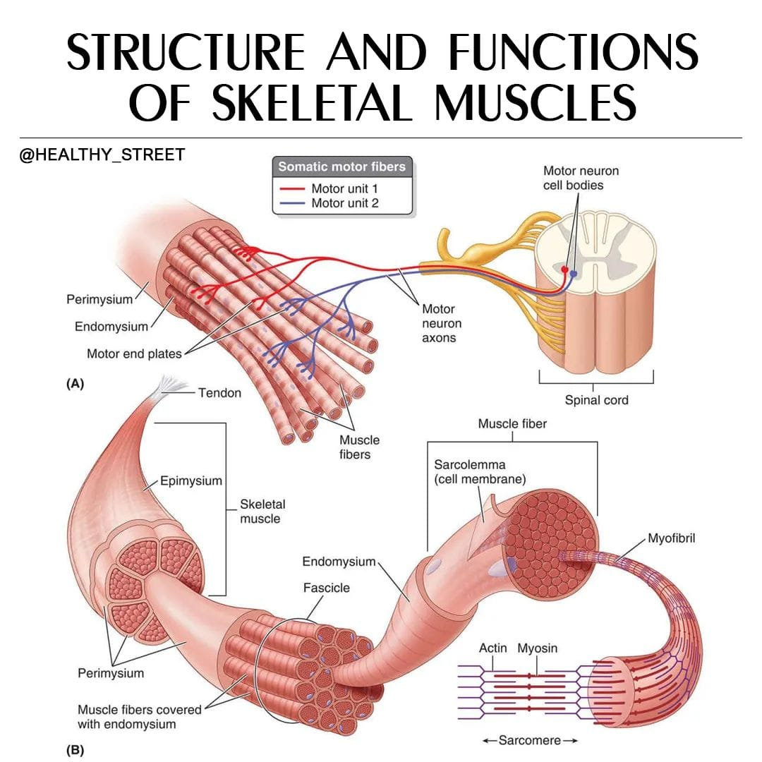
The strength of muscle contraction

Slide 22
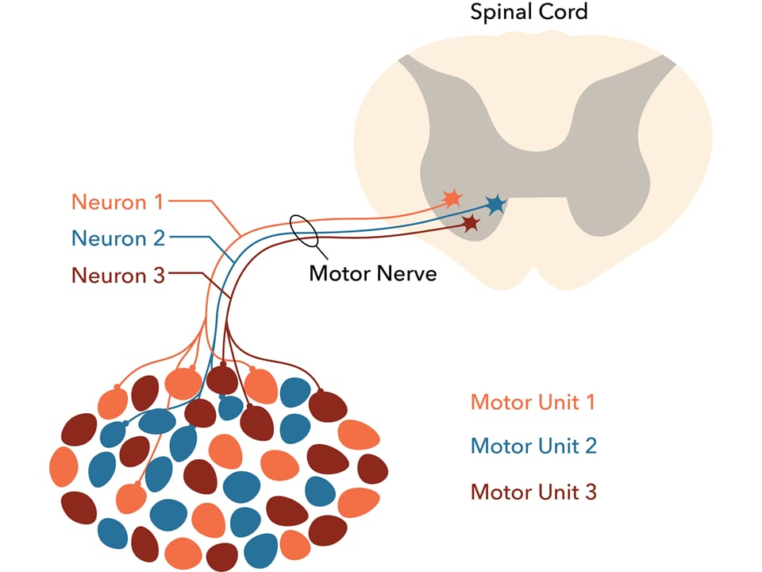

Slide 23
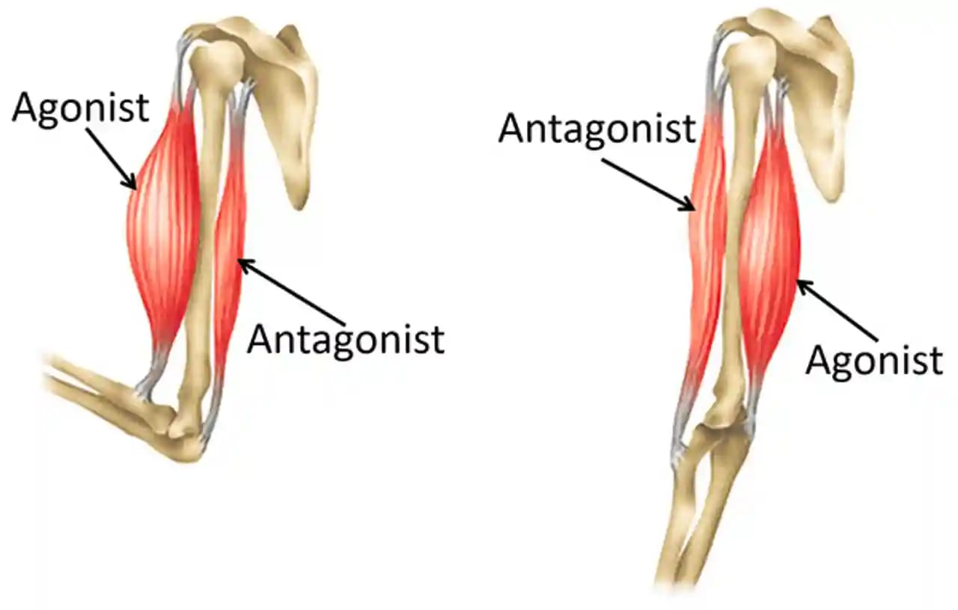
The group action of muscles

Slide 24
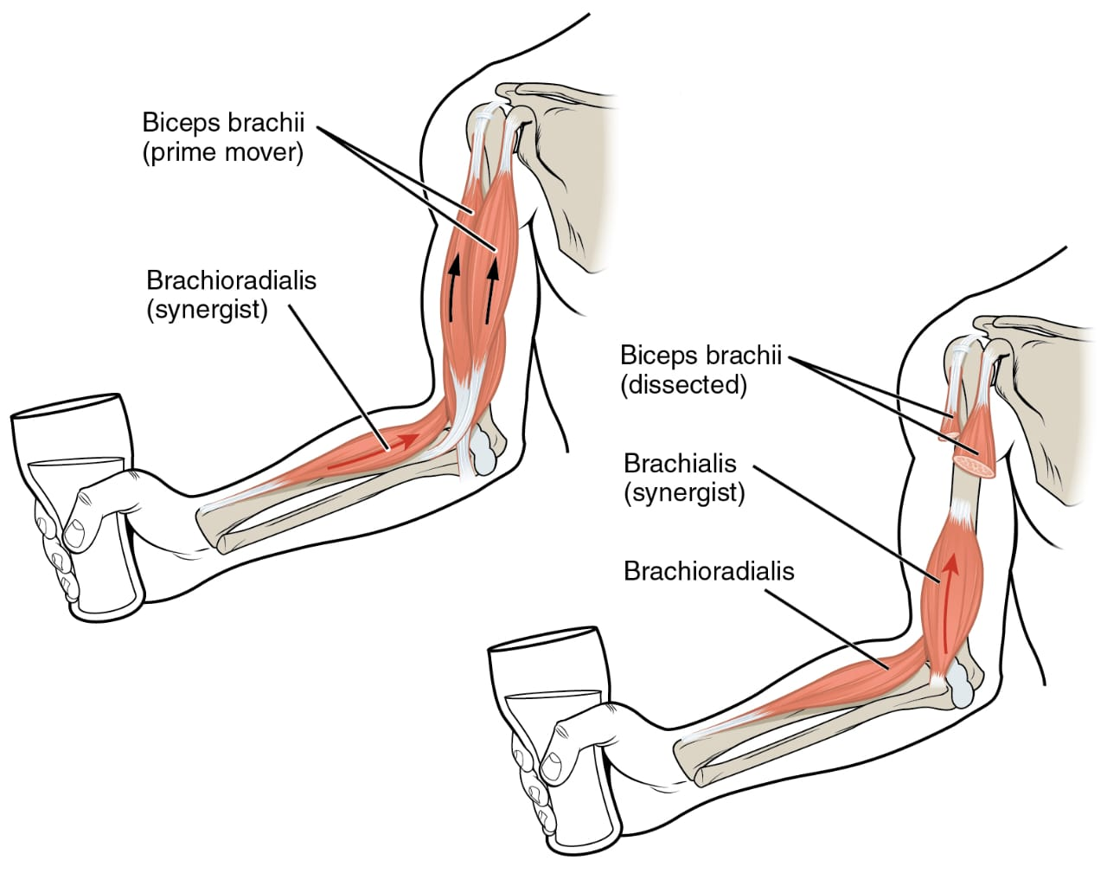

Slide 25
Thank you

