Slide 1
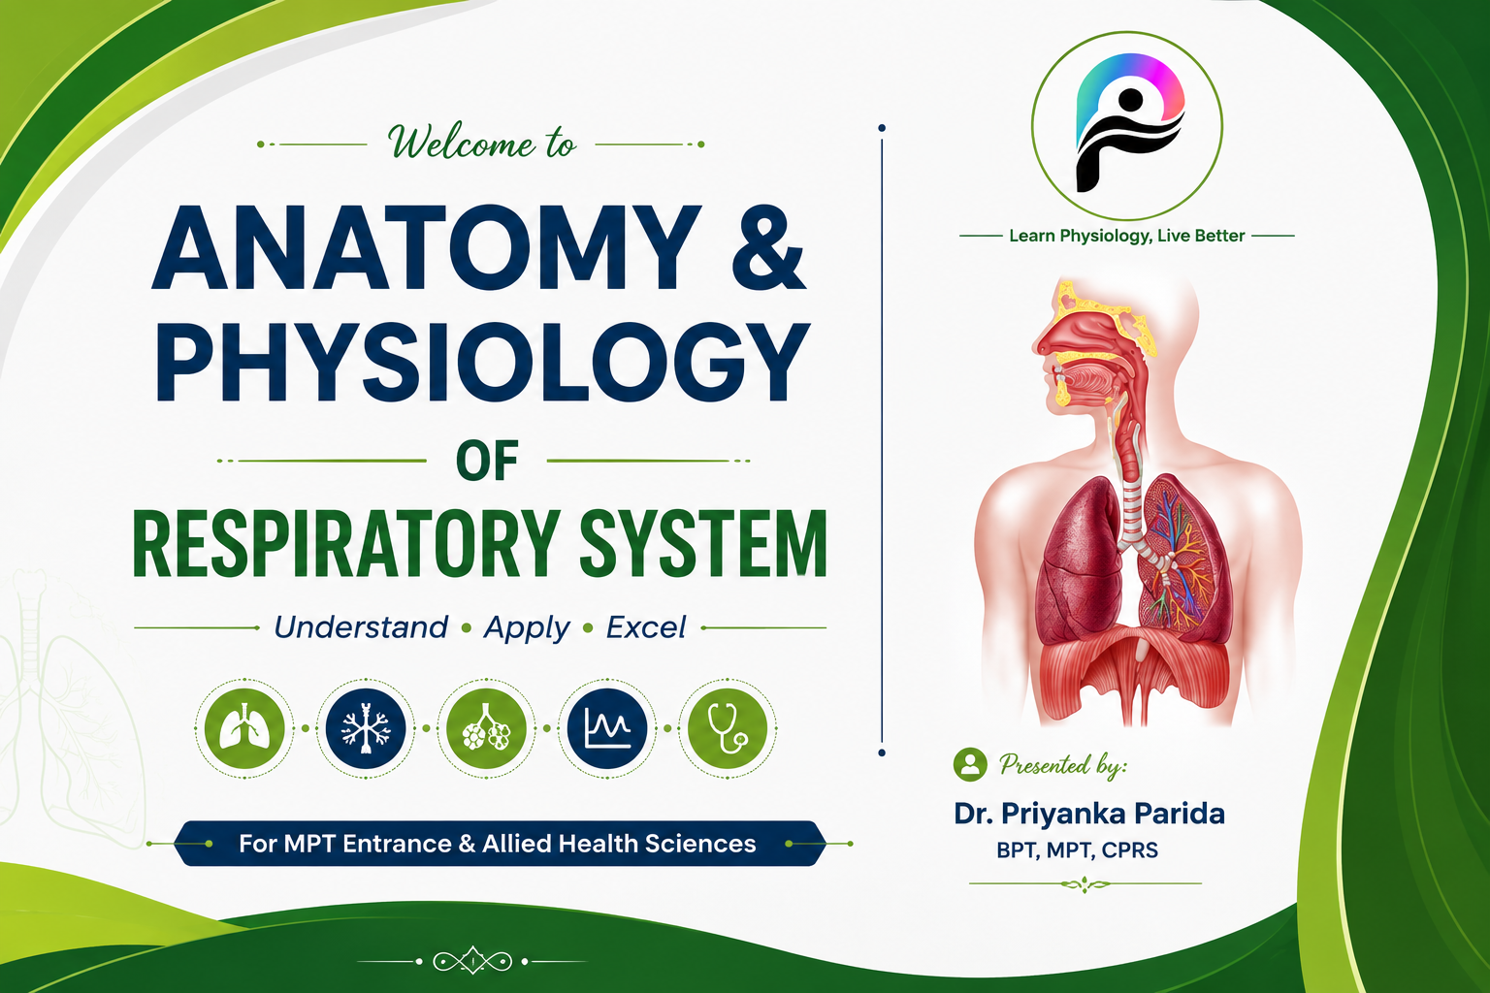
PHYSIOCITY

Slide 2
Contents
Anatomy
Surfactant
Circulation
Mechanics of breathing
Pump handle & bucket handle movement
Boyle’s law
Lung volume & capacities
Spirometry
Gas exchange
Diffusion
V/Q
Gas transport
Regulation of respiration

Slide 3
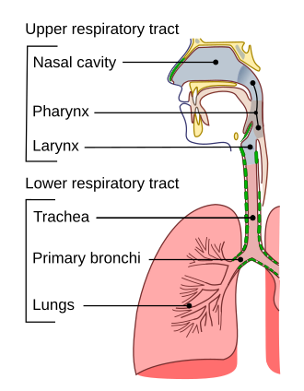
Respiratory System

Slide 4
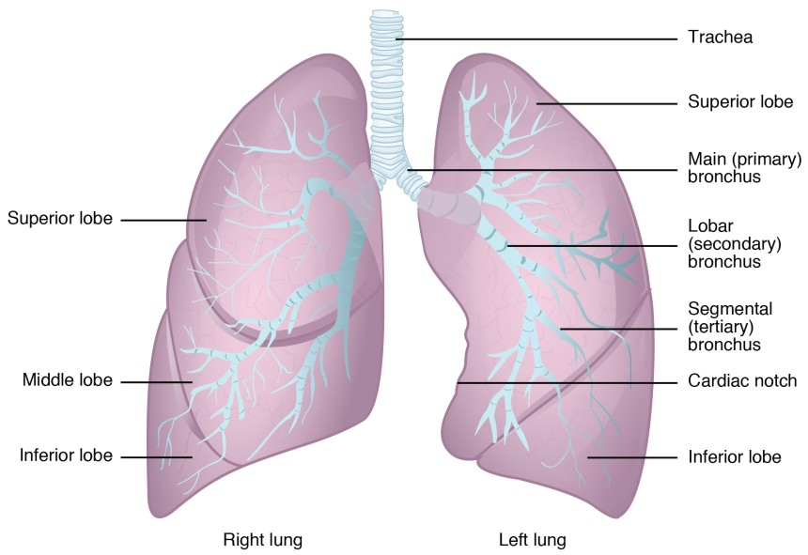

Slide 5
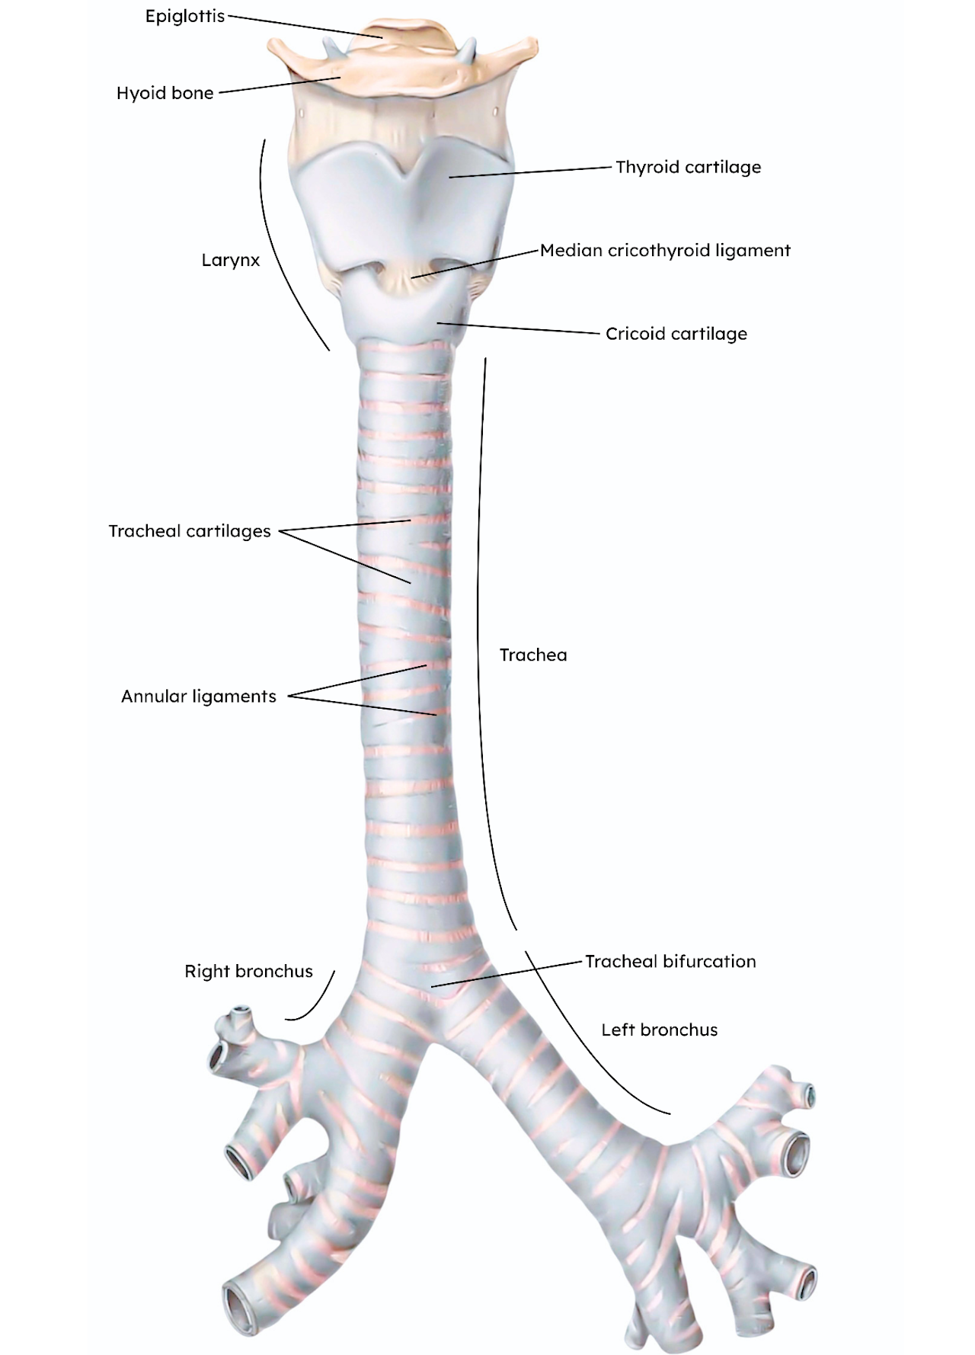
Trachea
10-12cm long
16-20 C-shaped rings
Right bronchus wider, shorter, vertical

Slide 6
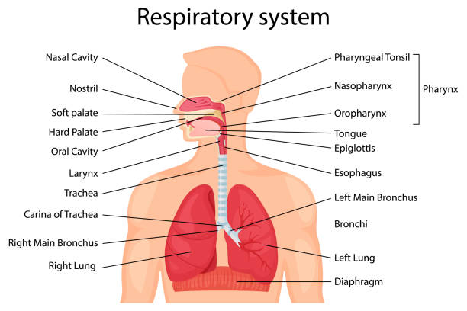

Slide 7
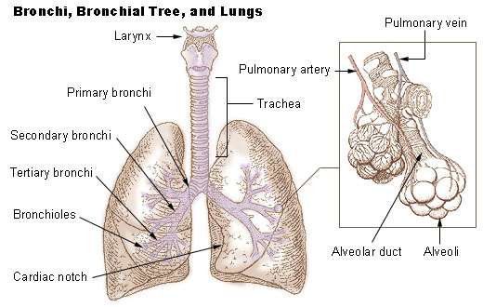
Bronchial Tree

Slide 8
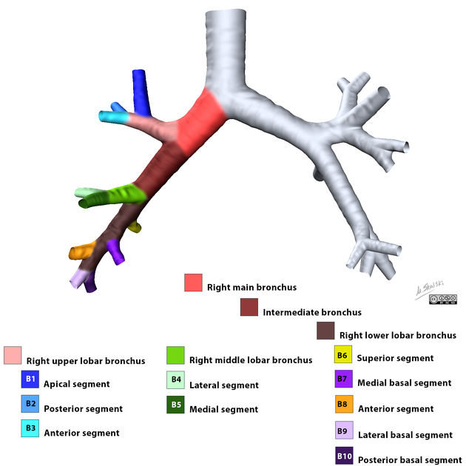
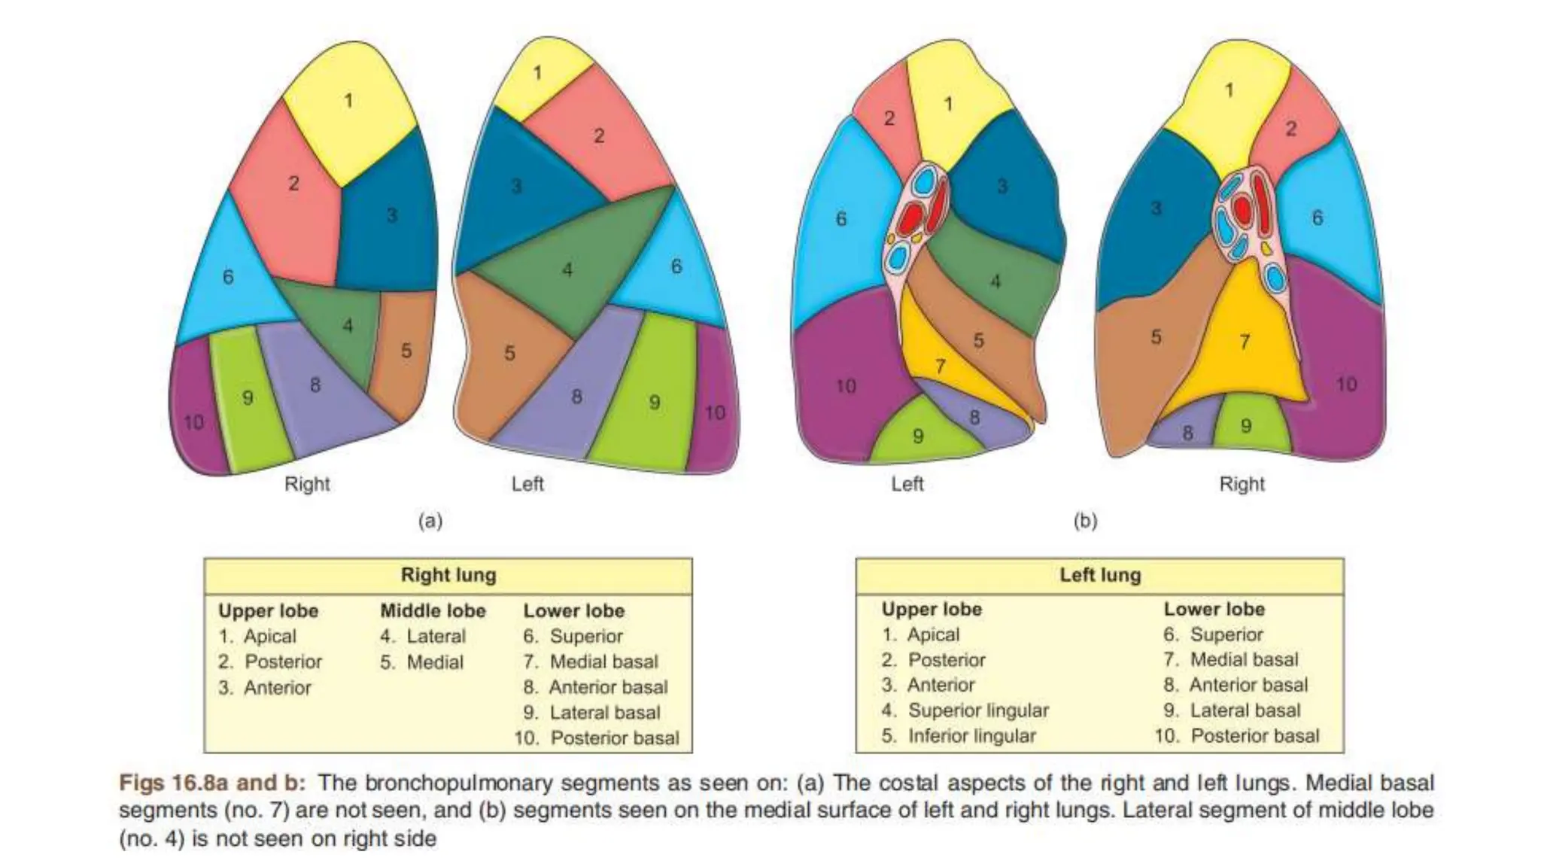
Bronchopulmonary Segments

Slide 9
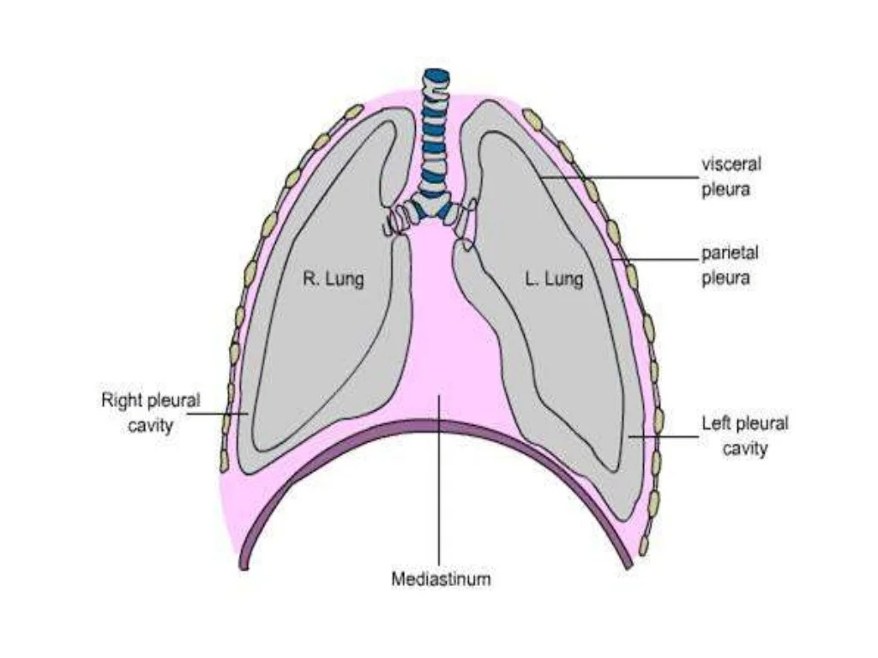
Pleura and pleural cavity

Slide 10
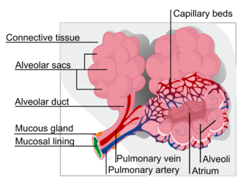
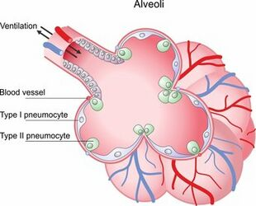
Alveoli

Slide 11
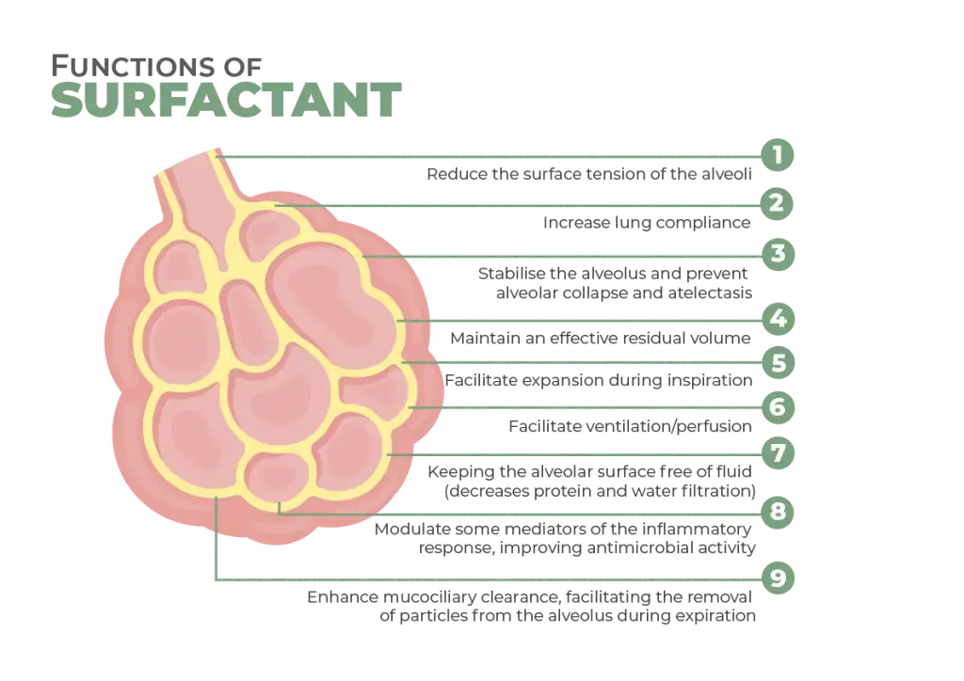
Surfactant

Slide 12
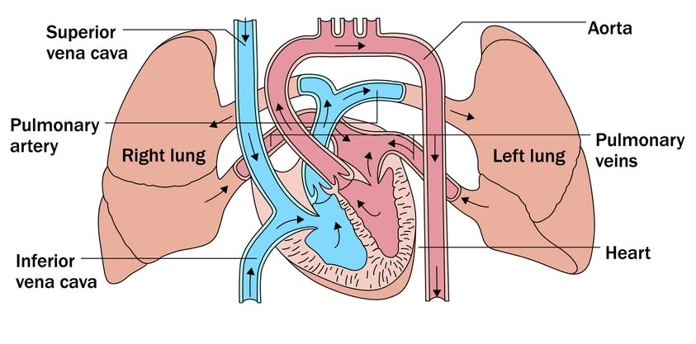
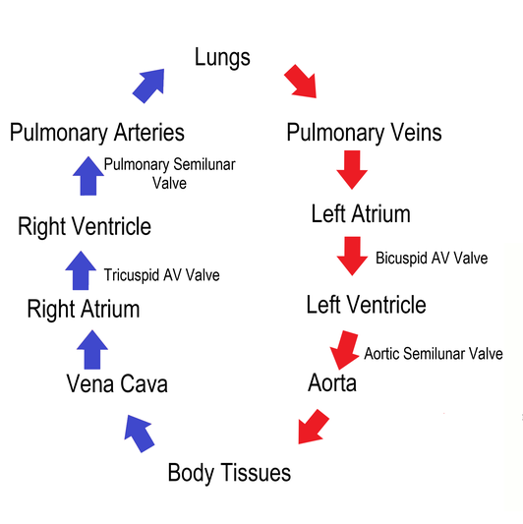
Circulation

Slide 13
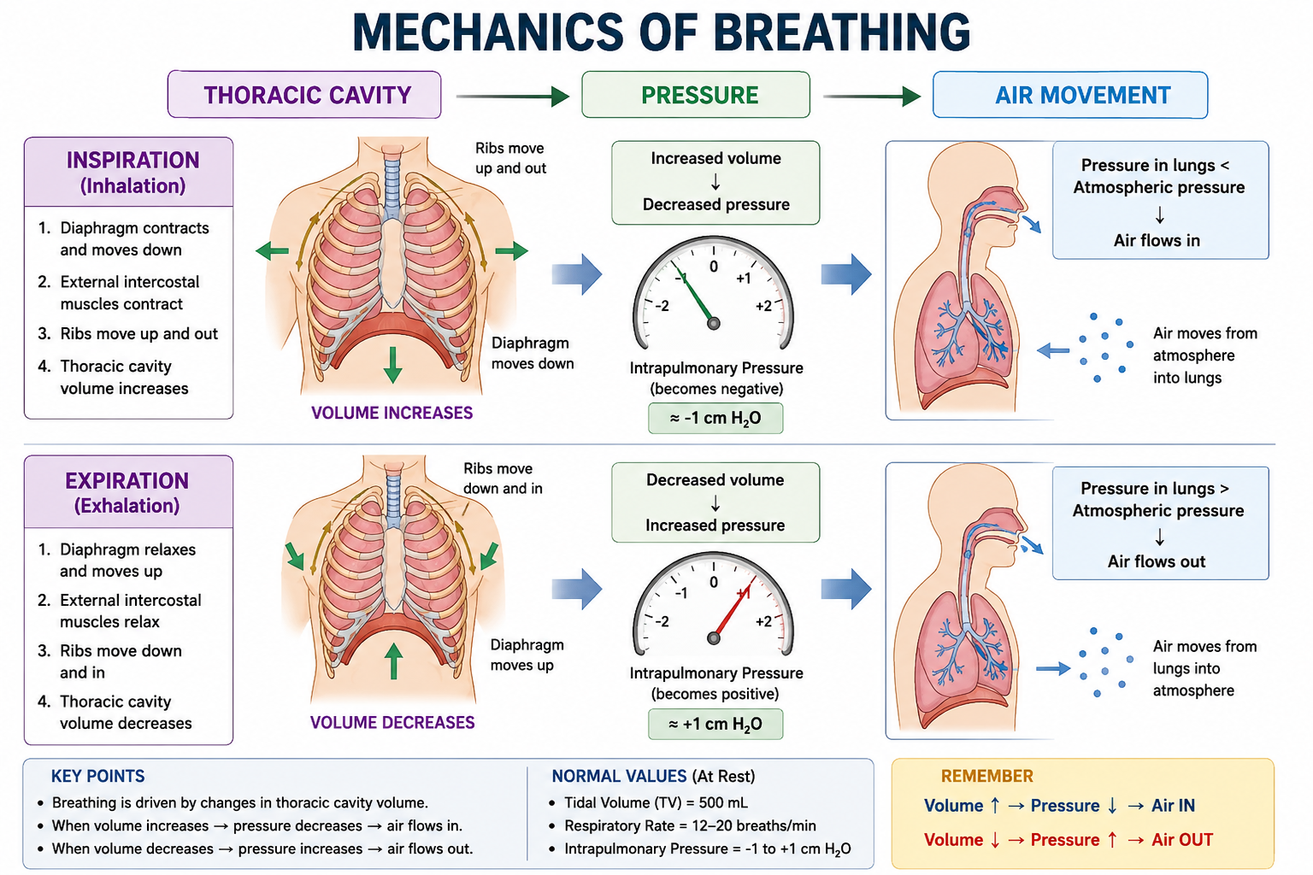
Notes:
Primary inspiratory muscles are the diaphragm, which is supplied by phrenic nerve (C3 to C5) and external intercostal muscles, supplied by intercostal nerves (T1 to T11).

Slide 14
Inspiration | Expiration
Diaphragm contracts | Diaphragm relaxes
Thoracic cavity ↑ | Thoracic cavity ↓
Lung volume ↑ | Lung volume ↓
Alveolar pressure ↓ | Alveolar pressure ↑
Air enters | Air exits

Slide 15
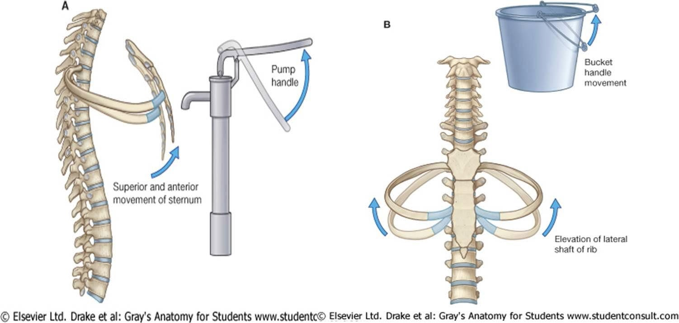
Pump handle & Bucket handle movement
Notes:
Intrapleural Pressure
Normally negative.
Approximately:
−4 to −5 mmHg at rest.
Functions:
Prevents lung collapse.
Keeps lungs expanded.

Slide 16
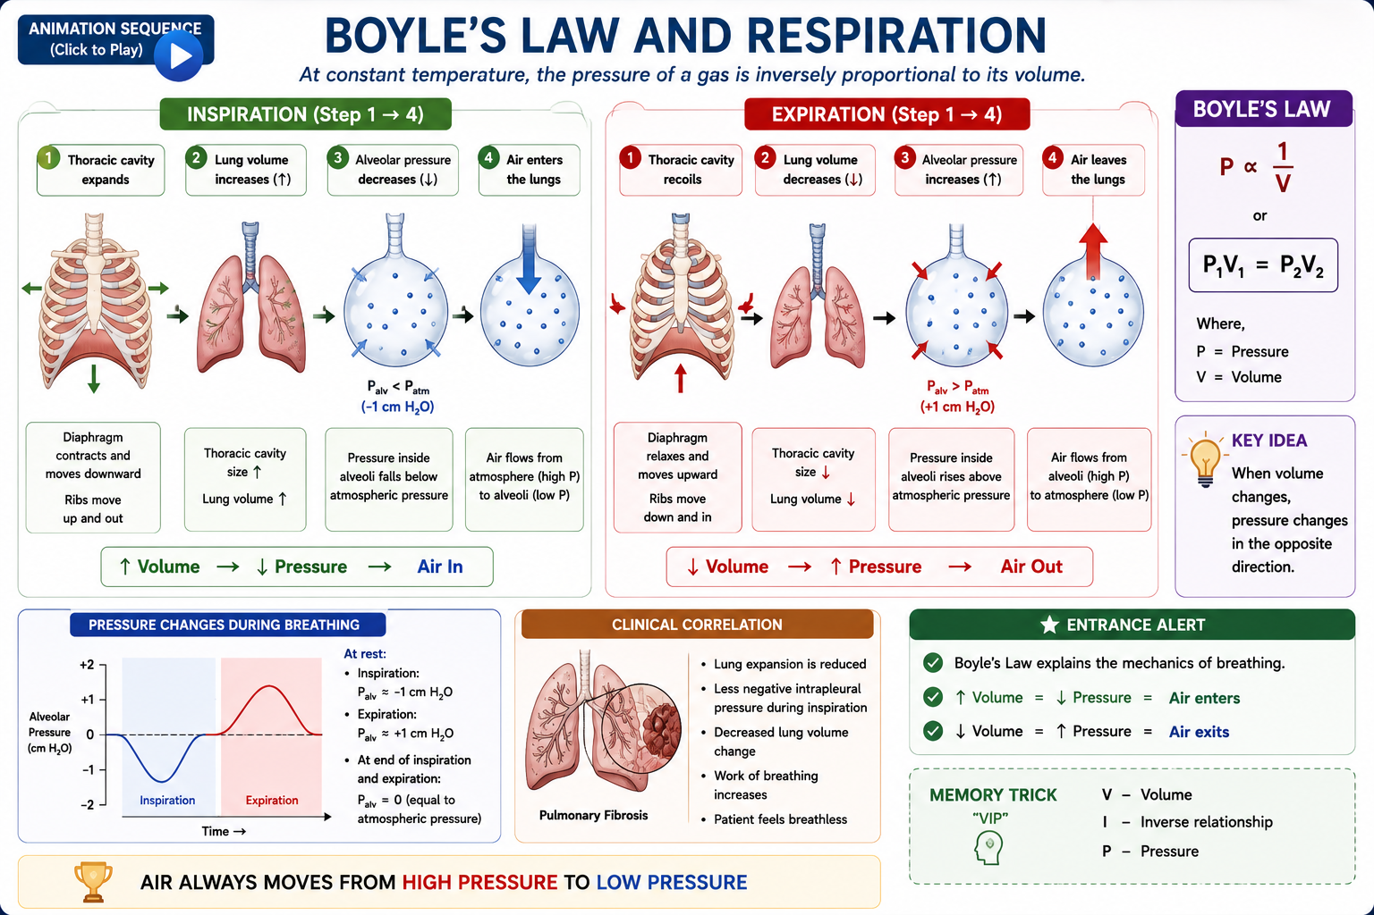
Boyle’s law

Slide 17
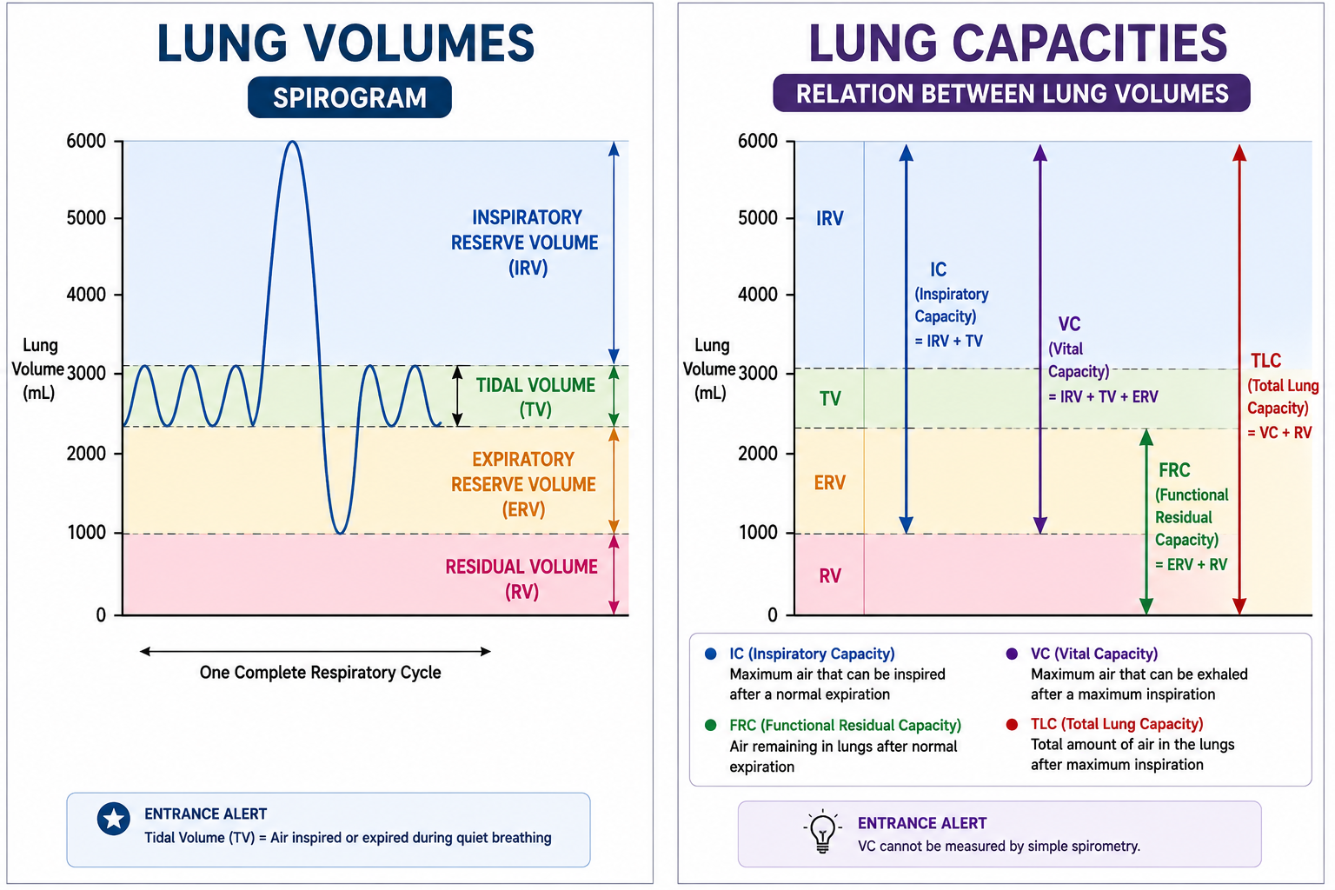
Lung Volumes & Capacities
Notes:
Lung volumes are the individual amounts of air present in the lungs during different phases of the respiratory cycle.
Lung capacities are combinations of two or more lung volumes.

Slide 18
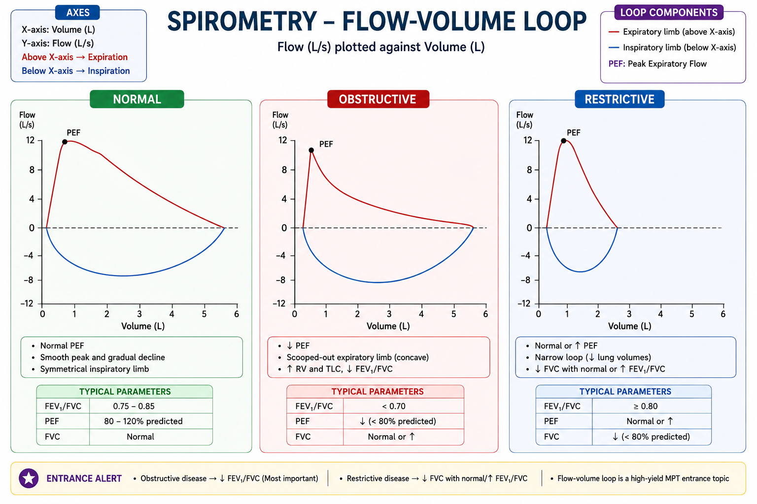
Spirometry(Flow-volume loop)

Slide 19
Gaseous exchange
Gaseous exchange is the process by which oxygen (O₂) is taken into the body and carbon dioxide (CO₂) is removed. It is essential for cellular respiration, which releases energy needed for life activities.
Lungs serve to exchange these two gases with blood.
In the lungs, exchange of respiratory gases takes place between the alveoli of lungs and the blood.
Oxygen enters the blood from alveoli and carbon dioxide is expelled out of blood into alveoli.
Exchange of gases between blood and alveoli takes place through respiratory membrane.
Process of Gaseous Exchange
Gaseous exchange occurs in two levels:
External respiration – Between alveoli and pulmonary blood
Internal respiration – Between systemic blood and tissues

Slide 20
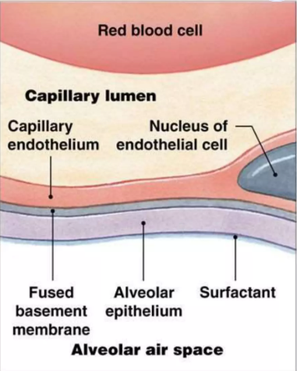
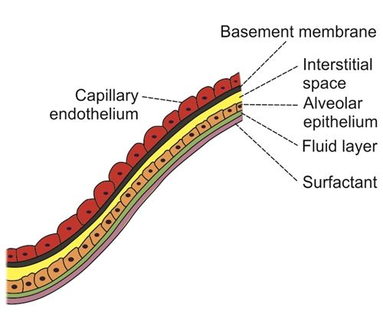
Respiratory membrane

Slide 21
In spite of having many layers, respiratory membrane is very thin with an average thickness of 0.5 μ.
Total surface area of the respiratory membrane in both the lungs is about 70 square meter.
Average diameter of pulmonary capillary is only 8 µ, which means that the RBCs with a diameter of 7.4 µ actually squeeze through the capillaries.
Therefore, the membrane of RBCs is in close contact with capillary wall. This facilitates quick exchange of oxygen and car bon dioxide between the blood and alveoli.

Slide 22
Diffusing Capacity
The volume of a gas that diffuses across the respiratory membrane per minute for a pressure gradient of 1 mmHg.
Diffusing capacity for oxygen is 21 mL/minute/1 mm Hg.
Diffusing capacity for carbon dioxide is 400 mL/minute/1 mm Hg.
Thus, the diffusing capacity for carbon dioxide is about 20 times more than that of oxygen

Slide 23
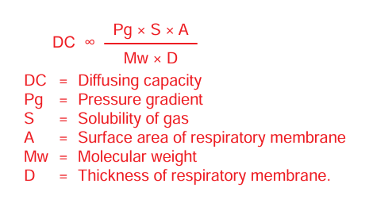
Factors Affecting Diffusing Capacity
1. Pressure gradient
2. Solubility of gas in fluid medium
3. Total surface area of respiratory membrane
4. Molecular weight of the gas
5. Thickness of respiratory membrane
Notes:
Pressure gradient is the difference between the partial pressure of a gas in alveoli and pulmonary capillary blood.

Slide 24
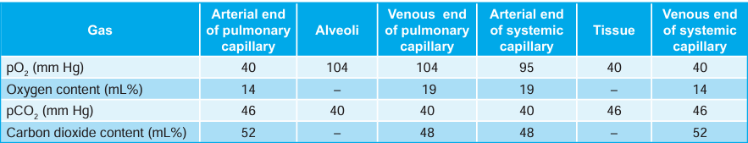
Partial pressure of oxygen and carbon dioxide
GAS | Atmosphere | Alveoli | Deoxygenated (Venous) | Oxygenated (Arterial) | Tissue
O2 | 159 | 104 | 40 | 95 | 40
CO2 | 0.3 | 40 | 46 | 40 | 46

Slide 25
Diffusion of Oxygen from Atmospheric Air into Alveoli
Partial pressure of oxygen in the atmospheric air is 159 mm Hg and, in the alveoli, it is 104 mm Hg.
Because of the pressure gradient of 55 mm Hg, oxygen easily enters from atmospheric air into the alveoli.

Slide 26
Diffusion of Oxygen from Alveoli into Blood
Each gas exerts its own partial pressure depending on its concentration in a mixture.
In the lungs:
Location | PO₂ (mmHg) | PCO₂ (mmHg)
Alveolar air | 104 | 40
Mixed venous blood | 40 | 45
Oxygen Diffusion
PO₂ in alveoli = 104 mmHg
PO₂ in venous blood = 40 mmHg
Gradient = 64 mmHg
Oxygen diffuses from alveoli → pulmonary capillary blood.

Slide 27
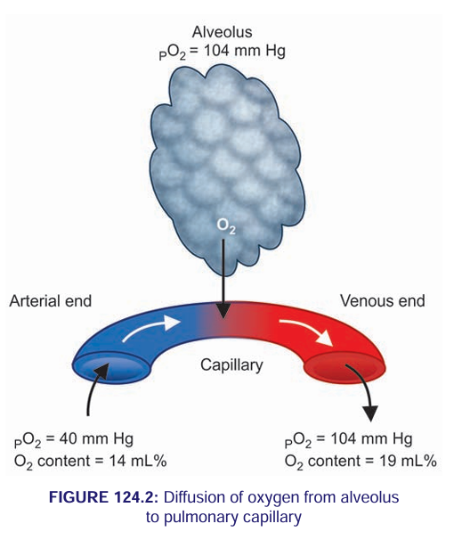

Slide 28
Carbon Dioxide Diffusion
Diffusion of Carbon Dioxide from Blood into Alveoli
PCO₂ in venous blood = 46 mmHg
PCO₂ in alveoli = 40 mmHg
Gradient = 6 mmHg
Although the gradient is small, CO₂ diffuses rapidly because:It is 20 times more soluble than oxygen.

Slide 29
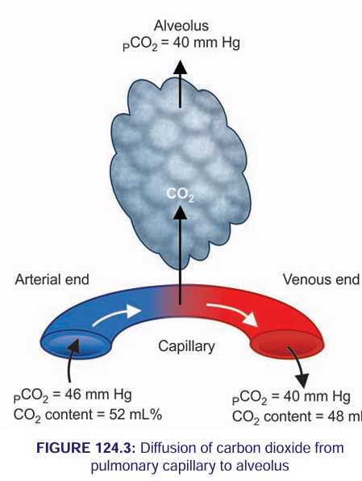

Slide 30
Diffusion of Carbon Dioxide from Alveoli into Atmospheric Air
In atmospheric air, partial pressure of carbon dioxide is very insignificant and is only about 0.3 mm Hg whereas, in the alveoli, it is 40 mm Hg. So, carbon dioxide enters passes to atmosphere from alveoli easily.

Slide 31
EXCHANGE OF RESPIRATORY GASES AT TISSUE LEVEL
Oxygen enters the cells of tissues from blood and carbon dioxide is expelled from cells into the blood.

Slide 32
DIFFUSION OF OXYGEN FROM BLOOD INTO THE TISSUES
Partial pressure of oxygen in venous end of pulmonary capillary is 104 mm Hg. However, partial pressure of oxygen in the arterial end of systemic capillary is only 95 mm Hg.
Average oxygen tension in the tissues is 40 mm Hg. It is because of continuous metabolic activity and constant utilization of oxygen.
Thus, a pressure gradient of about 55 mm Hg exists between capillary blood and the tissues so that oxygen can easily diffuse into the tissues

Slide 33
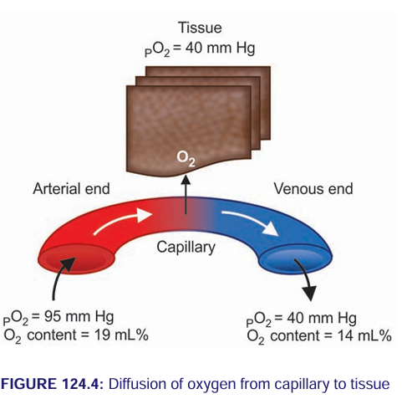

Slide 34
DIFFUSION OF CARBON DIOXIDE FROM TISSUES INTO THE BLOOD
Due to continuous metabolic activity, carbon dioxide is produced constantly in the cells of tissues.
So, the partial pressure of carbon dioxide is high in the cells and is about 46 mm Hg.
Partial pressure of carbon dioxide in arterial blood is 40 mm Hg.
Pressure gradient of 6 mm Hg is responsible for the diffusion of carbon dioxide from tissues to the blood

Slide 35
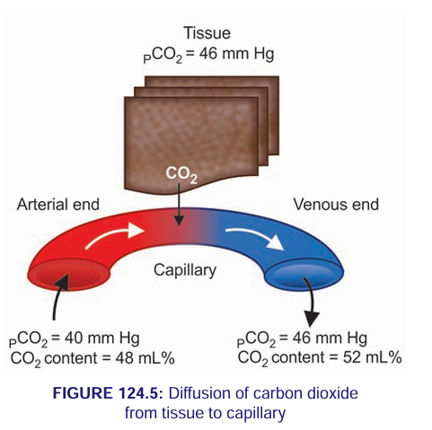

Slide 36
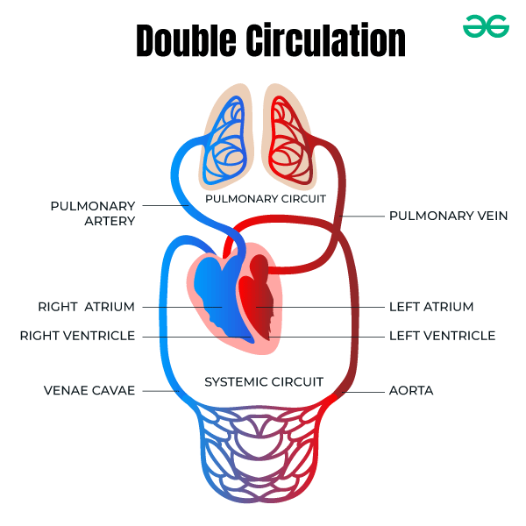
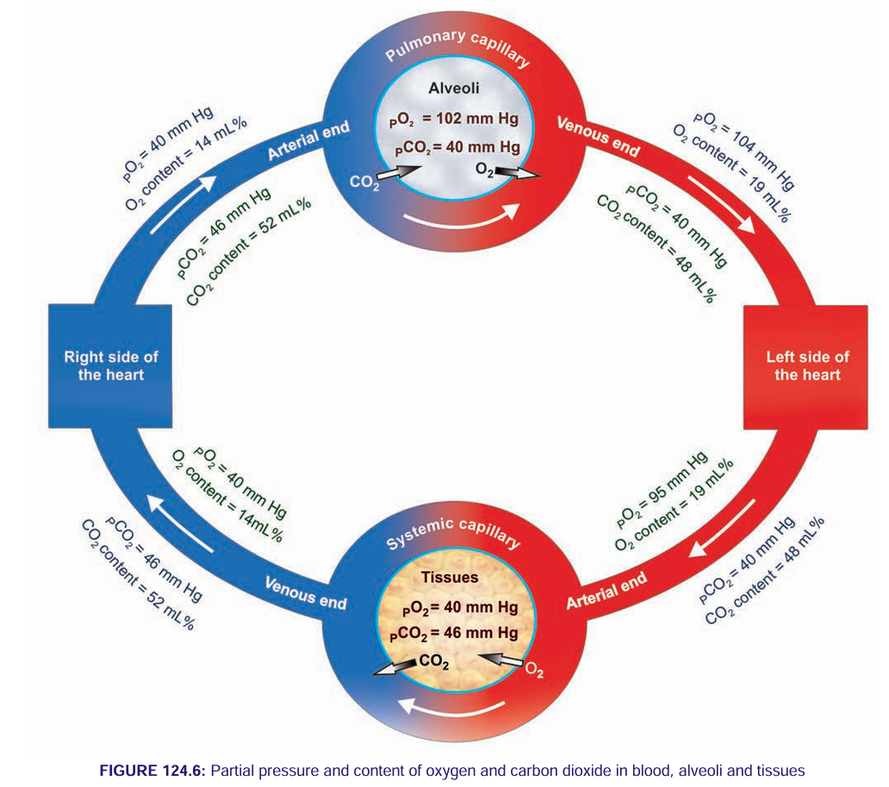

Slide 37
Impaired Gas Exchange
Gas is exchanged between the alveoli and the pulmonary capillaries via diffusion.
Diffusion of oxygen and carbon dioxide occurs passively, according to their concentration differences across the alveolar-capillary barrier.
These concentration differences must be maintained by ventilation of the alveoli and perfusion of the pulmonary capillaries.
Oxygen (O₂) diffusion from alveoli → blood
Carbon dioxide (CO₂) diffusion from blood → alveoli
A balance between the two exists typically, but certain conditions can alter this balance causing gas exchange impairment.
Dead space is the volume of a breath that does not participate in gas exchange. It is ventilation without perfusion.

Slide 38
Impaired gaseous exchange results when this process is disrupted, leading to:
• Hypoxemia (↓ PaO₂)
• Hypercapnia (↑ PaCO₂)
The functional consequences occur at:
• Cellular level
• Organ system level
• Whole-body functional capacity

Slide 39
This condition is central to many cardiopulmonary disorders which affects gaseous exchange are:
COPD
ARDS
Pneumonia
Pulmonary fibrosis
Pulmonary edema

Slide 40
Causes
Ventilation-perfusion imbalance
Hypoventilation due to weakened respiratory muscles or ineffective breathing patterns
Airway obstruction (e.g., mucus, foreign bodies)
Decreased lung expansion (e.g., atelectasis)
Alveolar-capillary membrane changes affecting diffusion
Reduced hemoglobin levels impacting oxygen transport
High metabolic demand (e.g., fever or physical exertion)
Smoking or exposure to pollutants
Prolonged immobility leading to shallow breathing
Altered chest wall mechanics (e.g., obesity, musculoskeletal limitations)
Neuromuscular conditions affecting respiratory muscle function
Anxiety or emotional distress impacting respiratory rate and depth
High altitudes leading to reduced oxygen availability
Post-surgical impacts (e.g., chest or upper abdominal surgeries)

Slide 41
Mechanisms of Impaired Gas Exchange
Ventilation–Perfusion (V/Q) Mismatch
Diffusion Limitation
Shunt
Alveolar Hypoventilation
Hemoglobin Abnormalities
Increased Oxygen Demand
Cellular Level Problem

Slide 42
Ventilation–Perfusion (V/Q) Mis-match
Ventilation (V) = air reaching alveoli
Perfusion (Q) = blood reaching alveoli
Ideal V/Q ratio ≈ 0.8,Gas exchange requires both to be matched.
Low V/Q Ratio (Shunt-like Effect)
Blood reaches alveoli but little or no air, Oxygen cannot enter blood, CO₂ may accumulate.
In pneumonia:
Alveoli fill with inflammatory exudate.
Blood passes normally.
Oxygen diffusion decreases.
Result: Hypoxemia.
High V/Q Ratio (Dead Space)
Alveoli receive air but no blood.
Oxygen cannot enter circulation
In pulmonary embolism:
Clot blocks pulmonary artery.
Ventilation is normal.
No perfusion, Gas exchange fails.

Slide 43
Diffusion Limitation
Gas exchange depends on:
Surface area
Membrane thickness
Diffusion gradient
According to Fick’s Law: ↑ thickness or ↓ surface area → ↓ diffusion.
In Pulmonary fibrosis: (Thickened membrane)
Alveolar walls become thick and stiff.
Oxygen takes longer to diffuse.
Leads to exertional hypoxemia
In emphysema: (Reduced surface area)
Alveolar walls are destroyed.
Fewer capillaries.
Reduced surface area.
Poor oxygen uptake.

Slide 44
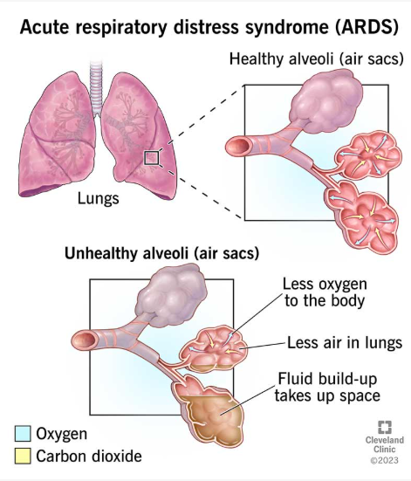
Shunt
Blood bypasses ventilated alveoli completely.
Ventilation =0, perfusion = present
In Acute Respiratory Distress Syndrome (ARDS):
Alveoli collapse or fill with fluid.
Blood flows without oxygenation.
Severe hypoxemia.
Shunt does NOT correct easily with oxygen therapy.

Slide 45
Alveolar Hypoventilation
Less Oxygen to Alveoli
Neuromuscular weakness
CNS depression
Chest wall disorders

Slide 46
Haemoglobin Abnormalities
Even if lungs are normal:
Anemia → ↓ oxygen carrying capacity
Carbon monoxide poisoning → Hemoglobin cannot bind O₂
Result: Tissue hypoxia despite normal PaO₂.

Slide 47
Increased Oxygen Demand
Even with normal lungs:
Fever
Sepsis
Exercise
If oxygen demand exceeds supply → relative hypoxia.

Slide 48
Cellular Level Problem
Energy Failure
Anaerobic metabolism → less ATP
Muscle fatigue and organ dysfunction
Cellular Edema
Failure of Na⁺–K⁺ pump
Increased membrane permeability
Mitochondrial dysfunction
Oxidative Stress
Hypoxia increases reactive oxygen species
Alters ion channels and cellular transport mechanisms

Slide 49
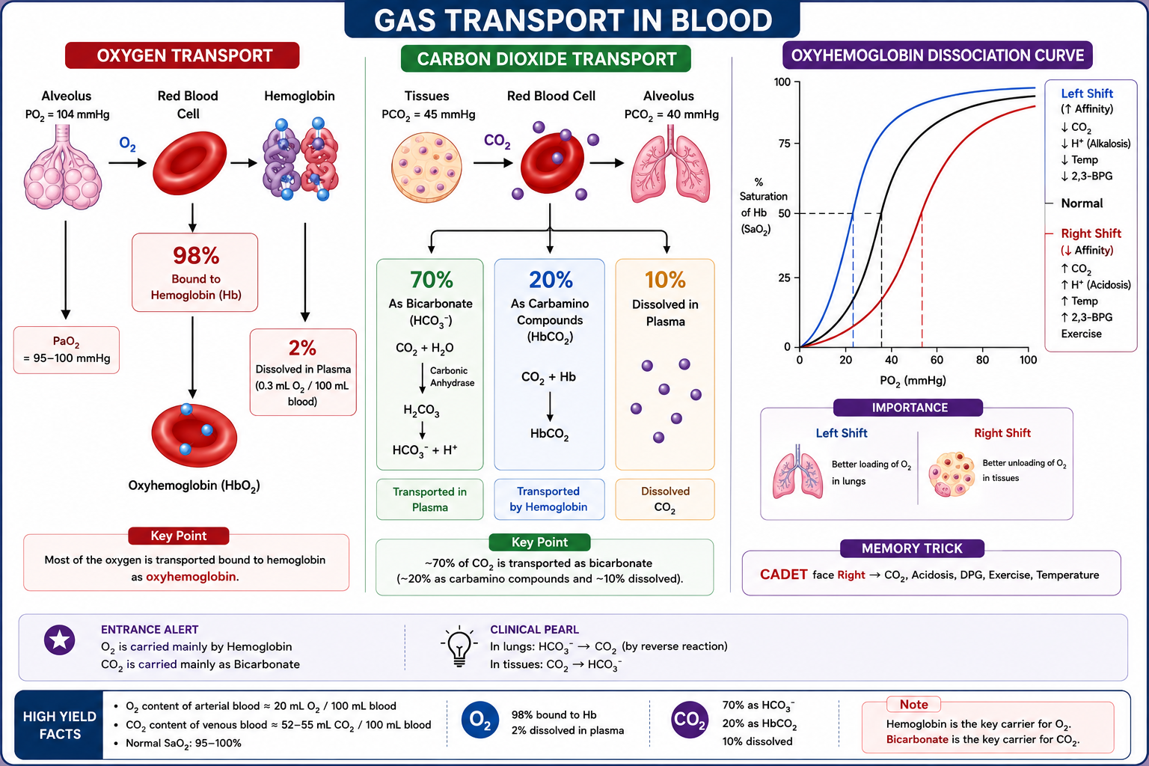
Gas transport

Slide 50
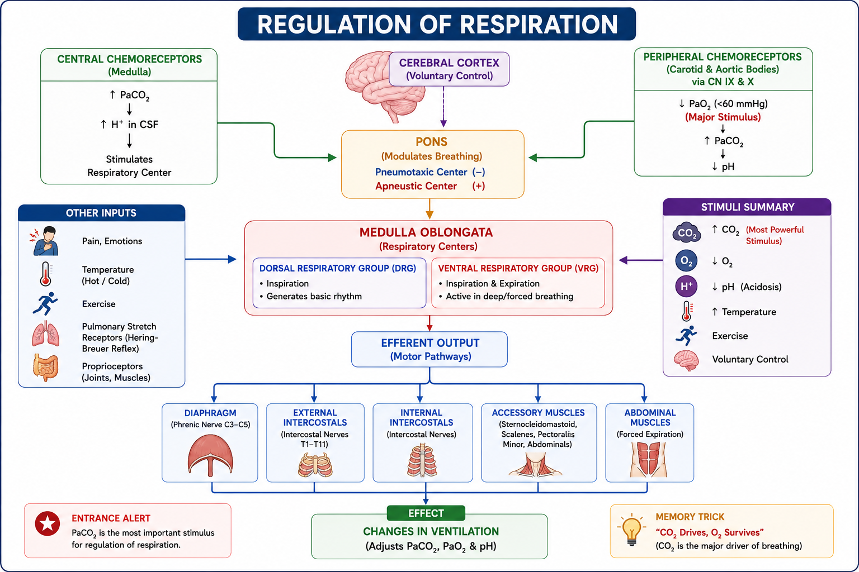
Regulation of respiration
Notes:
CO₂ is the strongest stimulus for normal breathing.

Slide 51
CO₂ ↑
↓
Central Chemoreceptors
↓
Medulla
↓
Phrenic Nerve
↓
Diaphragm
↓
Breathing ↑
Peripheral Chemoreceptors
↓
Low O₂ (<60 mmHg)
↓
Increase Respiration

Slide 52
THANK YOU

Slide 53
