Slide 1

COPD
Presented by : Dr. Mayuri Maheshwari PT (MPT Cardio)

Slide 2
Chronic Obstructive Pulmonary Disease
Group of long-term pulmonary diseases characterized by chronic airflow obstruction.
Includes
  Chronic bronchitis – long term inflammation of airways with mucus production and cough
  Emphysema – destruction of alveoli, reducing lung's ability to exchange oxygen.

Slide 3
Risk Factors
Smoking
Air pollution
Occupational exposure
Alpha 1 anti trypsin deficiency
History of childhood respiratory infections

Slide 4
Chronic bronchitis
Long term irritation of tracheobronchial tree
Inhaled smoke stimulates goblet cells and mucous glands
Mucus secretion increases
Hypersecretion of mucus and ciliary damage leads to chronic productive cough
Ciliary action is inhibited

Slide 5
Emphysema
Types of emphysema
  Centrilobular – changes are marked in upper lobes and superior segments of lower lobes
  Panlobular – affects primarily the lower lobes

Slide 6
Alpha 1 antitrypsin deficiency
Smoking
Decreased antiproteinase
Increased Proteinase
Damaged lung elasticity
Emphysema

Slide 7
Clinical Features
Breathlessness
Cyanosis (Central/peripheral)
Peripheral Oedema( due to cor-pulmonale)
Chronic Cough
Chest shape – Barrel shaped
Hoover's sign

Slide 8
Auscultation – Diminished and vesicular breath sounds. Crackles and wheezing may be there
Pattern of breathing : Use of accessory muscles
JVP : may show giant A waves
Percussion notes – May be dull (bronchitis) or hyper-resonated (emphysema)

Slide 9
Investigations
Chest X Ray
  Bullae (black area + thin white wall + no vascular markings)
  Low diaphragm (flat curvature of diaphragm dome)
  Tubular heart (B/L emphysema)
  Increase in cardiac size
PFT
  TLC ( emphysema-increased; bronchitis-normal)
  RV ( Emphysema – increased; bronchitis – moderate elevation)
  VC (reduced in both)
ABG
Hypoxemia
  Hypercapnia
  Respiratory acidosis

Slide 10
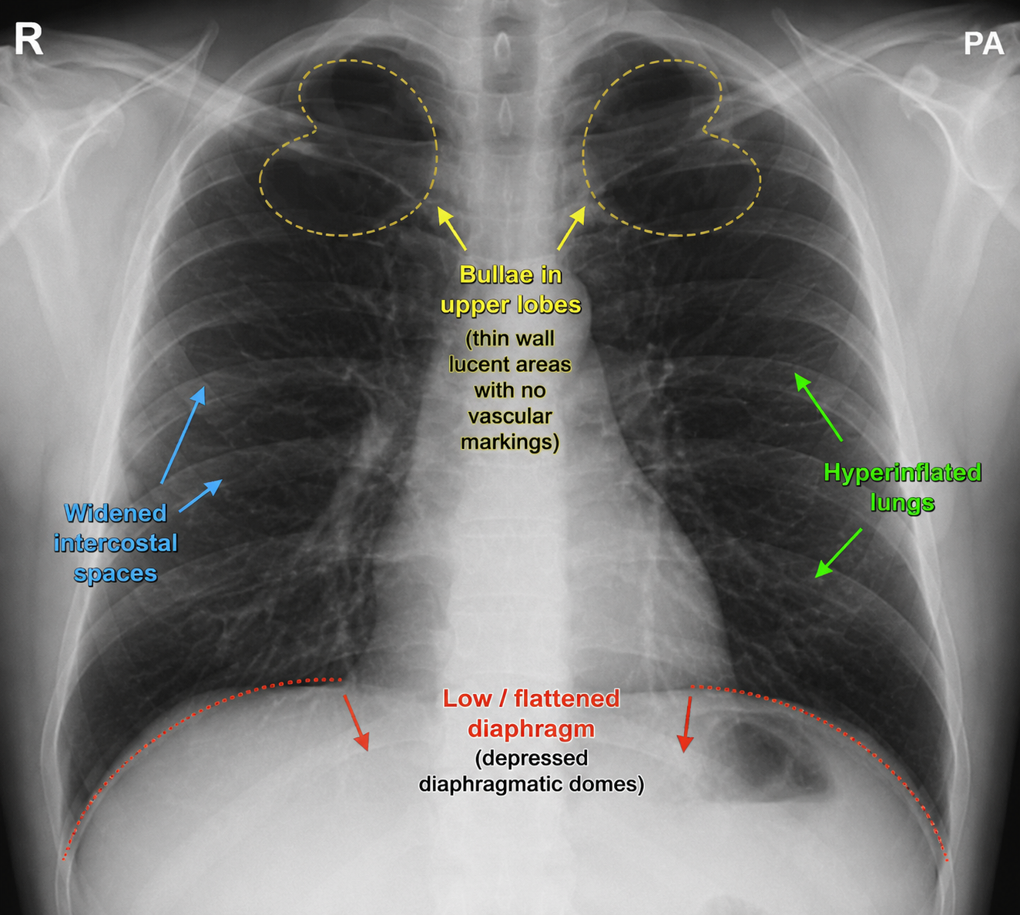

Slide 11
GOLD classification for severity of COPD
Mild COPD | FEV1 >=80%
Moderate COPD | FEV1 50-80%
Severe COPD | FEV1 30 – 50 %
Very severe COPD | FEV1 <30%

Slide 12
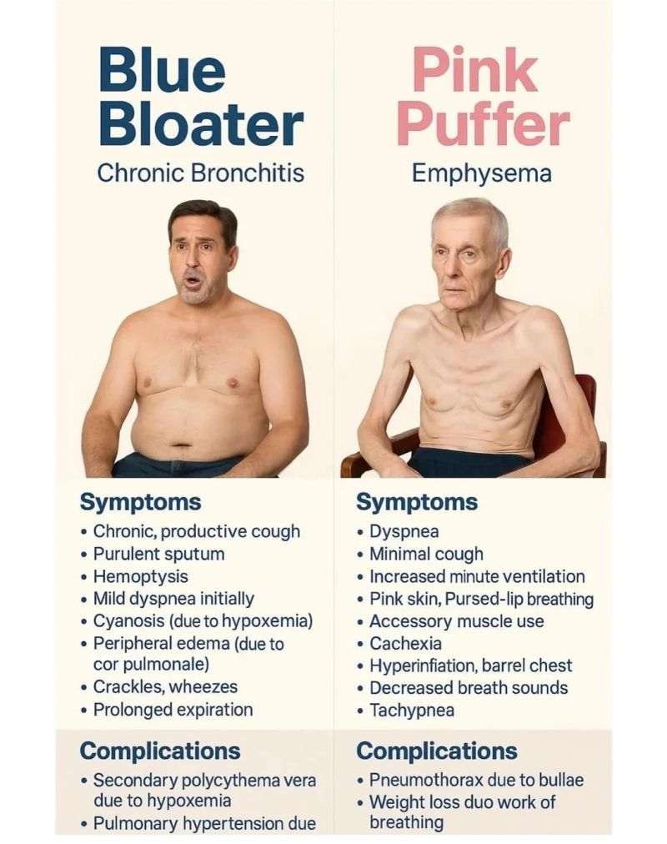
OLD PHENOTYPES

Slide 13
Complications
Respiratory failure
Cor pulmonale
Pulmonary hypertension
Recurrent respiratory infections
Pneumothorax
Weight loss/malnutrition

Slide 14
Medical management
1. Smoking cessation
2. Bronchodilator therapy
Short-acting bronchodilators for symptom relief:
  Salbutamol
  Ipratropium
Long-acting bronchodilators for maintenance:
  Tiotropium
  Salmeterol

Slide 15
3. Inhaled corticosteroids
Used in selected patients with frequentexacerbations
Often combined with LABA (long actingbeta agonist)
4. Oxygen therapy
Long-term oxygen therapy in chronichypoxemia

Slide 16
MANAGEMENT OF ACUTE EXACERBATIONS
Management of acute exacerbations
Nebulized bronchodilators
Systemic corticosteroids
Antibiotics if bacterial infection suspected
Oxygen support if needed

Slide 17
Clinical Implications for Rehabilitation
Timing: PT sessions should ideally be scheduled 30–60 minutes after the administration of bronchodilators to ensure maximal airway patency and exercise tolerance.
Adverse Effects: Be alert for side effects like tachycardia or tremors (common with beta-agonists) or elevated blood pressure, which can affect a patient's ability to participate in aerobic conditioning.
Steroid Caution: Long-term corticosteroid use is associated with muscle wasting and skin thinning; clinicians should be mindful of skin integrity during transfers or manual techniques.

Slide 18
Physiotherapy management
Aims of physiotherapy treatment
  Facilitate mucociliary transport
  Optimize secretion clearance
  Optimize alveolar ventilation
  Reduce the work of breathing
  Maximize aerobic capacity
  Optimize physical endurance and exercise tolerance
  Optimize ventilation and perfusion matching and gas exchange
  Maximize patient's quality of life, and overall health by maximizing his physiological reserve capacity

Slide 19
To facilitate mucociliary transport
Interventions
Adequate hydration
Humidification/nebulization
Active Cycle of Breathing Technique (ACBT)
Positive Expiratory Pressure (PEP) therapy
Benefits
Improves ciliary activity
Helps mobilize mucus toward larger airways

Slide 20
To optimize secretion clearance
Interventions
Postural drainage
Percussion
Vibration
Autogenic drainage
Active Cycle of Breathing Technique (ACBT)
Benefits
Facilitates expectoration
Reduces airway obstruction

Slide 21
To optimize alveolar ventilation
Interventions
Breathing exercises
Diaphragmatic breathing
Pursed-lip breathing
Segmental expansion exercises
Thoracic expansion exercises
Benefits
Improves tidal volume
Reduces air trapping

Slide 22
To reduce work of breathing
Interventions
Pursed-lip breathing
Breathing control exercises
Relaxation techniques
Forward leaning position (tripod position)
Inspiratory muscle training
Benefits
Reduces dyspnea
Decreases respiratory muscle fatigue

Slide 23
To optimize ventilation–perfusion matching and gas exchange
Interventions
Breathing retraining
Oxygen therapy (if prescribed)
Ventilatory muscle training

Slide 24
PULMONARY REHABILITATION

Slide 25
Assessment
Exercise testing protocols
6 minute walk test (walk as far as possible in the alloted time)
10 M shuttle test (walking between two markers 10 M apart)
Treadmil test
  bruce protocol
  Naughton protocol
  balke ware and ware protocol

Slide 26
Patient A:
500 m walk
SpO₂ 96 → 94%
Borg 3/10
Patient B:
500 m walk
SpO₂ 96 → 84%
Borg 8/10

Slide 27
Exercise test termination criteria
Severe dyspnea / intolerable breathlessness
Severe fatigue
Leg cramps or pain
Chest pain
Dizziness / light-headedness
Syncope feeling
Significant fall in SpO₂ (below 90)

Slide 28
Borg dyspnea scale (perceived breathlessness)
Score | Meaning
0 | No breathlessness
1–2 | Very mild
3–4 | Moderate
5–6 | Severe
7–9 | Very severe
10 | Maximum

Slide 29
PFT is performed before and after exercise tolerance test. A reduction of 15% in FEV1 is indication of a positive pulmonary test.

Slide 30
Exercise prescription
Mode
Intensity
  Target hear rate range measured by karvonen's formula
  [(HRmax-HRrest)x.40] + HRrest (lower limit)
  [(HRmax-HRrest)x.85] + HRrest (upper limit)
Duration (20-30 minutes)
Frequency (3-5 sessions per week)

Slide 31
THANK YOU

