Slide 1
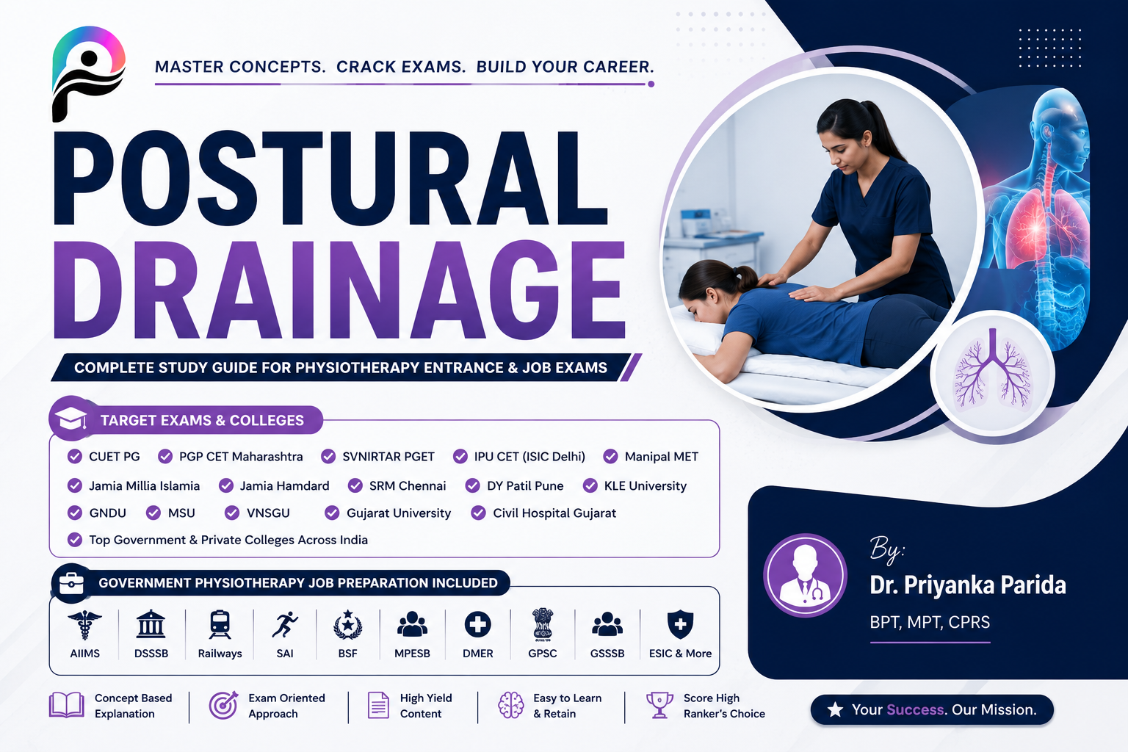

Slide 2
Objectives
Define postural drainage
Explain physiological basis
Describe indications and contraindications
Demonstrate drainage positions
Perform percussion and vibration
Apply evidence-based airway clearance principles

Slide 3
Definition
Postural drainage (PD) is a therapeutic positioning technique that uses gravity to facilitate movement of bronchopulmonary secretions from peripheral lung segments toward the central airways where they can be removed by coughing, huffing, or suctioning.
It is a component of chest physiotherapy (CPT) commonly combined with percussion and vibration to improve bronchial hygiene.

Slide 4
Postural drainage was considered:
Individualized airway clearance
Patient-centered treatment
Integration with ACBT, PEP, OPEP, Autogenic Drainage
Reduced reliance on routine head-down positions
Usually combined with percussion and vibration

Slide 5
Physiological basis
1. Gravity-Assisted Mucus Transport
Mucus movement based on:
Gravity
Airflow bias
Mucociliary clearance
PD positions align bronchial segments vertically so secretions move toward larger airways.
Secretions move:
Peripheral Airways
↓
Segmental Bronchi
↓
Lobar Bronchi
↓
Main Bronchi
↓
Trachea

Slide 6
2.Mucociliary Clearance Enhancement
Normal mucus transport depends upon:
Ciliary Activity
Frequency:
10–15 Hz
Function:
Propel mucus toward pharynx

Slide 7
3. Two-Phase Gas-Liquid Flow Theory
Modern airway clearance physiology suggests mucus movement depends on:
Expiratory airflow exceeding inspiratory airflow
Ventilation behind mucus plugs
Airway shear forces
Gravity alone is often insufficient.
This explains why modern techniques such as ACBT and OPEP may outperform postural drainage alone.

Slide 8
4. Ventilation–Perfusion Effects
Potential benefits:
Improved regional ventilation
Reduced mucus plugging
Prevention of atelectasis
Potential adverse effects:
Increased V/Q mismatch
Oxygen desaturation
Increased work of breathing in severe disease

Slide 9
Goals of PD
Mobilize retained secretions
Improve mucociliary transport
Reduce airway obstruction
Improve gas exchange
Prevent recurrent infection
Improve pulmonary function
Reduce work of breathing
Improve exercise tolerance
Enhance quality of life

Slide 10
Indication
Excessive Secretions
Bronchiectasis
Cystic Fibrosis
Chronic bronchitis
Neuromuscular Disorders
Muscular Dystrophy
Guillain-Barré Syndrome
Spinal cord injury
Postoperative Patients
Thoracic surgery
Upper abdominal surgery
Artificial Airway Patients
Intubated patients
Tracheostomy patients

Slide 11
Contraindication
Absolute Contraindications
Untreated tension pneumothorax
Massive hemoptysis
Active pulmonary hemorrhage
Unstable spinal injury
Severe hemodynamic instability

Slide 12
Relative Contraindications
Neurological
Increased intracranial pressure
Recent neurosurgery
Cardiovascular
Unstable hypertension
Severe heart failure
Cardiac arrhythmias
Gastrointestinal
Gastroesophageal reflux disease (GERD)
Hiatal hernia
Recent esophageal surgery
Musculoskeletal
Rib fractures
Severe osteoporosis
Recent spinal surgery

Slide 13
Precautions
Monitor:
Heart rate
Blood pressure
Respiratory rate
Oxygen saturation (SpO₂)
Dyspnoea
Fatigue
Terminate treatment if:
Severe desaturation
Bronchospasm
Chest pain
Hemodynamic instability

Slide 14
Equipment's required
Adjustable Hospital Bed
Manual or electric beds facilitate proper positioning.
Air therapy beds are especially useful in ICU settings for large, critically ill, or unresponsive patients.
Positioning Aids
Pillows
Bedrolls
Cushions
Used to support body parts and reduce pressure on bony prominences.
Home-Based Positioning Equipment
Pillows
Foam wedges
Slant boards
Sofa cushions
Bean bag chairs
Ironing board (for paediatric patients, when appropriate)

Slide 15
Preparations
Administer Bronchodilator (if prescribed)
Nebulized bronchodilators may help loosen and mobilize secretions before treatment.
Ensure Adequate Hydration
Adequate fluid intake reduces secretion viscosity, making mucus easier to clear.
Check Bed Functionality
Be familiar with bed controls, especially adjustment to the Trendelenburg position when required.
Assess Tubes, Lines, and Monitoring Devices
In ICU patients, ensure sufficient slack in all IV lines, catheters, drains, and monitoring leads before positioning.
Arrange Adequate Assistance
Ensure sufficient staff are available for safe patient handling and positioning.
Prepare Suction Equipment
Keep suction apparatus ready for patients with artificial airways or those unable to effectively expectorate secretions.

Slide 16
Postural Drainage Positions
Lung Segment | Position
Apical Upper Lobe | Sitting upright, Lean backward 30°
Posterior Upper Lobe | Sitting, leaning forward
Anterior Upper Lobe | Supine
Right Middle Lobe | Quarter turn left, Trendelenburg 15–20°
Lingula | Quarter turn right, Trendelenburg 15–20°
Superior Lower Lobe | Prone, bed flat
Anterior Basal | Supine, head-down
Lateral Basal | Side-lying, head-down
Posterior Basal | Prone, head-down

Slide 17
Modified Postural Drainage
Modified Postural Drainage
No head-down tilt
Gravity-assisted positioning without Trendelenburg
Recommended when:
GERD present
Patient intolerance
Increased aspiration risk
British Thoracic Society guidelines

Slide 18
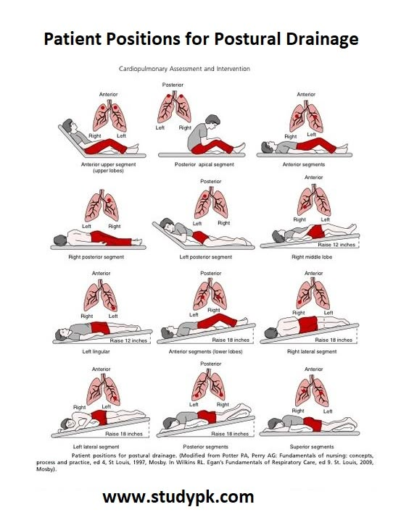

Slide 19
Procedure
Step 1- Assessment
Evaluate:
Subjective
Sputum volume
Dyspnea
Fatigue
Objective
Respiratory rate
Oxygen saturation
Chest X-ray
CT scan
Breath sound

Slide 20
Step 2 Positioning
Appropriate segmental position maintained for:
5–15 minutes

Slide 21
Step 3 Percussion
Technique
Cup-shaped hands applied rhythmically.
Frequency:
3–5 Hz
Duration:
3–5 minutes

Slide 22
Step 4 Vibration
Applied during expiration.
Purpose:
Loosen mucus
Increase expiratory flow

Slide 23
Step 5 Airway Clearance
Methods:
Directed cough
Huffing
Suctioning

Slide 24
Complications
Respiratory
Hypoxemia
Bronchospasm
Increased dyspnea
Gastrointestinal
Nausea
Vomiting
Cardiovascular
Arrhythmias
Blood pressure changes

Slide 25
Advantages
Easy to Learn and Perform
Patients and caregivers can be trained to perform PD effectively.
Can Be Integrated into Daily Activities
In hospitals: combined with repositioning, bathing, or other care activities.
At home: can be performed while reading, watching television, or relaxing.
Low Equipment Cost
Requires minimal equipment.
Household items such as pillows, cushions, and foam wedges can be used.
Suitable for Home Management
Family members or caregivers can be trained, improving treatment accessibility and flexibility.
Facilitates Secretion Clearance
Uses gravity to assist mucus drainage from affected lung segments.

Slide 26
DISADVANTAGES
Positioning Contraindications
Certain drainage positions may be unsuitable for patients with:
  GERD
  Raised intracranial pressure
  Cardiovascular instability
  Musculoskeletal limitations
Time-Consuming
Multiple positions may be required during a treatment session.
Long treatment duration may reduce adherence.
Compliance Issues
Patients may find some positions uncomfortable.
Children often require distractions and supervision to maintain positions.
Caregiver Dependence
Some patients require assistance for positioning and monitoring.
Long-Term Cost of Caregiver Time
Although equipment costs are low, caregiver involvement can be demanding, especially in chronic respiratory conditions.

Slide 27
THANK YOU

