Slide 1
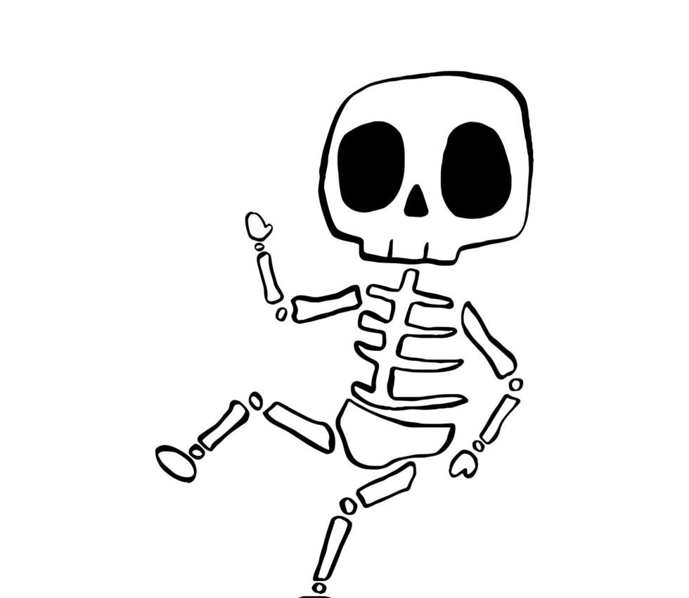
Special Orthopaedic Tests
B.Maithili Dutta Pradhan,
Sports Physio, Asst. Professor, PhD Scholar

Slide 2
Why Special Tests Matter
Special (clinical/orthopedic) tests are provocative maneuvers used to stress a specific structure - ligament, tendon, labrum, meniscus, or nerve - to reproduce a patient’s symptoms or reveal instability.
Each test has a purpose, a procedure, and a positive finding.

Slide 3
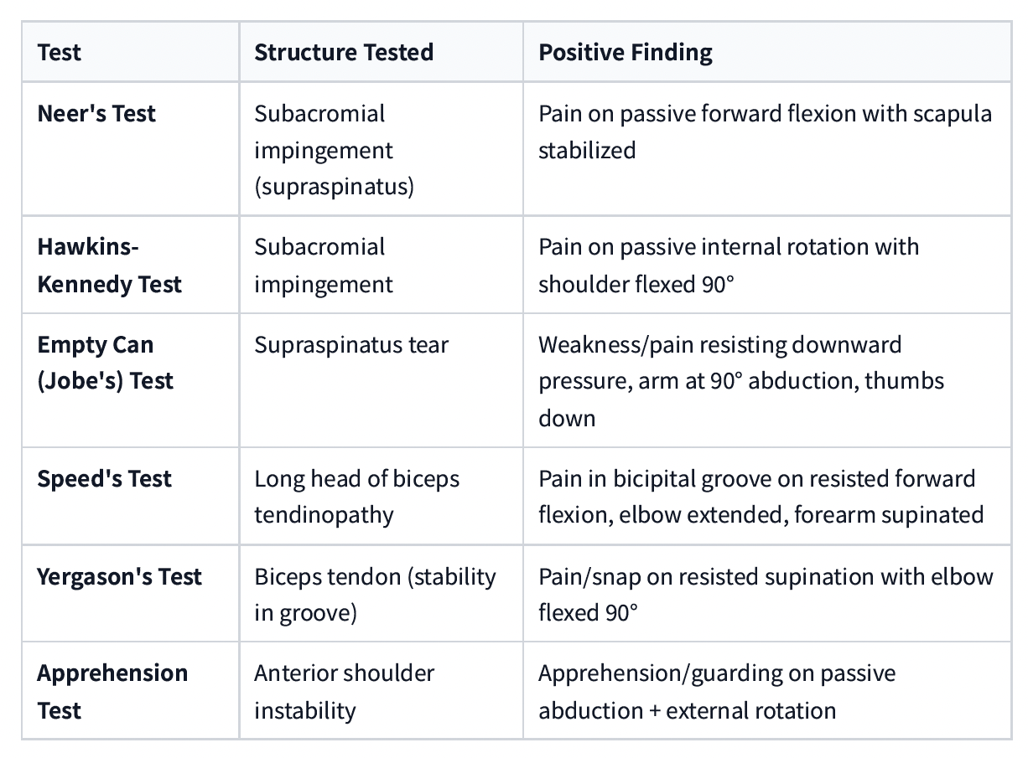
Shoulder Joint:

Slide 4
Sulcus Sign | Inferior glenohumeral instability | Sulcus/dimple below acromion on downward traction of arm
Drop Arm Test | Rotator cuﬀ (supraspinatus) tear | Inability to slowly lower arm from 90° abduction

Slide 5
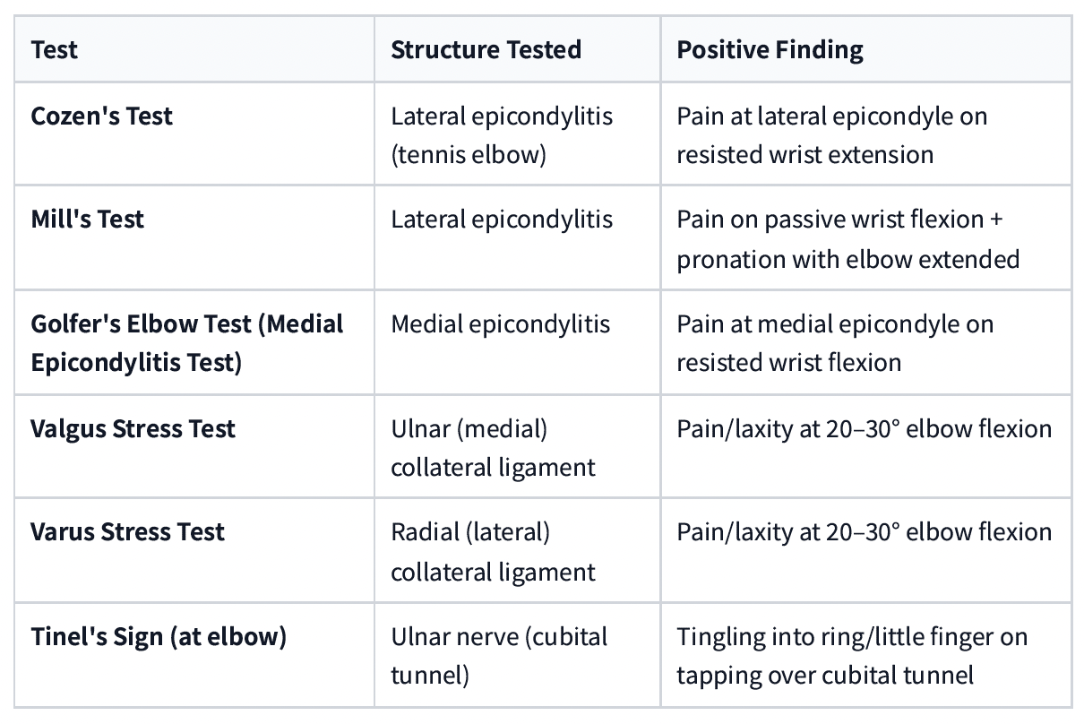
Elbow Joint & surroundings

Slide 6
Trivia:
Cozen's test vs Mill's test - both test lateral epicondylitis, but Cozen's is anactive/resisted test (resisted wrist extension) while Mill's is a passive stretch test(passive wrist flexion + pronation).
"Tennis elbow" = lateral epicondylitis; "Golfer's elbow" = medial epicondylitis – a classic mix-up trap in exams (many students reverse these).
Lateral epicondylitis primarily involves the Extensor Carpi Radialis Brevis (ECRB)tendon - a frequently asked "which muscle" question.
Valgus stress test at the elbow is tested at 20–30° flexion (not full extension) because the olecranon locks the joint in full extension, masking ligament laxity.
Ulnar nerve at the elbow travels through the cubital tunnel, posterior to the medial epicondyle - Tinel's sign here should never be confused with Tinel's at the wrist(median nerve).

Slide 7
Wrist & Hand
Test | Structure Tested | Positive Finding
Finkelstein's Test | De Quervain's tenosynovitis (APL/EPB) | Pain over radial styloid on ulnar deviation with thumb clasped in ﬁst
Phalen's Test | Median nerve (carpal tunnel) | Tingling/numbness in median distribution within 60 sec of wrist ﬂexion
Tinel's Sign (at wrist) | Median nerve | Tingling on tapping volar wrist over carpal tunnel
Watson's Test (Scaphoid Shift Test) | Scapholunate ligament instability | Painful clunk as scaphoid subluxes dorsally
Bunnel-Littler Test | Intrinsic tightness of hand | Restricted PIP ﬂexion when MCP held extended

Slide 8
Hip:
Test | Structure Tested | Positive Finding
Thomas Test | Hip ﬂexor (iliopsoas) tightness | Inability to keep opposite thigh ﬂat on table
FABER / Patrick's Test | Hip pathology, SI joint, iliopsoas | Pain (groin = hip; posterior = SI joint); knee fails to reach table
Trendelenburg Test | Hip abductor weakness (gluteus medius) | Pelvis drops on contralateral side during single-leg stance
Ober's Test | IT band tightness | Thigh fails to adduct/drop to table
Craig's Test | Femoral anteversion | Excessive internal rotation needed to palpate greater trochanter
Scour Test (Quadrant Test) | Labral tear / acetabular pathology | Pain or catching with hip ﬂexion-adduction + axial compression

Slide 9
Knee:
Test | Structure Tested | Positive Finding
Lachman Test | Anterior cruciate ligament (ACL) - most sensitive | Increased anterior tibial translation, soft/mushy end-feel
Anterior Drawer Test | ACL | Excessive anterior tibial glide at 90° knee ﬂexion
Posterior Drawer Test | Posterior cruciate ligament (PCL) | Excessive posterior tibial glide at 90° knee ﬂexion
McMurray's Test | Meniscal tear | Palpable/audible click with pain on tibial rotation + extension
Apley's Compression/Distraction Test | Meniscus (compression) vs ligament (distraction) | Pain on compression = meniscus; pain on distraction = ligament
Valgus Stress Test (0° and 30°) | Medial collateral ligament (MCL) | Pain/laxity on medial gapping
Varus Stress Test (0° and 30°) | Lateral collateral ligament (LCL) | Pain/laxity on lateral gapping
Patellar Apprehension Test | Patellar instability | Guarding/apprehension on lateral patellar glide

Slide 10
Ankle & Foot:
Test | Structure Tested | Positive Finding
Anterior Drawer Test (Ankle) | Anterior taloﬁbular ligament (ATFL) | Excessive anterior translation of talus
Talar Tilt Test | Calcaneoﬁbular ligament (CFL) | Excessive inversion of talus compared to opposite side
Thompson Test (Simmonds' Test) | Achilles tendon rupture | No plantarﬂexion on calf squeeze
Squeeze Test | Syndesmosis (high ankle sprain) | Pain at syndesmosis on compressing tibia/ﬁbula mid-calf
Homans' Sign | Deep vein thrombosis (screening) | Calf pain on passive ankle dorsiﬂexion (low speciﬁcity — used cautiously)

Slide 11
Cervical Spine:
Test | Structure Tested | Positive Finding
Spurling's Test | Cervical nerve root compression | Reproduction of radicular pain on extension + lateral ﬂexion + axial compression
Cervical Distraction Test | Nerve root compression (relief test) | Relief of symptoms with manual traction
Lhermitte's Sign | Cervical cord/dural irritation | Electric shock sensation down spine on neck ﬂexion
Vertebral Artery Test | Vertebral artery insuﬃciency | Dizziness/nystagmus on sustained neck extension + rotation

Slide 12
Lumbar Spine:
Test | Structure Tested | Positive Finding
Straight Leg Raise (SLR) / Lasègue's Test | Lumbar disc herniation, sciatic nerve tension | Radicular pain between 30°‒70° of hip ﬂexion
Slump Test | Neural tension (dural mobility) | Reproduction of radicular symptoms in slumped, ﬂexed position
Femoral Nerve Stretch Test | L2‒L4 nerve root/femoral nerve | Anterior thigh pain on passive knee ﬂexion in prone position
Well Leg Raise (Crossed SLR) | Disc herniation (highly speciﬁc) | Symptoms reproduced in aﬀected leg when opposite leg is raised

Slide 13
Sacroiliac Joint:
Test | Structure Tested | Positive Finding
Gaenslen's Test | SI joint stress | Pain on hyperextension of one hip with opposite hip ﬂexed
FABER Test | SI joint / hip | Posterior pain on ﬂexion-abduction-external rotation
Compression Test | SI joint (posterior stress) | Pain on side-lying compression of pelvis
Distraction Test | SI joint (anterior stress) | Pain on supine distraction of ASIS
Thigh Thrust Test (Posterior Shear Test) | SI joint | Pain on posterior shear force through ﬂexed hip

Slide 14
TMJ:
Test | Structure Tested | Positive Finding
TMJ Compression Test | Intra-articular disc/retrodiscal tissue | Pain on posterior compression of condyle
Joint Play/Distraction Test | Capsular restriction | Pain or restricted glide on distraction

Slide 15

Thank You
&
All the Best

