Slide 1
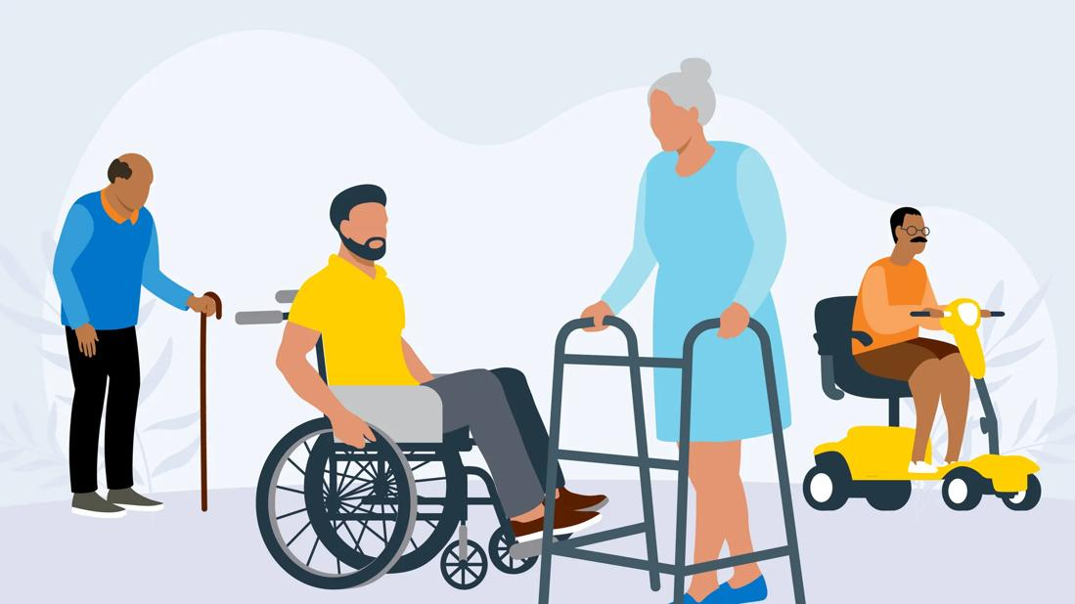
Walking Aids & Assistive Devices
B. Maithili Dutta Pradhan,
Sports Physio, Assistant Professor, PhD Scholar.

Slide 2
Definition
A walking aid is one of several devices a patient may be issued in order to improve their walking pattern, balance or safety while mobilising independently.
They can also be a means of transferring weight from the upper limb to the ground, in cases where reducing weight bearing through the lower limb is desired.
Assistive devices and technologies are those whose primary purpose is to maintain or improve an individual’s functioning and independence to facilitate participation and enhance overall well-being.
Examples of assistive devices and technologies include wheelchairs, prostheses, hearing aids, visual aids, and specialised computer software and hardware that increase mobility, hearing, vision, or communication capacities.

Slide 3
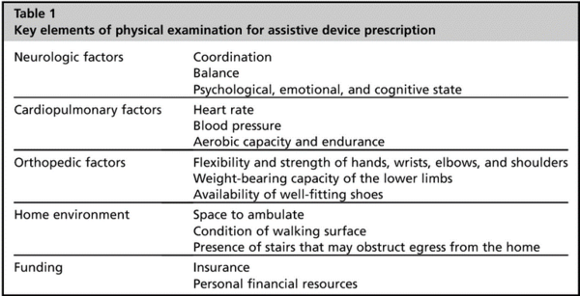

Slide 4
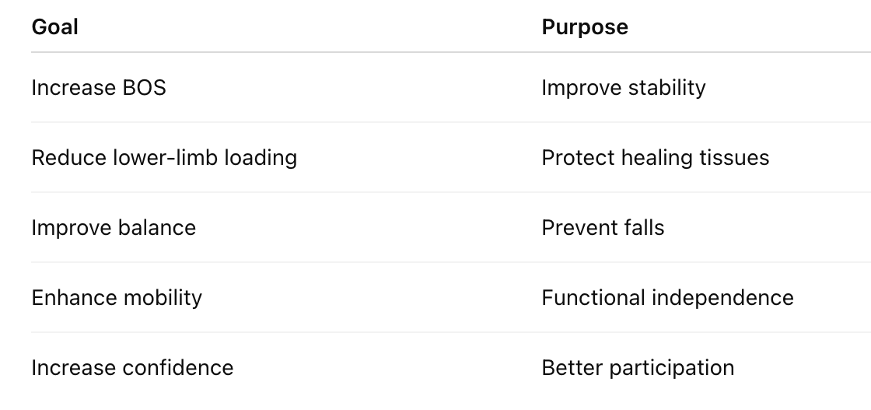
Walking Aids:

Slide 5
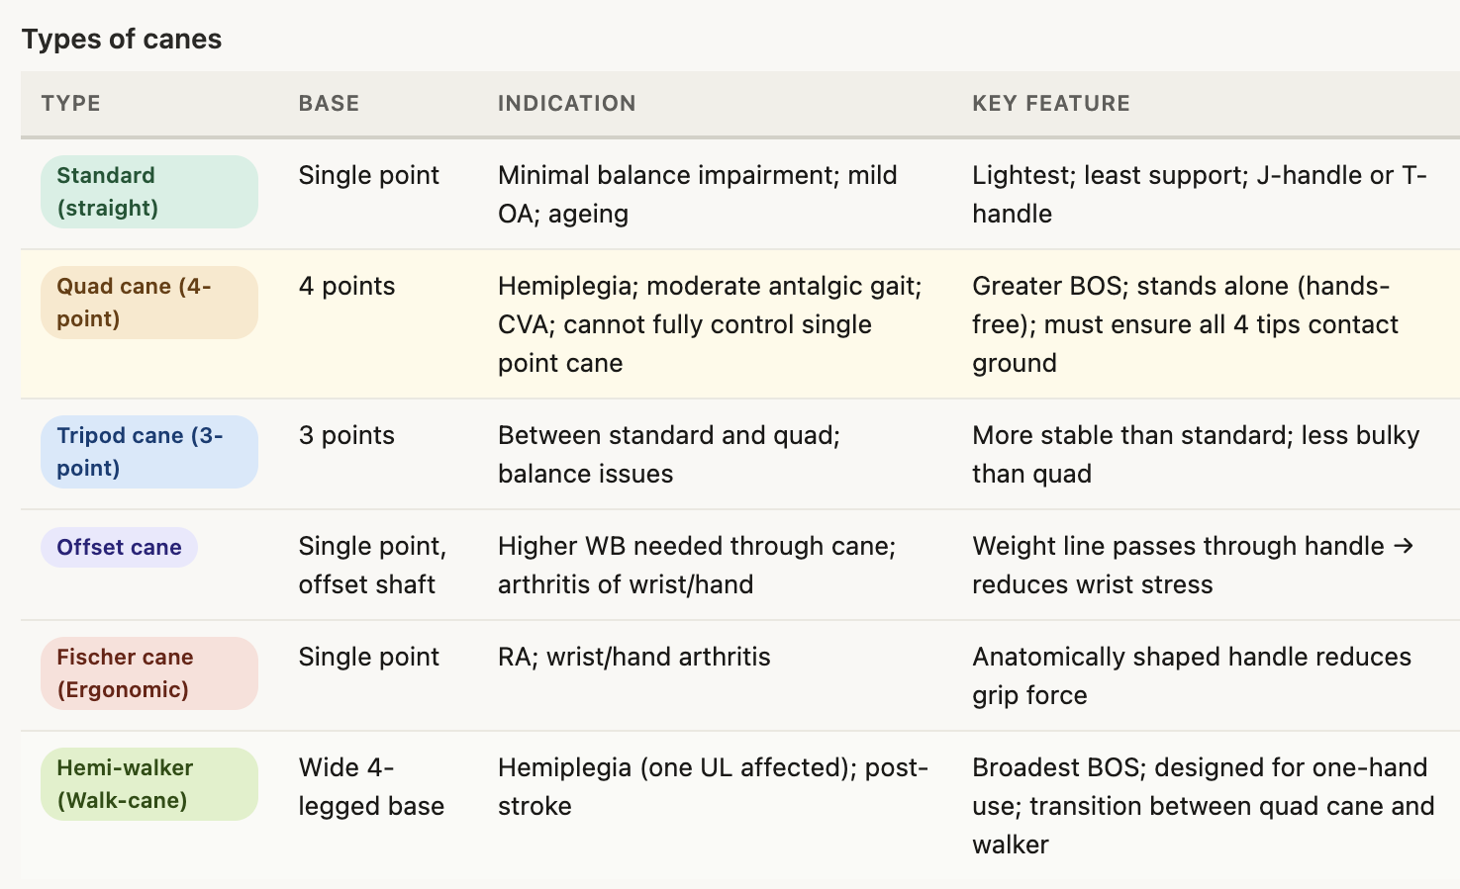

Slide 6
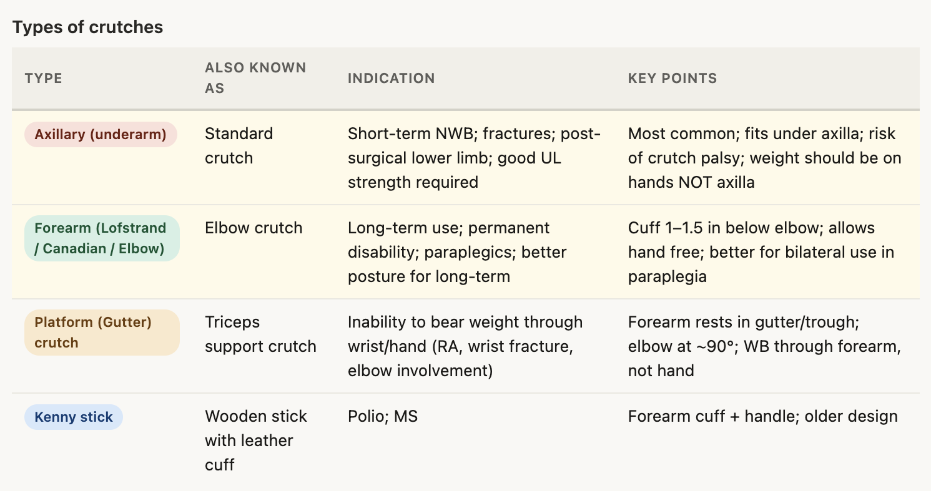

Slide 7
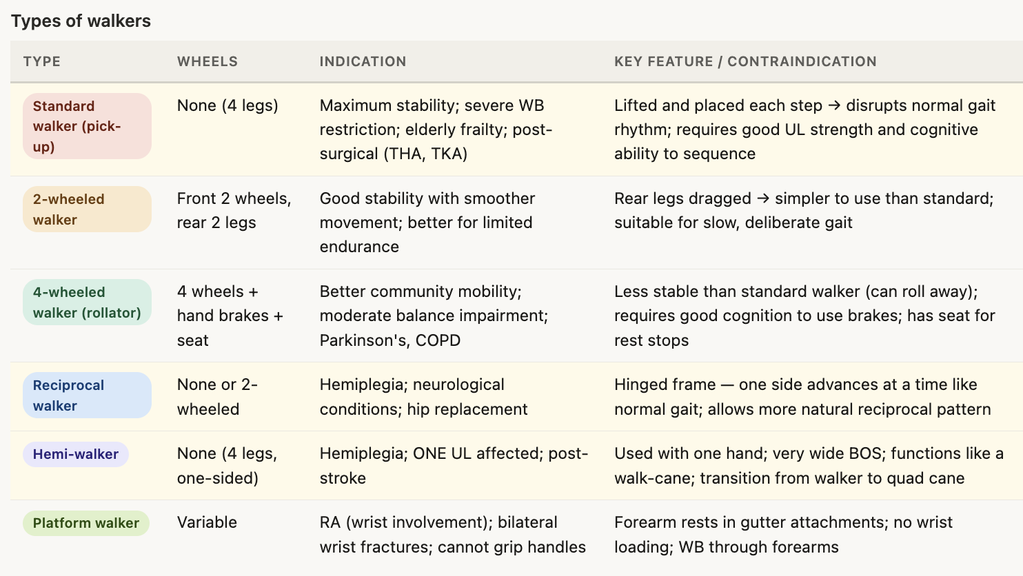

Slide 8
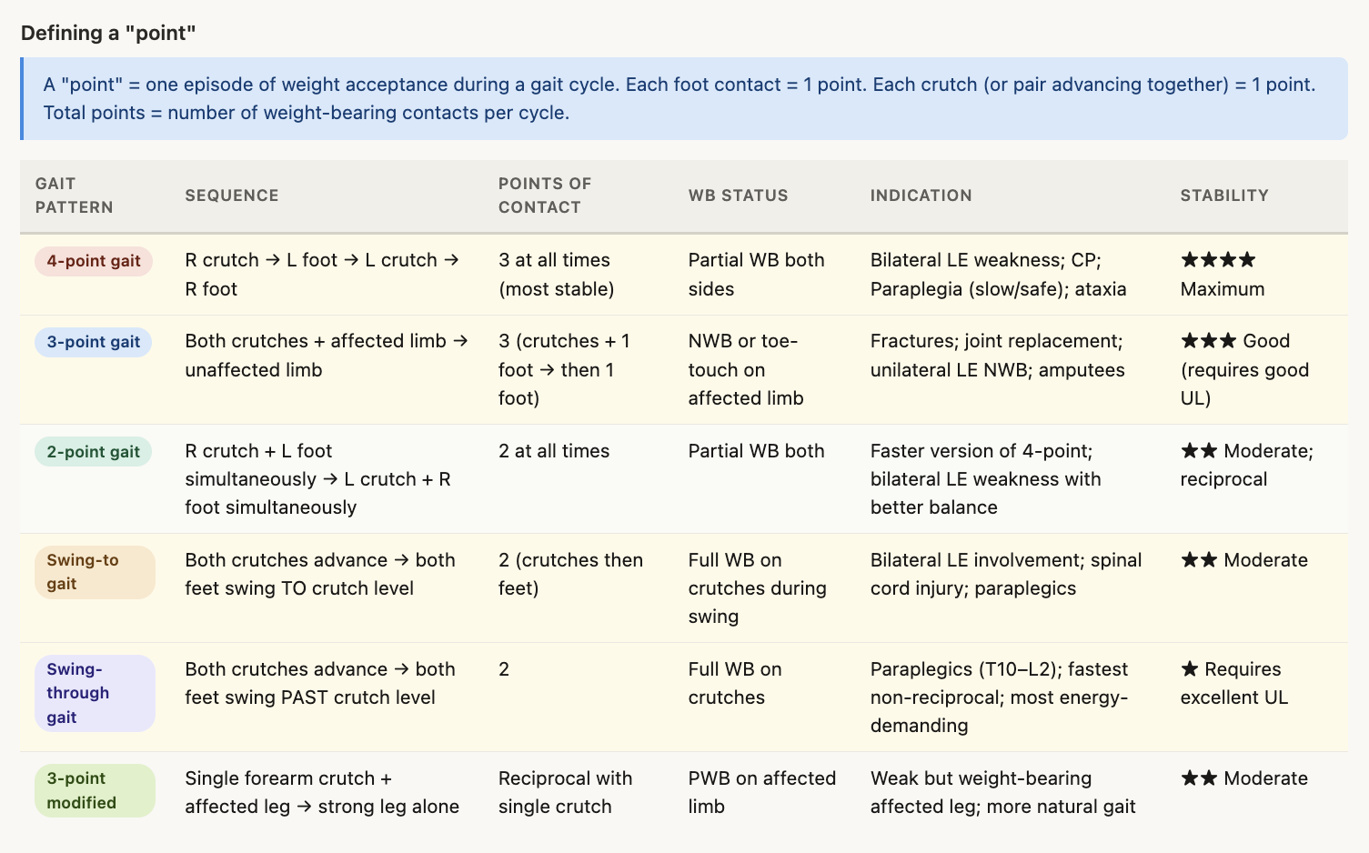

Slide 9
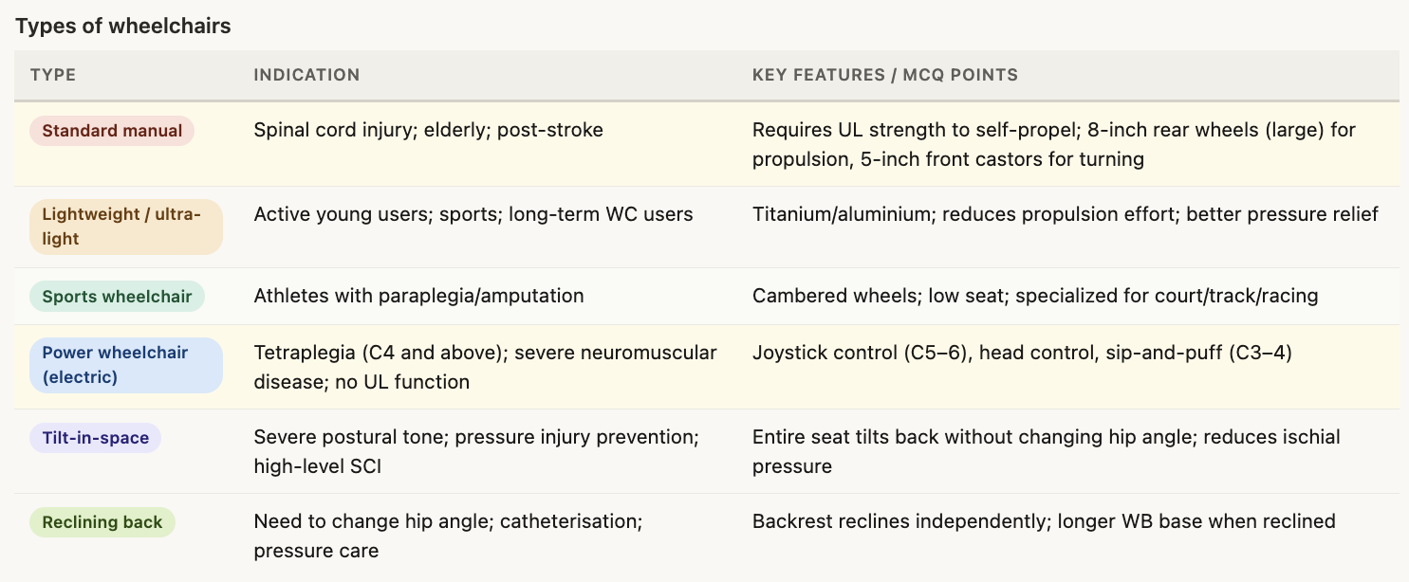

Slide 10
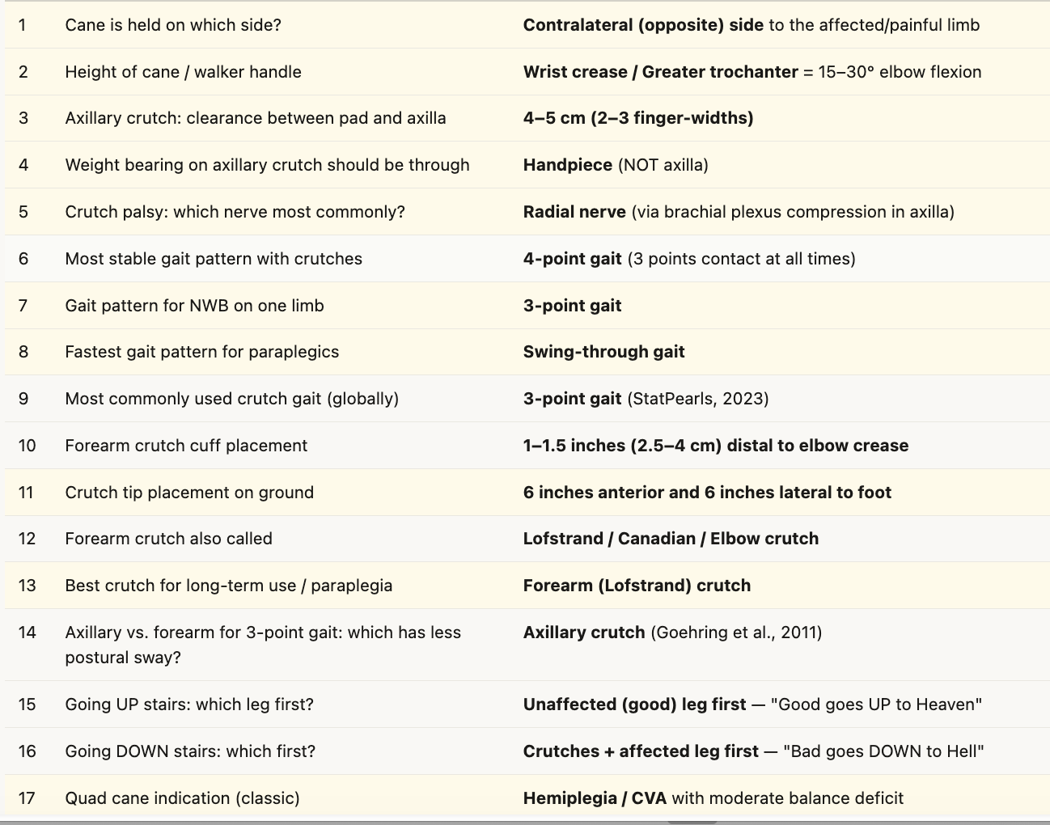

Slide 11
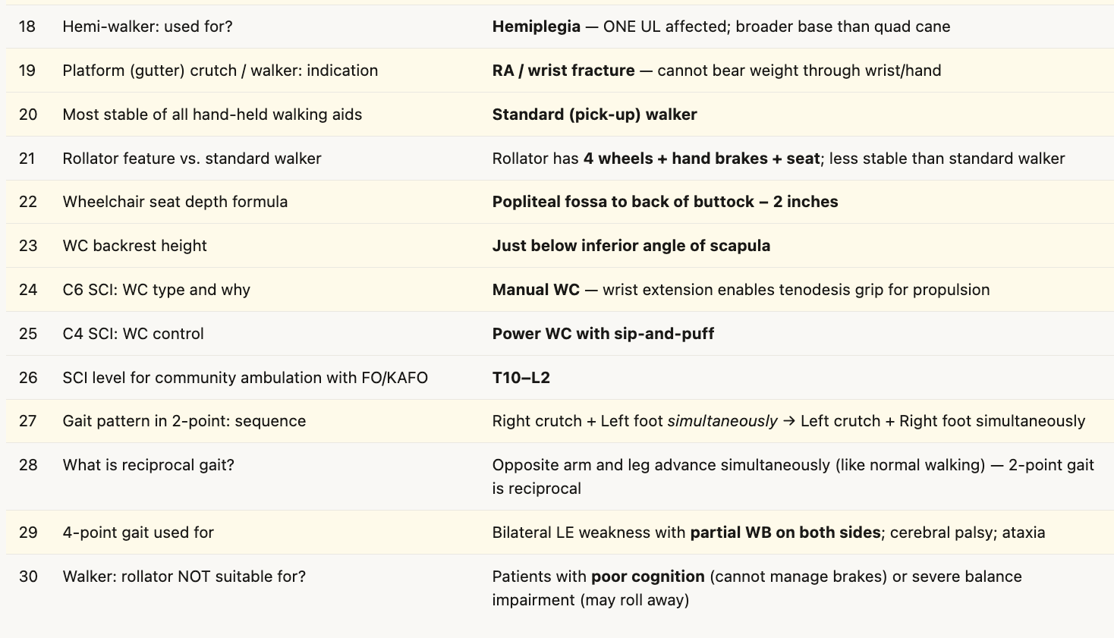

Slide 12

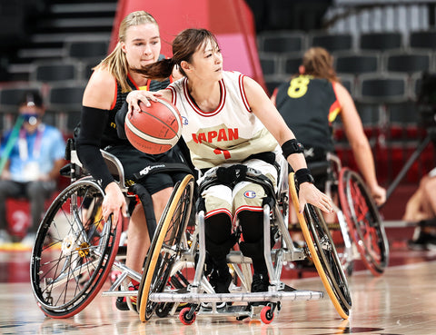


Thank You
&
Good Luck
Instagram: being_ekam
Linked in: B.Maithili Dutta Pradhan
Mail: bmaithilimpt@gmail.com

