Slide 1

ABG Analysis
Presented by – Dr. Mayuri Maheshwari PT

Slide 2
Findings
ABG Analysis is done to evaluate the following
  Acid base balance (pH, Paco_{2,} HCO₃⁻, base excess)
  Oxygenation status ( Pao₂, Sao₂, Cao₂, Pvo₂)
  Adequacy of ventilation (Paco₂)

Slide 3
Arterial blood / venous blood

Slide 4
Sampling
Artery is punctured and sample taken.
Sample may be obtained from radial, dorsalis pedis, brachial or femoral arteries.
Radial artery is preferred
Collateral circulation is assessed before puncturing radial artery
Assessed through modified allen's test.

Slide 5
Normal values
PH – 7.35 - 7.45
Pao₂ – 80-100 mm Hg
Pco₂ – 35-45 mmHg
HCO₃⁻ - 22-26 mEq/L
Sao₂ - > 95%

Slide 6
Pao₂
Pressure of oxygen in plasma of arterial blood.
Normal predicted range depends on patient's age, F_{IO2}, barometric pressure.

Slide 7
Clinical significance
Hypoxia
Hypoxemia
Pao₂ | Severity of Hypoxemia
60-79 | Mild
40-59 | Moderate
<40 | Severe

Slide 8
Causes of hypoxemia
Ventilation/Perfusion (V/Q) mismatch
Breathing gas with a low P_{IO2}

Slide 9
Oxygen Saturation (S_{ao2})
Amount of oxygen bound to hemoglobin, expressed as percentage of total capacity.
True, reliable measurements can be obtained by co-oximeter.
Depends upon various factors like body temperature, arterial blood pH, P_{aCO2}

Slide 10
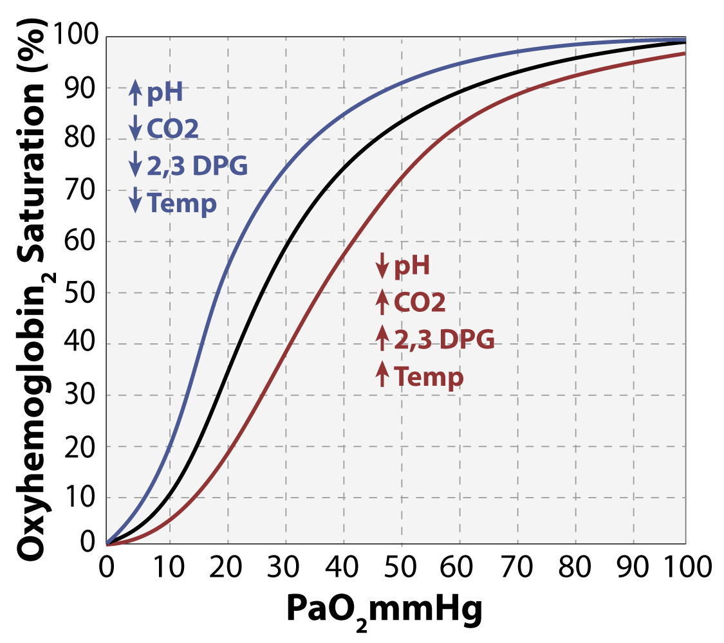
Oxygen dissociation curve
Relationship between Pao2 and Sao2 is demonstrated by oxygen dissociation curve.

Slide 11
Factors affecting the curve
Alkalosis, hypocapnia, hypothermia, fetal Hb, carboxyhemoglobin shifts the curve to left, resulting in higher Sao2.
Acidosis, hypercapnia, pyrexia shifts the curve to right, resulting in lower Sao2.

Slide 12
Cao₂
Amount of oxygen bound to Hb.
Reduced in carboxyhemoglobin. (eg., CO poisoning after inhalation of smoke from a fire) or low hemoglobin.

Slide 13
Partial pressure of oxygen in mixed venous blood
Pvo_{2,} Normal value 38 to 42 mm Hg.
Pao₂, Sao₂, Cao₂ provide only evaluation of the respiratory component.
Pvo₂ is important to evaluate tissue oxygenation status.
Mixed venous sample is required.
Sample of pulmonary artery blood is taken through a pulmonary artery catheter.

Slide 14


Value lower than 35 mm Hg suggest reduced cardiac output or severe hypoxemia.
Can be assessed in ICU only.

Slide 15
Acid-base balance
Body produces approximately 12000 mEq of acid each day.
Acid base balance is maintained by lungs and kidneys.
Lungs remove metabolic acid by removing CO₂ from blood.
Kidneys work on the buffer capacity of body by replenishing the HCO₃⁻ concentration.

Slide 16
pH
Normal value 7.35 - 7.45
Measurement of hydrogen ion concentration in blood.
Acids can donate the hydrogen ions and bases can accept hydrogen ions.
pH and hydrogen ion are inversely proportional to each other.

Slide 17
pH below 7.35 - blood is acidotic and condition is acidosis.
pH above 7.45 - blood is alkalotic and condition is alkalosis.
Homeostasis is when the blood is pH is around 7.40.
pH has significant impact on the nervous system.

Slide 18
Partial pressure of arterial carbon dioxide (Paco₂)
Normal value 35 – 45 mm Hg
Respiratory component of acid base balance
elevated Paco₂ is called hypercapnia/hypercarbia
Lower Paco₂ is called hypocapnia/hypocarbia
Hypoventilation/hyperventilation?

Slide 19
Hypercapnia – respiratory acidosis
Hypocapnia – respiratory alkalosis

Slide 20
Arterial blood bicarbonate (HCO⁻₃)
Normal value 22 – 26 mEq/L
Metabolic component of acid base balance.
Managed by the renal system
Plasma bicarbonate reduced – metabolic acidosis
Plasma bicarbonate increased – metabolic alkalosis

Slide 21
Acid-base disorders
Respiratory acidosis
Respiratory alkalosis
Metabolic acidosis
Metabolic alkalosis

Slide 22
Respiratory acidosis
Inadequate ventilation
Paco₂ is elevated above normal
Causes
  Airway obstruction
  Massive pulmonary edema
  Drug overdose
  Spinal cord/head/thoracic cage trauma
  Gross obesity

Slide 23
 | pH | Paco₂ | HCO₃⁻
UNCOMPENSATED
PARTIALLY COMPENSATED
FULLY COMPENSATED

Slide 24
Respiratory alkalosis
Ventilation exceeds the normal level
Paco₂ is below normal range
Causes
  Hypoxia induced hyperventilation
  High fever
  Anxiety, panic attacks
  Severe physical pain

Slide 25
 | pH | Paco₂ | HCO₃⁻
UNCOMPENSATED
PARTIALLY COMPENSATED
FULLY COMPENSATED

Slide 26
Metabolic acidosis
Plasma bicarbonate below normal
Causes
  Diarrhea
  Renal disorders
  Ketoacidosis
  Ingestion of toxins such as methanol

Slide 27
Gets compensated by reduction in Paco_{2.}
Uncompensated metabolic acidosis rarely occurs because Paco₂ is rapidly altered by changes in ventilation.
Kussmaul's respiration is seen.

Slide 28
 | pH | Paco₂ | HCO₃⁻
UNCOMPENSATED
PARTIALLY COMPENSATED
FULLY COMPENSATED

Slide 29
Metabolic alkalosis
Above normal elevation of plasma bicarbonate
Causes
  Hypokalemia
  Nasogastric suction
  Persistent vomiting
  Diuretic therapy
  Steroid therapy
  Excessive administration of sodium bicarbonate

Slide 30
 | pH | Paco₂ | HCO₃⁻
UNCOMPENSATED
PARTIALLY COMPENSATED
FULLY COMPENSATED

Slide 31
Mixed acid base disorders
Respiratory acidosis and metabolic acidosis
Respiratory alkalosis and metabolic alkalosis
Respiratory acidosis and metabolic alkalosis
Respiratory alkalosis and metabolic acidosis

Slide 32
Acid base assessment
Identify the pH value.
Check for respiratory or metabolic component
Check for compensation

Slide 33
Case studies

Slide 34
Case study 1
PH – 7.51
Paco₂ - 33
HCO₃⁻ - 18
Partially compensated respiratory alkalosis

Slide 35
Case study 2
PH – 7.54
Paco₂ - 30
HCO₃⁻ - 24
Non compensated respiratory alkalosis

Slide 36
Case study 3
PH – 7.3
Paco₂ - 40
HCO₃⁻ - 18
Non compensated metabolic acidosis

Slide 37
Case study 4
PH – 7.58
Paco₂ - 50
HCO₃⁻ - 30
Partially compensated metabolic alkalosis

Slide 38
Case study 5
PH – 7.28
Paco₂ - 30
HCO₃⁻ - 10
Partially compensated metabolic acidosis

Slide 39
Case study 6
PH – 7.10
Paco₂ - 60
HCO₃⁻ - 14
Mixed respiratory acidosis and metabolic acidosis

Slide 40
Case study 7
PH – 7.55
Paco₂ - 30
HCO₃⁻ - 34
Mixed respiratory alkalosis and metabolic alkalosis

Slide 41
Importance for physios
Acute hypercapnia – shows acute respiratory failure/ severe respiratory muscle fatigue
Chronic hypercapnia with normal pH
Shift of oxygen dissociation curve

