Slide 1
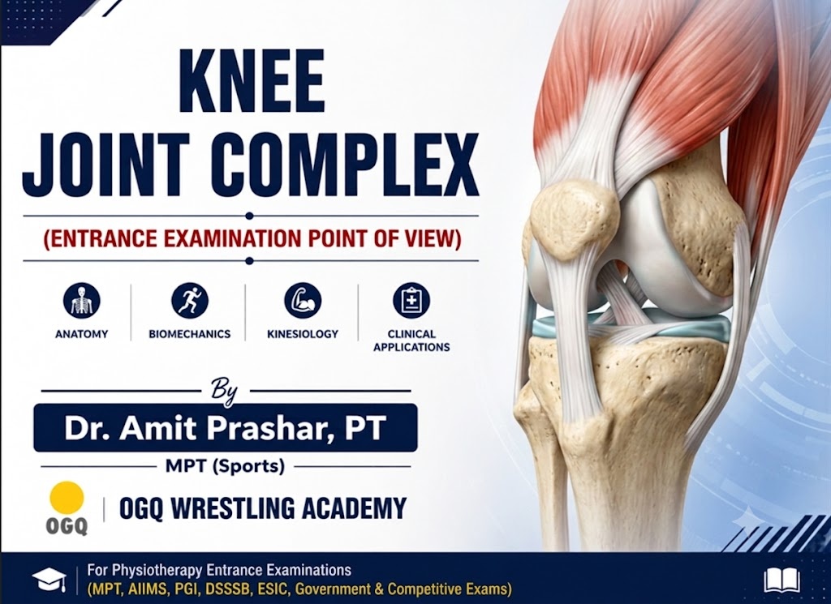
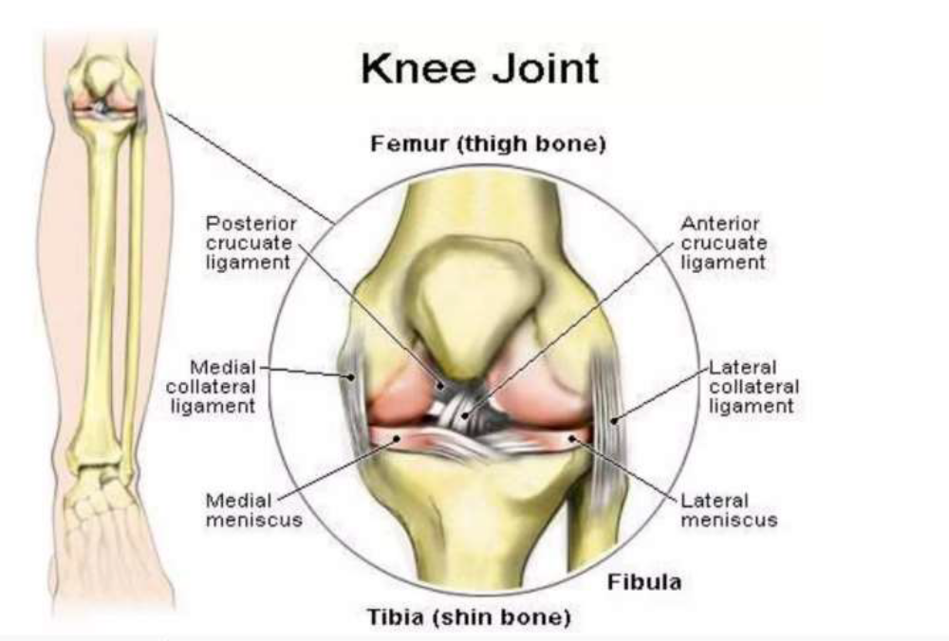

Knee Joint Complex

Slide 2
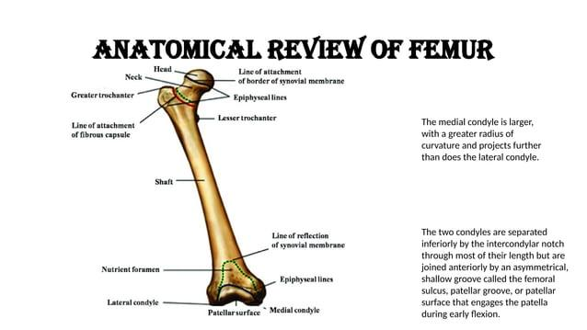

Slide 3
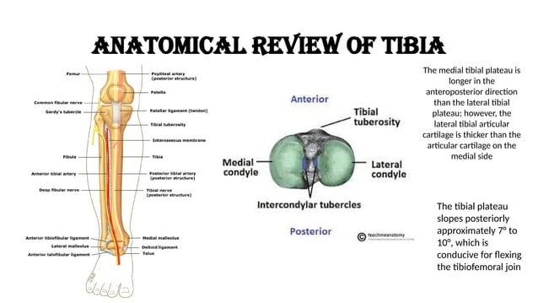

Slide 4
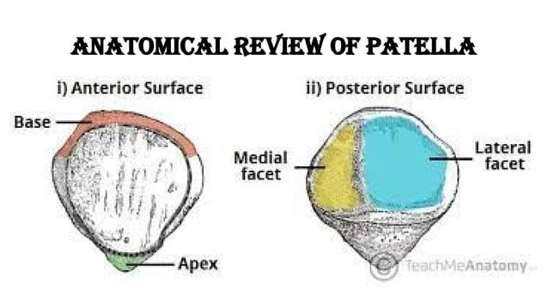

Slide 5
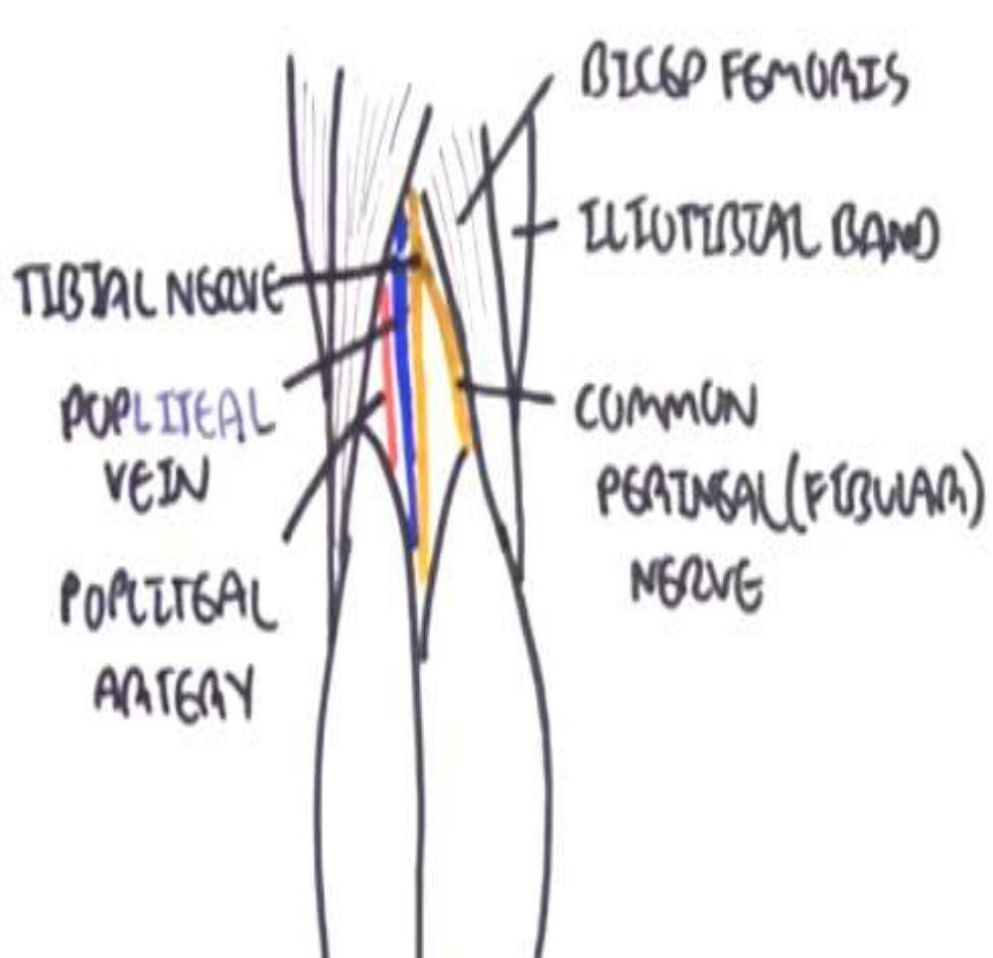
Popliteal Fossa
SAVNB (Serve And Volley Next Ball)to remember the popliteal fossa anatomy medial-to-lateral in arrangement.
Semimembranosus, Artery, Vein, Nerve, Biceps femoris

Slide 6
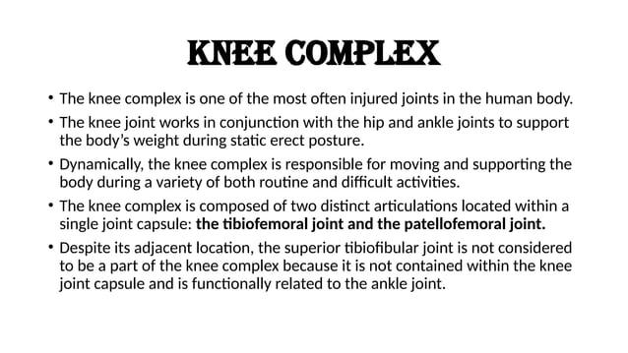

Slide 7
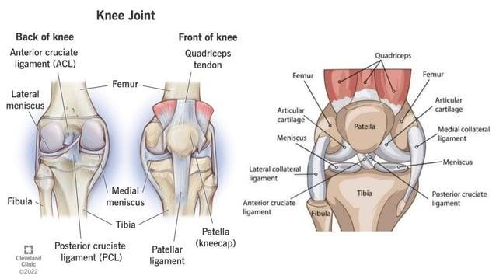

Slide 8
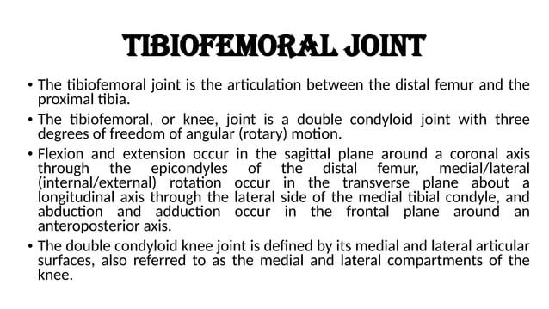

Slide 9
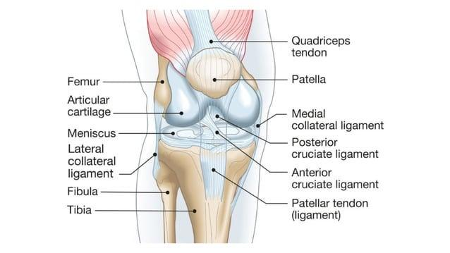

Slide 10
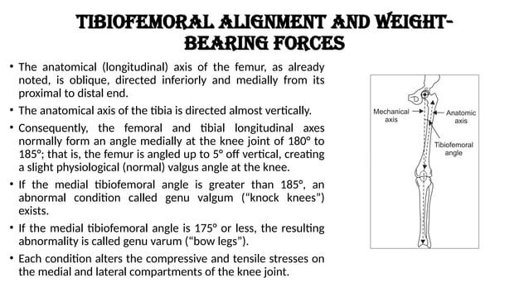

Slide 11
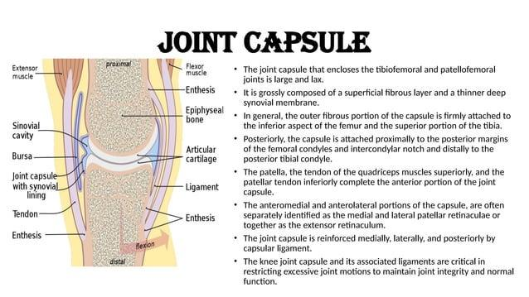

Slide 12
Knee capsule is weak anteriorly, strong posteriorly, fused with MCL, and contains intracapsular-extrasynovial cruciate ligaments.
CAPSULE = MAPS
M → MCL fused and attached with meniscus
A → ACL intracapsular, extrasynovial
P → PCL intracapsular, extrasynovial
S → Strong posteriorly, weak anteriorly

Slide 13
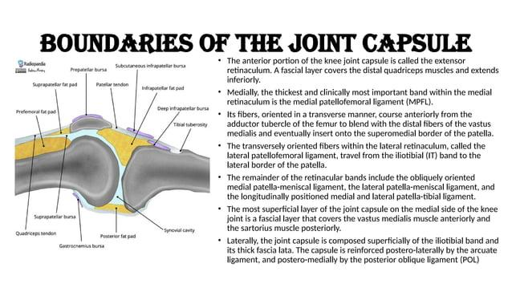

Slide 14
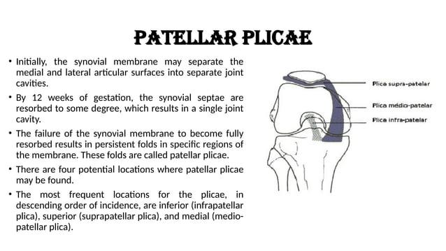

Slide 15
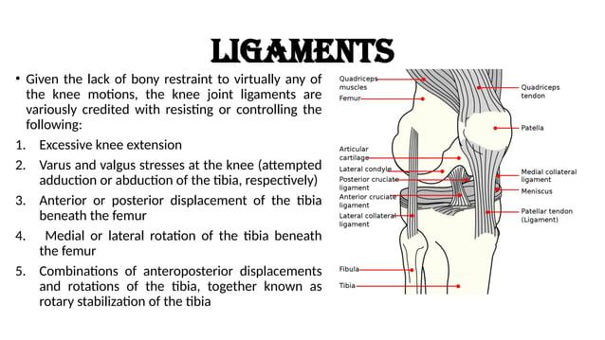

Slide 16
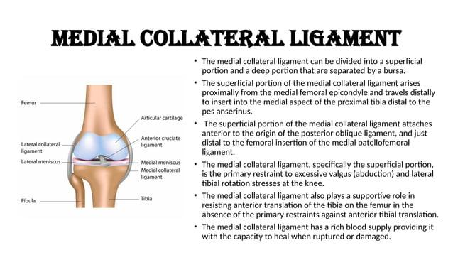

Slide 17
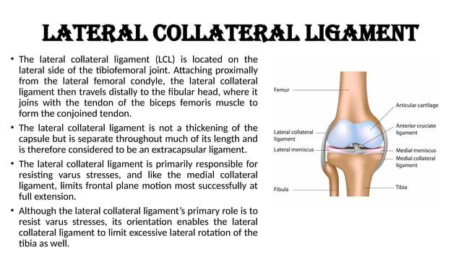

Slide 18
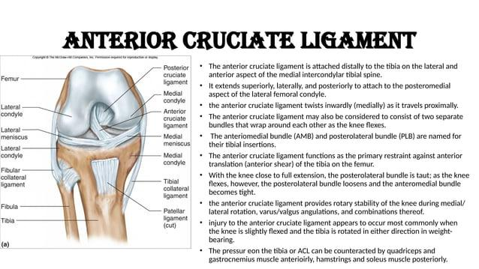

Slide 19
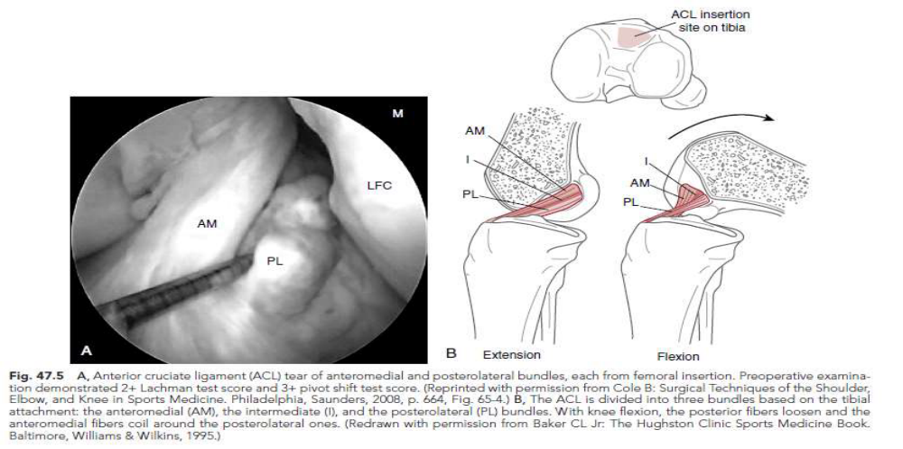
ACL bundles:
•In flexion, the AM bundle tightens as the PL bundle becomes lax, while in extension the PL bundle tightens and the AM bundle relaxes

Slide 20
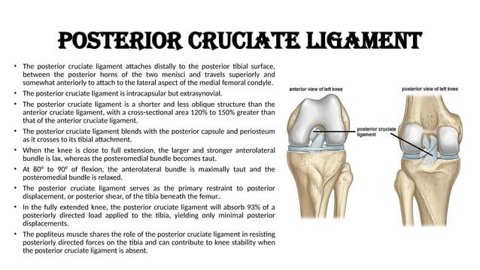

Slide 21
Insertions on the posterior aspect of the proximal tibia and the lateral
aspect of the medial femoral condyle-
PCL secondary restrain to:
1. anterior translation
2. posterior translation
3. external rotation
4. internal rotation
Mneumonic: LAMP lateral condyle to ACL and Medial condyle to PCL

Slide 22
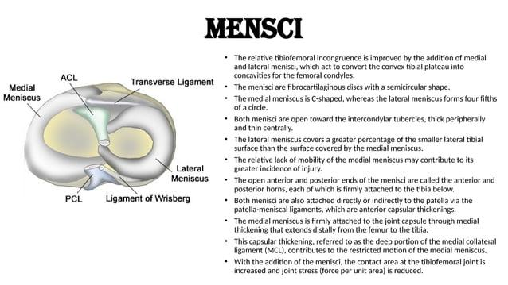

Slide 23
3. Which portion of the meniscus is most vascular?
A. Inner third
B. Middle third
C. Outer third
D. Entire meniscus equally
6. A patient complains of pain while descending stairs and prolonged sitting. Most likely diagnosis?
A. ACL tear
B. Patellofemoral Pain Syndrome
C. Baker's cyst
D. PCL injury
4. The close-packed position of the tibiofemoral joint is:
A. 25° flexion
B. 90° flexion
C. Full extension with tibial external rotation
D. 45° flexion
7. Which muscle contributes to dynamic control of frontal-plane knee stability?
A. Gluteus medius
B. Tibialis anterior
C. Soleus
D. Rectus abdominis
5. Which muscle is the most important dynamic stabilizer preventing lateral patellar tracking?
A. Rectus femoris
B. Vastus lateralis
C. Vastus medialis obliquus
D. Sartorius
8. The patellofemoral contact area:
A. Decreases with flexion
B. Remains constant
C. Increases with flexion
D. Disappears after 90°
9. Excessive foot pronation commonly contributes to:
A. Genu varum B. Dynamic valgus C. Genu recurvatum D. Fixed flexion deformity

Slide 24
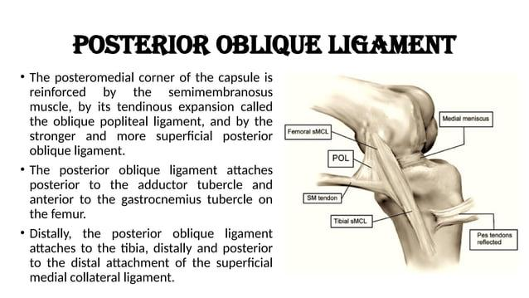

Slide 25
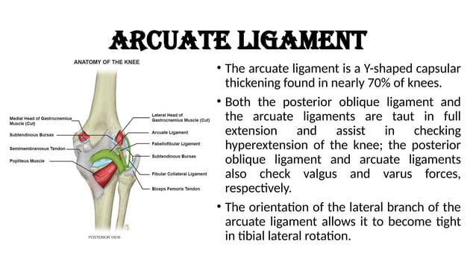

Slide 26
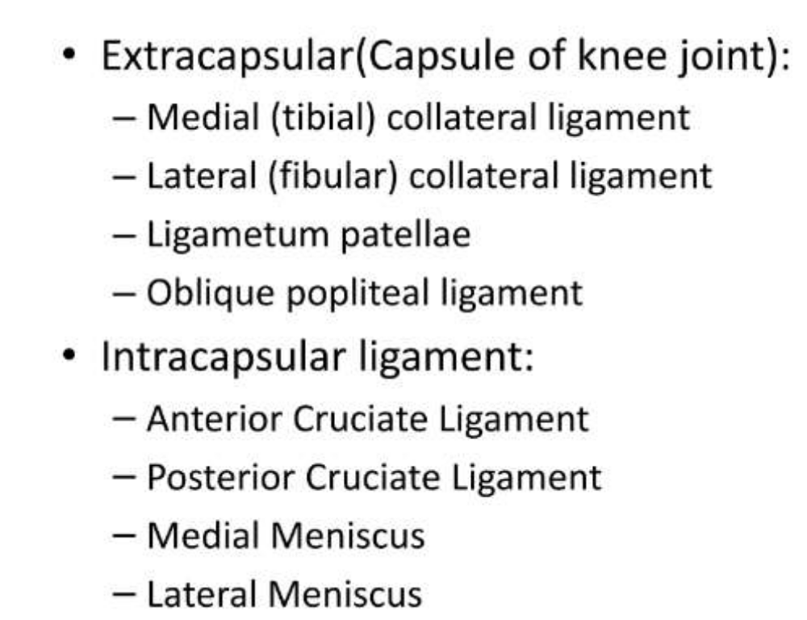

Slide 27
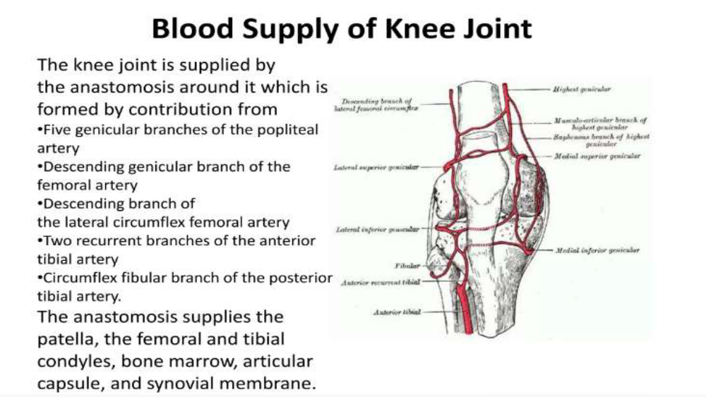

Slide 28
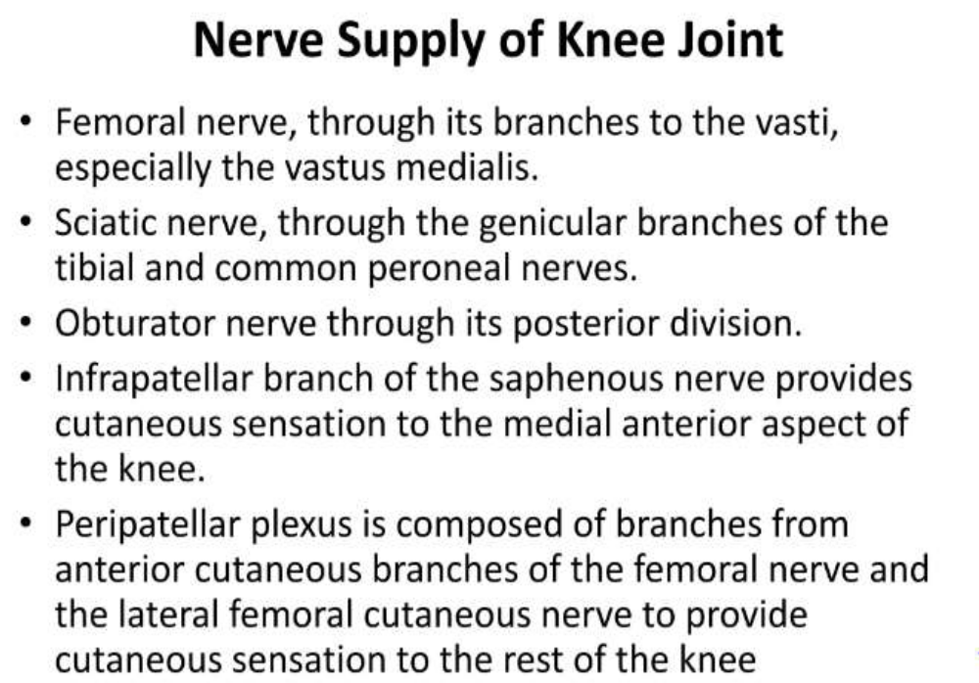

Slide 29
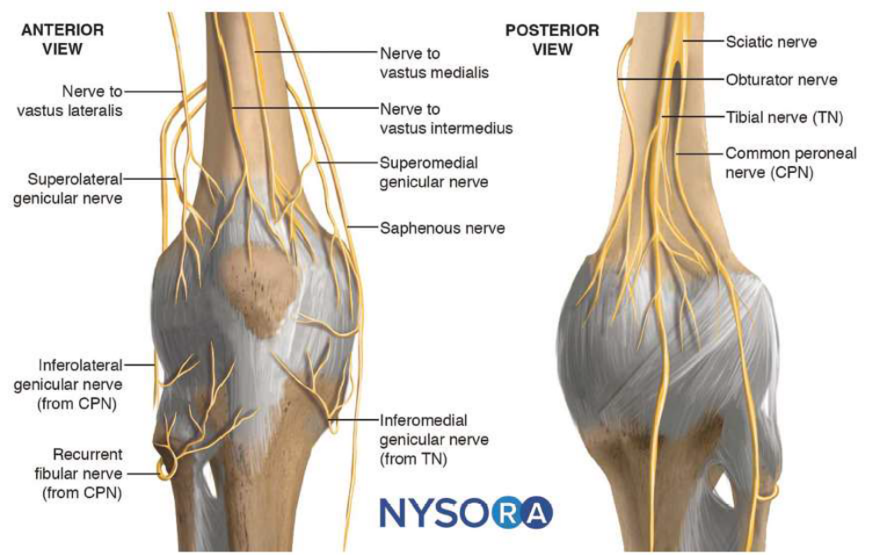

Slide 30
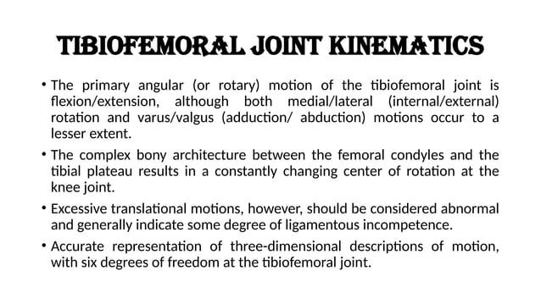

Slide 31
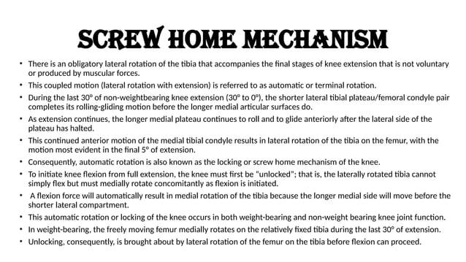

Slide 32
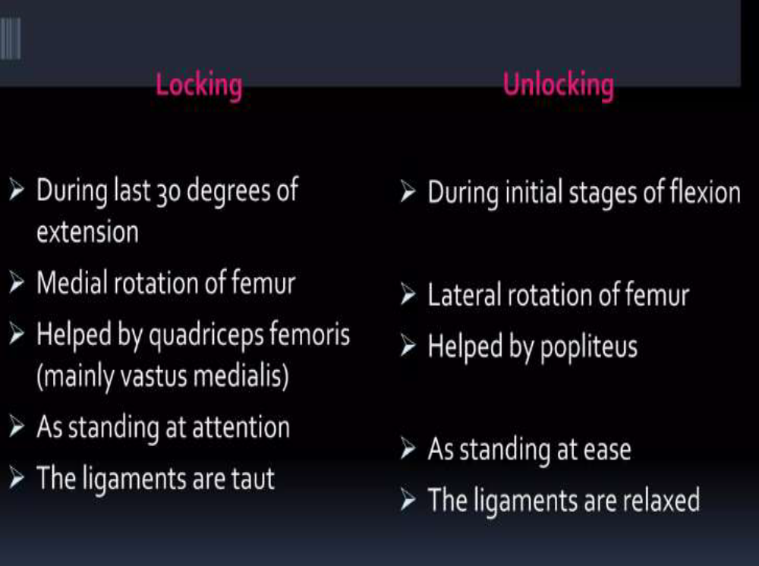

Slide 33
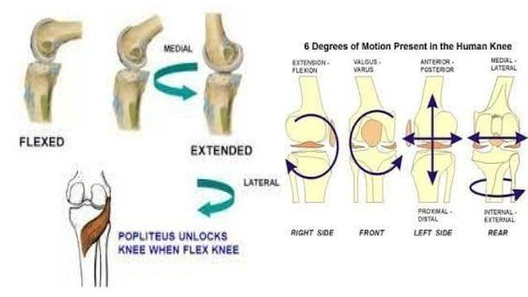

Slide 34
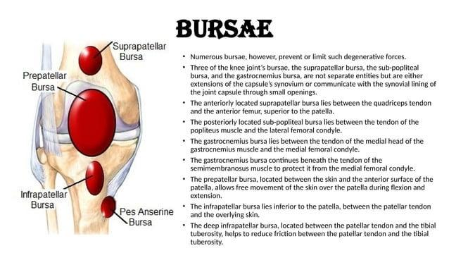

Slide 35
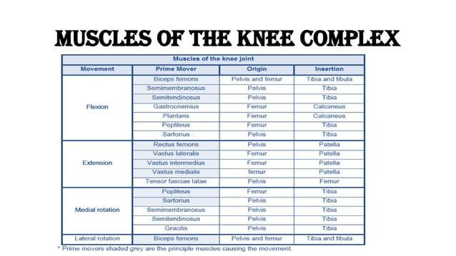

Slide 36
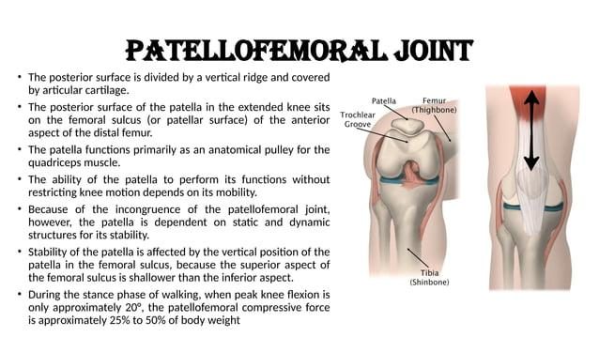

Slide 37
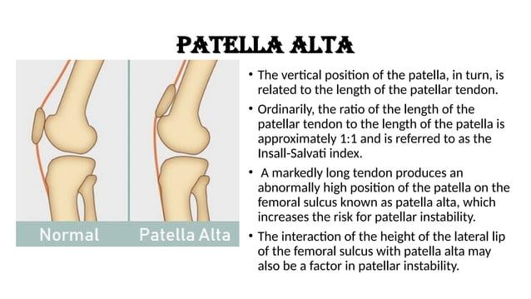

Slide 38
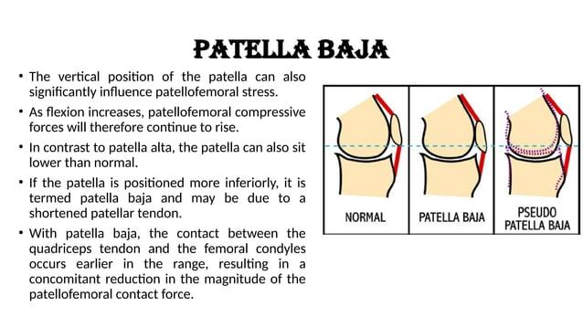

Slide 39
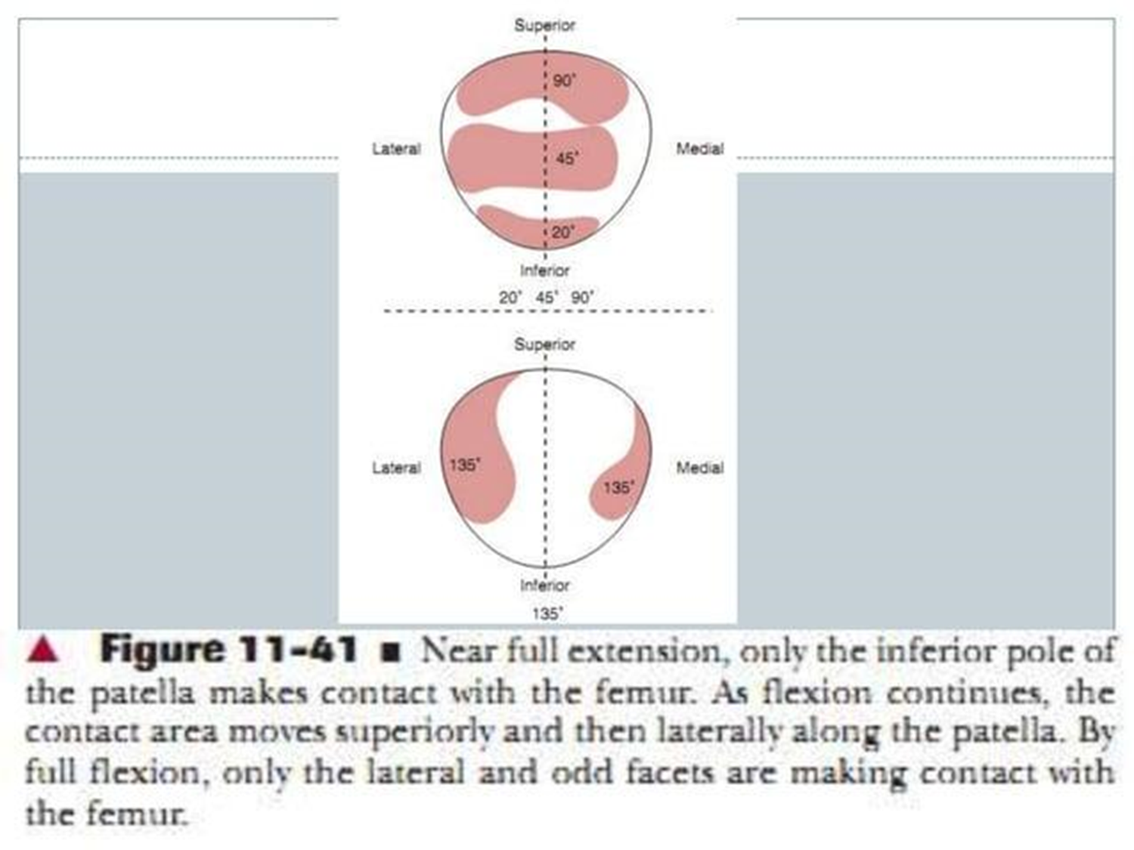

Slide 40
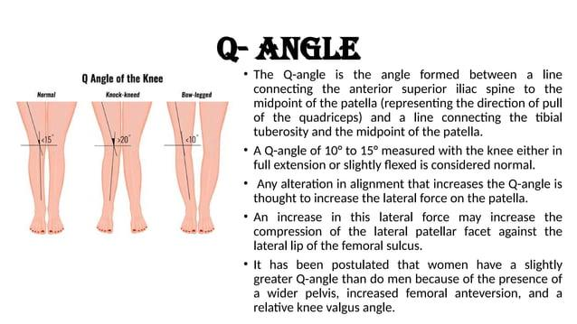

Slide 41
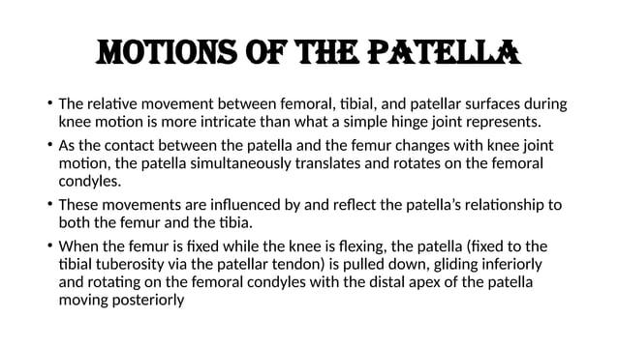

Slide 42
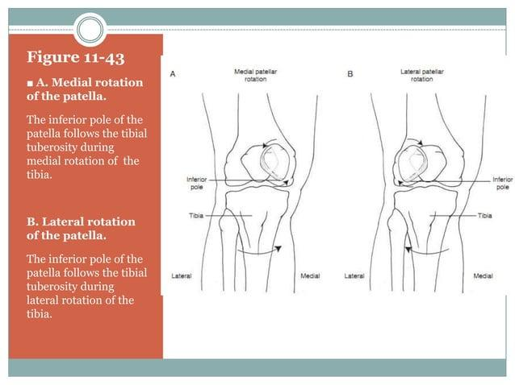

Slide 43
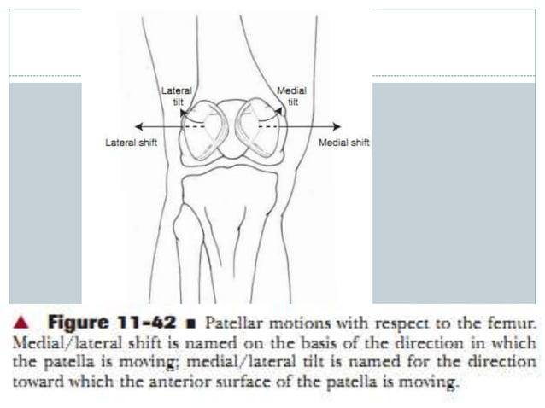

Slide 44
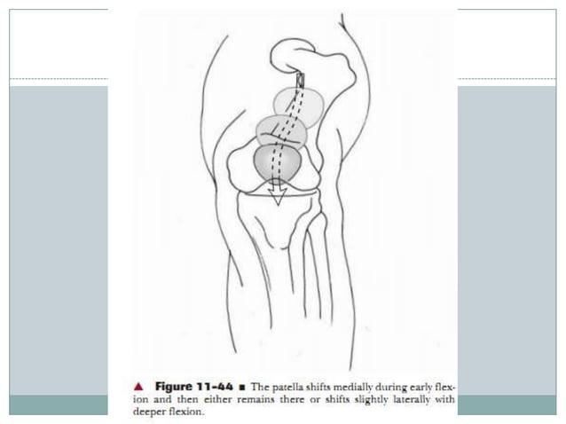

Slide 45
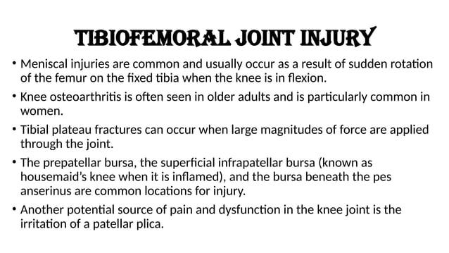

Slide 46
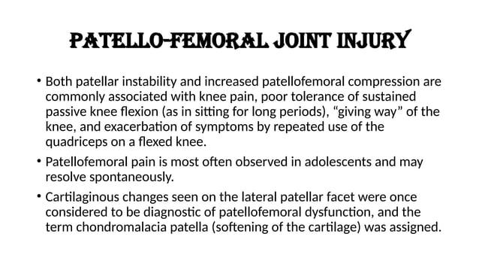

Slide 47
Acute Knee Injuries
LIGAMENT INJURIES
ACL
PCL
MCL
LCL
MENISCAL INJURIES

Slide 48
ACL TEAR
the tibia may rotate under the femur in an anterolateral direction, such as when a sportsperson attempts to land from a jump, pivot, or stop suddenly, in absence of which ligament:
1-pcltear
2-LCL tear
3-ACL tear
4-ACL, MCL tear
•The degree and time of onset of swelling can reflect either intra-articular or extra-articular injury and, thus, provide an important clue to the injured structure .lntra-articular swelling (e.g. hemarthrosis) is usually voluminous (obvious) and develops within one or two hours of the injury.

Slide 49
Graft Type | Advantages | Disadvantages
BPTB (Bone-Patellar Tendon-Bone) | Strong fixation, rapid bone healing | Anterior knee pain
Hamstring Tendon (Semitendinosus ± Gracilis) | Less anterior knee pain | Hamstring weakness
Quadriceps Tendon | Large graft size | Extensor mechanism discomfort
Allograft | No donor-site morbidity | Slower incorporation, higher failure in young athletes

Slide 50
FEMALE PREDISPOSITION TO ACL INJURY
Epidemiology
Female athletes have a 2.4–9.7 times higher risk of ACL injury compared with male athletes participating in similar sports.
Intrinsic Risk Factors
Smaller intercondylar notch width
Smaller ACL size
Generalized joint and ligamentous laxity
Hormonal influences
  Increased estrogen levels during the ovulatory and luteal phases of the menstrual cycle may increase ligament laxity and susceptibility to ACL injury.
Extrinsic Risk Factors
Altered lower-limb kinematics
  Increased dynamic knee valgus during landing and cutting activities.
Abnormal kinetics
  Greater ground reaction forces and knee loading patterns.
Muscle strength deficits
  Especially reduced hamstring strength relative to quadriceps strength.
Decreased muscle endurance
  Fatigue may impair neuromuscular control.
Altered muscle activation patterns
  Delayed or insufficient hamstring activation, reducing dynamic ACL protection.

Slide 51
females perform these tasks (e.g., landing) with increased dynamic knee valgus from femoral internal rotation, femoral adduction, and tibial external rotation
•Females utilize greater quadriceps activation relative to the hamstrings.
•hip musculature weakness

Slide 52
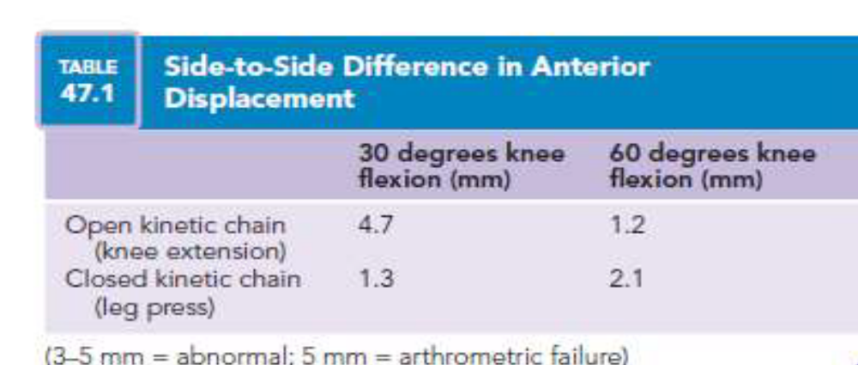
ACLR REHAB
•OKC V/S CKC
Perturbation training involves applying potentially destabilizing forces to the injured knee to enhance the neuromuscular awareness, neuromuscular response, and dynamic stability of the knee to stabilize the joint

Slide 53
CKC exercises are preferred in the early phase after ACL reconstruction.
OKC knee extension between 40°–0° produces maximum anterior tibial translation and ACL graft strain.
Modern ACL rehab uses a combination of CKC + OKC rather than CKC alone.

Slide 54
MCL TEAR
•Because the MCL is extra-articular,
•isolated MCL injuries seldom produce large
•intra-articular swelling.
•Injuries to the MCL are graded based on the amount of laxity to valgus stress testing:
• Grade I injury: no increase in medial joint line opening compared to the opposite knee at 30 degrees of knee flexion and tenderness along the ligament
• Grade II injury: more generalized tenderness with 5 to 10 mm of joint line opening on examination but a moderately firm endpoint
• Grade III injury: complete disruption of the ligament.
•To assess the integrity of the MCL and posteromedial capsule, valgus stress testing is done with the knee in full extension. Increased laxity with the knee in full extension suggests a severe injury of the MCL and the posteromedial capsule and a possible injury to one or both of the cruciate ligament

Slide 55
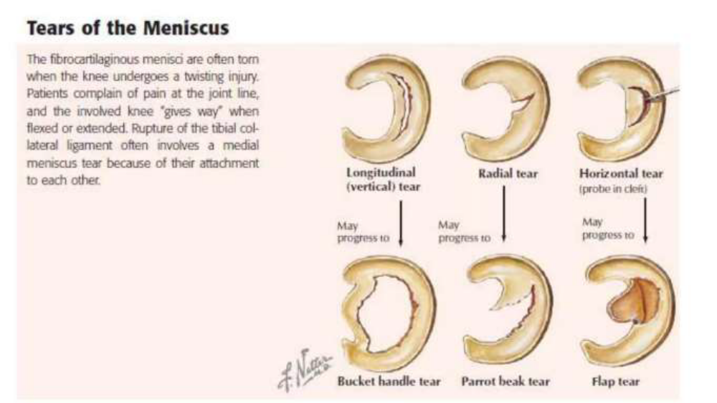
Meniscus Tears

Slide 56
MENISCAL INJURIES
Common Surgical Procedures
🔹 Meniscectomy
Partial or complete removal of the damaged meniscus.
Provides rapid symptom relief but reduces shock absorption.
🔹 Meniscal Repair
Suturing of the torn meniscus to preserve native tissue.
Preferred in vascular zones (red-red/red-white zones).
🔹 Meniscal Allograft Transplantation
Replacement with donor meniscus.
Considered in young, symptomatic patients after total/subtotal meniscectomy.
Note- Total meniscectomy decreases tibiofemoral contact area by approximately 50%, increasing joint stress and risk of early osteoarthritis.

Slide 57
Rehabilitation Considerations
Effect of Knee Flexion on Meniscus
0°–60° flexion: Minimal meniscal displacement.
>60° flexion: Menisci translate posteriorly, increasing stress on the healing repair site.
Precautions for Low-Healing-Potential Tears
(White-white tears, radial tears, complex tears)
✅ Limit knee flexion to ≤60° for the first 4 weeks
✅ Restrict weight bearing during the early healing phase
✅ Progress ROM and loading gradually to protect the repair

Slide 58
Meniscectomy vs Meniscal Repair (Early Rehabilitation)
Parameter | Meniscectomy | Meniscal Repair
Rehabilitation Goal | Rapid recovery | Protection of repair site
Weight Bearing | Usually delayed ~10–12 days (as per surgeon protocol) | Early protected weight bearing
ROM Progression | Faster | Restricted initially (≤60° flexion)
Return to Activity | Earlier | Slower due to biological healing
Note- Meniscectomy rehabilitation is generally faster, whereas meniscal repair rehabilitation prioritizes protection of the healing meniscus through restricted ROM and controlled loading.

Slide 59
Knee Special Tests
ACL Tests
• Lachman Test
• Anterior Drawer Test
• Pivot Shift Test
PCL Tests
• Posterior Drawer Test
• Posterior Sag Sign
MCL Tests
• Valgus Stress Test
LCL Tests
• Varus Stress Test
Meniscal Tests
• McMurray Test
• Apley Compression Test
• Thessaly Test
• Joint Line Tenderness +
Patellofemoral Tests
• Clarke’s Test (Patellar Grind Test)
• Patellar Compression Test
Iliotibial Band Tests
• Ober’s Test
Effusion Tests
• Patellar Tap Test
Highly accurate tests-
ACL → Lachman Test
PCL → Posterior Drawer Test
Meniscus → Thessaly Test
MCL → Valgus Stress Test
LCL → Varus Stress Test

Slide 60
OA
five of the nine criteria must be met for the diagnosis to be made:
•Age 50 years or older
• Morning stiffness lasting less than 30 minutes
• Crepitus with active motion
• Bony tenderness
• Bony enlargement
• No warmth to touch
•ESR <40 mm/hour,
•rheumatoid factor (RF) <1:40
•synovial fluid signs of OA.
according to severity:
minimal, no radiologic narrowing is seen; mild, loss of one third of the joint space; moderate, two thirds of the joint space is narrowed; and severe, evidence of bone-on-bone contact

Slide 61
TKR
What is TKR?
Total Knee Replacement (TKR) is a surgical procedure in which damaged articular surfaces are replaced with prosthetic components to reduce pain and improve function in end-stage knee osteoarthritis.
Risk Factors Leading to TKR
🔹 Advanced Knee Osteoarthritis
🔹 Increasing Age
🔹 Obesity
🔹 Previous Knee Trauma/Injury
🔹 Malalignment (Varus/Valgus Deformity)
🔹 Inflammatory Arthritis (e.g., Rheumatoid Arthritis)
Non-Operative Management Before TKR
💊 NSAIDs – Pain and inflammation control
💊 Glucosamine Sulphate – Symptomatic relief (variable evidence)
💉 Intra-articular Corticosteroid Injection – Short-term pain reduction
💉 Intra-articular Hyaluronic Acid Injection – Improves lubrication and joint function

Slide 62
TKR Implants and Rehab
Components of a TKR Prosthesis
Femoral Component
Cobalt-Chromium Alloy
Tibial Tray
Cobalt-Chromium Alloy or Titanium
Tibial Bearing Insert
UHMWPE (Ultra-High Molecular Weight Polyethylene)
Patellar Component
UHMWPE

Slide 63
Early TKR Rehabilitation
Immediate Post-Operative Goals
✔ Pain & Edema Control
✔ DVT Prevention
✔ Early Mobilization
✔ Restore ROM
Key Interventions
Limb Elevation for swelling reduction
Continuous Passive Motion (CPM)
  Begin early post-operatively
  Flexion progressed gradually
  Approximately 40° flexion by Day 4, then increased as tolerated
Quadriceps activation exercises
Gait training and functional mobility
MPT Exam Pearls
Most common bearing material = UHMWPE
Most commonly used femoral component material = Cobalt-Chromium Alloy
Early goals after TKR = Pain control, ROM restoration, DVT prevention, and early ambulation.

Slide 64
1 What is the primary goal of physiotherapy after a Total Knee Replacement?
•A. Pain management
•B. Rest and immobilization
•C. Early weight-bearing
•D. Strengthening the hip muscles
2 When should post-operative physiotherapy typically begin after a Total Knee Replacement?
•A. 1-2 weeks post-surgery
•B. 4-6 weeks post-surgery
•C. 3-4 months post-surgery
•D. Immediately after surgery
3 Which exercise is commonly prescribed to improve range of motion after TKR?
•A. Squats
•B. Leg press
•C. Calf raises
•D. Heel slides
8. During the acute phase of TKR rehabilitation, what is the main focus of physiotherapy?
•A. Building endurance
•B. Improving balance
•C. Pain control and swelling management
•D. Strengthening the core muscles

Slide 65
4. Which of the following is NOT a common complication addressed through physiotherapy after TKR?
•A. Joint stiffness
•B. Muscle weakness
•C. Infection
•D. Swelling
5 Which muscle group is essential to strengthen for improved stability and function after TKR?
•A. Biceps brachii
•B. Quadriceps
•C. Deltoids
•D. Triceps
6 How often should patients perform their physiotherapy exercises after a Total Knee Replacement?
•A. Once a week
•B. Three times a week
•C. Every day
•D. Once a month
7 Which of the following is a common weight-bearing progression order in TKR physiotherapy?
•A. Full weight-bearing from day one
•B. Partial weight-bearing with crutches
•C. Non-weight-bearing for three months
•D. Partial weight-bearing with walker

Slide 66
Answers
1 A. Pain management
2 D. Immediately after surgery
3 D. Heel slides
4 C. Infection
5 B. Quadriceps
6 C. Every day
7 B. Partial weight-bearing with crutches
8 C. Pain control and swelling management

Slide 67
THANKYOU

