Slide 1

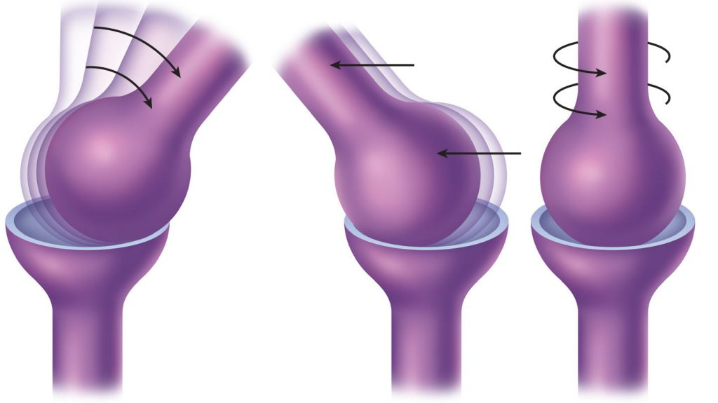
MOBILISATIONS
B.Maithili Dutta Pradhan
Sports Physio, Asst. Proff (SSU),
PhD Scholar

Slide 2
JOINT MOBILISATION
Joint mobilisation is defined as a continuum of skilled passive movements applied to joint and related soft tissues at varying speeds and amplitudes, with the aim of decreasing pain, restoring joint play, and optimising articular function.
Key distinction:
Mobilisation — performed within the patient's ability to stop the movement (Grades I–IV)
Manipulation (Grade V) — high-velocity, low-amplitude thrust beyond voluntary patient control; requires additional training

Slide 3
Foundations of Arthrokinematics & Joint Mechanics
Osteokinematics vs. Arthrokinematics
Osteokinematics: Refers to the gross, visible movement of bones in space during physiological activities (e.g., flexion, extension, abduction). These movements are under voluntary control.
Arthrokinematics: Refers to the microscopic, intrinsic movements occurring between the articular surfaces of a joint. These are involuntary accessory movements (also called joint play) that are essential for full, pain-free osteokinematics.

Slide 4
Articular Surface Movements
Roll: New points on one surface meet new points on the opposing surface. Rolling always occurs in the same direction as the osteokinematic bone movement, regardless of whether the moving surface is convex or concave.
Slide/Glide: The same point on one surface contacts new points on the opposing surface. The direction of a slide depends entirely on the geometry of the moving surface.
Spin: Pure rotation of a bone around a stationary mechanical axis (e.g., radial head rotation during pronation/supination).

Slide 5
The Convex-Concave Rule
Formulated by Freddy Kaltenborn based on MacConaill’s joint morphology, this rule determines the direction of the therapeutic glide:
Convex-on-Concave: Roll and glide occur in opposite directions.
Example:
Glenohumeral abduction
Humeral head rolls superiorly
Humeral head glides inferiorly

Slide 6
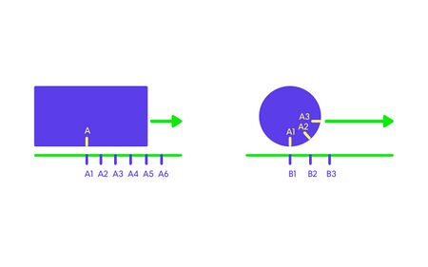
The Convex-Concave Rule
Concave-on-Convex: Roll and glide occur in same direction.
Example: Tibial movement on femur
In most joints, roll and glide occur simultaneously. The ratio is regulated by articular surface shape to prevent the convex surface from migrating out of the concave surface.

Slide 7
Joint Positions: Open-Packed vs. Close-Packed
Resting (Open-Packed or Loose-Packed) Position: The joint capsule and periarticular ligaments are maximally relaxed, providing the minimum congruency between articular surfaces. This position yields the maximum joint play and is the optimal starting position for evaluating joint mobility and administering initial, lower-grade mobilization techniques.
Close-Packed Position: Articular surfaces achieve maximum congruency, and the surrounding ligaments and capsule are tightly coiled and maximally taut. Joint play is virtually eliminated. This position is highly stable and should generally be avoided when performing joint mobilizations, as it increases the risk of structural microtrauma.

Slide 8
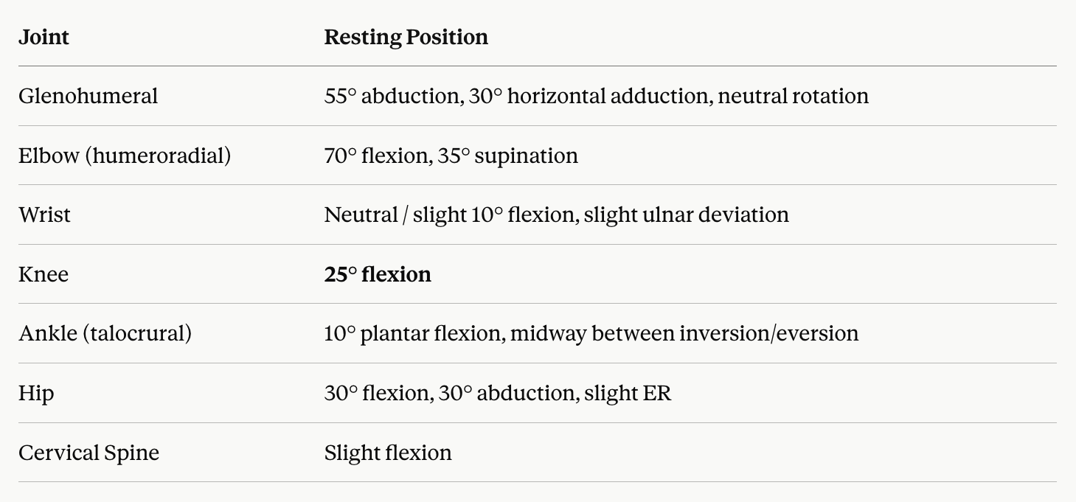

Slide 9
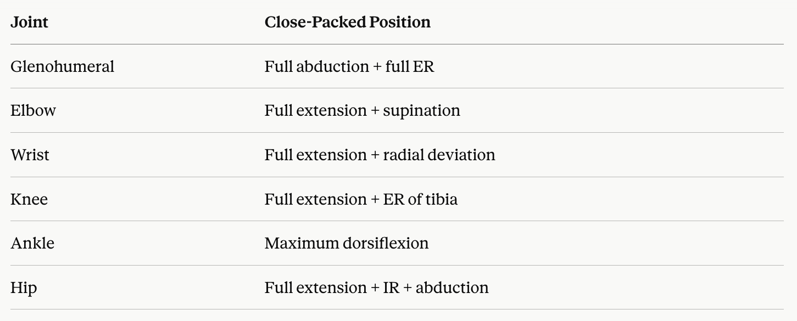

Slide 10
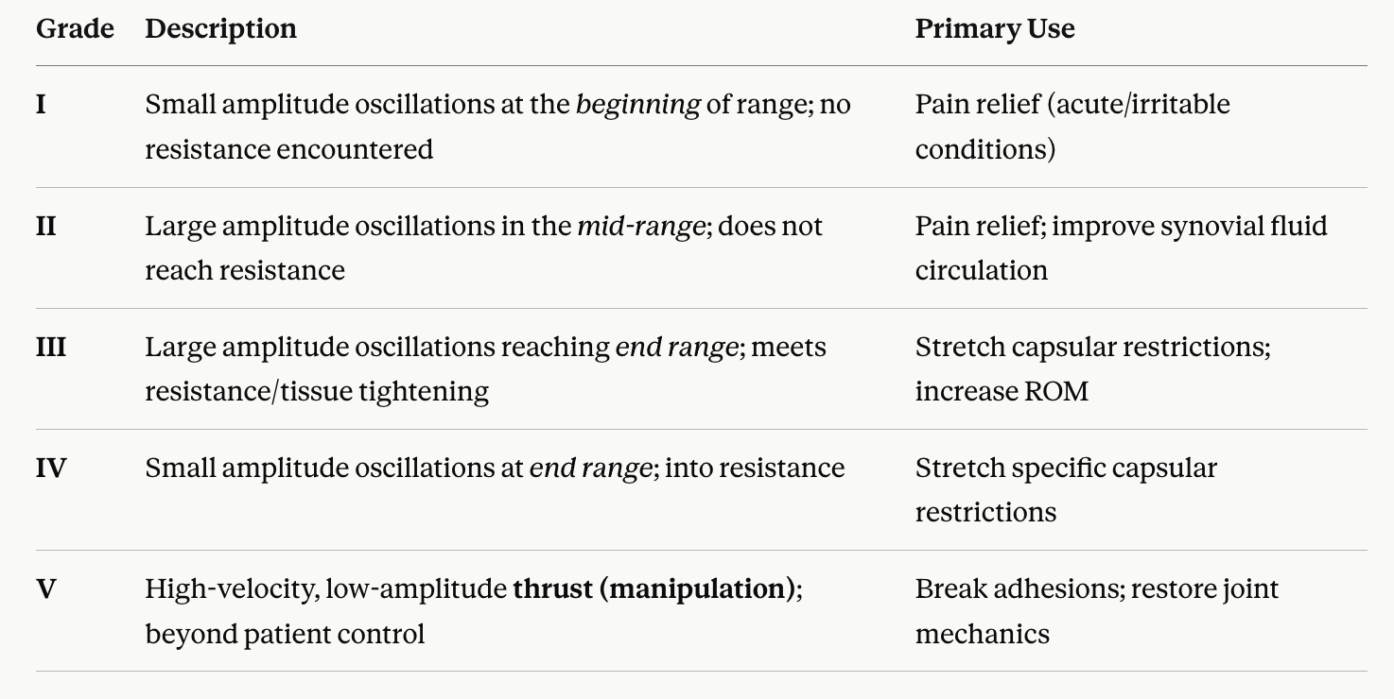
Maitland Concept

Slide 11
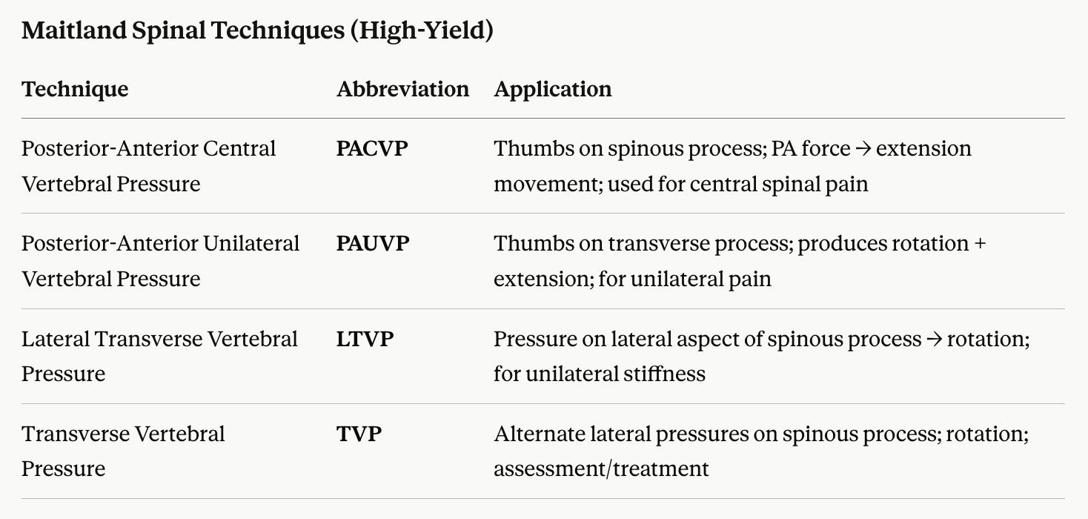

Slide 12
The Kaltenborn System (Freddy Kaltenborn)
Sustained vs. Oscillatory Stretch
Unlike Maitland’s rhythmic oscillations, Kaltenborn utilizes sustained static holds to stretch tight tissues, ensuring that viscoelastic creep occurs within the collagenous frameworks of the joint capsule.
Kaltenborn Traction Grading System
Grade I (Piccolo / Loosen): An extremely small amplitude traction force that produces no appreciable separation of the joint surfaces. It simply neutralizes the internal compressive forces (such as cohesive fluid forces and baseline muscle tone) acting on the joint. It is primarily used for pain relief during acute episodes.
Grade II (Tighten / Slack Zone): Takes up the slack in the surrounding periarticular tissues. The joint surfaces are separated, and the tissue transitions from a relaxed state to a point of initial resistance. This grade helps assess joint play, relieve pain, and ease muscle guarding.
Grade III (Stretch): An intense, sustained traction force applied past the transition zone to actively elongate shortened periarticular soft tissues. It is used to remediate joint hypomobility and capsular restrictions.

Slide 13
The Kaltenborn System (Freddy Kaltenborn)
The Treatment Plane (Kaltenborn)
The treatment plane lies in the concave articular surface, parallel to the joint surface and perpendicular to a line from the axis of rotation to the centre of the concave surface.
Glides → applied parallel to the treatment plane
Traction/Distraction → applied perpendicular to the treatment plane (i.e., along the joint axis)
Traction always pulls perpendicular to the concave surface, no matter the joint position.

Slide 14
The Mulligan Concept (Brian Mulligan)
Mulligan introduced a dynamic paradigm based on the concept of positional faults—subtle structural misalignments resulting from trauma, injury, or muscular imbalances that lead to pain and restricted movement.
Mobilization with Movement (MWM)
MWM combines a sustained, passive accessory glide applied by the clinician with concurrent, active physiological movement performed by the patient. A hallmark of the Mulligan concept is the PILL response:
P - Pain-free performance during the execution of the technique.
I - Immediate functional results.
LL - Long-Lasting therapeutic benefits.

Slide 15
The Mulligan Concept (Brian Mulligan)
Spinal Techniques: NAGs and SNAGs
NAGs (Natural Apophyseal Glides): Oscillatory, mid-to-end range accessory glides applied parallel to the facet joints of the mid-cervical to upper thoracic spine (C3–T3). They are performed passively while the patient remains seated in a resting position, making them ideal for irritable spinal conditions.
SNAGs (Sustained Natural Apophyseal Glides): A combination of a sustained passive accessory glide applied along the plane of the facet joints while the patient actively performs the restricted spinal movement.

Slide 16
The Cyriax Framework (James Cyriax)
Capsular Patterns of Restriction: Cyriax identified that inflammation of the joint capsule produces a predictable, proportional pattern of passive limitation unique to each joint. This is known as a capsular pattern.
Deep Friction Massage (DFM): DFM is a localized, therapeutic cross-friction technique applied directly to the site of soft tissue lesions (such as tendonitis, tenosynovitis, or ligamentous sprains). It must be performed transversely (perpendicularly) across the long axis of the target tissue fibers to break down irregular adhesions.

Slide 17
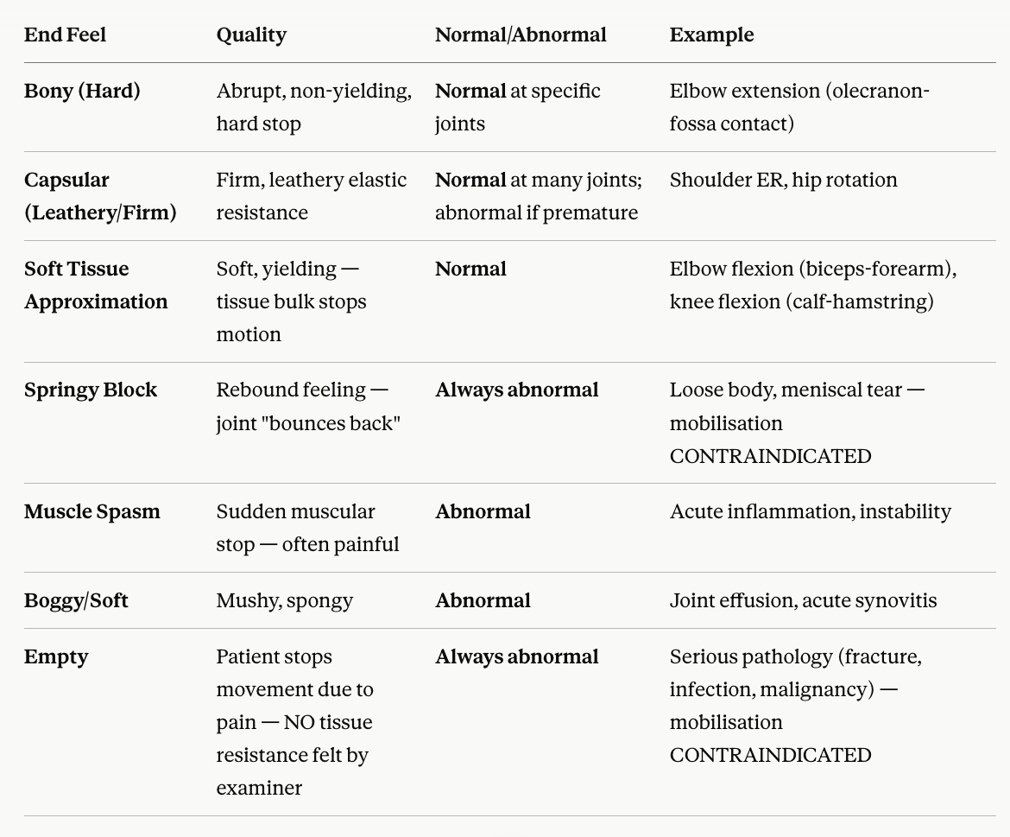

Slide 18
Mennell's Mobilization
James Cyriax Mennell (J.B. Mennell) was one of the pioneers of manual therapy and joint mobilization. His work preceded many modern concepts such as Maitland, Kaltenborn, and Mulligan. Mennell emphasized that pain and dysfunction often arise from loss of normal joint play, and that restoration of accessory movement is essential for normal physiological movement.
According to Mennell:
Physiological movement depends on normal accessory movement.
Restriction of accessory movement leads to dysfunction.
Restoration of accessory movement restores physiological movement.

Slide 19
Joint Play
Joint play refers to:
Small involuntary movements occurring between articular surfaces that are necessary for full physiological movement.
Examples:
Glenohumeral inferior glide during shoulder abduction
Tibial glide during knee flexion
Carpal glides during wrist motion
Without adequate joint play:
Pain may develop
ROM becomes restricted
Function decreases
This concept forms the basis of modern mobilization techniques.

Slide 20
Neurophysiological Mechanisms of Pain Modulation:
Low-grade manual therapy (Maitland Grades I/II; Kaltenborn Grade I) relieves pain primarily through neurophysiological mechanisms rather than mechanical stretching:
1. The Gate Control Theory: Stimulates low-threshold Type I and Type II mechanoreceptors, closing the gate at the spinal level.
2. Descending Inhibitory Pathways: Triggers the release of endogenous opioids to suppress pain.
3. Synovial Fluid Circulation: Enhances joint nutrition and clears irritating chemical mediators.

Slide 21
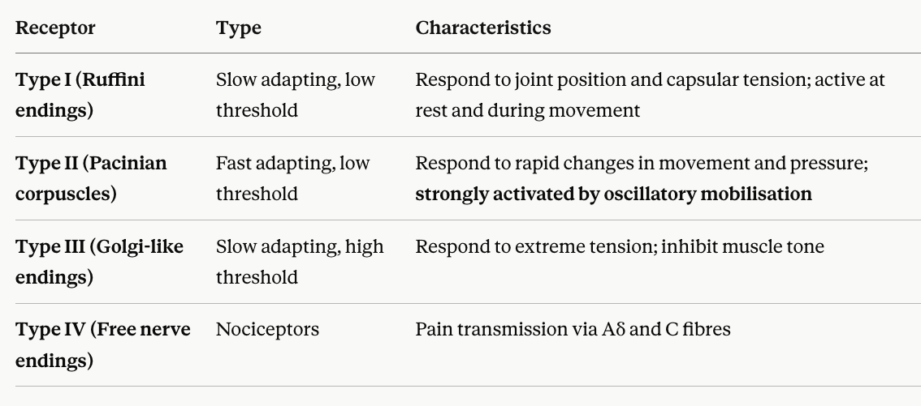
Mechanoreceptors of Joint:

Slide 22
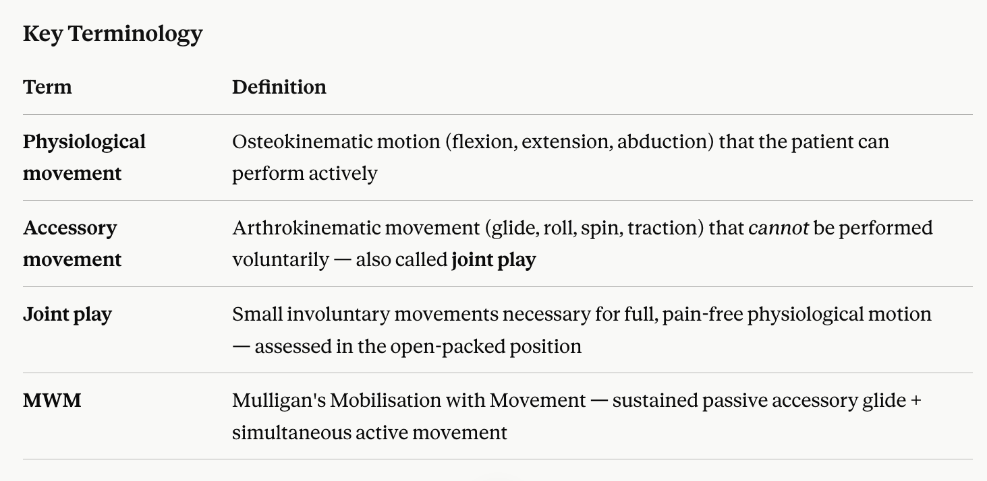

Slide 23
Informative Checklist:
Convex-on-Concave: Glide occurs opposite to bone movement.
Concave-on-Convex: Glide occurs in the same direction as bone movement.
Treatment Plane: Always sits parallel to the concave articular surface.
Maitland Grade I & II: Small/large amplitude in mid-range; used for pain relief.
Maitland Grade III & IV: Large/small amplitude at end-range; used for stretching.
Mulligan MWM: Combines sustained passive accessory glide with active movement; must be pain-free (PILL response).
Cyriax Capsular Pattern: Predictable proportional pattern of limitation unique to each joint (e.g., Shoulder: ER > ABD > IR).
Absolute Contraindication: Avoid mobilizing joints with an active intra-articular loose body.

Slide 24
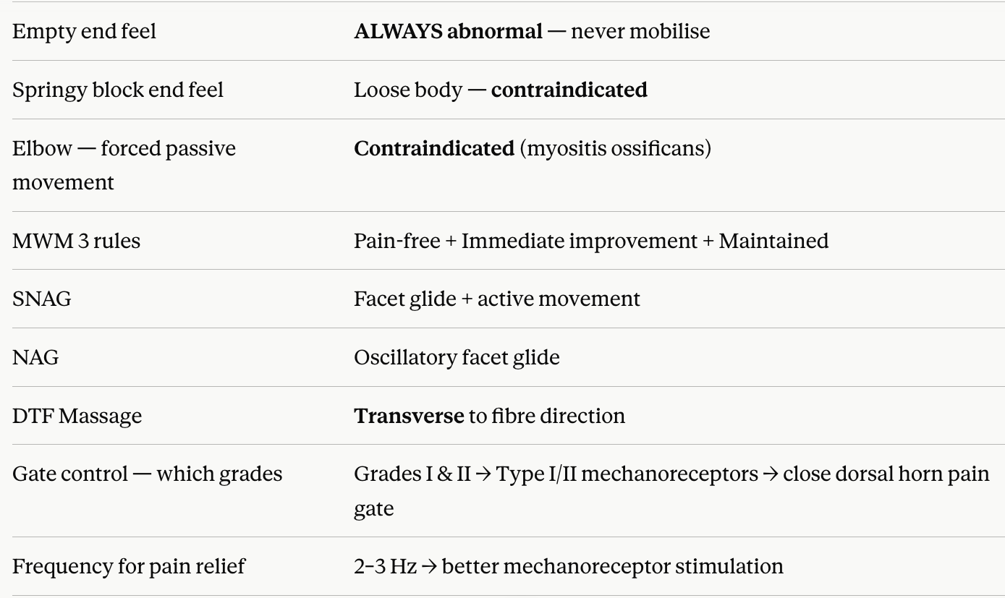
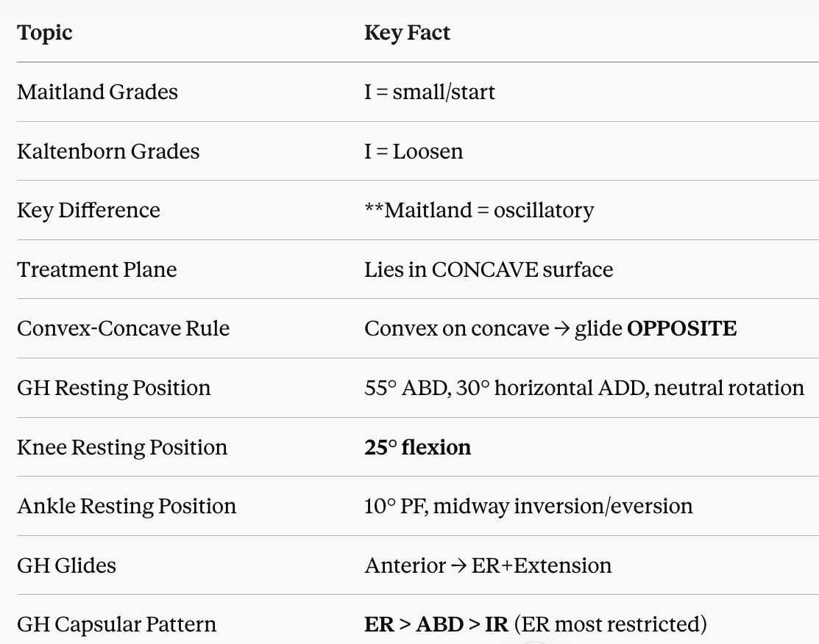

Slide 25
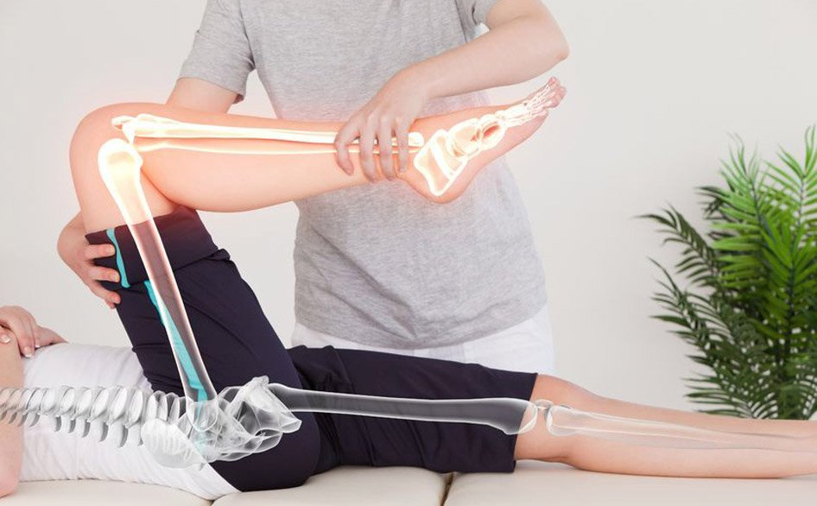
Thank You
&
All the Best

