Slide 1

Pulmonary function test
Presented by : Dr. Mayuri Maheshwari PT

Slide 2
PFT Includes
Lung volume studies
Spirometry
Flow volume loop (FVL)
Diffusion capacity
ABG analysis

Slide 3
Purpose of PFT
Evaluate the causes of pulmonary symptoms
Evaluate abnormalities seen on chest x-rays or CT scans
Follow the course of disease and response to treatment
Rue out significant pulmonary pathology in people with high risk for pulmonary dysfunction

Slide 4
Factors affecting the results
Height
Weight
Gender
Age
Race

Slide 5
Pulmonary function laboratory equipment
Spirometer
Body plethysmograph
Diffusion system
Gas analysis
Nebulizer equipment
ABG analyzer
Treadmill / bicycle for exercise evaluation

Slide 6
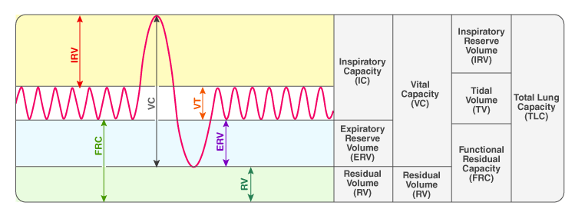
Lung volumes and capacities
Tested by spirometer / body plethysmograph

Slide 7
Lung volumes
Tidal volume (V_{T}) – air inhaled or exhaled during normal, quiet respiration.
  normal value – 350 – 600 ml.
  It is unconsciously adjusted by most people to maintain adequate minute ventilation
Inspiratory reserve volume (IRV) – amount of air that can be forcefully inhaled after normal inspiration.
  Normal value – 3.3 litre

Slide 8
Expiratory reserve volume (ERV) - amount of air that can be forcefully exhaled after normal expiration.
  Normal value – 1 liter
Residual volume (RV) - air remaining in lungs after forceful expiration.
  Normal value – 1.2 liter

Slide 9
Lung capacities
Vital capacity (VC) – maximum amount of air that a person ca exhale after maximal inspiration.
  Slow vital capacity (SVC)
  Forced vital capacity (FVC)
  Normal value – 4500 ml
Inspiratory capacity (IC) - amount of air that a person can take in maximal inspiratory effort after normal expiration.
Normal value – 3500 ml

Slide 10
Functional residual capacity (FRC) - amount of air that remains in lungs after normal expiration.
  Normal value – 2500 ml
  Which two volumes adds up to make FRC ?
Total lung capacity (TLC) - amount of air present in lungs after maximal inspiration.
  Normal value – 6000 ml

Slide 11
SPIROMETRY
PFT that measures volume and speed of air that a person can inhale or exhale, as well as the ease of breathing.
Indications
  Cough
  Wheezing
  Shortness of breath
  Before surgery
  To check the effectiveness of the treatment/progression of disease.

Slide 12
Normal spirogram

Slide 13
American Thoracic Society (ATS) quality criteria
good inspiration
rapid start
no cough
expiration for at least six seconds
repeatability within acceptable limits.

Slide 14
Total lung capacity
TLC= ?
Can be obtained by
  Body plethysmography
  Open circuit nitrogen washout method
  Closed circuit helium dilution
  X-ray planimetry
Out of these body plethysmography is the most accurate method

Slide 15
Body plethysmography
Works on boyle's law
V₁ = V₂ * P₂ / P₁
V₁ = volume of gas in lungs
V₂ = body box gas volume
P₁ = Gas pressure of lungs
P₂ = Gas pressure of the box

Slide 16
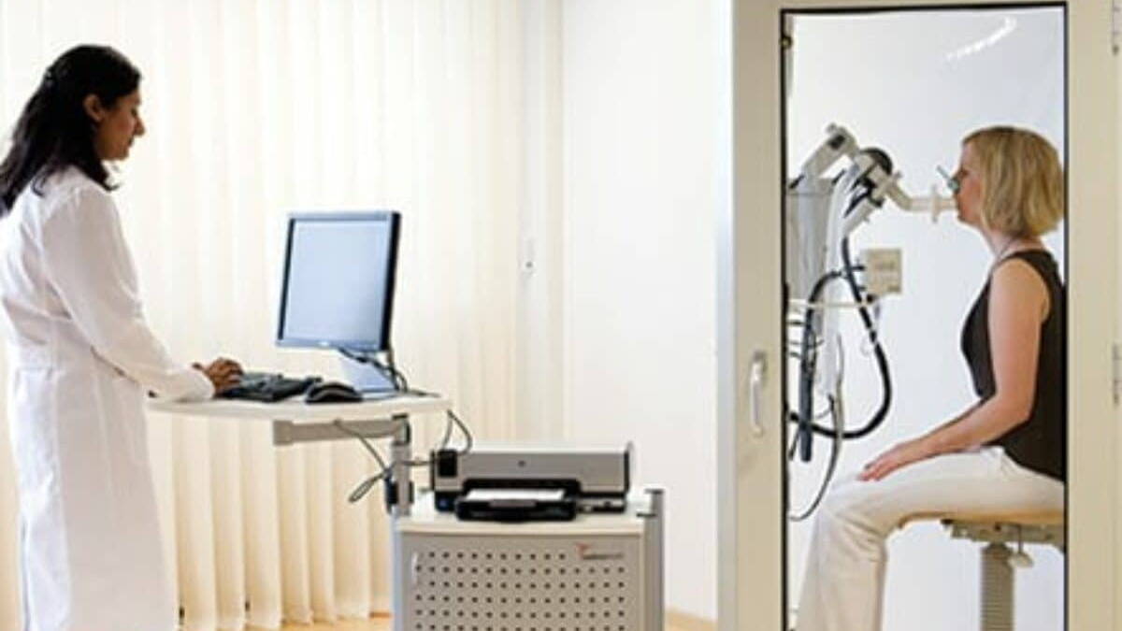

Slide 17
Open circuit nitrogen washout method
Patient breathe 100% oxygen for 7 minutes while a PFT technician measures the exhaled nitrogen.
It depends on the fac that air is 79 % nitrogen.
So, the amount of nitrogen exhaled is equal to 79% of the total lung volume.
The test ignores air trapped in the lungs because, it would not be exhaled.
Thus, this test gives inaccurate conditions with significant air trapping

Slide 18
Closed circuit helium dilution method
Helium is used because it is an inert gas and is not significantly absorbed by lungs.
FRC = (initial helium – final helium)*V*BTPS / Final helium
  V = volume in the spirometer
  BTPS = values at body temperature and pressure standardized
Principle – if a known volume and concentration of helium is added to the patient's respiratory system, the helium will be diluted in proportion to the size of lung volume.

Slide 19
X-ray planimetry
Least used method
PA and lateral x-ray are used
TLC is calculated by measuring the inside of the chest wall ( to determine total intrathoracic volume ), then measuring the outside of the heart and great vessels ( to determine the intrathoracic tissue volume ).
TLC = total intrathoracic volume – intrathoracic tissue volume

Slide 20
Indices of flow
Flows routinely identified are
  FEV1
  FEV3
  Forced expiratory flow, mid expiratory phase FEF _{(25%-75%)}
  Peak expiratory flow (PEF)

Slide 21
Forced expiratory volume at 1 second
It measures maximal volume of air exhaled during the first second of expiration.
It varies with age, gender, race and height of the patient.
Normal value – 80% to 100% of the predicted value.
Reduced in both, obstructive lung diseases as well as restrictive lung diseases.

Slide 22
Differentiation between restrictive and obstructive lung disease
Facilitated by calculation ratio of FEV1 to FVC.
Normal – 0.75
The ratio is normal in restrictive lung diseases and reduced in obstructive lung diseases.

Slide 23
Forced expiratory volume at 3 seconds
It is the volume exhaled in the first three seconds of expiration.
Not as reproducible as the FEV₁
Has limited clinical relevance in routine studies

Slide 24
Forced expiratory flow
Measures the average flow rate during the middle half of the expiratory curve.
Normal range is 65% to 100% of the predicted value.
More sensitive to airway obstruction than the FEV₁.

Slide 25
Peak expiratory flow rate (PEFR)
It is the maximum flow rate achieved by the patient during the FVC maneuver.
Can be measured by spirogram as well as peak flow meter.
Commonly used by asthmatics to evaluate severity of bronchospasm and response to the treatment.

Slide 26
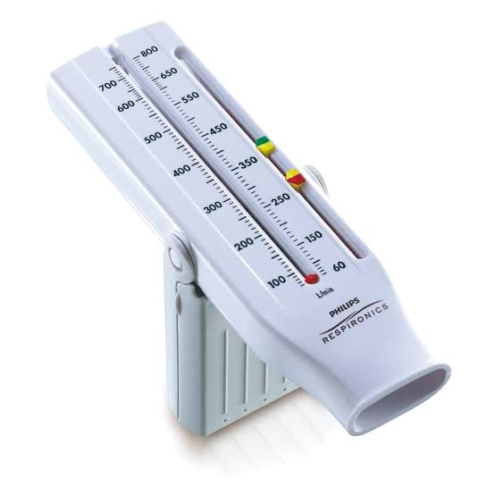

Slide 27
Flow volume loops
Presented with volume plotted on the horizontal axis and flow on the vertical axis.
Inspiratory loop is shown below the horizontal line and expiratory is shown above.
There are distinctive pattern for obstructive diseases and restrictive diseases.
PFT reports generally show a post bronchodialator FVL superimposed on a pre bronchodilator curve.

Slide 28
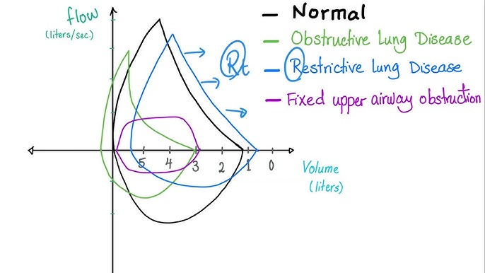

Slide 29
PFT before and after bronchodilator administration
The amount of change required to qualify as improvement
  FVC – increase greater than 10%
  FEV₁ – increase of 200 ml or 15 % over base line FEV ₁
  FEF _{25% -75%} - 20% to 30% increase

Slide 30
Diffusion capacity
Ability of gas to diffuse across the alveolar-capillary membrane can be measured and is known as the diffusion capacity.
Determinants of gas exchange
  Diffusion coefficient of the gas used in testing
  Surface area of the membrane
  Thickness of the membrane
  Hb and blood flow in the pulmonary capillaries
  Distribution of the inspired gas ( matching of ventilation to perfusion)

Slide 31
Diffusion is commonly measured by having the patient inhale a single breath (SB) of gas containing 0.4% of carbon monoxide (CO).
The designation of test is D_{LCO-SB}
CO is mixed with an insoluble tracer as (usually helium).
Patient inhales and holds his/her breath for 10 seconds. CO's rate of removal from this closed system is an indication of effective alveolar-capillary surface area.
Normal range is 80% to 120% of the predicted range.

Slide 32
Disease | DLCO
Emphysema | ↓
Pulmonary fibrosis | ↓
Pulmonary embolism | ↓
Asthma | Usually normal or ↑
Polycythemia | ↑

Slide 33
Airway resistance
Narrowing of airways in obstructive pulmonary diseases cause airflow resistance to increase.
It indicates the severity of the disease and effect of therapy.
Plethysmograph is used to measure airway resistance
Normal range is 80% to 120% of predicted value.

Slide 34
Parameter | Obstructive | Restrictive
FEV₁ | ↓↓↓ | ↓
FVC | ↓ | ↓↓↓
FEV₁/FVC | ↓ | Normal/↑
TLC | ↑/Normal | ↓
RV | ↑ | ↓/Normal
DLCO | ↓ in emphysema | ↓ in ILD

Slide 35
Case studies

Slide 36
Case study 1
70 years old man comes with chief complaint of severe dyspnea on exertion. He has severe kyphoscoliosis since his teenage years. No history of cough, sputum production, smoking, working in a polluted environment or any respiratory disease.

Slide 37
Spirometry Report | Predicted | Observed
+FVC | 3.78 | 1.46
SVC | 3.78 | 1.42
FEV1 | 2.57 | 1.40
FEV1/FVC | 70% | 96%
FEF 25%-75% | 2.46 | 2.01

Slide 38
Spirometry Report | Predicted | Observed
VC | 3.78 | 1.79
FRC | 2.42 | 2.01
RV | 1.75 | 1.86
TLC | 5.78 | 3.65
RV/TLC | 30% | 51%

Slide 39
Case study 2
38 years old man with a chronic complaint of dyspnea on exertion. His dyspnea has increased over the past year and now occur with minimal exertion. There is history of cough and sputum production. He has a 40 pack year smoking history. Family history positive for COPD. Physical examination shows large anteroposterior diameter of chest and decreased lung sounds during respiration.

Slide 40
Spirometry Report | Predicted | Observed
+FVC | 6.06 | 3.39
SVC | 6.06 | 4.49
FEV1 | 4.52 | 0.95
FEV1/FVC | 75% | 28%
FEF 25%-75% | 4.39 | 0.34

Slide 41
Spirometry Report | Predicted | Observed
VC | 6.06 | 4.88
FRC | 3.24 | 9.75
RV | 1.86 | 7.92
TLC | 7.75 | 12.80
RV/TLC | 24% | 61.90%

Slide 42
How PFT findings impact physiotherapy approach
Finding | Physiotherapy implication
Obstructive pattern | Breathing retraining, airway clearance, pulmonary rehabilitation
Restrictive pattern | Thoracic expansion exercises, inspiratory muscle training (where appropriate), exercise conditioning
Hyperinflation | Pursed-lip breathing, breathing control, energy conservation
Bronchodilator responsiveness | Reassess exercise tolerance after medication
Reduced DLCO | Monitor oxygen saturation during exercise and adjust intensity accordingly

