Slide 1
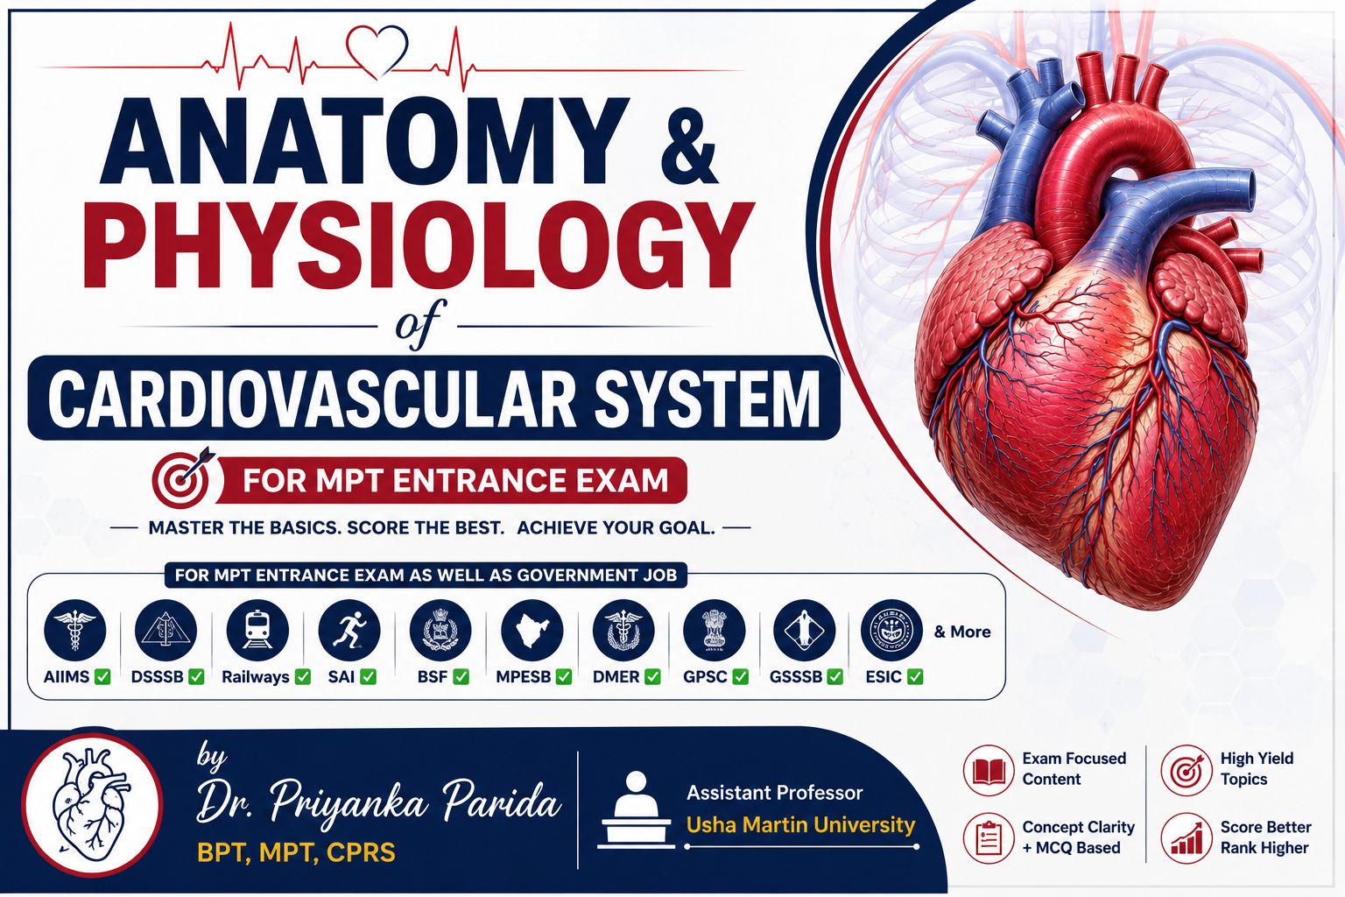


Slide 2
CONTENTS
Heart Anatomy (chambers, valves, layers)
Coronary circulation
Conduction system
Circulation (Systemic & Pulmonary)
Cardiac cycle
ECG
Exercise Physiology
Cardiac Rehabilitation

Slide 3
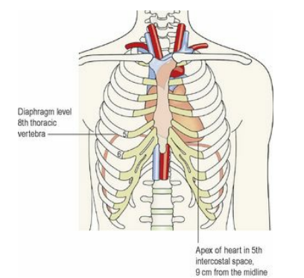
HEART
Heart is a hollow, cone-shaped muscular organ.
Size: It is about 10 cm long and is about the size of the owner’s fist.
Weight: It weighs about 225 g in women and is heavier in men (about 310 g).
Location: The heart lies in the thoracic cavity in the mediastinum (the space between the lungs). It lies obliquely, a little more to the left than the right, and presents a base above, and an apex below. The apex is about 9 cm to the left of the midline at the level of the 5th intercostal space, i.e. a little below the nipple and slightly nearer the midline. The base extends to the level of the 2nd rib.

Slide 4
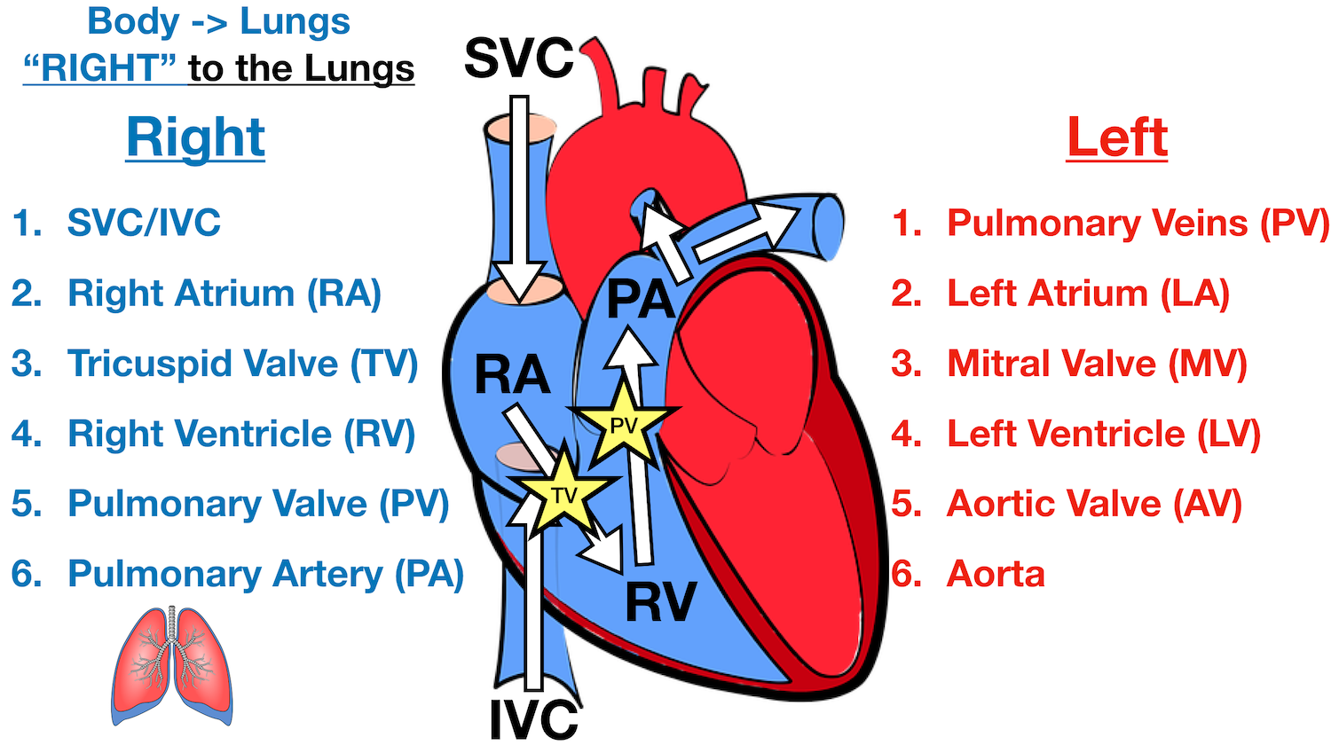
CHAMBERS OF HEART
The heart is divided into right and left halves by an obliquely placed longitudinal septum.
Each half has two chambers-
1)The atrium-which receives blood from veins, and
2)The ventricles-which eject blood into the arteries
LV is the thickest chamber (It works hardest and pumps blood to the entire body)

Slide 5
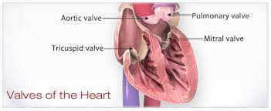
VALVES OF THE HEART
There are four valves in the human heart.
Two valves are in between the atria and the ventricles called atrioventricular valves; left is known as mitral valve or bicuspid valve and right side is called tricuspid valve.
The other two are the semilunar valves, placed at the opening of blood vessels arising from ventricles, namely the aorta valve and pulmonary valve.

Slide 6
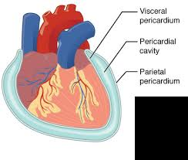
PERICARDIUM
Pericardium is the outer covering of the heart.
It is made up of two layers:
i. Outer parietal pericardium
ii. Inner visceral pericardium.
The space between the two layers is called the pericardial cavity or pericardial space and it contains a thin film of fluid.
Outer sac consists of: fibrous tissue
Inner sac consists of: continues double layer of serous membrane
Notes:
Pericardial Effusion
Excess fluid in pericardial cavity.
May cause:
Cardiac tamponade
Reduced cardiac output

Slide 7
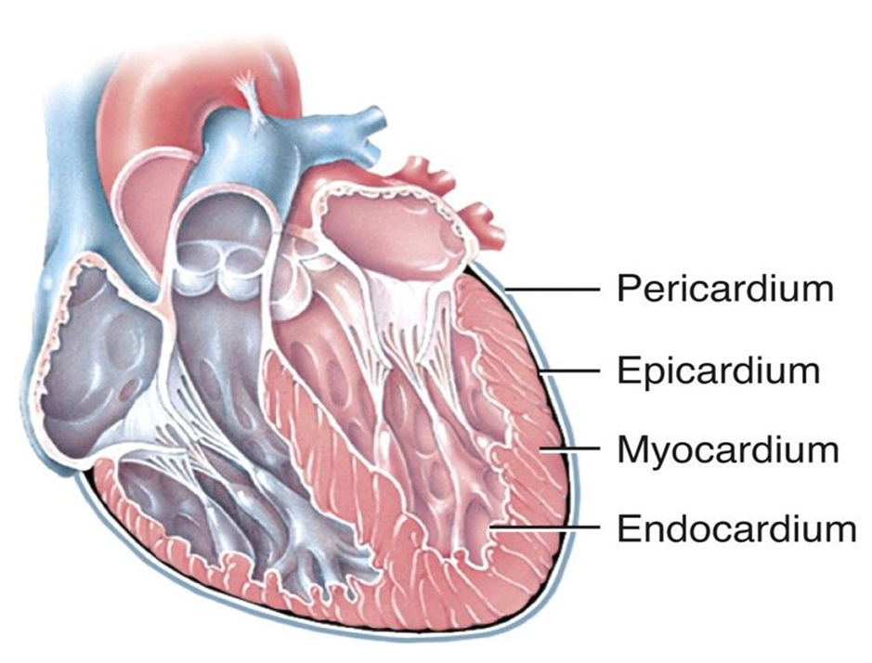
LAYERS OF HEART
The heart is made up of three layers.
1)Epicardium
2)myocardium
2)Endocardium

Slide 8
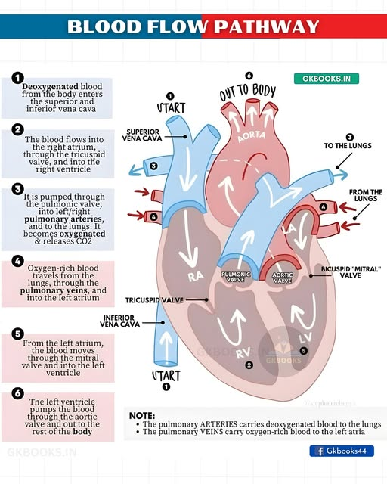

Slide 9
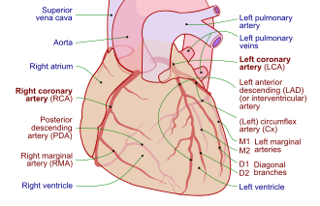
CORONARY CIRCULATION
Coronary circulation is the dedicated network of blood vessels that supplies oxygenated blood to the heart muscle (myocardium) and removes deoxygenated blood.
THE PATHWAY OF BLOOD:
The right and left coronary arteries branch off directly from the base of the aorta.
Left Coronary Artery: Branches into the circumflex artery and the left anterior descending (LAD) artery (Widow maker) , supplying the left atrium and left ventricle.
Right Coronary Artery: Supplies the right atrium, right ventricle, and crucial conduction nodes (SA and AV nodes)
CLINICAL RELEVANCE:
When coronary circulation is restricted—usually due to atherosclerosis —it causes myocardial ischemia. This can lead to conditions like angina pectoris or a myocardial infarction.
Notes:
LAD supplies:
Anterior wall of LV
Interventricular septum
Called:
"Widow Maker"
because blockage causes major MI.

Slide 10
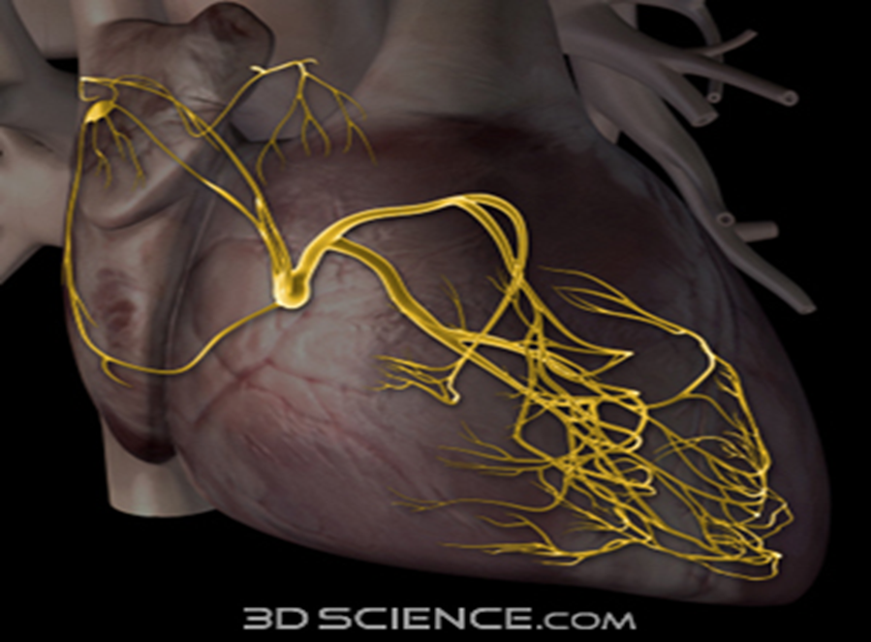
CONDUCTING SYSTEM OF HEART
A network of specialized muscle cells is found in the heart's walls. These muscle cells send signals to the rest of the heart muscle causing a contraction. This group of muscle cells is called the cardiac conduction system.
Normal heart rate-70-90per minute
The main parts of the system are the SA node, AV node, bundle of HIS, bundle branches, and Purkinje fibers

Slide 11
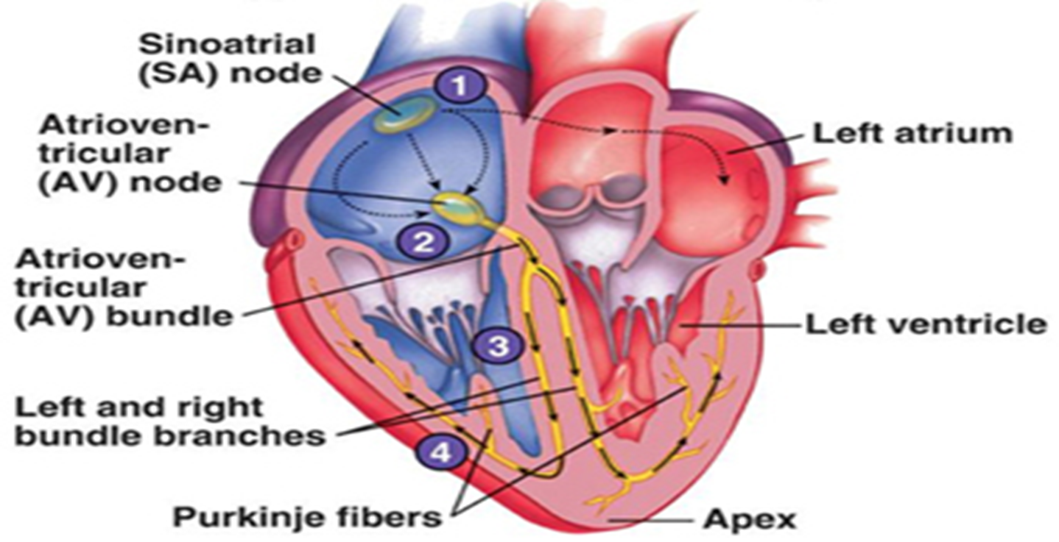
THE WIRING DIAGRAM OF THE HEART

Slide 12
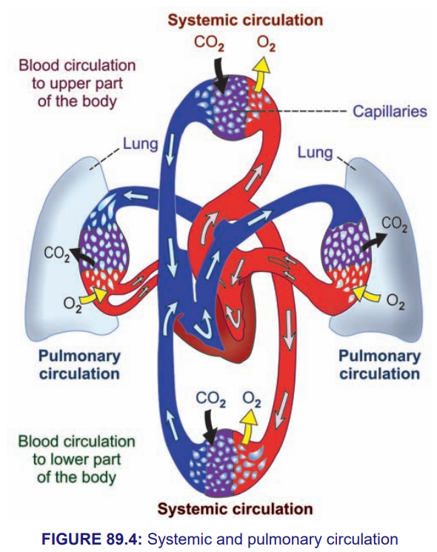
DIVISIONS OF CIRCULATION
Blood flows through two divisions of circulatory system:
1. Systemic circulation(greater circulation)
2. Pulmonary circulation(lesser circulation)

Slide 13
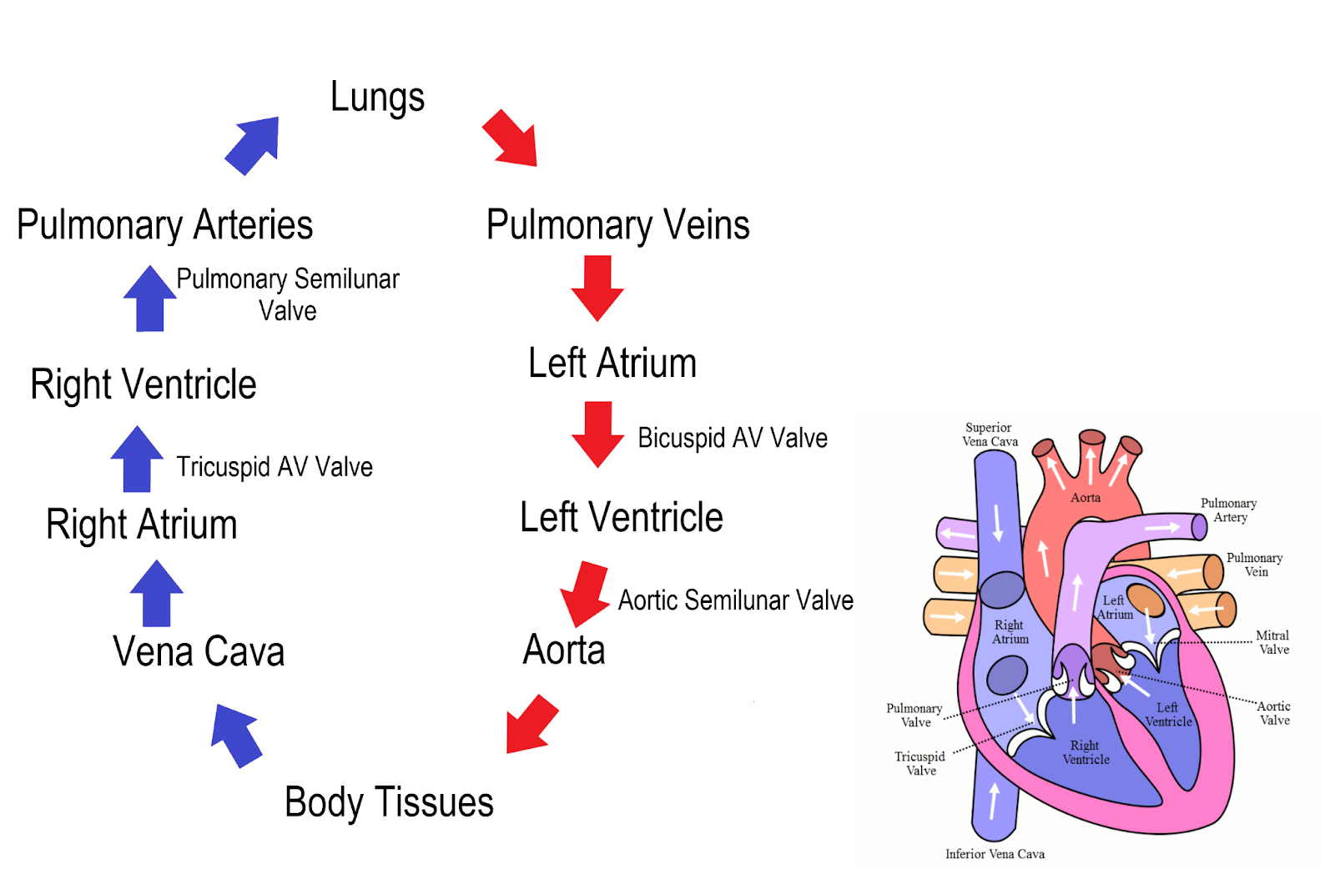
FLOW DIAGRAM OF CIRCULATION

Slide 14
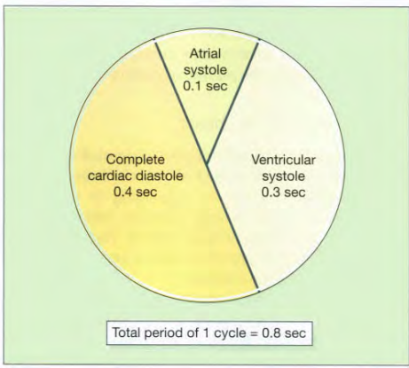
CARDIAC CYCLE
The function of the heart is to maintain a constant circulation of blood throughout the body.
The heart acts as a pump and its action consists of a series of events known as the cardiac cycle.
During each heartbeat, or cardiac cycle, the heart contracts and then relaxes.
The period of contraction is called systole and that of relaxation, diastole.

Slide 15
ATRIAL SYSTOLE
Atria contract
AV valves open
Semilunar valves closed
Final 20–30% ventricular filling
Result in End-Diastolic Volume (EDV)

Slide 16
VENTRICULAR SYSTOLE
Isovolumetric Contraction
Ventricles begin contraction
Mitral & Tricuspid valves close (S1 sound “LUB”)
Semilunar valves remain closed
All valves closed
Result in ⬆ Ventricular Pressure,➡ Volume unchanged
Ventricular Ejection
Ventricular pressure exceeds arterial pressure
Aortic valve opens
Pulmonary valve opens
Blood ejected (Rapid ejection: 70% blood, Slow ejection: 30% blood) [Stroke volume ejected]

Slide 17
VENTRICULAR DIASTOLE
Isovolumetric Relaxation
Ventricles relax
Semilunar valves close (S2 sound produced “DUB”)
AV valves still closed
All valves closed
Result in ⬇ Ventricular Pressure,➡ Volume unchanged
Rapid Ventricular Filling
AV valves open
Blood rapidly enters ventricles
Ventricular filling occurs
Sometimes S3 sound heard

Slide 18
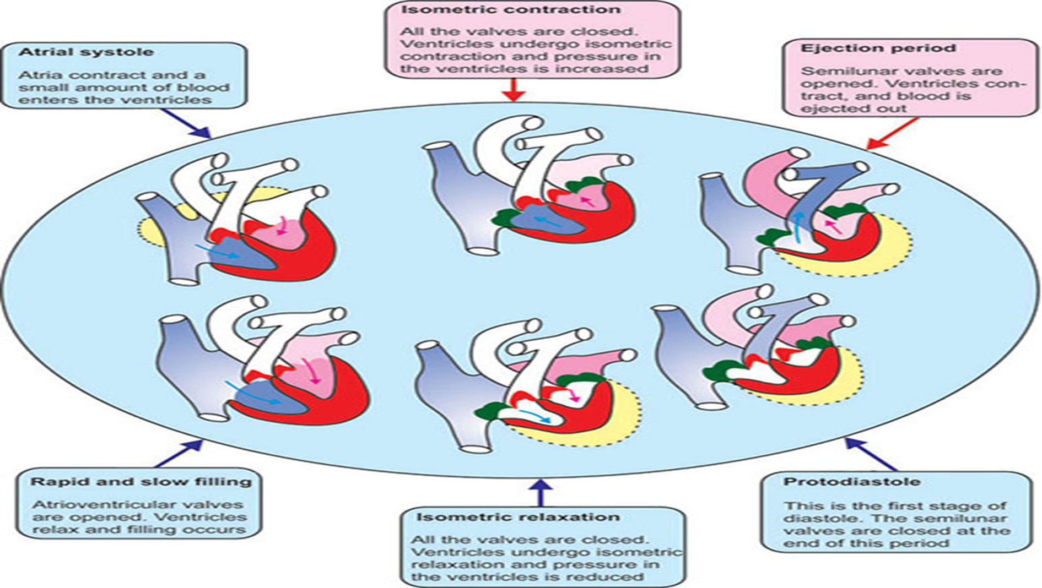
Reduced Filling (Diastasis)
Slow ventricular filling
Atria & ventricles relaxed
Longest phase during rest
Result in Preparation for next atrial systole

Slide 19
VALVE EVENTS TABLE
Phase | AV Valves | Semilunar Valves
Atrial Systole | Open | Closed
Isovolumetric Contraction | Closed | Closed
Ejection | Closed | Open
Isovolumetric Relaxation | Closed | Closed
Filling | Open | Closed

Slide 20
HEART SOUNDS
S1 S2 S3 S4
S1=AV closure
S2=Semilunar closure
S3=Rapid filling
S4=Atrial contraction
CARDIAC OUTPUT
CO = HR × SV
HR= Heart Rate
SV= It is the amount of blood ejected by one ventricle during a single heartbeat.
CO Normal:
≈ 5 L/min

Slide 21
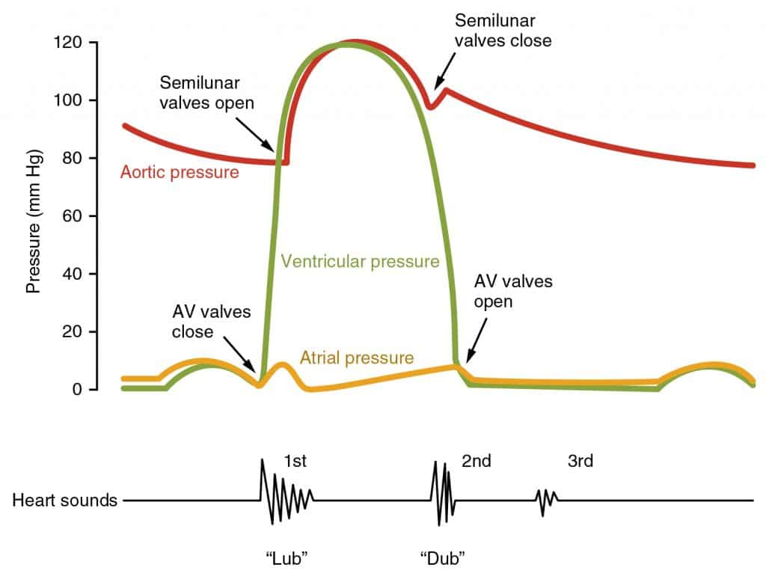
VOLUME CHANGES
End Diastolic Volume (EDV) (blood in ventricle before contraction)
End Systolic Volume (ESV) (blood remaining after contraction)
Stroke Volume (SV= EDV – ESV)
EJECTION FRACTION
Ejection Fraction (EF) is the percentage of blood in the ventricle at the end of diastole that is pumped out during systole.
EF = SV/EDV ×100
Normal 55–70%

Slide 22
PRE LOAD
Definition
Initial stretch of ventricular muscle fibers before contraction.
Clinically Related To
Venous return
End-diastolic volume
Preload ↑ → Stroke volume ↑

Slide 23
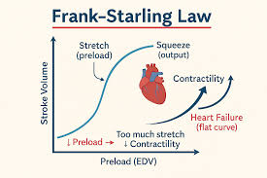
FRANK-STERLING MECHANISM
The force of contraction of the heart muscle is directly proportional to the initial length of the cardiac muscle fibers (preload).
Stroke Volume ∝ End-Diastolic Volume
More filling
→ More stretch
→ Stronger contraction
→ Greater stroke volume

Slide 24
AFTER LOAD
Definition
Afterload is the resistance or pressure that the ventricles must overcome to eject blood during systole.
Determined By :
Aortic pressure
Systemic vascular resistance
Increased afterload causes:
↓ Stroke volume

Slide 25
PRESSURE BASICS
SBP and DBP
Pulse Pressure = SBP – DBP
Mean Arterial Pressure = DBP + 1/3(PP)

Slide 26
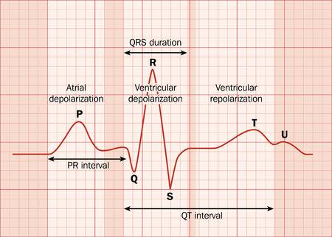
ELECTROCARDIOGRAM (ECG)

Slide 27
Pathology
Atrial fibrillation-P wave is absent, Irregular rhythm
Atrial flutter-flutter waves in P waves
Ventricular tachycardia-P wave absent , QRS duration is wide(>0.12sec),regular QRS wave present, Fast rhythm
Ventricular fibrillation-no HR, no P wave, death line
Mitral valve disease-P wave is bifid(m type)
Myocardial infarction-ST segment elevate
Angina(ischemia)-ST segment depression
Heart block- P waves & QRS are not related

Slide 28
EXERCISE PHYSIOLOGY
Exercise Physiology is the branch of physiology that studies how the body responds and adapts to physical activity and exercise.
Acute Cardiovascular Responses to Exercise
During Dynamic Exercise
↑ Heart Rate
↑ Stroke Volume
↑ Cardiac Output
↑ Systolic BP
↑ Coronary Blood Flow
↑ Venous Return
↓ Total Peripheral Resistance

Slide 29
RESPONSE TO EXERCISE
Heart Rate Response:
Resting HR: 60–100 bpm
During Exercise
Increases linearly with intensity
Due to sympathetic stimulation (β1 receptors)
Stroke Volume Response:
Stroke Volume Increases Due To:
Increased venous return
Frank-Starling mechanism
Increased contractility

Slide 30
Cardiac Output
Rest:
≈ 5 L/min
Maximal Exercise:
15–25 L/min
Elite Athletes:
30–40 L/min
BLOOD PRESSURE RESPONSE DURING DYNAMIC EXERCISE:-
Parameter | Change
Systolic BP | ↑
Diastolic BP | ↔ or slight ↓
Pulse Pressure | ↑

Slide 31
Chronic Adaptations to Training:
Cardiovascular Adaptations
↑ Stroke Volume
↓ Resting Heart Rate
↑ Vagal Tone
↑ Cardiac Efficiency
↑ VO₂max

Slide 32
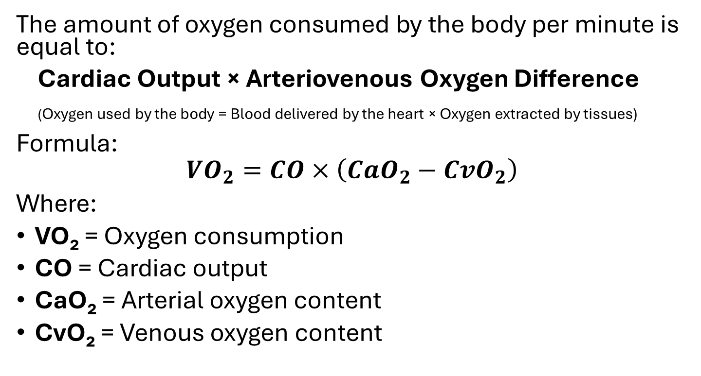
FICK PRINCIPLE
The amount of oxygen consumed by the body per minute is equal to:
Cardiac Output × Arteriovenous Oxygen Difference
(Oxygen used by the body = Blood delivered by the heart × Oxygen extracted by tissues)
Formula:
$$VO_{2}=CO×\left(CaO_{2}−CvO_{2}\right)$$
Where:
VO₂ = Oxygen consumption
CO = Cardiac output
CaO₂ = Arterial oxygen content
CvO₂ = Venous oxygen content

Slide 33
Cardiac Rehabilitation
Phase I - In-hospital
Phase II - Supervised outpatient
Phase III - Long-term maintenance

Slide 34


