Slide 1
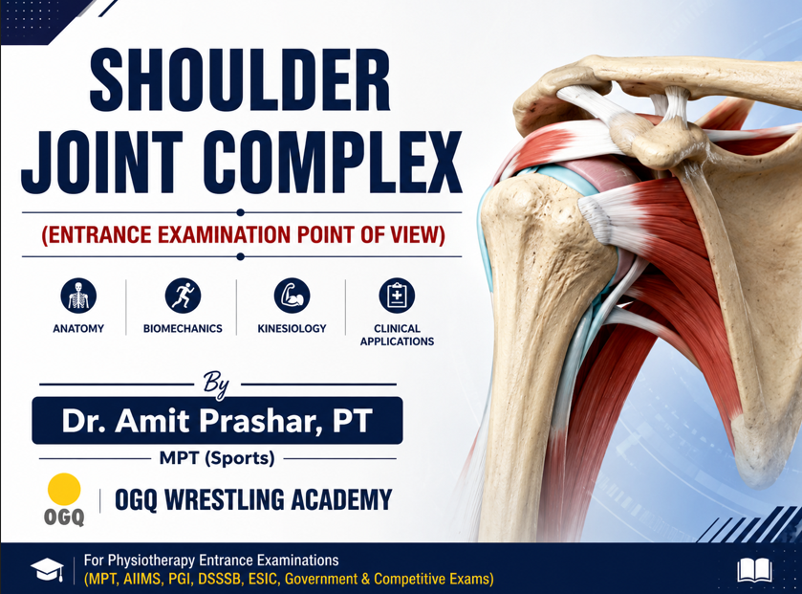
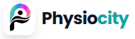

Slide 2
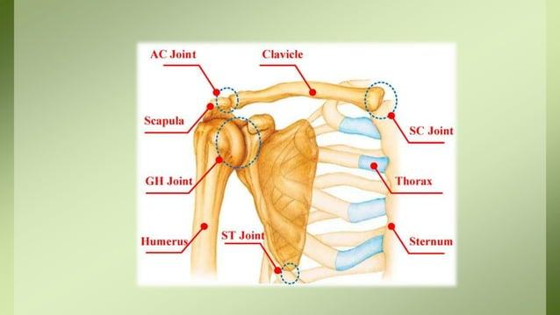

Slide 3
1. Which muscle is not included under rotator cuff muscles:
A. Supraspinatus
B. Infraspinatus
C. Teres Major
D. Teres Minor
2. Which of the following muscle is responsible for abducting the arm during initial 0 to 30 degrees:
A. Infraspinatus
B. Deltoid
C. Supraspinatus
D. None of the above
3. The muscle that assists in shoulder extension, adduction, and medial rotation is:
A. Pectoralis Major
B. Trapezius
C. Latissimus Dorsi
D. Deltoid

Slide 4
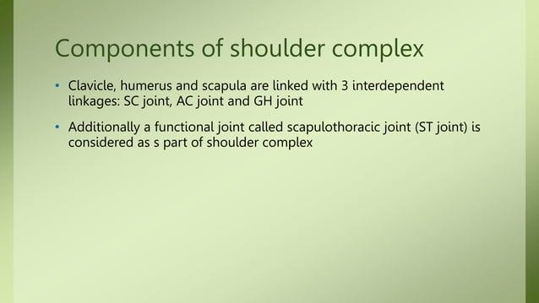

Slide 5
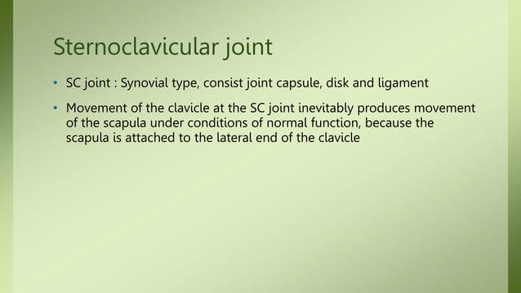
Serves as only structural attachment of Sh complex and UE to Axial skeleton.
Consists of Synovial capsule, disc and 3 Lg(s).

Slide 6
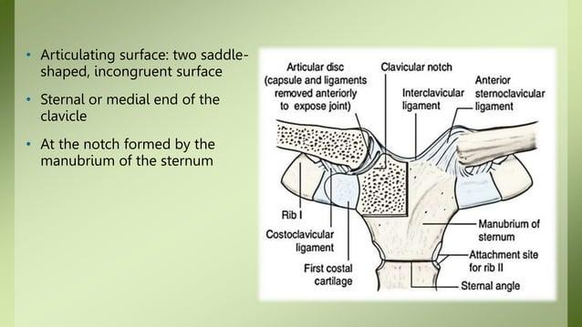

Slide 7
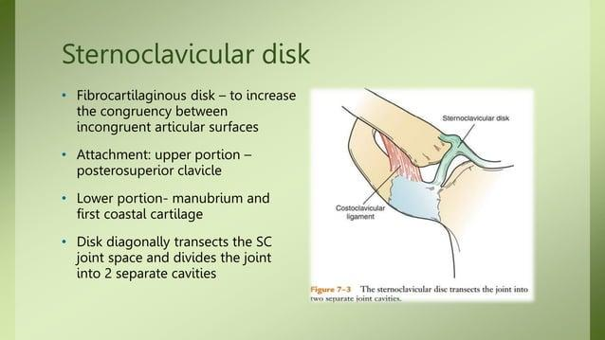

Slide 8
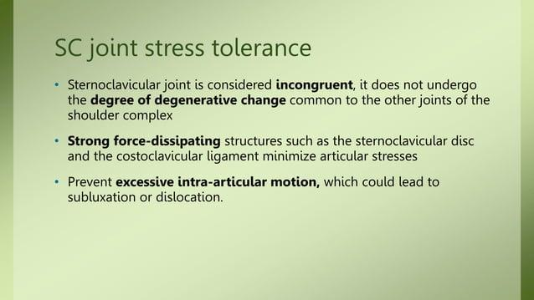

Slide 9
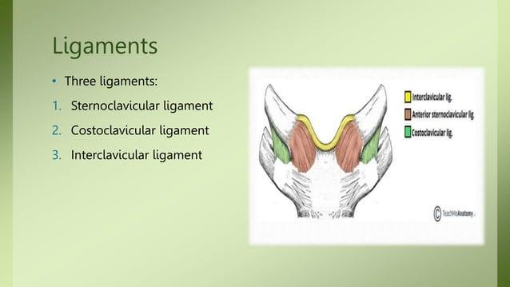

Slide 10
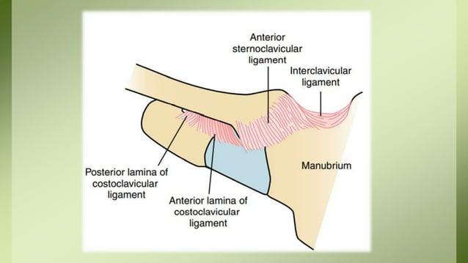

Slide 11
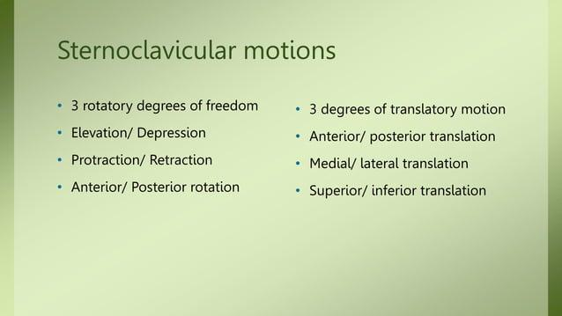

Slide 12
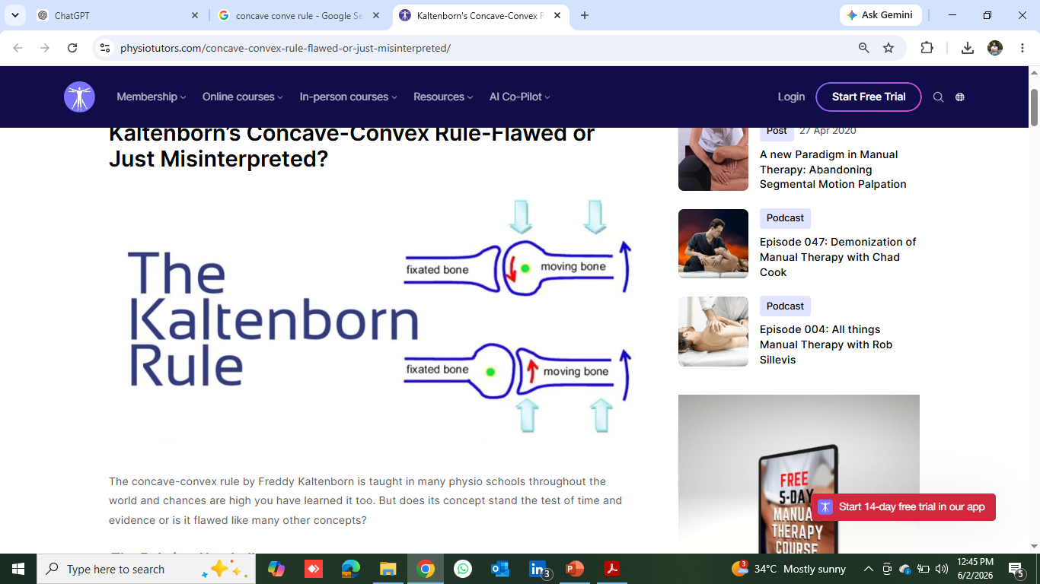
Concave- Convex Rule
If concave surface is moving on a stationary convex surface, gliding will occur in the same direction as the rolling motion
If a convex surface is moving on a stationary concave surface, gliding will occur in opposite direction to rolling

Slide 13
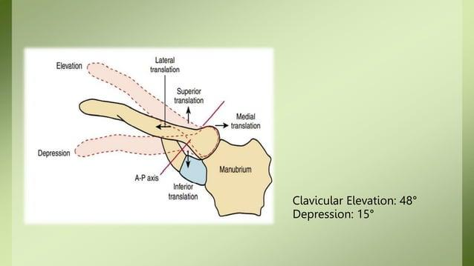

Slide 14
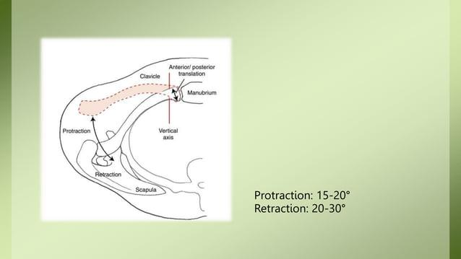

Slide 15
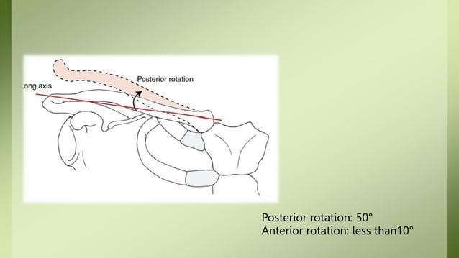

Slide 16
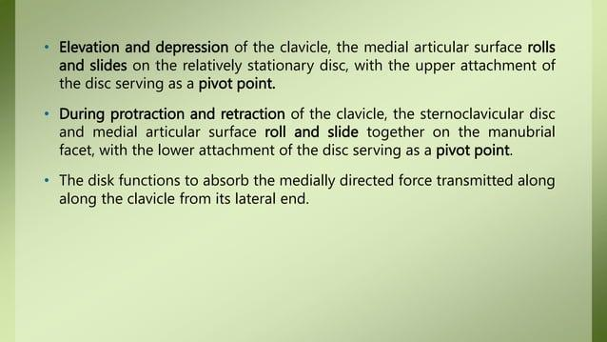

Slide 17
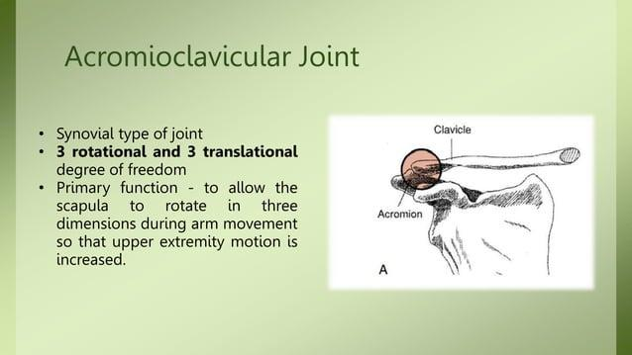

Slide 18
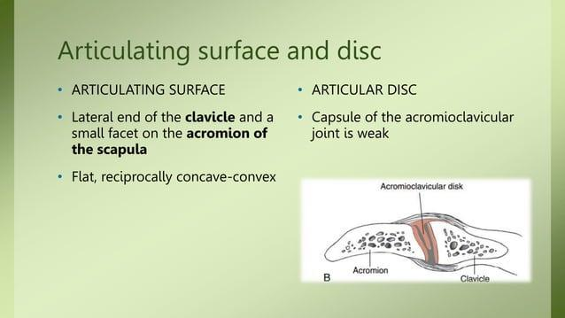

Slide 19
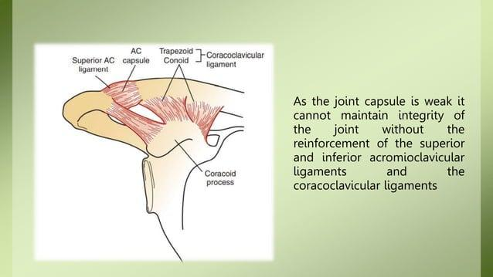

Slide 20
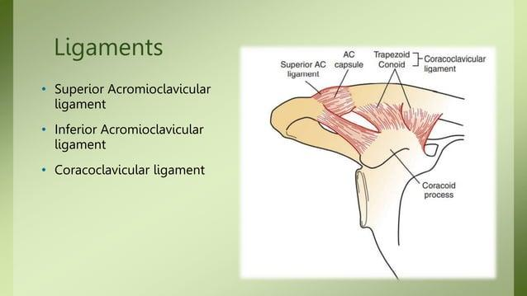

Slide 21
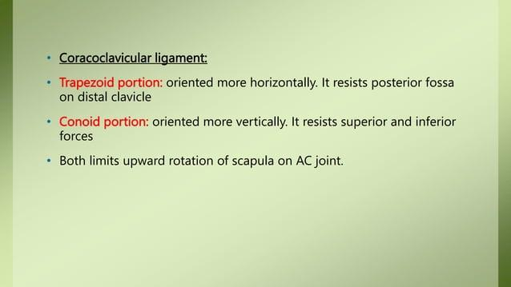

Slide 22
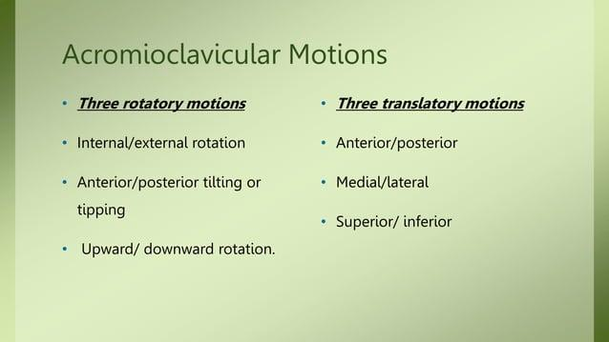

Slide 23
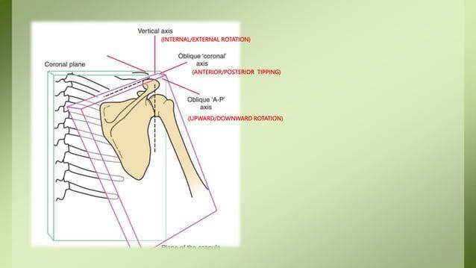

Slide 24
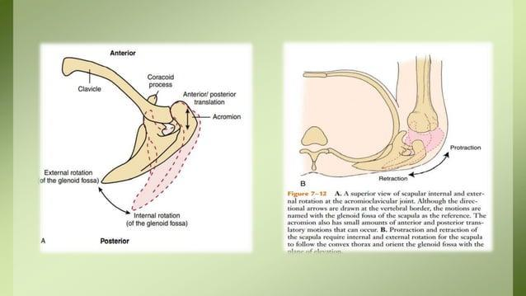

Slide 25
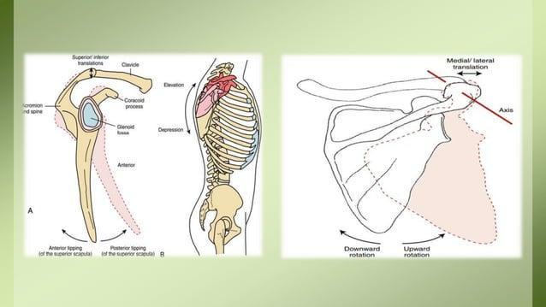

Slide 26
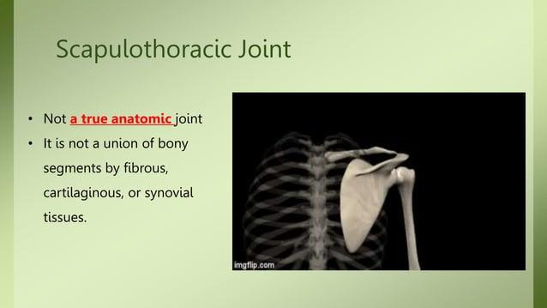

Slide 27
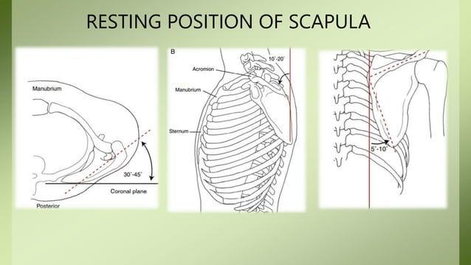
Resting Position Of Scapula
It is positioned at posterior thorax approx. 5 cm from midline between 2nd to 7th rib.
Top edge aligns with T2, Spine aligns with T4 and bottom tip aligns with T7.
Internal Rotated- 35- 45 degree from coronal plane.
Anterior Tilted- 10- 15 degree from vertical.
Upward Rotated- 5-10 degree from vertical.

Slide 28
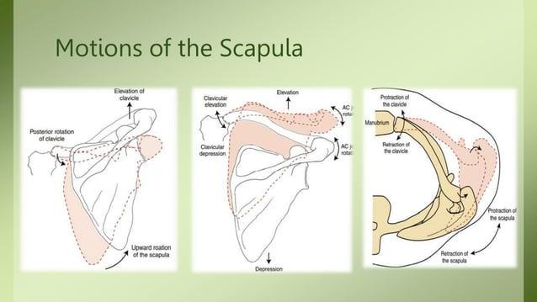
Motion of Scapula-
Scapular movement occur in combination.
Upward and Downward Rotation- Primary scapular movement, combination of clavicular rotation and elevation, while upward rotation at AC joint.
Elevation/Depression- Secondary movement, clavicular elevation and depression, rotation at Ac joint.
Protraction/Retraction- Secondary movement, Pro and retraction at SC jt and Rotation at AC jt.
Internal/External Rotation- Normally not identifiable, occurs with protraction and retraction. Excessive IR at AC joint will lead to vertebral border exposure

Slide 29
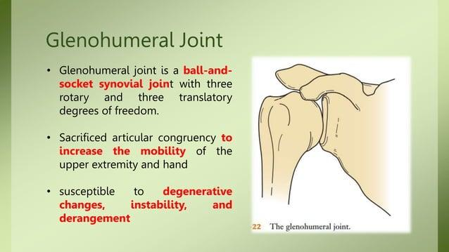

Slide 30
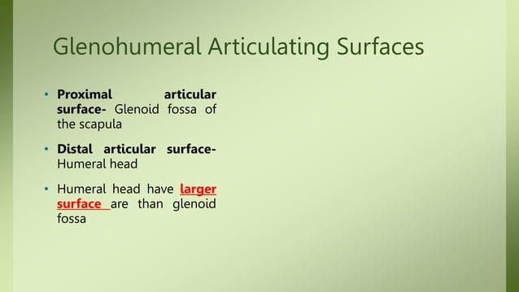


Slide 31
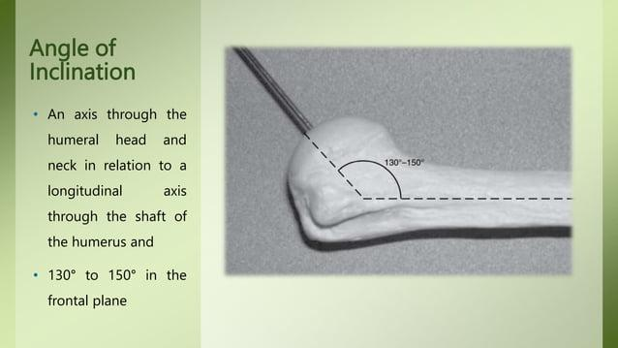

Slide 32
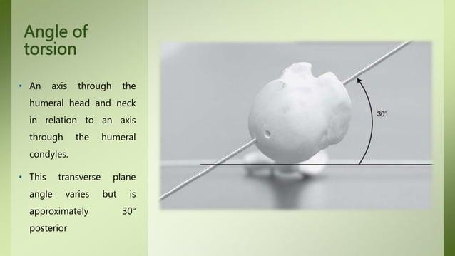
Posterior angled humeral head maked ER ROM> IR ROM.

Slide 33
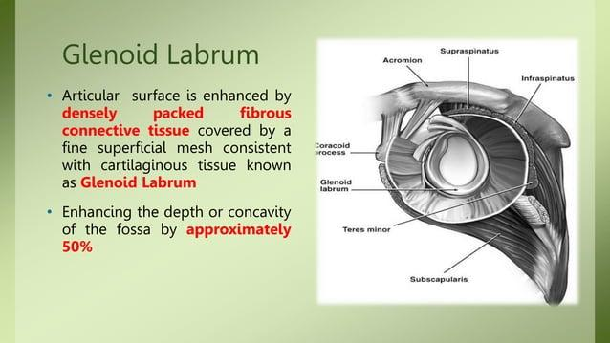
*Serves as Attachment site for GH lgs and tendon of long head of biceps.

Slide 34
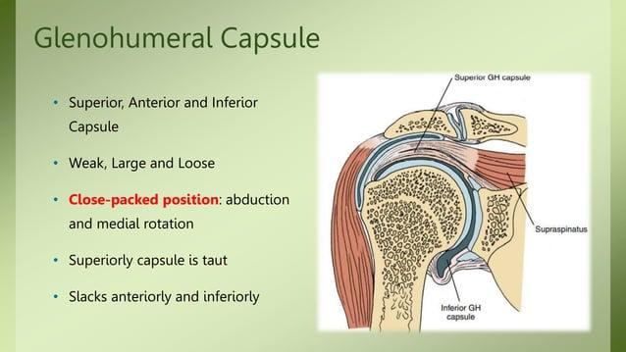
GH Capsule
Large , Loose structure , Superior, Anterior and Inferior present. Taut Superiorly
Slacks anteriorly and Inferiorly.
Close pack position- 90° Abduction + Full ER
Open pack position- 55° Abduction + 30° Horizontal Adduction

Slide 35
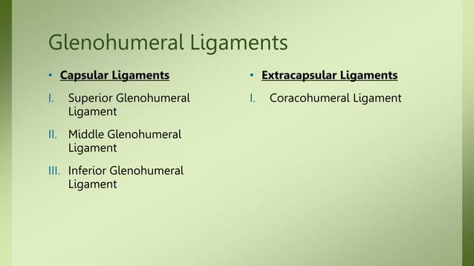

Slide 36
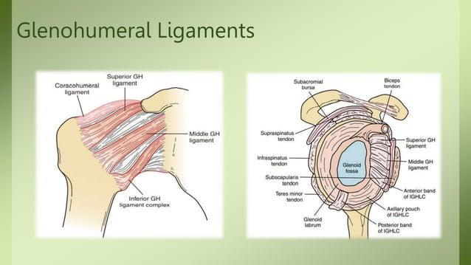

Slide 37
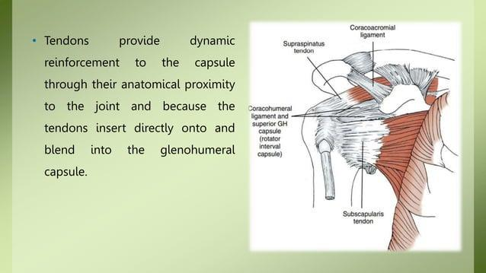

Slide 38
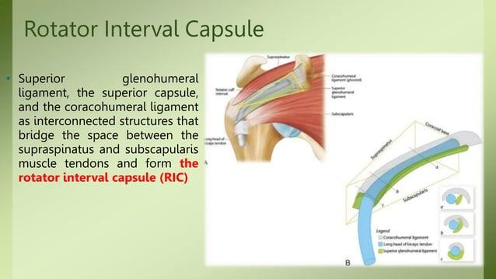
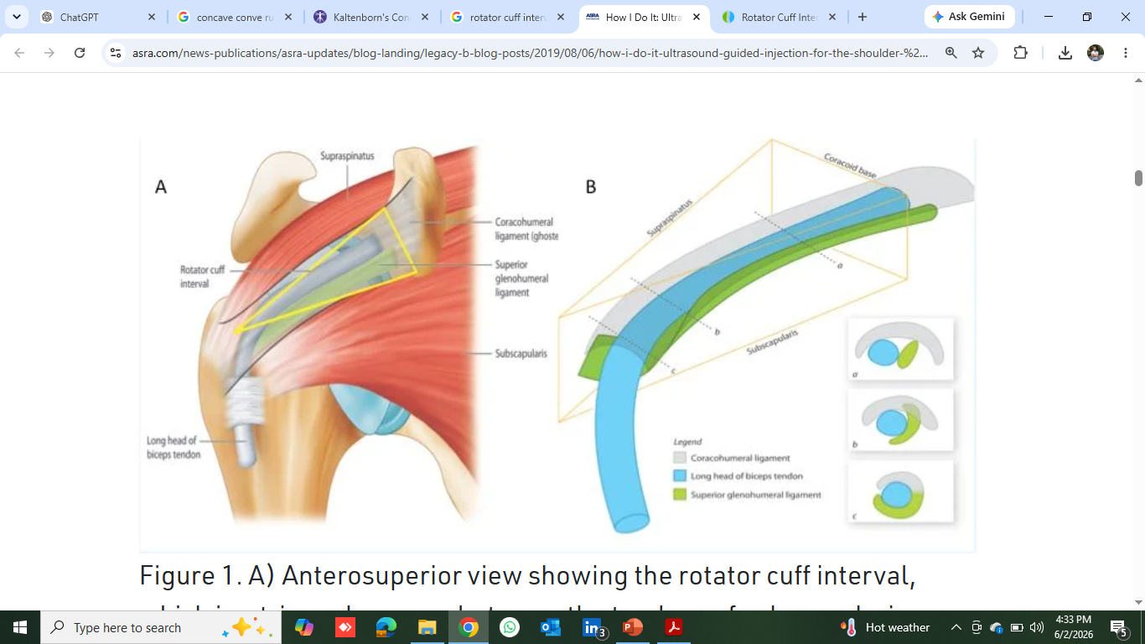

Slide 39
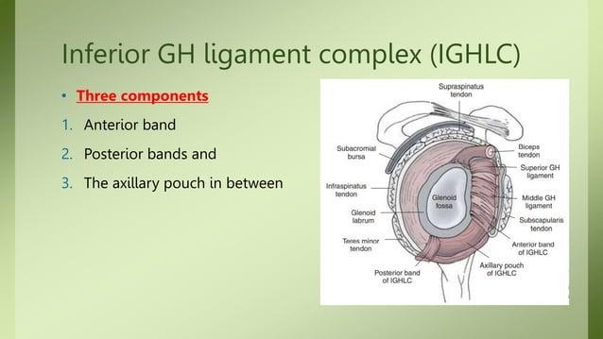

Slide 40
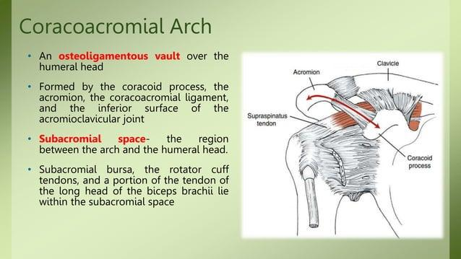
It is 10 mm in rest position and reduced to 5 mm in aducted arm.

Slide 41
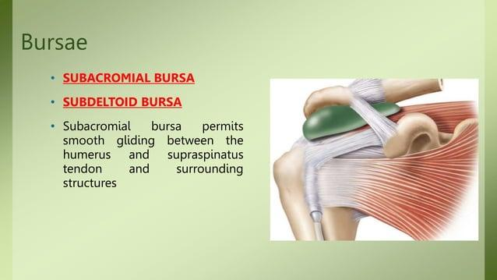

Slide 42
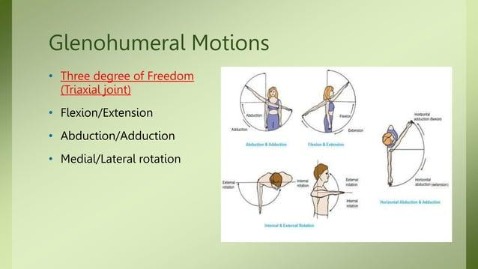

Slide 43
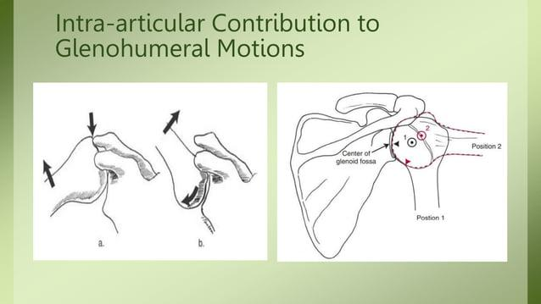

Slide 44
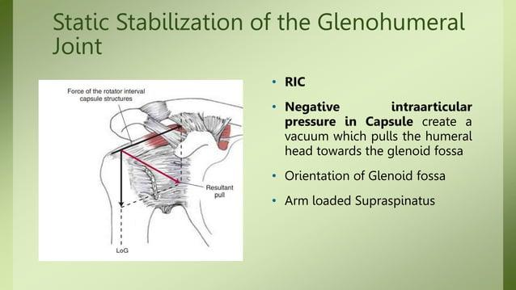

Slide 45
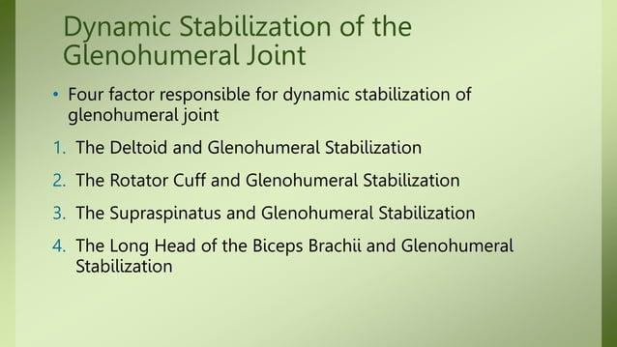

Slide 46
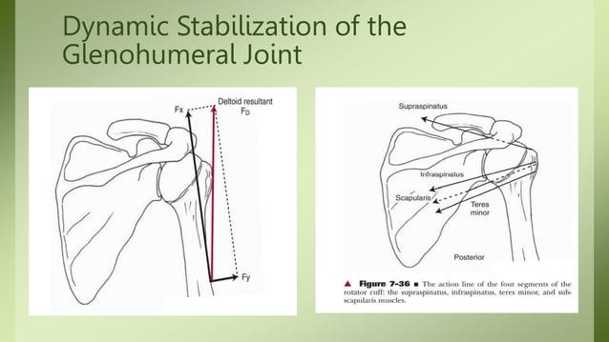

Slide 47
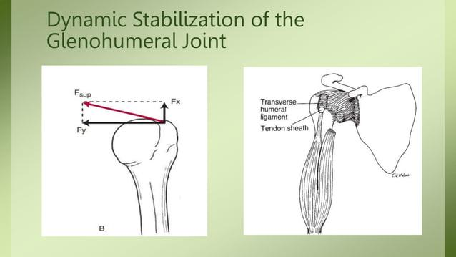

Slide 48
Which of the following muscles plays a critical role in maintaining proper dynamic stability of the shoulder joint by compressing the humeral head into the glenoid fossa during arm elevation?
•a) Teres major
•b) Subscapularis
•c) Pectoralis major
•d) Latissimus dorsi

Slide 49
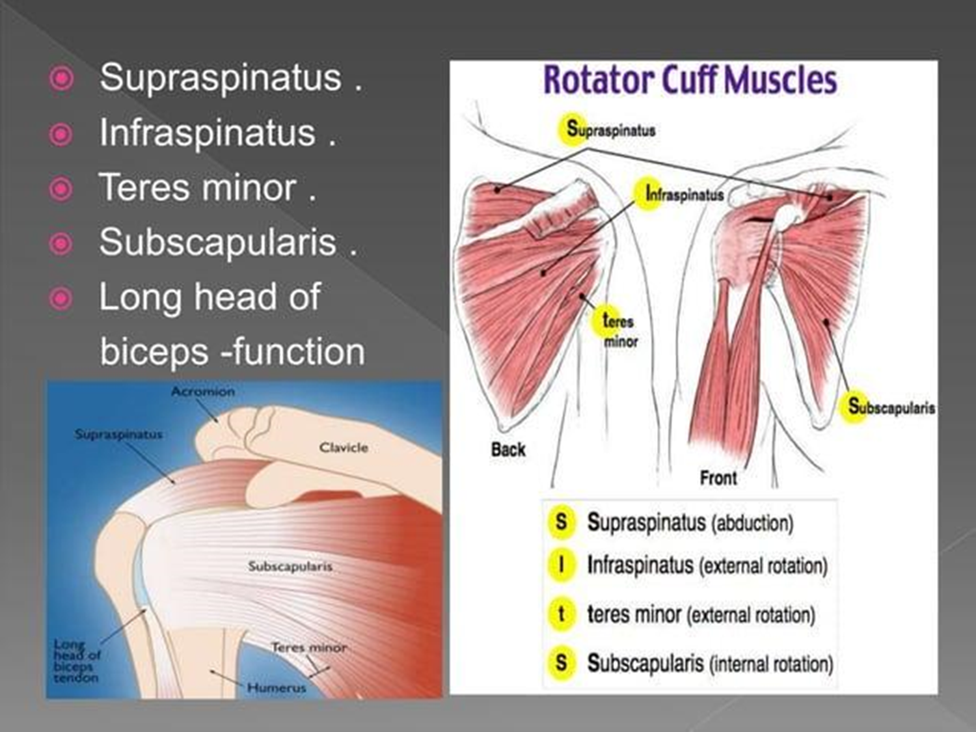

Slide 50
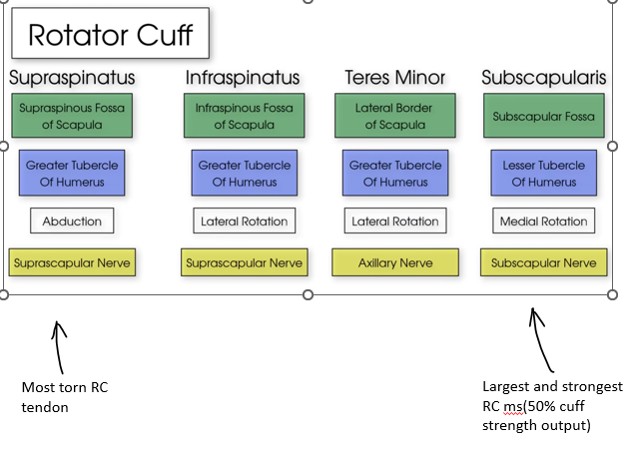

Slide 51

How to memorize

Slide 52

Scapulo- humeral rhythm

Slide 53


Slide 54
Common Pathologies and Injuries

Slide 55

1. Adhesive capsulitis or ‘frozen shoulder’
Frozen Shoulder
(Adhesive Capsulitis)
- Pain and loss of motion in shoulder with no other
apparent cause
- XR is normal
- Fibrosis of joint capsule; soft tissue scarring and
contracture
- Biopsy reveals fibroblastic proliferation
- Associated with diabetes (Type |, II), thyroid disorders,
previous surgery, immobilisation and hospitalisation
O/E. Painful arc of motion, decreased ROM.

Slide 56
Glycation: In diabetes, persistently high blood glucose levels lead to the formation of advanced glycation end products (AGEs). These AGEs cause cross-linking of collagen fibers in the shoulder capsule, resulting in increased tissue stiffness, reduced flexibility, and restricted range of motion, thereby contributing to the development of frozen shoulder (adhesive capsulitis).
Codman's Paradox: In frozen shoulder, patients often experience severe pain and restricted active shoulder movement while awake. However, under anesthesia or during sleep, passive movement of the shoulder may show a significantly greater range of motion with minimal pain. This phenomenon is known as Codman's paradox, suggesting that pain and muscle guarding contribute substantially to the movement restriction.
* Conservative treatment — successful in majority
Physiotherapy, NSAIDs, intra-articular corticosteroid
injection
- Operative — only if conservative unsuccessful
manipulation under anaesthesia
arthroscopic surgical release

Slide 57

Shoulder Joint Mobilization
1. Maitland Mobilization Grades/Non- Thrust Oscillation Technique-
Grade | Amplitude | Range | Purpose
I | Small | Beginning | Pain relief
II | Large | Mid-range | Pain relief
III | Large | End-range | Increase ROM
IV | Small | End-range | Increase ROM

Slide 58

2. Kaltenborn Mobilization Grades/ Non-Thrust Sustained Joint Play-
Separation (distraction) or glide/translate the joint surface.
Grade I (Loose)
Neutralizes joint compression
Pain reduction
Grade II (Tighten)
Takes up slack in tissues
To determine joint sesnitivity and pain reduction.
Grade III (Stretch)
Stretches capsule and ligaments
Improves joint mobility
*Clinical Application- Frozen Shoulder → Inferior glide + Grade III traction

Slide 59
Indication & Contraindication
Indications
Pain
Joint stiffness
Capsular restriction
Adhesive capsulitis
Reversible hypomobility
Contraindications
Malignancy
Fracture
Joint instability
Acute inflammation
Infection

Slide 60
Restricted Movement | Mobilization Glide Direction
Abduction | Inferior Glide
Flexion | Posterior Glide
Extension | Anterior Glide
External Rotation | Anterior Glide
Internal Rotation | Posterior Glide
General Pain Relief | Long-Axis Distraction/Traction
Clinical Examples
Frozen Shoulder with limited abduction → Grade III-IV Inferior Glide
Limited External Rotation → Grade III-IV Anterior Glide
Limited Internal Rotation (e.g., GIRD in throwers) → Grade III-IV Posterior Glide
Painful Shoulder → Grade I-II Distraction/Traction
Remember
For the GH joint, the humeral head is convex moving on the concave glenoid, so according to the concave-convex rule, the glide occurs in the opposite direction to the osteokinematic movement.

Slide 61
A patient with a frozen shoulder has 30 degrees of external rotation. Which
mobilization technique would be indicated with such a limitation?
a. Lateral distraction and anterior glide
b. Lateral distraction and posterior glide
c. medial distraction and posterior glide
d. Medial distraction and inferior glide

Slide 62


Slide 63

Mechanisms of Injury:
Anterior dislocation:
- Direct blow from the posterior aspect of
the shoulder.
- Abduction + External rotation + Extension
injury.
Posterior dislocation:
- Direct blow from the anterior aspect of
the shoulder.
- Internal rotation + Adduction + Flexion
injury.

Slide 64


Slide 65



Slide 66
Treatment of anterior dislocation of
shoulder is by
(A) Kocher's maneuver
(B) Dennis browne splint
(C) Barlow's maneuver
(D) Surgery
Shoulder dislocation is caused by vigorous (SV NIRTAR 2023)
a) Flexion with internal rotation
b) Flexion with external rotation
c) Abduction with internal rotation
d) Abduction with external rotation

Slide 67

Pathological changes
The following pathological changes occur in the commoner, anterior dislocation-

Slide 68
Which of the following special test will be positive for a 70-year-old patient with frozen shoulder?
A. Drop Arm Test
b. Hawkin’s Kennedy
C. All of the above
D. None
Which of the following medical conditions is often associated with an increased risk of developing frozen shoulder?
a) Osteoporosis
b) Hypertension (high blood pressure)
c) Diabetes
d) Migraines

Slide 69


SLAP Tear

Slide 70



Slide 71


Impingement
The Term Impingement Syndrome was popularized by Charles Neer in 1972. He defined impingement as pathologically compression of rotator cuff against the anterior structure of coracoacromial arch, anterior 1/3 of acromion, coraco- acromial lig and AC joint.
Impingement causes Mechanical irritation of cuff tendons-resulting in haemorrhage and swelling (commonly known as tendonitis of rotator cuff)
–The supraspinatus muscle is usually involved.
This also affect the bursa–resulting in bursitis.
Shoulder complex is susceptible to impingement injuries from overhead sports–
–Such as baseball, tennis, swimming, volleyball etc.

Slide 72


Slide 73


Slide 74


Slide 75

Rotator Cuff Tears
Part of a ‘continuum’ of rotator cuff
disease and impingement
Tears of rotator cuff muscles that
maintain stability of glenohumeral
joint (supraspinatus, infraspinatus,
teres minor, subscapularis; at least 1
tendon involved)
Mechanism:
- chronic degenerative
- acute avulsion injury (falls,
shoulder dislocations)
- iatrogenic (surgical failure)
Common in athletes who throw

Slide 76

BICEPS TENDINITIS
Bicipital tendinitis, or biceps tendinitis, is an inflammatory process of the long head of the biceps
tendon and is a common cause of shoulder pain due to its position and function.
TYPES:
The type of bicep tendonitis a person has depends on which tendon has become affected:
Distal bicep tendonitis: This is when inflammation occurs at the end of the tendon
connecting the biceps muscle to the elbow.
Proximal bicep tendonitis: This is when there is inflammation at the end of the tendon
rope through connecting the biceps muscle to the shoulder.

Slide 77
Drop arm test indicates-
(A) Weakness of deltoid
(B) Rupture of supraspinatus
(C) Positive painful arc
(D} Weakness of brachialis
Which bursa often communicates with the shoulder joint
a. subacromial bursa
b. subscapular bursa
c. subdeltoid bursa
d. none
Impingement position of rotator cuff of shoulder is
a) Abduction, flexion and internal rotation
b) Abduction, flexion and external rotation
c) Abductions extension and internal rotation
d) Abduction, flexion and external rotation

Slide 78

Scapular Dyskinesia
Altered scapular motion and positioning during arm movements

Slide 79


Slide 80

Shoulder special Test

Slide 81


Slide 82




Slide 83




Slide 84


Slide 85
THANK- YOU

